Slide 1
Exploratory Data Analysis Part 1

Slide 2

Today
Box of Data

Slide 3
Congratulations!
You have collected or been given a box of data?
Box of Data
What do you do next?

Slide 4
(B)Question & Problem Formulation
?
(IA) Data Acquisition
(AVU) Prediction and Inference
(EVA)
Exploratory Data Analysis

Slide 5
EVA
Data Cleaning
Exploratory Data
Analysis
… the infinite loop of data science.

Slide 6
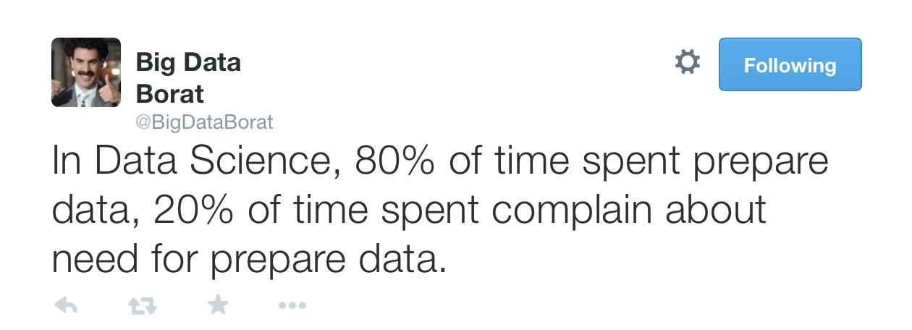
Data Cleaning
The process of transforming raw data to facilitate subsequent analysis
Data cleaning often addresses
structure / formatting
missing or corrupted values
unit conversion
encoding text as numbers
…
Sadly data cleaning is a big part of data science…

Slide 7
Data Cleaning
Exploratory Data Analysis
… the infinite loop of data science.

Slide 8
Exploratory Data Analysis
“Getting to know the data”
The process of transforming, visualizing, and summarizing data to:
Build/confirm understanding of the data and its provenance
Identify and address potential issues in the data
Inform the subsequent analysis
discover potential hypothesis … (be careful)
EDA is an open ended analysis
Be willing to find something surprising

Slide 9

John Tukey
Princeton Mathematician & Statistician
Introduced
Fast Fourier Transform
“Bit” : binary digit
Exploratory Data Analysis
Early Data Scientist
Data Analysis & Statistics, Tukey 1965
Image from LIFE Magazine
Notes:
John Tukey, Princeton mathematician and statistician, inventor of the Fast Fourier Transform and father of Exploratory Data Analysis. Also coined the word “bit”.
Emphasis courtesy Jeff Heer, U. Washington

Slide 10
EDA is like detective work
“Exploratory data analysis is an attitude, a state of flexibility, a willingness to look for those things that we believe are not there, as well as those that we believe to be there.”
Data Analysis & Statistics, Tukey 1965
Image from LIFE Magazine
Notes:
Contrast to confirmatory data analysis (statistical hypothesis testing)

Slide 11
What should we look for?

Slide 12
Outline
Exploratory Data Analysis
Chart types
Some important distributions
Important Statistical Tests

Slide 13
Descriptive vs. Inferential Statistics
Descriptive: e.g., Median; describes data you have but can't be generalized beyond that
We’ll talk about Exploratory Data Analysis
Inferential: e.g., t-test, that enable inferences about the population beyond our data
These are the techniques we’ll leverage for Machine Learning and Prediction

Slide 14
Examples of Business Questions
Simple (descriptive) Stats
“Who are the most profitable customers?”
Hypothesis Testing
“Is there a difference in value to the company of these customers?”
Segmentation/Classification
What are the common characteristics of these customers?
Prediction
Will this new customer become a profitable customer? If so, how profitable?
adapted from Provost and Fawcett, “Data Science for Business”

Slide 15
Applying techniques
Most business questions are causal: what would happen if? (e.g. I show this ad)
But its easier to ask correlational questions, (what happened in this past when I showed this ad).
Supervised Learning:
Classification and Regression
Unsupervised Learning:
Clustering and Dimension reduction
Note: Unsupervised Learning is often used inside a larger Supervised learning problem.
E.g. auto-encoders for image recognition neural nets.

Slide 16
Applying techniques
Supervised Learning:
kNN (k Nearest Neighbors)
Naïve Bayes
Logistic Regression
Support Vector Machines
Random Forests
Unsupervised Learning:
Clustering
Factor analysis
Latent Dirichlet Allocation

Slide 17
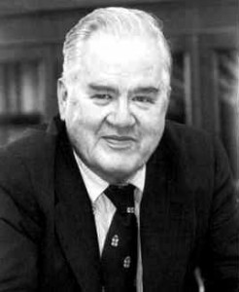
Exploratory Data Analysis 1977
Based on insights developed at Bell Labs in the 60’s
Techniques for visualizing and summarizing data
What can the data tell us? (in contrast to “confirmatory” data analysis)
Introduced many basic techniques:
5-number summary, box plots, stem and leaf diagrams,…
5 Number summary:
extremes (min and max)
median & quartiles
More robust to skewed & longtailed distributions

Slide 18
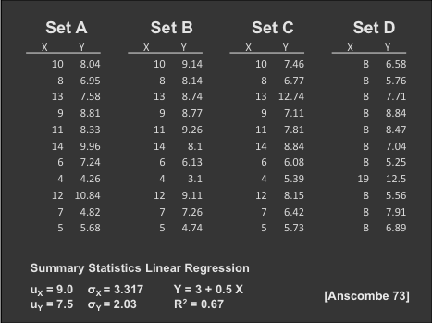
The Trouble with Summary Stats

Slide 19
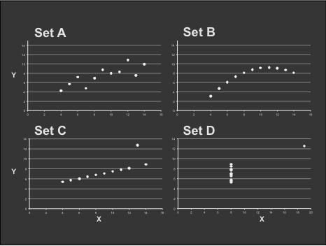
Looking at Data

Slide 20

Data Presentation
Data Art

Slide 21
The “R” Language
An evolution of the “S” language developed at Bell labs for EDA.
Idea was to allow interactive exploration and visualization of data.
The preferred language for statisticians, used by many other data scientists.
Features:
Probably the most comprehensive collection of statistical models and distributions.
CRAN: a very large resource of open source statistical models.
Chart examples from Jeff Hammerbacher’s CS194 class

Slide 22
Chart types
Single variable
Dot plot
Jitter plot
Error bar plot
Box-and-whisker plot
Histogram
Kernel density estimate
Cumulative distribution function
(note: examples using qplot library from R)
Chart examples from Jeff Hammerbacher’s 2012 CS194 class

Slide 23

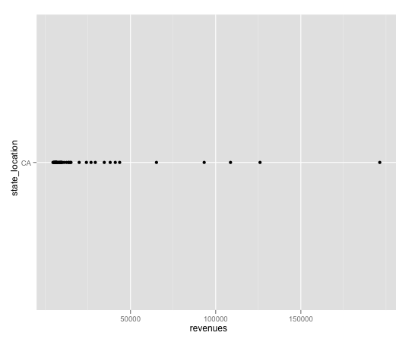
Chart types
Dot plot

Slide 24
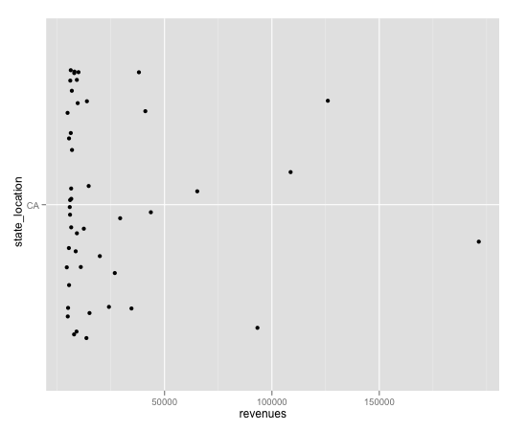
Chart types
Jitter plot
Noise added to the y-axis to spread the points

Slide 25
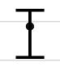
Chart types
Error bars: usually based on confidence intervals (CI). 95% CI means 95% of points are in the range, so 2.5% of points are above or below the bar.
Not necessarily symmetric:

Slide 26
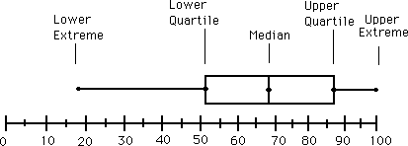
Chart types
Box-and-whisker plot : a graphical form of 5-number summary (Tukey)

Slide 27
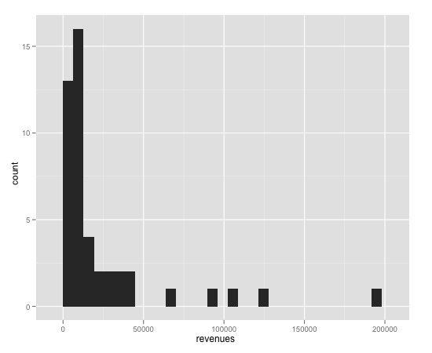
Chart types
Histogram

Slide 28
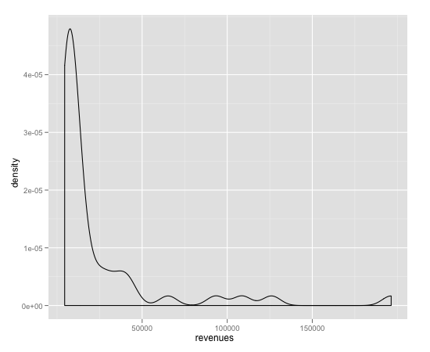
Chart types
Kernel density estimate

Slide 29
Chart types
Histogram and Kernel Density Estimates
Histogram
Proper selection of bin width is important
Outliers should be discarded
KDE (like a smooth histogram)
Kernel function
Box, Epanechnikov, Gaussian
Kernel bandwidth

Slide 30
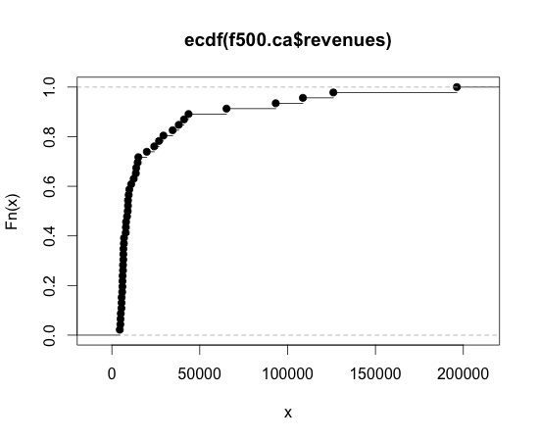
Chart types
Cumulative distribution function
Integral of the histogram – simpler to build than KDE (don’t need smoothing)

Slide 31
Chart types
Two variables
Bar chart
Scatter plot
Line plot
Log-log plot

Slide 32
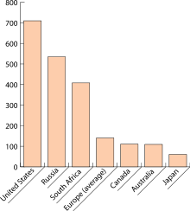
Chart types
Bar plot: one variable is discrete

Slide 33
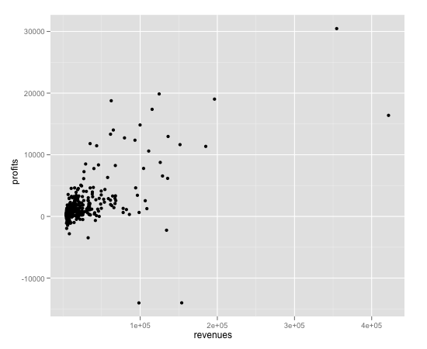
Chart types
Scatter plot

Slide 34
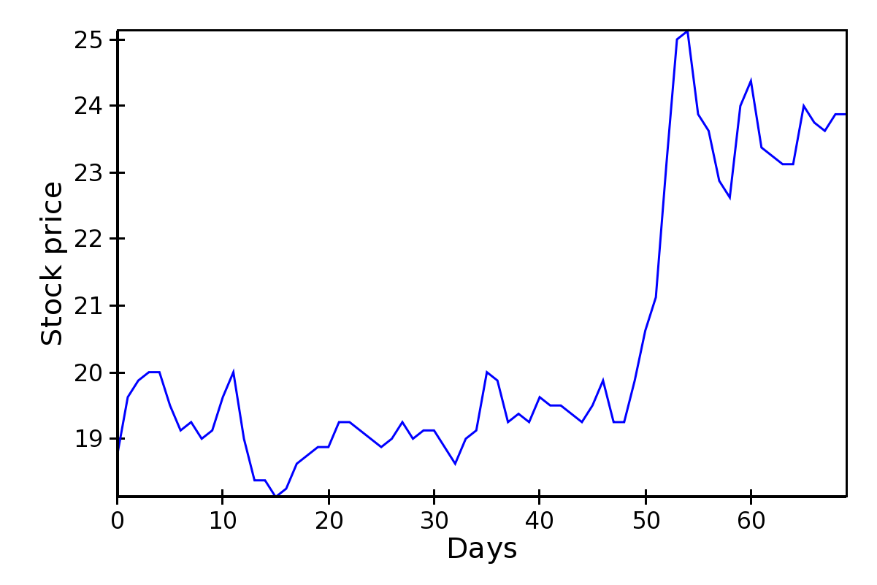
Chart types
Line plot

Slide 35
Chart types
Log-log plot: Very useful for power law data
Frequency of words in tweets
slope ~ -1
Rank of words in tweets, most frequent to least:
I, the, you,…

Slide 36
Chart types
More than two variables
Stacked plots
Parallel coordinate plot

Slide 37
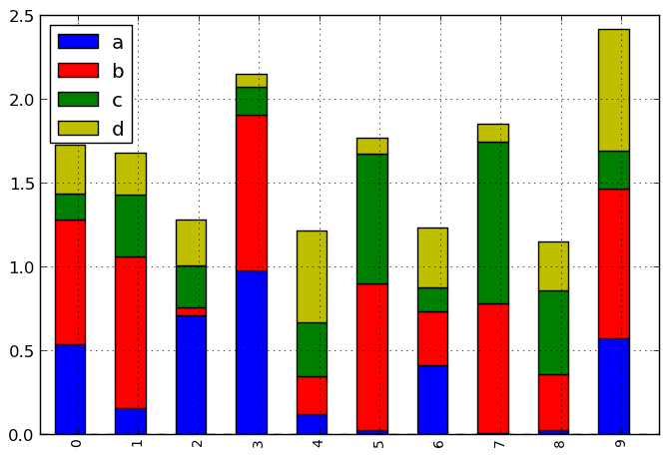
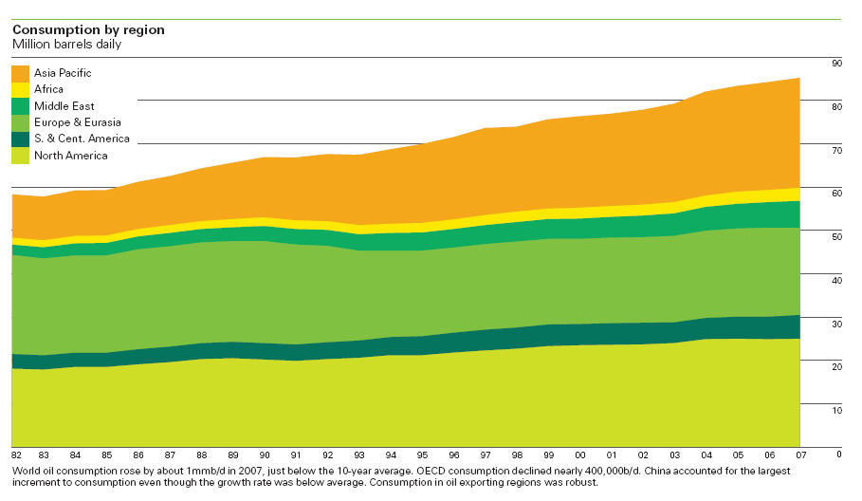
Chart types
Stacked plot: stack variable is discrete:

Slide 38
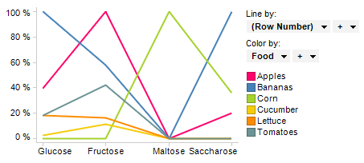
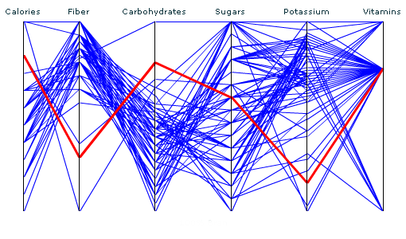
Chart types
Parallel coordinate plot: one discrete variable, an arbitrary number of other variables:

Slide 39
5-minute break

Slide 40
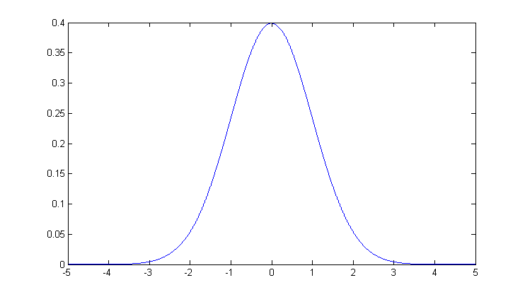
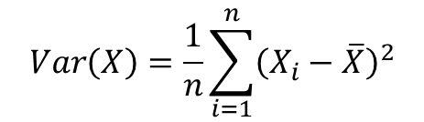
Normal Distributions, Mean, Variance
The mean of a set of values is just the average of the values.
Variance a measure of the width of a distribution. Specifically, the variance is the mean squared deviation of samples from the sample mean:
The standard deviation is the square root of variance.
The normal distribution is completed characterized by mean and variance.
$$Var\left(X\right)=\frac{1}{n}\sum_{i=1}^{n}{{\left(X_{i}−\overline{X}\right)}^{2}}$$
mean
Standard deviation

Slide 41
Central Limit Theorem
The distribution of the sum (or mean) of a set of n identically-distributed random variables Xi approaches a normal distribution as n → ∞.
The common parametric statistical tests, like t-test and ANOVA assume normally-distributed data, but depend on sample mean and variance measures of the data.
They typically work reasonably well for data that are not normally distributed as long as the samples are not too small.

Slide 42
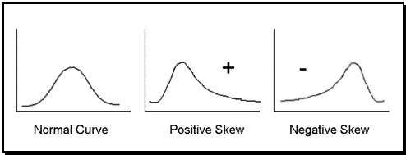
Correcting distributions
Many statistical tools, including mean and variance, t-test, ANOVA etc. assume data are normally distributed.
Very often this is not true. The box-and-whisker plot is a good clue
Whenever its asymmetric, the data cannot be normal. The histogram gives even more information

Slide 43
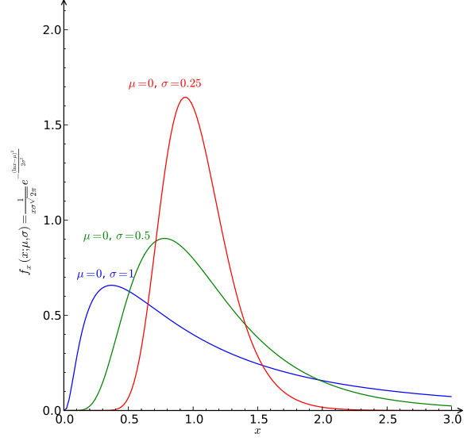
Correcting distributions
In many cases these distribution can be corrected before any other processing.
Examples:
X satisfies a log-normal distribution, Y=log(X) has a normal dist.
X poisson with mean k and sdev. sqrt(k). Then sqrt(X) is approximately normally distributed with sdev 1.

Slide 44
Distributions
Some other important distributions:
Poisson: the distribution of counts that occur at a certain “rate”.
Observed frequency of a given term in a corpus.
Number of visits to a web site in a fixed time interval.
Number of web site clicks in an hour.
Exponential: the interval between two such events.
Zipf/Pareto/Yule distributions: govern the frequencies of different terms in a document, or web site visits.
Binomial/Multinomial: The number of counts of events (e.g. die tosses = 6) out of n trials.
You should understand the distribution of your data before applying any model.

Slide 45
Rhine Paradox*
Autonomy Corp
Joseph Rhine was a parapsychologist in the 1950’s (founder of the Journal of Parapsychology and the Parapsychological Society, an affiliate of the AAAS).
He ran an experiment where subjects had to guess whether 10 hidden cards were red or blue.
He found that about 1 person in 1000 had ESP, i.e. they could guess the color of all 10 cards.
Q: what’s wrong with his conclusion?
* Example from Jeff Ullman/Anand Rajaraman
Notes:
2^10 ~ 1000 so 1 in 1000 is just the rate by of guessing correctly by chance

Slide 46
Rhine Paradox
Autonomy Corp
He called back the “psychic” subjects and had them do the same test again. They all failed.
He concluded that the act of telling psychics that they have psychic abilities causes them to lose it…(!)

Slide 47
p Value
A p value is the probability of obtaining a sample outcome, given that the value stated in the null hypothesis is true.
In many cases: when the p value is less than 5% (p < .05), we reject the null hypothesis
Note this means that 1 out of 20 times we incorrectly reject the null hypothesis
Do “green jelly beans cause acne?” (see XKCD)

Slide 48
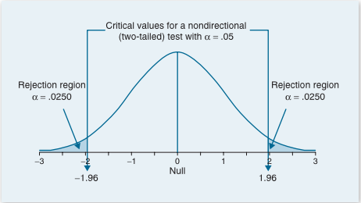
Two-tailed Significance
From G.J. Primavera, “Statistics for the Behavioral Sciences”
When the p value is less than 5% (p < .05), we reject the null hypothesis

Slide 49
Three important tests
T-test: compare two groups, or two interventions on one group.
CHI-squared and Fisher’s test. Compare the counts in a “contingency table”.
ANOVA: compare outcomes under several discrete interventions.

Slide 50
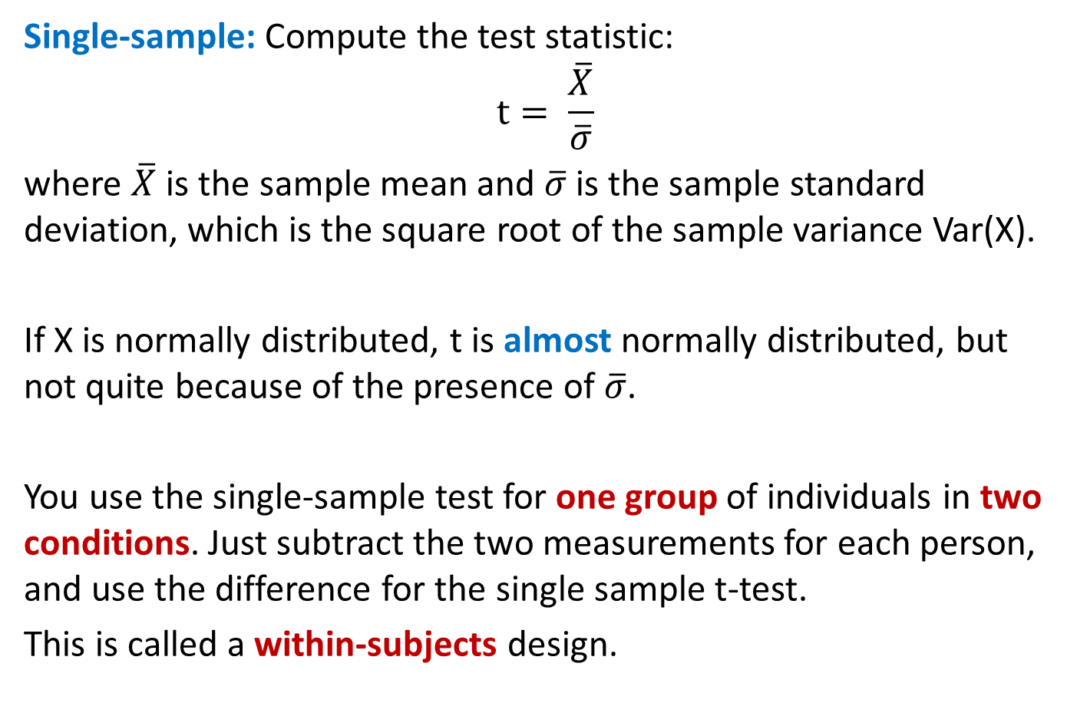
T-test
Single-sample: Compute the test statistic: $$t= \frac{\overline{X}}{\overline{σ}}$$
where $\overline{X}$ is the sample mean and $\overline{σ}$ is the sample standard deviation, which is the square root of the sample variance Var(X).
If X is normally distributed, t is almost normally distributed, but not quite because of the presence of $\overline{σ}$.
You use the single-sample test for one group of individuals in two conditions. Just subtract the two measurements for each person, and use the difference for the single sample t-test.
This is called a within-subjects design.

Slide 51
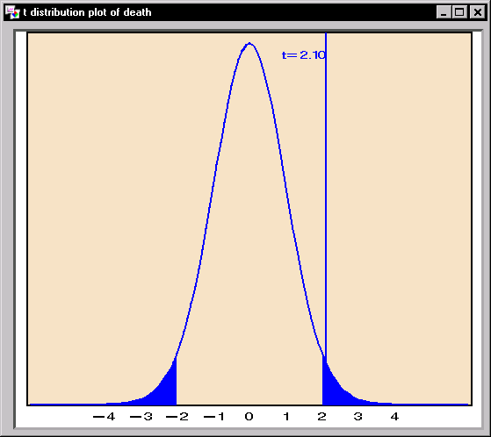
T-statistic and T-distribution
We use the t-statistic from the last slide to test whether the mean of our sample could be zero.
If the underlying population has mean zero, the t-distribution should be distributed like this:
The area of the tail beyond our measurement tells us how likely it is under the null hypothesis.
If that probability is low (say < 0.05) we reject the null hypothesis.

Slide 52


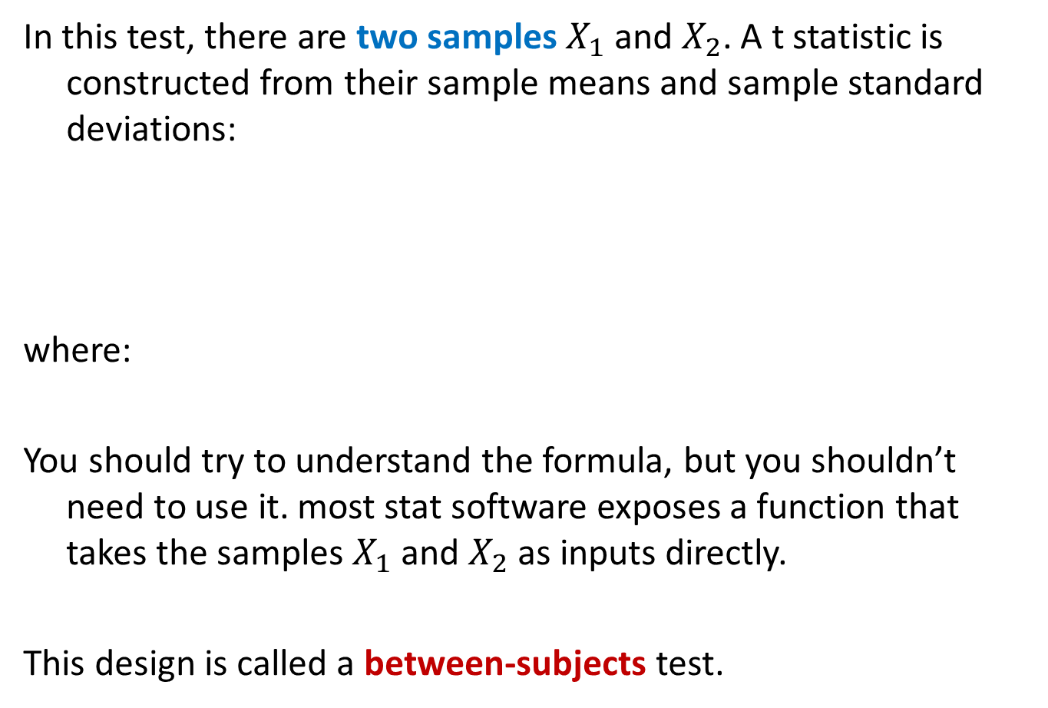
Two sample T-test
In this test, there are two samples and . A t statistic is constructed from their sample means and sample standard deviations:
where:
You should try to understand the formula, but you shouldn’t need to use it. most stat software exposes a function that takes the samples and as inputs directly.
This design is called a between-subjects test.

Slide 53

Chi-squared test
Often you will be faced with discrete (count) data. Given a table like this:
Where Prob(X) is part of a null hypothesis about the data (e.g. that a coin is fair).
The CHI-squared statistic lets you test whether an observation is consistent with the data:
O_{i} is an observed count, and E_{i} is the expected value of that count. It has a chi-squared distribution, whose p-values you compute to do the test.
 | Prob(X) | Count(X)
X=0 | 0.3 | 10
X=1 | 0.7 | 50

Slide 54
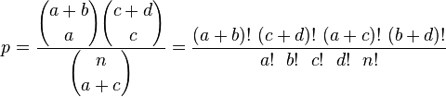
Fisher’s exact test
In case we only have counts under different conditions
We can use Fisher’s exact test (n = a+b+c+d):
Which gives the probability directly (its not a statistic).
 | Count1(X) | Count2(X)
X=0 | a | b
X=1 | c | d

Slide 55
One-Way ANOVA
ANOVA (ANalysis Of VAriance) allows testing of multiple differences in a single test. Suppose our experiment design has an independent variable Y with four levels:
The table shows the mean values of a response variable (e.g. avg number of Facebook posts per day) in each group.
We would like to know in a single test whether the response variable depends on Y, at some particular significance such as 0.05.
Y
Primary School | High School | College | Grad degree
4.1 | 4.5 | 4.2 | 3.8

Slide 56
ANOVA
In ANOVA we compute a single statistic (an F-statistic) that compares variance between groups with variance within each group.
The higher the F-value is, the less probable is the null hypothesis that the samples all come from the same population.
We can look up the F-statistic value in a cumulative F-distribution (similar to the other statistics) to get the p-value.
ANOVA tests can be much more complicated, with multiple dependent variables, hierarchies of variables, correlated measurements etc.

Slide 57
Closing Words
All the tests so far are parametric tests that assume the data are normally distributed, and that the samples are independent of each other and all have the same distribution (IID).
They may be arbitrarily inaccurate is those assumptions are not met. Always make sure your data satisfies the assumptions of the test you’re using. e.g. watch out for:
Outliers – will corrupt many tests that use variance estimates.
Correlated values as samples, e.g. if you repeated measurements on the same subject.
Skewed distributions – give invalid results.

Slide 58
Non-parametric tests
These tests make no assumption about the distribution of the input data, and can be used on very general datasets:
K-S test
Permutation tests
Bootstrap confidence intervals

Slide 59
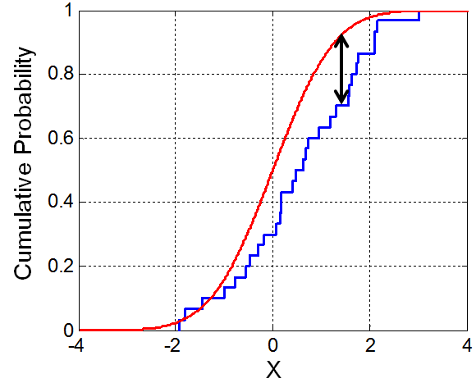
K-S test
The K-S (Kolmogorov-Smirnov) test is a very useful test for checking whether two (continuous or discrete) distributions are the same.
In the one-sided test, an observed distribution (e.g. some observed values or a histogram) is compared against a reference distribution.
In the two-sided test, two observed distributions are compared.
The K-S statistic is just the max distance between the CDFs of the two distributions.
While the statistic is simple, its distribution is not!
But it is available in most stat packages.

Slide 60
K-S test
The K-S test can be used to test whether a data sample has a normal distribution or not.
Thus it can be used as a sanity check for any common parametric test (which assumes normally-distributed data).
It can also be used to compare distributions of data values in a large data pipeline: Most errors will distort the distribution of a data parameter and a K-S test can detect this.

Slide 61
Non-parametric tests
Permutation tests
Bootstrap confidence intervals
We wont discuss these in detail, but its important to know that non-parametric tests using one of the above methods exist for many forms of hypothesis.
They make no assumptions about the distribution of the data, but in many cases are just as sensitive as parametric tests.
They use computational cycles to simulate sample data, to derive p-value estimates approximately, and accuracy improves with the amount of computational work done.

Slide 62
The Need for Models
“All models are wrong, but some models are useful.” George Box
Data represents the traces of the real-world processes.
Two sources of randomness and uncertainty:
1) those underlying the process themselves
2) those associated with the data collection methods
To simplify the traces into something more comprehensible you need:
mathematical models or functions of the data -> Statistical estimators

Slide 63
More on Models
N is size of population
n is sample size (subset of the population)
Getting the subset (i.e. sampling) can introduce "bias" leading to incorrect conclusions

Slide 64
Probability Distributions
Natural processes tend to generate measurements whose empirical shape could be approximated by mathematical functions with a few parameters that could be estimated from the data.

Slide 65
Note on ML Algos vs. Stat Models
Techniques and underlying concepts in common
Difference in goals/use:
ML Algos – goal: predict or classify with high accuracy.
basis of many data products
Models – get at the underlying generative process
“Black box” vs. “White box”
Dealing with uncertainty (at the heart of stats)
Distributions vs. non-parametic approaches

Slide 66
EDA Part 2 Stats and Featurization

Slide 67
Outline
Statistics
Measurement
Hypothesis Testing
Featurization
Feature selection
Feature Hashing
Visualizing Accuracy

Slide 68
Measurement
Measurement: We often want to measure properties of data or models. For the data:
Basic properties: Min, max, mean, std. deviation of a dataset.
Relationships: between fields (columns) in a tabular dataset, via scatter plots, regression, correlation etc.
And for models:
Accuracy: How well does our model match the data (e.g. predict hidden values)?
Performance: How fast is a ML system on a dataset? How much memory does it use? How does it scale as the dataset size grows?

Slide 69
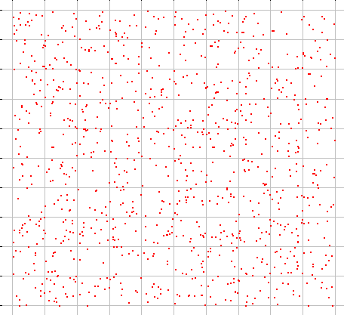
Measurement on Samples
Many datasets are samples from an infinite population.
We are most interested in measures on the population, but we have access only to a sample of it.
A sample measurement is called a “statistic”. Examples:
Sample min, max, mean, std. deviation

Slide 70
Measurement on Samples
Many datasets are samples from an infinite population.
We are most interested in measures on the population, but we have access only to a sample of it.
That makes measurement hard:
Sample measurements are “noisy,” i.e. vary from one sample to the next
Sample measurements may be biased, i.e. systematically be different from the measurement on the population.

Slide 71
Measurement on Samples
Many datasets are samples from an infinite population.
We are most interested in measures on the population, but we have access only to a sample of it.
That makes measurement hard:
Sample measurements have variance: variation between samples
Sample measurements have bias, systematic variation from the population value.

Slide 72
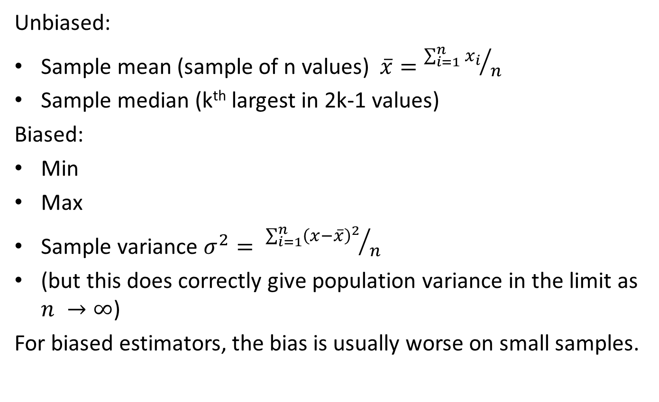
Examples of Statistics
Unbiased:
Sample mean (sample of n values)
Sample median (k^{th} largest in 2k-1 values)
Biased:
Min
Max
Sample variance
(but this does correctly give population variance in the limit as )
For biased estimators, the bias is usually worse on small samples.

Slide 73

Statistical Notation
We’ll use upper case symbols “$X$” to represent random variables, which you can think of as draws from the entire population.
Lower case symbols “$x$” represent particular samples of the population, and subscripted lower case symbols to represent instances of a sample: $x_{i}$

Slide 74
Measurement
Statistics
Measurement
Hypothesis Testing
Featurization
Feature selection
Feature Hashing
Visualizing Accuracy

Slide 75
Hypothesis Testing
We want to prove a hypothesis H_{A} but its hard so we try to disprove a null hypothesis H₀
A test statistic is some measurement we can make on the data which is likely to be big under H_{A} but small under H₀.

Slide 76
Hypothesis Testing
Example:
We suspect that a particular coin isn’t fair.
We toss it 10 times, it comes up heads every time…
We conclude it’s not fair, why?
How sure are we?
Now we toss a coin 4 times, and it comes up heads every time.
What do we conclude?

Slide 77
Hypothesis Testing
We want to prove a hypothesis H_{A} (the coin is biased), but its hard so we try to disprove a null hypothesis H₀ (the coin is fair).
A test statistic is some measurement we can make on the data which is likely to be big under H_{A} but small under H₀. the number of heads after k coin tosses – one sided the difference between number of heads and k/2 – two-sided
Note: tests can be either one-tailed or two-tailed. Here a two-tailed test is convenient because it checks either very large or very small counts of heads.

Slide 78
Hypothesis Testing
Another example:
Two samples a and b, normally distributed, from A and B.
H₀ hypothesis that mean(A) = mean(B) test statistic is: s = mean(a) – mean(b).
s has mean zero and is normally distributed* under H₀.
But its “large” if the two means are different.
* - We need to use the fact that the sum of two independent, normally-distributed variables is also normally distributed.

Slide 79
Hypothesis Testing – contd.
s = mean(a) – mean(b) is our test statistic, H₀ the null hypothesis that mean(A)=mean(B)
We reject if Pr(x > s | H₀ ) < p, i.e. the probability of a statistic value at least as large as s, should be small.
p is a suitable “small” probability, say 0.05.
This threshold probability is called a p-value.
P directly controls the false positive rate (rate at which we expect to observe large s even if is H₀ true).
As we make p smaller, the false negative rate increase – situations where mean(A), mean(B) differ but the test fails.
Common values 0.05, 0.02, 0.01, 0.005, 0.001

Slide 80
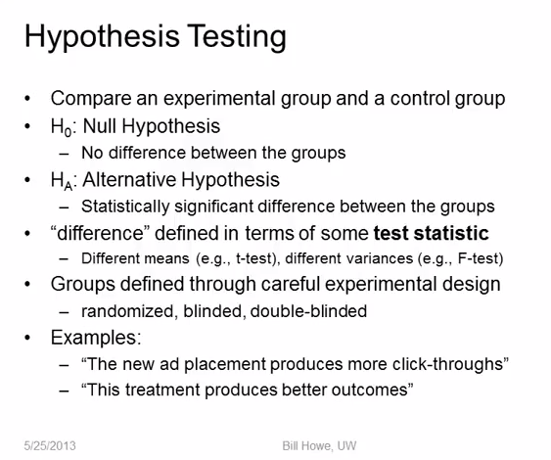

Slide 81
More on Hypothesis Testing
Null Hypothesis is given the benefit of the doubt (e.g., innocent until proven guilty).
Alternative Hypothesis directly contradicts the Null Hypothesis
"Step 1: State the hypotheses."
"Step 2: Set the criteria for a decision."
"Step 3: Compute the test statistic."
"Step 4: Make a decision."

Slide 82
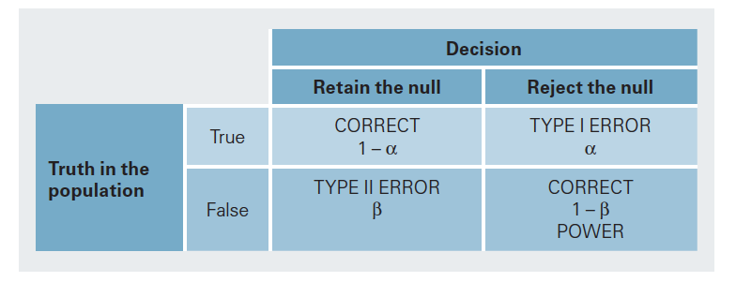
Hypothesis Testing
From G.J. Primavera, “Statistics for the Behavioral Sciences”

Slide 83
Non-Parametric Tests
All the tests so far are parametric tests that assume the data are normally distributed, and that the samples are independent of each other and all have the same distribution (IID).
They may be arbitrarily inaccurate is those assumptions are not met. Always make sure your data satisfies the assumptions of the test you’re using. e.g. watch out for:
Outliers – will corrupt many tests that use variance estimates.
Correlated values as samples, e.g. if you repeated measurements on the same subject.
Skewed distributions – give invalid results.

Slide 84
Non-parametric tests
These tests make no assumption about the distribution of the input data, and can be used on very general datasets:
K-S test
Permutation tests
Bootstrap confidence intervals

Slide 85
Bootstrap samples
Often you have only one sample of the data, but you would like to know how some measurement would vary across similar samples (i.e. the variance or histogram of a statistics).
You can get a good approximation to related samples by “resampling your sample”.
This is called bootstrap sampling (by analogy to lifting yourself up by your bootstraps).
For a sample S of N values, a bootstrap sample is a set S_{B} of N values drawn with replacement from S.

Slide 86
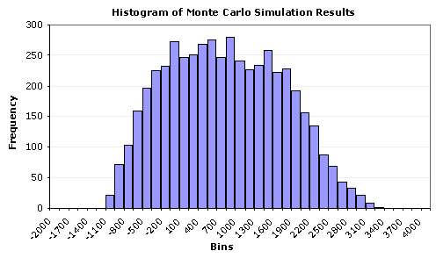
Idealized Sampling
idealized original population (through an oracle)
take samples
apply test statistic (e.g. mean)
histogram of statistic values
compare test statistic on the given data, compute p

Slide 87
Bootstrap Sampling
Original pop.
Given data (sample)
bootstrap samples,
drawn with replacement
apply test statistic (e.g. mean)
histogram of statistic values
The region containing 95% of the samples is a 95% confidence interval (CI)

Slide 88
Bootstrap Confidence Interval tests
Then a test statistic outside the 95% Confidence Interval (CI) would be considered significant at 0.05, and probably not drawn from the same population.
e.g. Suppose the data are differences in running times between two algorithms. If the 95% bootstrap CI does not contain zero, then original distribution probably has a mean other than zero, i.e. the running times are different.
We can also test for values other than zero. If the 95% CI contains only values greater than 2, we conclude that the difference in running times is significantly larger than 2.

Slide 89
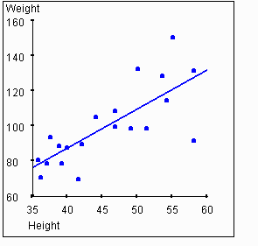
Bootstrap Test for Regression
Suppose we have a single sample of points, to which we fit a regression line?
How do we know whether this line is “significant”? And what do we mean by that?

Slide 90
Bootstrap Test for Regression
ANS: Take bootstrap samples, and fit a line to each sample.
The possible regression lines are shown below:
What we really want to know is “how likely is a line with zero or negative slope”.

Slide 91
Bootstrap Test for Regression
ANS: Take bootstrap samples, and fit a line to each sample.
The possible regression lines are shown below:
What we really want to know is “how likely is a line with zero or negative slope”.
Negative slope
Positive slope
histogram of slope values
The region containing 95% of the samples is a 95% confidence interval (CI)

Slide 92
Outline
Statistics
Measurement
Hypothesis Testing
Featurization – train/test/validation sets
Feature selection
Feature Hashing
Visualizing Accuracy

Slide 93
Train-Test-Validation Sets
When making measurements on a ML algorithm, we have additional challenges.
With a sample of data, any model fit to it models both:
Structure in the entire population
Structure in the specific sample not true of the population
1. is good because it will generalize to other samples.
2. is bad because it wont.
Example: a 25-year old man and a 30-year old woman.
Age predicts gender perfectly. (age < 27 => man else woman)
Gender predicts age perfectly. (gender == man => 25 else 30)
Neither result generalizes. This is called over-fitting.

Slide 94
Train-Test-Validation Sets
Train/Test split:
By (randomly) partitioning our data into train and test sets, we can avoid biased measurements of performance.
The model now fits a different sample from the measurement.
ML models are trained only on the training set, and then measured on the test set.
Example:
Build a model of age/gender based on the man/woman above.
Now select a test set of 40 random people (men + women).
The model will fail to make reliable predictions on this test set.

Slide 95
Validation Sets
Statistical models often include “tunable” parameters that can be adjusted to improve accuracy.
You need a test-train split in order to measure performance for each set of parameters.
But now you’ve used the test set in model-building which means the model might over-fit the test set.
For that reason, its common to use a third set called the validation set which is used for parameter tuning.
A common dataset split is 60-20-20 training/validation/test

Slide 96
Model Tuning
Tune Parameters
Training Data
ML model
Validation Data
Build Model
Evaluate
Test Data
Final Model Scores

Slide 97
A Brief History of Machine Learning
Before 2012*:
* Before publication of Krizhevsky et al.’s ImageNet CNN paper.
Input Data
Cleverly-Designed Features
ML model
Most of the “heavy lifting” in here.
Final performance only as good as the feature set.

Slide 98
A Brief History of Machine Learning
After 2012:
Input Data
Features
model
Deep Learning
Features and model learned together, mutually reinforcing

Slide 99
A Brief History of Machine Learning
But this (pre-2012) picture is still typical of many pipelines.
We’ll focus on one aspect of feature design: feature selection, i.e. choosing which features from a list of candidates to use for a ML problem.
Input Data
Cleverly-Designed Features
ML model

Slide 100
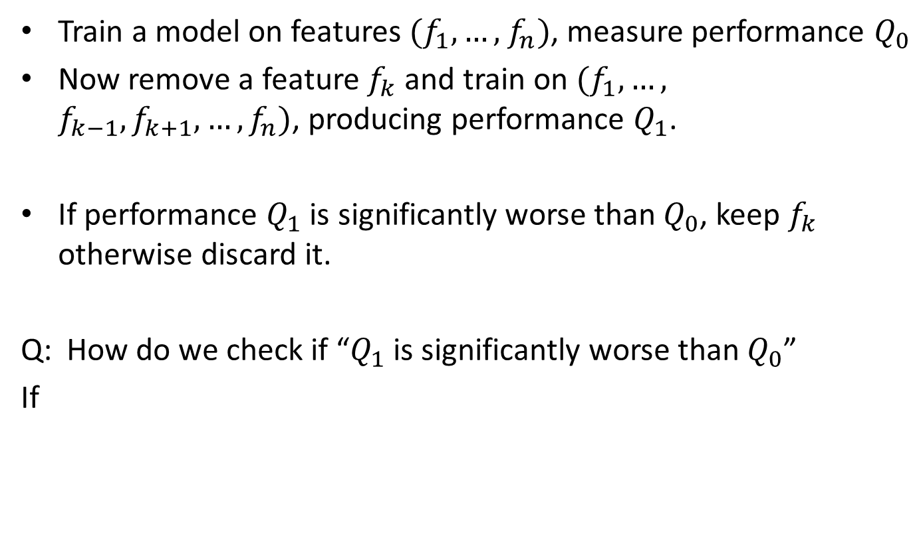
Method 1: Ablation
Train a model on features , measure performance
Now remove a feature and train on , producing performance .
If performance is significantly worse than , keep otherwise discard it.
Q: How do we check if “ is significantly worse than ”
If

Slide 101
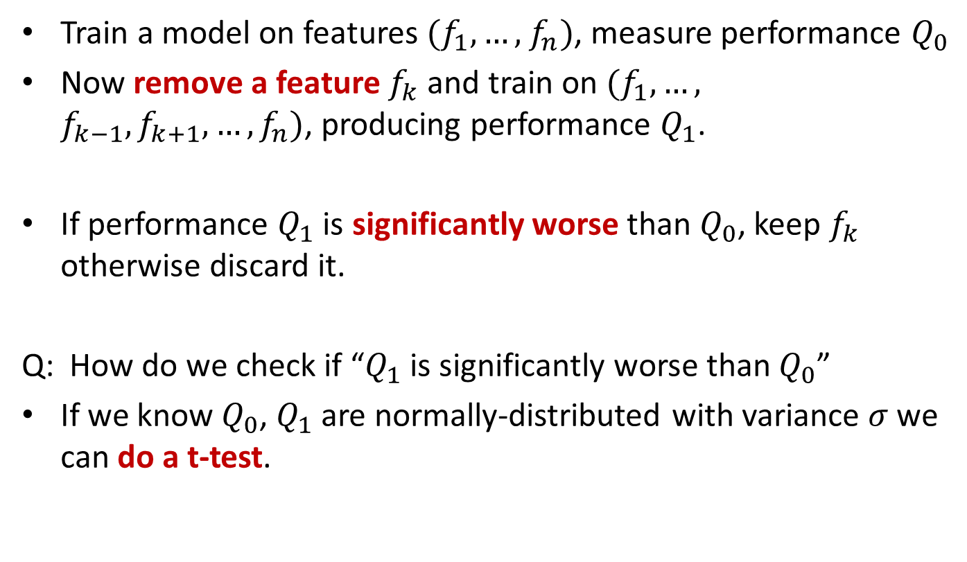
Method 1: Ablation
Train a model on features , measure performance
Now remove a feature and train on , producing performance .
If performance is significantly worse than , keep otherwise discard it.
Q: How do we check if “ is significantly worse than ”
If we know , are normally-distributed with variance we can do a t-test.

Slide 102
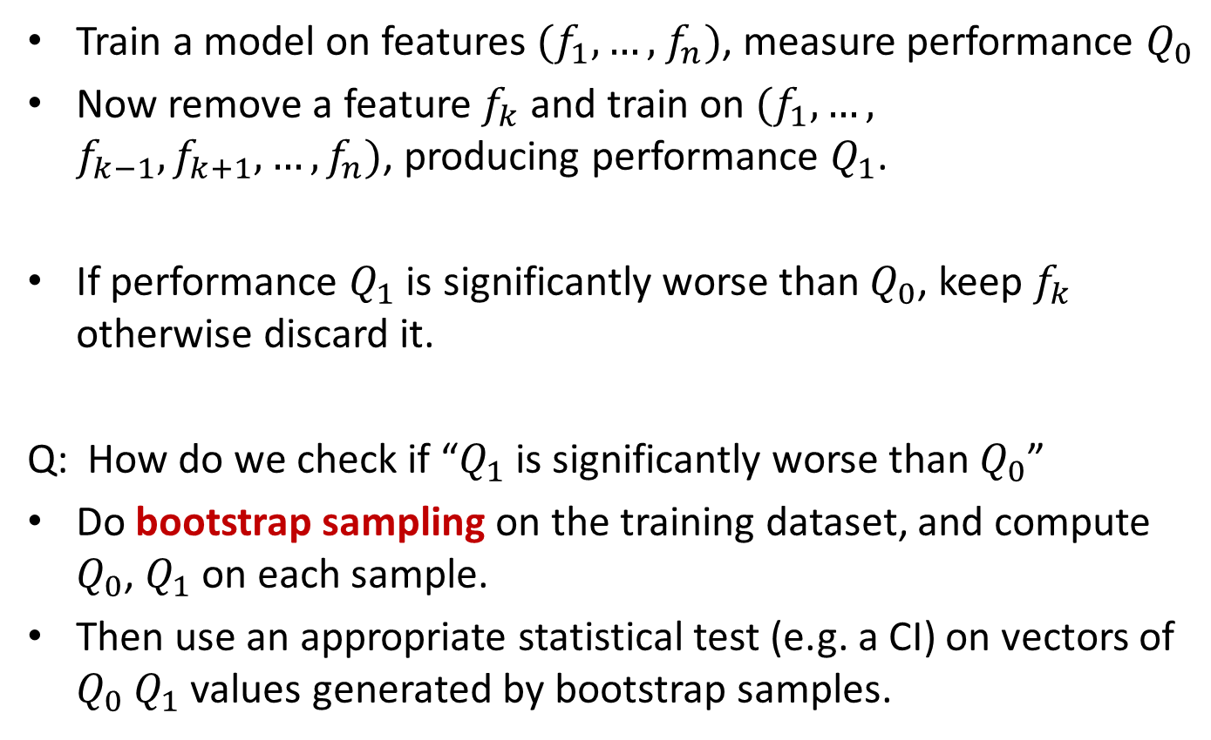
Method 1: Ablation
Train a model on features , measure performance
Now remove a feature and train on , producing performance .
If performance is significantly worse than , keep otherwise discard it.
Q: How do we check if “ is significantly worse than ”
Do bootstrap sampling on the training dataset, and compute , on each sample.
Then use an appropriate statistical test (e.g. a CI) on vectors of values generated by bootstrap samples.

Slide 103
Method 1: Ablation
Question: Why do you think ablation starts with all the features and removes one-at-a-time rather than starting with no features, and adding one-at-a-time?

Slide 104
Method 2: Mutual Information
Mutual information measures the extent to which knowledge of one feature influences the distribution of another (the classifier output).
Where U is a random variable which is 1 if term e_{t} is in a given document, 0 otherwise. C is 1 if the document is in the class c, 0 otherwise. These are called indicator random variables.
Mutual information can be used to rank features, the highest will be kept for the classifier and the rest ignored.

Slide 105
Method 3: CHI-Squared
CHI-squared is an important statistic to know for comparing count data.
Here it is used to measure dependence between word counts in documents and in classes. Similar to mutual information, terms that show dependence are good candidates for feature selection.
CHI-squared can be visualized as a test on contingency tables like this one:
 | Right-Handed | Left-Handed | Total
Males | 43 | 9 | 52
Females | 44 | 4 | 48
Total | 87 | 13 | 100

Slide 106
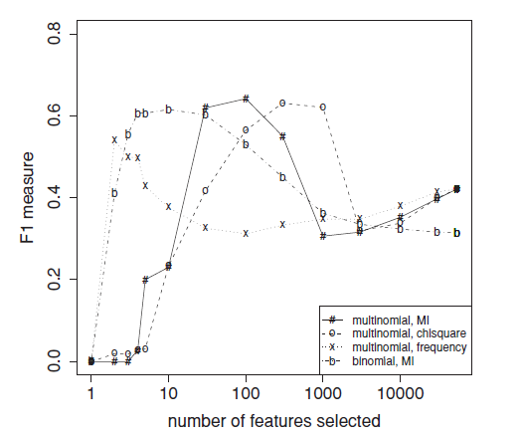
Example of Feature Count vs. Accuracy

Slide 107
Outline
Statistics
Measurement
Hypothesis Testing
Featurization
Feature selection
Feature Hashing
Visualizing Accuracy

Slide 108
Feature Hashing
Challenge: many prediction problems involve very, very rare features, e.g. URLs or user cookies.
There are billions to trillions of these, too many to represent explicitly in a model (or to run feature selection on!)
Most of these features are not useful, i.e. don’t help predict the target class.
A small fraction of these features are very important for predicting the target class (e.g. user clicks on a BMW dealer site has some interest in BMWs).

Slide 109
Feature Hashing
Word
The
Quick
Brown
Fox
Jumps
Over
the
Lazy
Dog
Hash Function
Feature | Count
1 | 2
2 | 2
3 | 3
4 | 1
5 | 0
6 | 1
Feature table much smaller than feature set.
We train a classifier on these features

Slide 110
Feature Hashing
Feature 3 receives “Brown”, “Lazy” and “Dog”.
The first two of these are not very salient to the category of the sentence, but “Dog” is.
Classifiers trained on hashed features often perform surprisingly well – although it depends on the application.
They work well e.g. for add targeting, because the false positive cost (target dog ads to non-dog-lovers) is low compared to the false negative cost (miss an opportunity to target a dog-lover).

Slide 111
Feature Hashing and Interactions
One very important application of feature hashing is to interaction features.
Interaction features (or just interactions) are tuples (usually pairs) of features which are treated as single features.
E.g. the sentence “the quick brown fox…” has interaction features including: “quick-brown”, “brown-fox”, “quick-fox” etc.
Interaction features are often worth “more than the sum of their parts” e.g. “BMW-tires,” “ipad-charger,” “school-bags”
There are N² interactions among N features, but very few are meaningful. Hashing them produces many collisions but most don’t matter.

Slide 112
Outline
Statistics
Measurement
Hypothesis Testing
Featurization
Feature selection
Feature Hashing
Visualizing Accuracy

Slide 113
Why not to use “accuracy” directly
The simplest measure of performance would be the fraction of items that are correctly classified, or the “accuracy” which is:
(tp = true positive, fn = false negative etc.).
But this measure is dominated by the larger set (of positives or negatives) and favors trivial classifiers.
e.g. if 5% of items are truly positive, then a classifier that always says “negative” is 95% accurate.
tp + tn
tp + tn + fp + fn

Slide 114
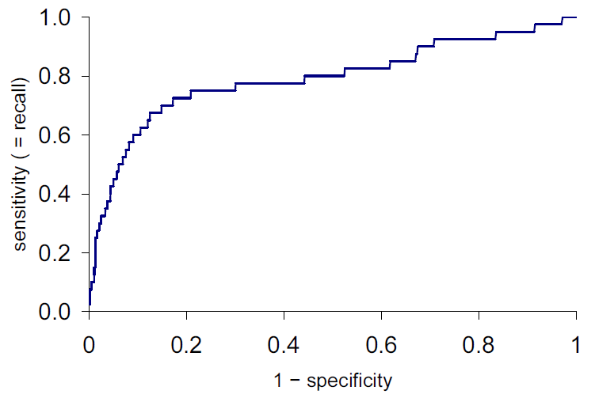
ROC plots
ROC is Receiver-Operating Characteristic. ROC plots
Y-axis: true positive rate = tp/(tp + fn), same as recall
X-axis: false positive rate = fp/(fp + tn) = 1 - specificity
Score increasing

Slide 115
ROC AUC
ROC AUC is the “Area Under the Curve” – a single number that captures the overall quality of the classifier. It should be between 0.5 (random classifier) and 1.0 (perfect).
Random ordering
area = 0.5

Slide 116
Lift Plot
A variation of the ROC plot is the lift plot, which compares the performance of the actual classifier/search engine against random ordering, or sometimes against another classifier.
Lift is the ratio of these lengths

Slide 117
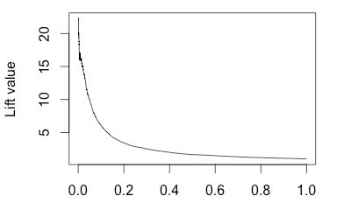
Lift Plot
Lift plots emphasize initial precision (typically what you care about), and performance in a problem-independent way.
Note: The lift plot points should be computed at regular spacing, e.g. 1/00 or 1/1000. Otherwise the initial lift value can be excessively high, and unstable.
1 - specificity

Slide 118
Summary
Statistics
Measurement
Hypothesis Testing
Featurization
Feature selection
Feature Hashing
Visualizing Accuracy

