Slide 1

Student Final Project Format (50%)
Research Proposal (Due: 9/28)
Overview, and Motivation: Provide an overview of the project goals and the motivation for it. Consider that this will be read by people who did not see your project proposal.
Related Work and Audience: Anything that inspired you, such as a paper, a web site, or something we discussed in class. Who is your audience. Who will you show your results?
Initial Questions: What questions are you trying to answer? How did these questions evolve over the course of the project? What new questions did you consider in the course of your analysis?
Data: Source, scraping method, cleanup, storage, etc.
Final Paper (also includes Abstract, Overview, Motivation, Related Work, Initial Questions and Data from the Research Proposal):
Exploratory Data Analysis: What visualizations did you use to look at your data in different ways? What are the different statistical methods you considered? Justify the decisions you made, and show any major changes to your ideas. How did you reach these conclusions?
Final Analysis: What did you learn about the data? How did you answer the questions? How can you justify your answers?
Presentation: Present your final results in a compelling and engaging way using text, visualizations, images, and videos on your project web site.
Benjamin Harvey, Ph.D., EMSE 6992 – Introduction to Data Analytics

Slide 2
Lecture 6: Understanding Data science and Big Data Motivation/Drivers for Adoption
Benjamin Simeon Harvey (Ben)
Faculty, EMSE Department
The George Washington University
E-mail: bsharve@gwu.edu
Web: TBD
Benjamin Harvey, Ph.D., EMSE 6992 – Introduction to Data Analytics

Slide 3
Agenda
Chapter 2: Business Motivations and Drivers for Big Data Adoption
Marketplace Dynamics
Business Architecture
Business Process Management
Information and Communication Technology
Data Analytics and Data Science
Digitization
Affordable Technology and Commodity Hardware
Social Media
Hyper-Connected Communities and Devices
Cloud Computing
Internet of Everything
Benjamin Harvey, Ph.D., EMSE 6992 – Introduction to Data Analytics

Slide 4

Big Data Characteristics
Volume
The anticipated amount/volume of data that is processed by Big Data solutions is substantial and ever-growing. High data volumes impose distinct data storage and processing demands, as well as additional data preparation, curation and management processes.
Velocity
In Big Data environments, data can arrive at fast speeds, and enormous datasets can accumulate within very short periods of time. From an enterprise’s point of view, the velocity of data translates into the amount of time it takes for the data to be processed once it enters the enterprise’s perimeter.
Variety
Data variety refers to the multiple formats and types of data that need to be supported by Big Data solutions. Data variety brings challenges for enterprises in terms of data integration, transformation, processing, and storage.
Veracity
Veracity refers to the quality or fidelity of data. Data that enters Big Data environments needs to be assessed for quality, which can lead to data processing activities to resolve invalid data and remove noise.
Value
Value is defined as the usefulness of data for an enterprise. The value characteristic is intuitively related to the veracity characteristic in that the higher the data fidelity, the more value it holds for the business.
Benjamin Harvey, Ph.D., EMSE 6992 – Introduction to Data Analytics

Slide 5
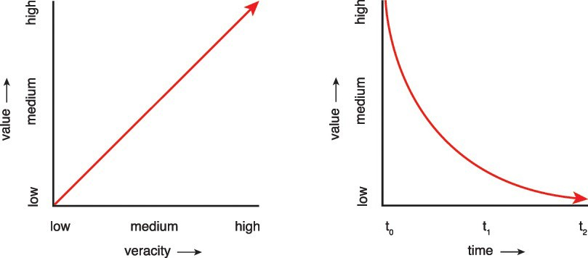
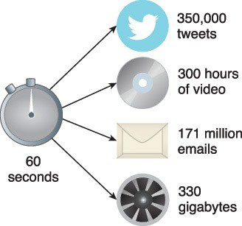



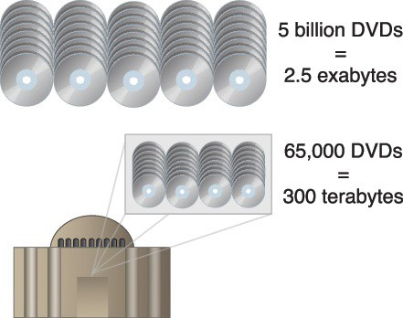
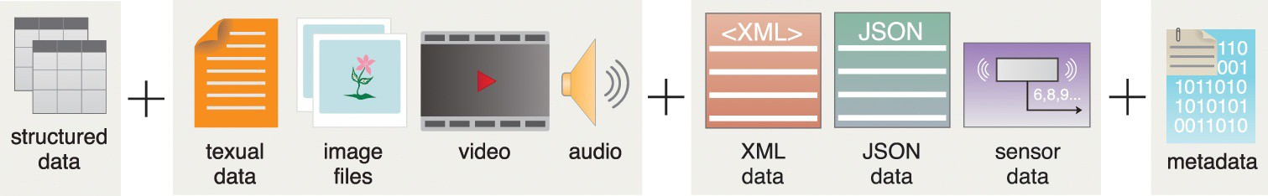
Big Data Characteristics
Velocity
Value
Figure 1.15 Data that has high veracity and can be analyzed quickly has more value to a business
Veracity
Volume
Variety
Figure 1.12-15 The Five Vs of Big Data.
Erl, Thomas, Wajid Khattak, and Paul Buhler. Big data fundamentals: concepts, drivers & techniques. Prentice Hall Press, 2016.
Benjamin Harvey, Ph.D., EMSE 6992 – Introduction to Data Analytics

Slide 6
Motivation and Drivers for Big Data Adoption
Here we will explore the business motivations and drivers behind the adoption of Big Data solutions and technologies:
Marketplace Dynamics,
An appreciation and formalism of Business Architecture (BA),
The realization that a business’ ability to deliver value is directly tied to Business Process Management (BPM),
Innovation, Information, and Communications Technology (ICT), and
The Internet of Everything
Erl, Thomas, Wajid Khattak, and Paul Buhler. Big data fundamentals: concepts, drivers & techniques. Prentice Hall Press, 2016.
Benjamin Harvey, Ph.D., EMSE 6992 – Introduction to Data Analytics

Slide 7
Motivation and Drivers for Big Data Adoption
Motivation and drivers include:
Marketplace Dynamics,
An appreciation and formalism of Business Architecture (BA),
The realization that a business’ ability to deliver value is directly tied to Business Process Management (BPM),
Innovation and Information and Communications Technology (ICT), and
The Internet of Everything
Benjamin Harvey, Ph.D., EMSE 6992 – Introduction to Data Analytics

Slide 8
Motivation and Drivers for Big Data Adoption
Marketplace Dynamics:
Businesses working to improve efficiency and effectiveness to stabilize their profitability by reducing costs.
Companies conduct transformation projects to improve their corporate processes to achieve savings.
Data – a discrete, objective facts about events.
Information – data that makes a difference
Knowledge – a fluid mix of framed experience, values, contextual information and expert insight that provides a framework for evaluating and incorporating new experiences and information.
Benjamin Harvey, Ph.D., EMSE 6992 – Introduction to Data Analytics

Slide 9






Data Mining
Analytics
use
Data Warehouse
are comprised of
uses
uses data stored in
is closely related to
automate
interfaces with/ provides
analyze
Machine Learning
Data Analytics
Business Intelligence
OLAP
uses
uses
is a type
is a type of
reports
feeds data into
of
Quantitative Analysis
Quantitative Analysis
KPIs
ETL
uses
OLTP
is used for
is used for
Commodity Hardware
Data Science Model
- Shows the “Big Picture”
- Dependencies
generally uses
Big Data Solution
can process
is an open-source implementation of
provides storage for
Large Datasets
Hadoop
NoSQL Databases
Source: www.arcitura.com
Benjamin Harvey, Ph.D., EMSE 6992 – Introduction to Data Analytics

Slide 10
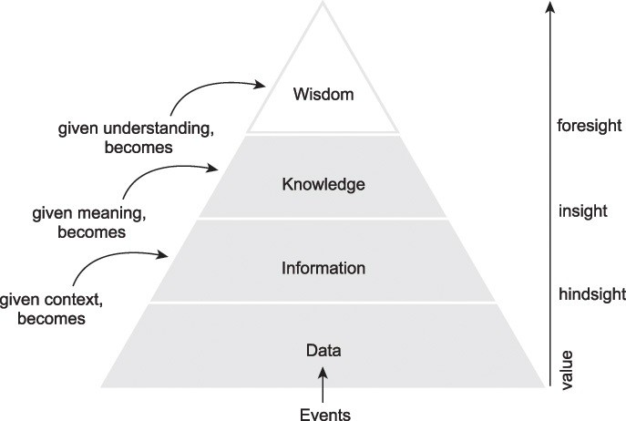
Motivation and Drivers for Big Data Adoption
Latitude – Longitude
Jacksonville FL
Benjamin Harvey – 10668 Pine Rd Jax FL
Ben will be at home at 6pm today
Figure 2.1 The DIKW pyramid shows how data can be enriched with context to create information, information can be supplied with meaning to create knowledge and knowledge can be integrated to form wisdom.
Erl, Thomas, Wajid Khattak, and Paul Buhler. Big data fundamentals: concepts, drivers & techniques. Prentice Hall Press, 2016.
Benjamin Harvey, Ph.D., EMSE 6992 – Introduction to Data Analytics

Slide 11
Motivation and Drivers for Big Data Adoption
Business Architecture:
Provides a means of blueprinting or concretely expressing the design and the processes of the business
Helps and organization align its strategic vision, goals, objectives with its underlying execution.
Layered system:
Strategic Layer– C-Level Executives and Advisory Groups
Managerial Layer – seeks to steer the organization in alignment with the strategy
Operations Layer – where a business executes its core processes and delivers value to its customers
Benjamin Harvey, Ph.D., EMSE 6992 – Introduction to Data Analytics

Slide 12
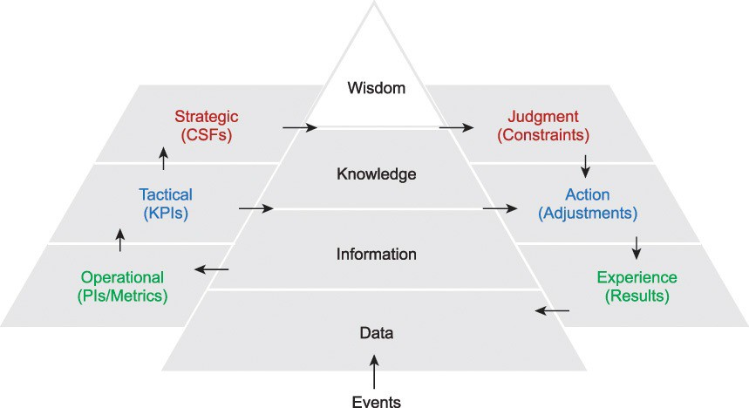
Motivation and Drivers for Big Data Adoption
(Know-Why)
(Know-How)
(Know-What)
(Know-Nothing)
Figure 2.3 The creation of a virtuous cycle to align an organization across layers via a feedback loop.
Erl, Thomas, Wajid Khattak, and Paul Buhler. Big data fundamentals: concepts, drivers & techniques. Prentice Hall Press, 2016.
Benjamin Harvey, Ph.D., EMSE 6992 – Introduction to Data Analytics

Slide 13
Motivation and Drivers for Big Data Adoption
Business Process Management:
A business process is a description of how work is performed in an organization. It describes all work-related activities and their relationships, aligned with the organizational actors and resources responsible for conducting them.
When the combination of Big Data analytic results and goal-driven behavior are used together, process execution can become adaptive to the marketplace and responsive to environmental conditions.
Benjamin Harvey, Ph.D., EMSE 6992 – Introduction to Data Analytics

Slide 14
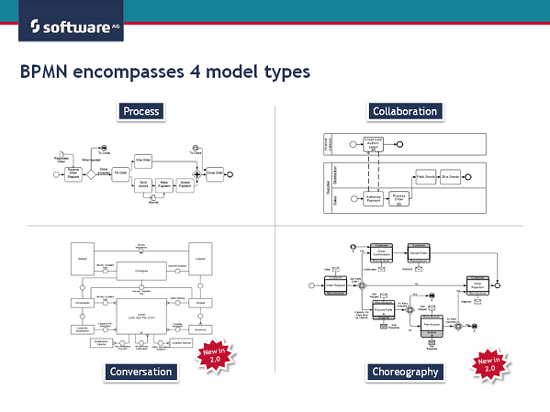
Motivation and Drivers for Big Data Adoption
Figure: BPMN four model types
Source: http://www.ariscommunity.com/users/roland-woldt/2011-01-28-learning-bpmn-2-which-models-are-available-bpmn
Benjamin Harvey, Ph.D., EMSE 6992 – Introduction to Data Analytics

Slide 15
Motivation and Drivers for Big Data Adoption
Information and Communications Technology
ICT developments that have accelerated the pace of Big Data adoption include:
Data analytics and data science
Digitization
Affordable technology and commodity hardware
Social media
Hyper-connected communities and devices
Cloud computing
Benjamin Harvey, Ph.D., EMSE 6992 – Introduction to Data Analytics

Slide 16
Information and Communications Technology
Data analytics and data science
Enterprises are collecting, procuring, storing, curating, and processing increasing quantities of data to find new insights that can drive more efficient and effective operations.
Companies are looking for new ways to gain a competitive edge by using Data Science tools and technologies to extract meaningful information and insights.
Digitization
Businesses have replaced physical mediums as the de facto communications and delivery mechanisms.
This allows for the opportunity to collect secondary data for analysis
Affordable technology and commodity hardware
Technology capable of storing and processing large quantities of diverse data has become increasingly affordable.
Big data solutions also often leverage open-source software that executes on commodity hardware, further reducing costs.
Benjamin Harvey, Ph.D., EMSE 6992 – Introduction to Data Analytics

Slide 17
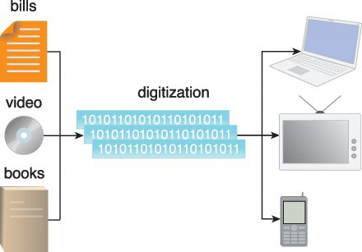
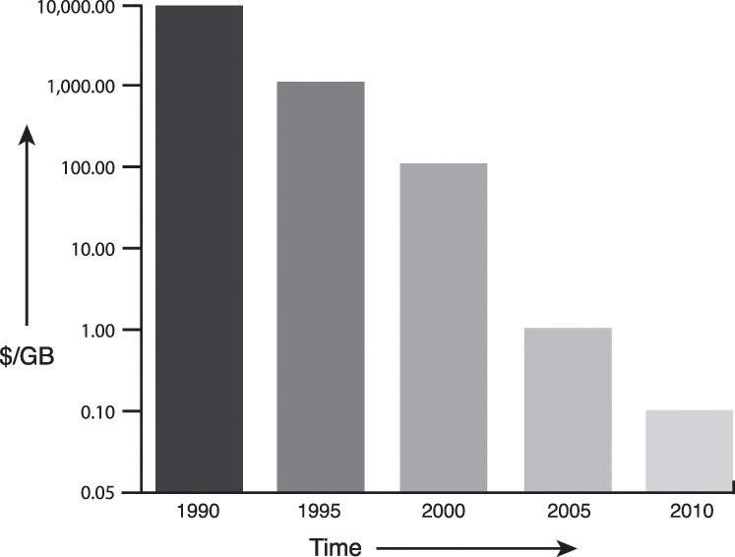
Information and Communications Technology
Figure 2.4 Examples of digitization including online banking, on-demand television and streaming video.
Figure 2.5 Data storage prices have dropped dramatically from more than $10,000 to less than $0.10 per GB over the decades.
Erl, Thomas, Wajid Khattak, and Paul Buhler. Big data fundamentals: concepts, drivers & techniques. Prentice Hall Press, 2016.
Benjamin Harvey, Ph.D., EMSE 6992 – Introduction to Data Analytics

Slide 18
Information and Communications Technology
Social media
The emergence of social media has empowered costumers to provide feedback in near real-time via open and public mediums.
The shift has forced businesses utilize CRM’s to analyze customer feedback on their service and product offerings
Hyper-connected communities and devices
The broadening coverage of the Internet and the proliferation of cellular, Wi-Fi and sensor networks has enabled more people and their devices to be continuously active in virtual communities.
IoT – a vast collection of smart Internet-connected devices
IoE – combines the services provided by smart connected devices of the IoT into meaningful business processes that posses the ability to provide unique differentiating value propositions.
Cloud computing
Cloud computing advancements have led to the creating of environments that are capable of providing highly scalable, parallel, distributed on-demand IT resources.
Benjamin Harvey, Ph.D., EMSE 6992 – Introduction to Data Analytics

Slide 19
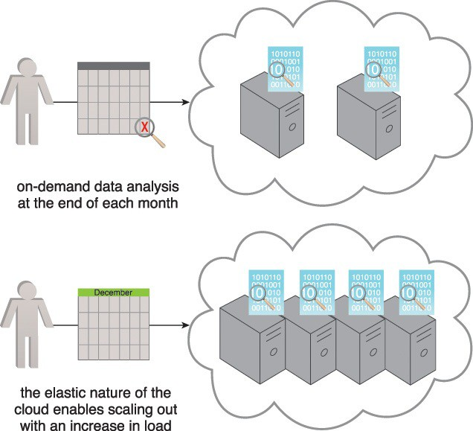
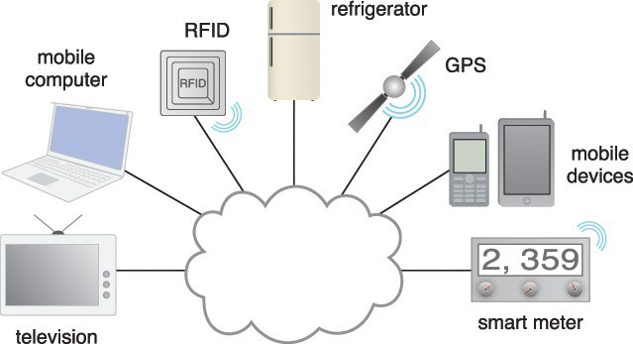
Information and Communications Technology
Figure 2.7 The cloud can be used to complete on-demand data analysis at the end of each month or enable the scaling out of systems with an increase in load.
Figure 2.6 Hyper-connected communities and devices include television, mobile computing, RFIDs, refrigerators, GPS devices, mobile devices and smart meters.
Erl, Thomas, Wajid Khattak, and Paul Buhler. Big data fundamentals: concepts, drivers & techniques. Prentice Hall Press, 2016.
Benjamin Harvey, Ph.D., EMSE 6992 – Introduction to Data Analytics

Slide 20












DATA
CLOUD
STORAGE
CLOUD
Amazon Elastic Elastic MapReduce (EMR)
Amazon Simple Storage Service (S3)
UTILITY
CLOUD
Amazon Elastic Compute Cloud (EC2)
Benjamin Harvey, Ph.D., EMSE 6992 – Introduction to Data Analytics

Slide 21






DATA
CLOUD
STORAGE
CLOUD
Amazon Elastic Elastic MapReduce (EMR)
Amazon Simple Storage Service (S3)
Utility
CLOUD
UTILITY
CLOUD
Data Cloud History
Amazon Elastic Compute Cloud (EC2)
Amazon Elastic Compute Cloud (EC2)
MapReduce
File System
Benjamin Harvey, Ph.D., EMSE 6992 – Introduction to Data Analytics

Slide 22


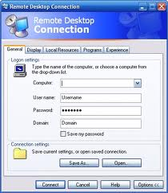

Cloud Infrastructures
Data Cloud (Comp.)
Storage Cloud
MapReduce
File System
Utility Cloud
Benjamin Harvey, Ph.D., EMSE 6992 – Introduction to Data Analytics

Slide 23
HDFS: The System Structure
File System
NameNode
1. filename
2. BlckId, DataNodes
o
Secondary
NameNode
Client
3.Read data
DataNodes
NameNode : Maps a file to a file-id and list of MapNodes
DataNode : Maps a block-id to a physical location on disk
Source: hadoop.apache.org
Benjamin Harvey, Ph.D., EMSE 6992 – Introduction to Data Analytics
Notes:
23

Slide 24
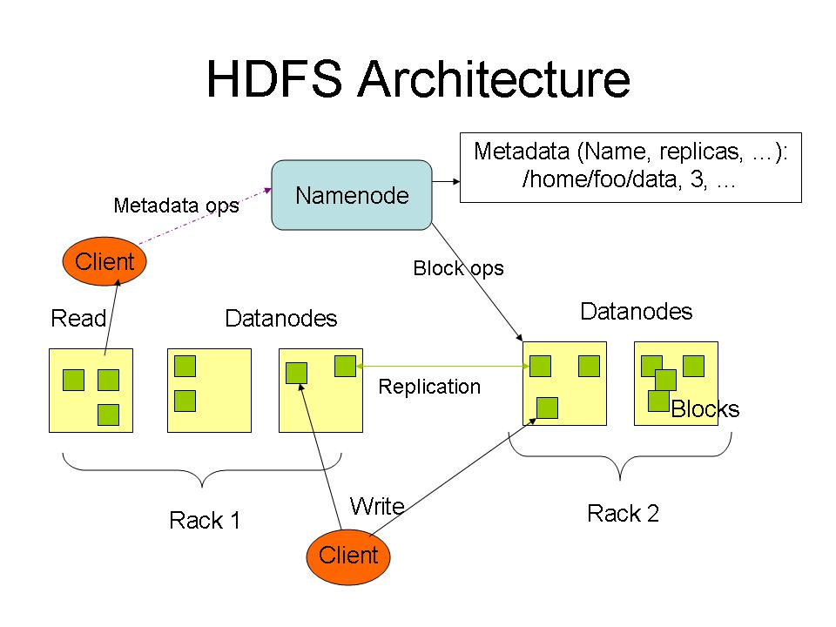
HDFS Architecture
File System
Source: hadoop.apache.org
Benjamin Harvey, Ph.D., EMSE 6992 – Introduction to Data Analytics

Slide 25
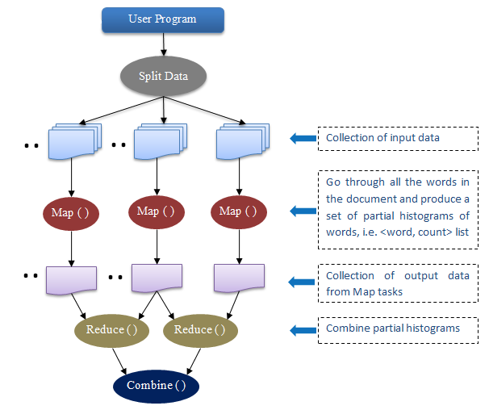
MapReduce WordCount
MapReduce
The day that the store was closed and was cold
<The,1> <day,1> <that,1> <the,1> <store,1> <was,1> <closed,1> <and,1> <was,1> <cold,1>
<the,1,1> <day,1> <that,1> <store,1> <was,1,1> <closed,1> <and,1> <cold,1>
<the,2> <day,1> <that,1> <store,1> <was,2> <closed,1> <and,1> <cold,1>
Source: hadoop.apache.org
Benjamin Harvey, Ph.D., EMSE 6992 – Introduction to Data Analytics

Slide 26
MapReduce Execution Overview
User Program
Distributed File System
fork
Master
fork
fork
Output File 1
Assign Map
Assign Reduce
Worker
Document A
Worker
Document B
Worker
Document C
Worker
Output File 1
Document D
Document E
Worker
Input Files
Map Phase
Intermediate Files
Reduce Phase
Output File
MapReduce
Source: hadoop.apache.org
Benjamin Harvey, Ph.D., EMSE 6992 – Introduction to Data Analytics
Notes:
26

Slide 27
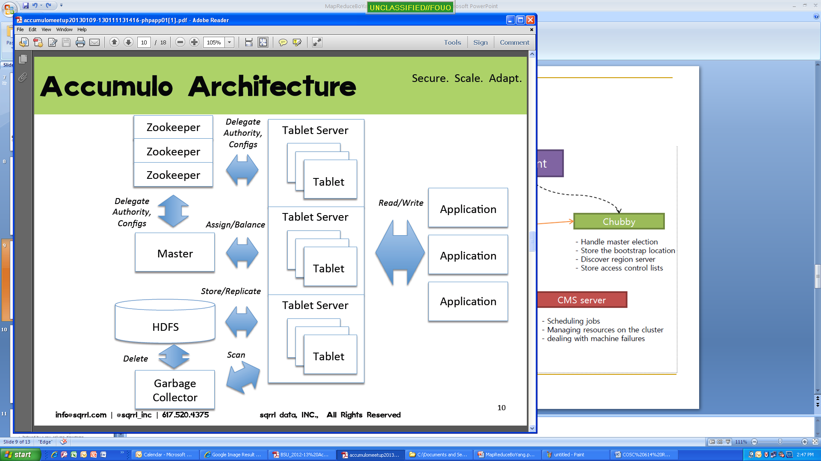
Hbase/Acculumo Architecture
Only Accumulo has this functionality!
Source: hadoop.apache.org
Benjamin Harvey, Ph.D., EMSE 6992 – Introduction to Data Analytics

Slide 28
Internet of Everything
Hyper-connected communities and devices running on affordable technology and commodity hardware stream digitized data that is subject to analytic processes hosted in elastic cloud computing environments.
Benjamin Harvey, Ph.D., EMSE 6992 – Introduction to Data Analytics

Slide 29
Internet of Everything
The results of the analysis can provide insights as to how much value is generated by the current process and whether or not the process should proactively seek opportunities to further optimize itself.
(1) Business processes in combination with analysis of (2) streaming data and customer context, being able to (3) adapt the execution of these process to align with the customer’s goals will become a key corporate differentiator in the future
Benjamin Harvey, Ph.D., EMSE 6992 – Introduction to Data Analytics

Slide 30
Summary: Drivers and Motivation for Big Data Adoption

Slide 31
Case Study: Ensure to Insure
Introduction to the Case Study
ETI new transformation and innovation corporate priorities:
Considering transformation, business process management disciplines will be adopted to document, analyze, and improve the processing of claims
Risk assessment and fraud detection will be enhanced with the application of innovative Big Data technologies that will produce analytic results that can drive data-drive decision-making.
Redefining CSFs and KPIs has helped ETI link and align the strategic, tactical, and operating levels of the business
Organization role responsible for innovation management.
Do you think the new transformation and innovations priorities will help? Justify your answer.
What’s missing?
Benjamin Harvey, Ph.D., EMSE 6992 – Introduction to Data Analytics

