Slide 1
Scaling Up
EMSE 6992
Benjamin Harvey

Slide 2
Overview
Why Big Data? (and Big Models)
Hadoop
Spark
MPI

Slide 3
Big Data
Lots of Data:
Facebook’s daily logs: 60 TB
1000 genomes project: 200 TB
Google web index: 10+ PB
Lots of Questions:
Computational Marketing
Recommendations and Personalization
Genetic analysis

Slide 4
But How Much Data Do You Need?
The answer of course depends on the question but for many applications the answer is:
As much as you can get
Big Data about people (text, web, social media) follow power law statistics.
Log feature frequency
Most features occur only once or twice
Log feature rank

Slide 5
How Much Data Do You Need?
The number of features grows in proportion to the amount of data – doubling the dataset size roughly doubles the number of users we observe.
Even one or two observations of a user improves predictions for them, so more data (and bigger models!) ➔ more revenue.
Log feature frequency
Most features occur only once or twice
Log feature rank

Slide 6
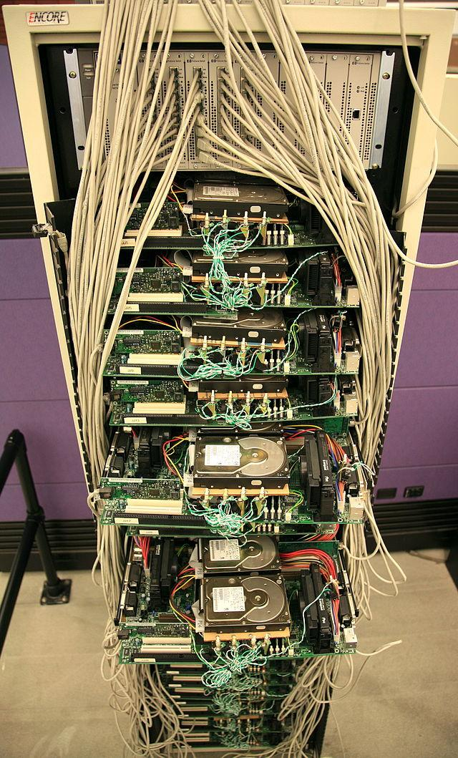
Hardware for Big Data
Budget hardware
Not "gold plated"
Many low-end servers
Easy to add capacity
Cheaper per CPU/disk
Increased Complexity in software:
Fault tolerance
Virtualization
Image: Steve Jurvetson/Flickr

Slide 7
Problems with Cheap HW
Failures, e.g. (Google numbers)
1-5% hard drives/year
0.2% DIMMs/year
Commodity Network (1-10 Gb/s) speeds vs. RAM
Much more latency (100x – 100,000x)
Lower throughput (100x-1000x)
Uneven Performance
Variable network latency
External loads
Notes:
ADD: How often do things fail?
Uneven performance: inconsistent hardware/data skew: outliers are rare -- but you'll see them more when you're spreading across more nodes

Slide 8
MapReduce: Word Count
“I am Sam
I am Sam
Sam I am
Do you like
Green eggs and ham?
I do not like them
Sam I am
I do not like
Green eggs and ham
Would you like them
Here or there?
…”
Notes:
New dataset in a bunch of pieces! Everything doesn’t need to be stored on one machine

Slide 9
Word Count with one Reducer
“I am Sam
I am Sam
Sam I am
Do you like
Green eggs and ham?
I do not like them
Sam I am
I do not like
Green eggs and ham
Would you like them
Here or there?
…”
{I: 3,
am: 3,
…}
{I: 6,
am: 5,
…}
{do: 2,
you: 1,
… }
{Sam: 1,
I: 2,
… }
{Would: 1, you: 1,… }
Notes:
A single reducer gets everything

Slide 10
Word Count with Multiple Reducers
“I am Sam
I am Sam
Sam I am
Do you like
Green eggs and ham?
I do not like them
Sam I am
I do not like
Green eggs and ham
Would you like them
Here or there?
…”
{I: 3,
am: 3,
…}
{I: 6,
do: 3,
…}
{do: 2,
you: 1,
… }
{am: 5,
Sam: 4
…}
{Sam: 1,
I: 2,
… }
{you: 2
…}
{Would: 1, you: 1,… }
{Would: 1
…}
Notes:
New dataset in a bunch of pieces! Everything doesn’t need to be stored on one machine

Slide 11
MapReduce: Word Count
Map
Reduce
“I am Sam
I am Sam
Sam I am
Do you like
Green eggs and ham?
I do not like them
Sam I am
I do not like
Green eggs and ham
Would you like them
Here or there?
…”
{I: 3,
am: 3,
…}
{I: 6,
do: 3,
…}
{do: 2,
you: 1,
… }
{am: 5,
Sam: 4
…}
{Sam: 1,
I: 2,
… }
{you: 2
…}
{Would: 1, you: 1,… }
{Would: 1
…}
Notes:
New dataset in a bunch of pieces! Everything doesn’t need to be stored on one machine

Slide 12
MapReduce: Failures?
“I am Sam
I am Sam
Sam I am
Do you like
Green eggs and ham?
I do not like them
Sam I am
I do not like
Green eggs and ham
Would you like them
Here or there?
…”
{I: 3,
am: 3,
…}
{do: 2,
you: 1,
… }
Start a new copy!
{Sam: 1,
I: 2,
… }
{Would: 1, you: 1,… }
Notes:
New dataset in a bunch of pieces! Everything doesn’t need to be stored on one machine

Slide 13
MapReduce: Slow Tasks
“I am Sam
I am Sam
Sam I am
Do you like
Green eggs and ham?
I do not like them
Sam I am
I do not like
Green eggs and ham
Would you like them
Here or there?
…”
{I: 3,
am: 3,
…}
Start a new copy!

Slide 14
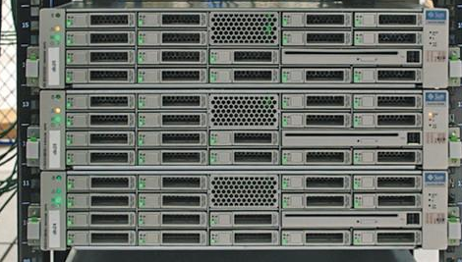
MapReduce: Distributed Execution
HDFS
data
HDFS
data
Image: Wikimedia commons (RobH/Tbayer (WMF))

Slide 15
MapReduce for Machine Learning
There are batch algorithms for most Machine Learning tasks:
process entire dataset, compute gradient, update model
Two kinds of parallel ML algorithm:
Data Parallel: distributed data, shared model.
Model Parallel: data and model are distributed.
Data Parallel batch algorithms can be implemented in one map-reduce step
Model parallel algorithms require two reduce steps for each iteration (reduce, and then redistribute to each mapper)

Slide 16
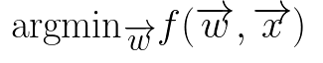
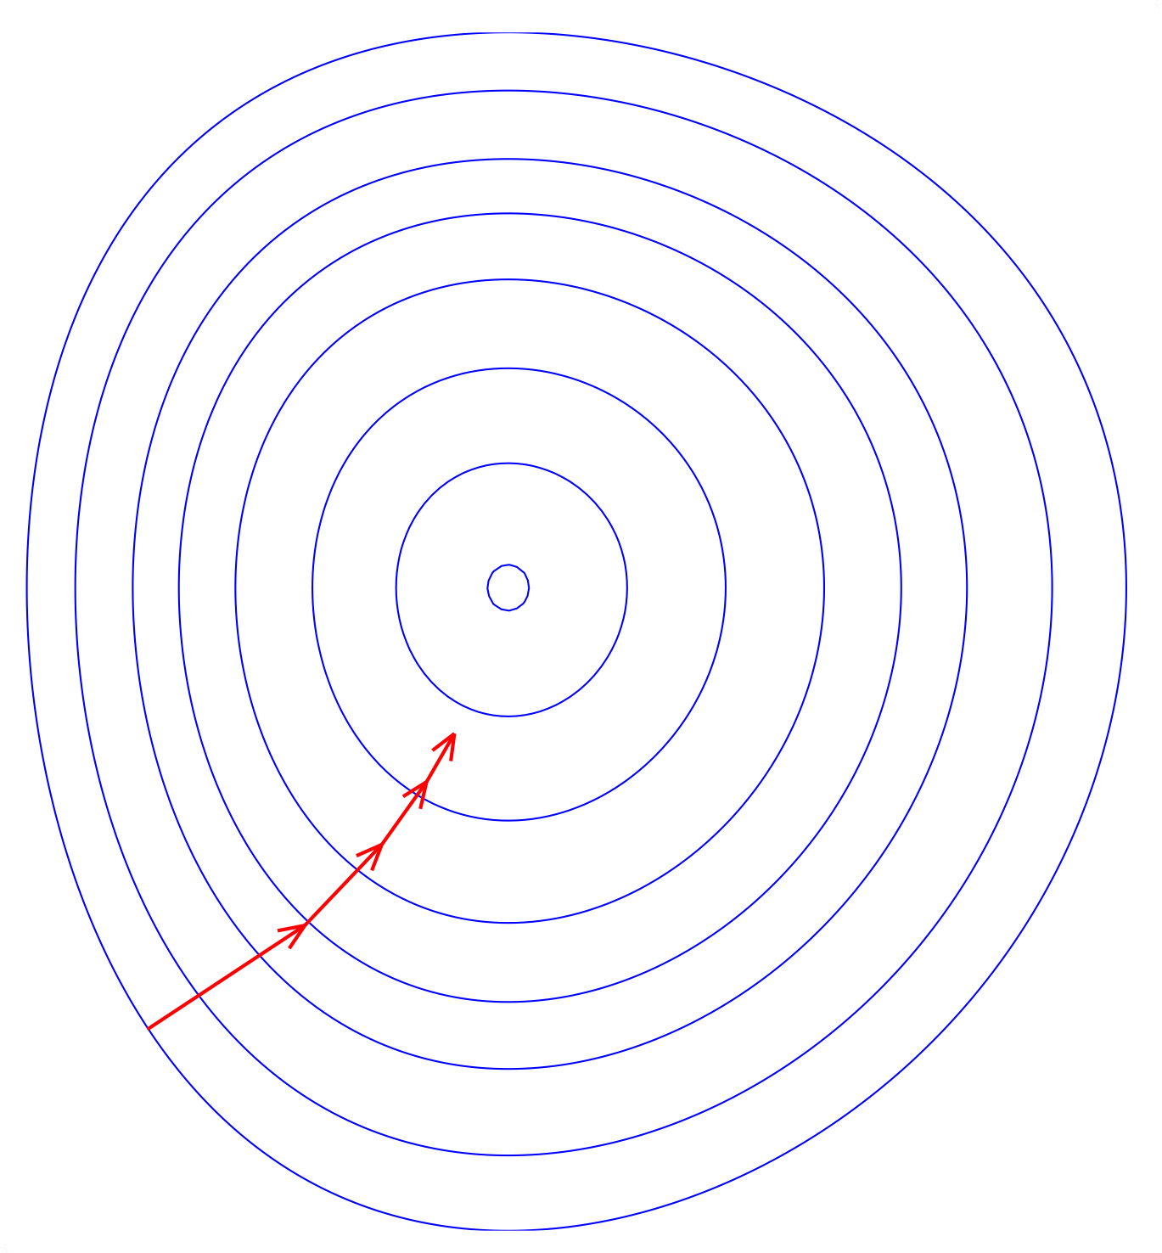

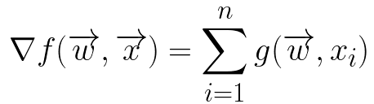
Batch Gradient Descent
model
data
w₁
Map over data
w₀
Reduce
Notes:
Gradient descent is a first-order iterative optimization algorithm for finding the minimum of a function. To find a local minimum of a function using gradient descent, one takes steps proportional to the negative of the gradient (or approximate gradient) of the function at the current point.

Slide 17

Gradient Descent on MR
Image: Wikimedia commons (RobH/Tbayer (WMF))

Slide 18
Gradient Descent on MR
Too much disk I/O
Image: Wikimedia commons (RobH/Tbayer (WMF))

Slide 19
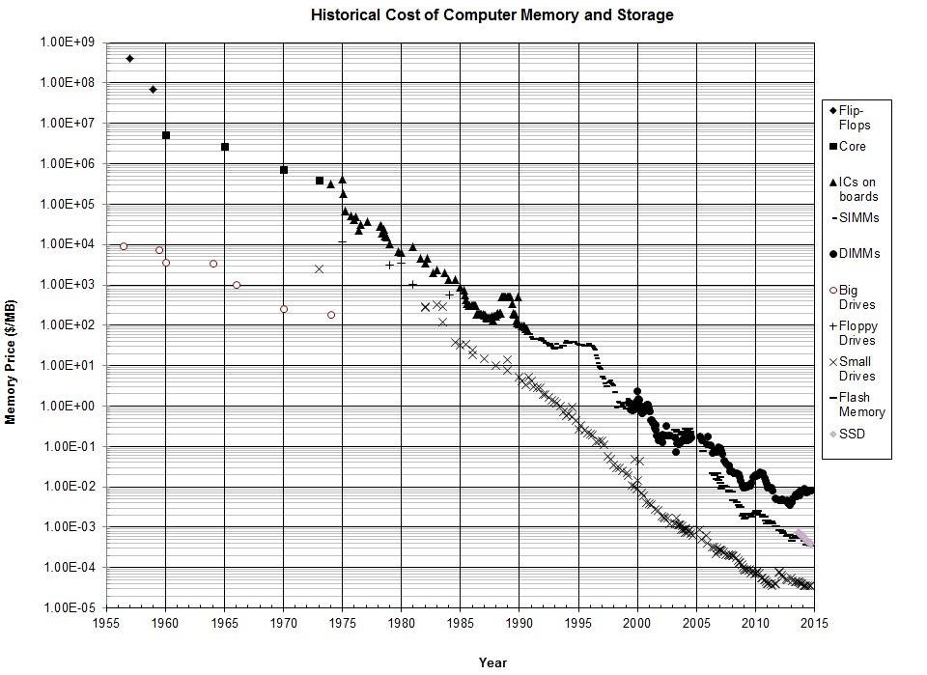
Tech trend: cost of memory
RAM
2010: RAM 1 cent/MB
PRICE
disk
flash
YEAR
Via http://www.jcmit.com/mem2014.htm

Slide 20
Approaches
Hadoop
Spark
MPI

Slide 21

Persist data in-memory:
Optimized for batch, data-parallel ML algorithms
An efficient, general-purpose language for cluster processing of big data
In-memory query processing (Shark)

Slide 22

Practical Challenges with Hadoop:
Very low-level programming model (Jim Gray)
Very little re-use of Map-Reduce code between applications
Laborious programming: design code, build jar, deploy on cluster
Relies heavily on Java reflection to communicate with to-be-defined application code.

Slide 23
Practical Advantages of Spark:
High-level programming model: can be used like SQL or like a tuple store.
Interactivity.
Integrated UDFs (User-Defined Functions).
High-level model (Scala Actors) for distributed programming.
Scala generics instead of reflection: Spark code is generic over [Key,Value] types.

Slide 24
Spark: Fault Tolerance
Hadoop: Once computed, don’t lose it
Spark: Remember how to recompute
User

Slide 25
Spark: Fault Tolerance
Hadoop: Once computed, don’t lose it
Spark: Remember how to recompute
User

Slide 26
Spark programming model (Python)
sc = pyspark.SparkContext(...)
raw_ratings = sc.textFile("...", 4)
RDD (Resilient Distributed Dataset)
Distributed array, 4 partitions
Elements are lines of input
Computed on demand
Compute = (re)read from input

Slide 27
Spark programming model (Python)
lines = sc.textFile("...", 4)
print lines.count()
#
#
#
#

Slide 28
Spark programming model (Python)
lines = sc.textFile("...", 4)
comments = lines.filter(isComment)
print lines.count(), comments.count()
lines
lines
comments
#
#
#
#
#
#
#
#

Slide 29
Spark programming model (Python)
lines = sc.textFile("...", 4)
lines.cache() # save, don't recompute!
comments = lines.filter(isComment)
print lines.count(), comments.count()
lines
#
comments
RAM
#
#
RAM
#
#
RAM
#
#
RAM
#

Slide 30
Other transformations
rdd.filter(lambda x: x % 2 == 0)
# [1, 2, 3] → [2]
rdd.map(lambda x: x * 2)
# [1, 2, 3] → [2, 4, 6]
rdd.flatMap(lambda x: [x, x+5])
# [1, 2, 3] → [1, 6, 2, 7, 3, 8]

Slide 31
Shuffle transformations
rdd.groupByKey()
# [(1,'a'), (2,'c'), (1,'b')] →
# [(1,['a','b']), (2,['c'])
rdd.sortByKey()
# [(1,'a'), (2,'c'), (1,'b')] →
# [(1,'a'), (1,'b'), (2,'c')]

Slide 32
Getting data out of RDDs
rdd.reduce(lambda a, b: a * b)
# [1,2,3] → 6
rdd.take(2)
# RDD of [1,2,3] → [1,2] # as list
rdd.collect()
# RDD of [1,2,3] → [1,2,3] # as list
rdd.saveAsTextFile(...)

Slide 33
Example:
Logistic Regression in PySpark
points = sc.textFile(...).map(parsePoint).cache()
w = numpy.random.ranf(size = D) # model vector
for i in range(ITERATIONS):
gradient = points.map(
lambda p: (1/(1+exp(-p.y*(w.dot(p.x))))-1)*p.y*p.x
).reduce(lambda a, b: a + b)
w -= gradient
print "Final model: %s" % w

Slide 34
Spark's Machine Learning Toolkit
MLLib: Algorithms
Classification
SVM, Logistic Regression, Decision Trees, Naive Bayes
Regression
Linear (with L1 or L2 regularization)
Unsupervised:
Alternating Least Squares
K-Means
SVD
Optimizers
Optimization primitives (SGD, L-BGFS)

Slide 35
Example:
Logistic Regression with MLLib
from pyspark.mllib.classification \
import LogisticRegressionWithSGD
trainData = sc.textFile("...").map(parsePoint) testData = sc.textFile("...").map(...)
model = \
LogisticRegressionWithSGD.train(trainData)
predictions = model.predict(testData)
Notes:
Should remind you of scikit-learn

Slide 36
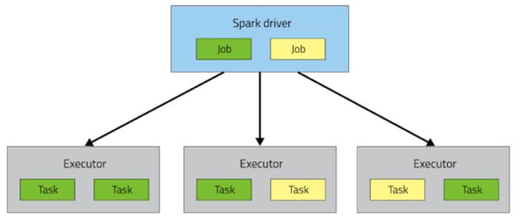
Spark Driver and Executors
Driver runs user interaction, acts as master for batch jobs
Driver hosts machine learning models
Executors hold data partitions
Tasks process data blocks
Typically tasks/executor = number of hardware threads
Model
Data blocks
Notes:
Should remind you of scikit-learn

Slide 37
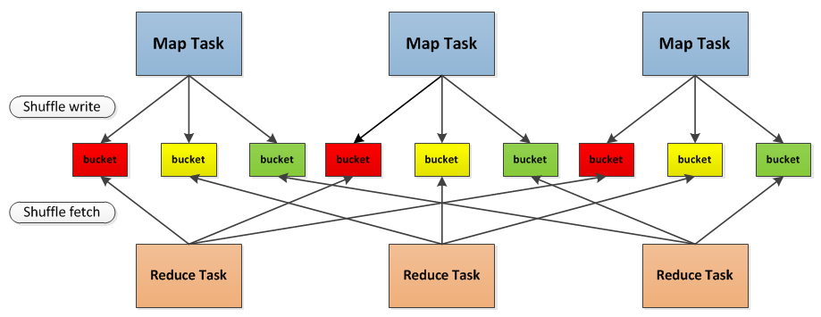
Spark Shuffle
Used for GroupByKey, Sort, Join operations
Map and Reduce tasks run on executors
Data is partitioned by key on by each mapper, saved to buckets, then forwarded to appropriate reducer using a key => reducer mapping function.
Notes:
Should remind you of scikit-learn

Slide 38
Architectural Consequences
Simple programming: Centralized model on driver, broadcast to other nodes.
Models must fit in single-machine memory, i.e. Spark supports data parallelism but not model parallelism.
Heavy load on the driver. Model update time grows with number of nodes.
Cluster performance on most ML tasks on par with single-node system with GPU.
Shuffle performance is similar to Hadoop, but still improving.

Slide 39
Other uses for MapReduce/Spark
Non-ML applications:
Data processing:
Select columns
Map functions over datasets
Joins
GroupBy and Aggregates
Spark admits 3 usage modes:
Type queries interactively, use :replay
Run (uncompiled) scripts
Compile Scala Spark code, use interactively or in batch

Slide 40
Other notable Spark tools
SQL-like query support (Shark, Spark SQL)
BlinkDB (approximate statistical queries)
Graph operations (GraphX)
Stream processing (Spark streaming)
KeystoneML (Data Pipelines)

Slide 41
5 Min Break
Notes:
Should remind you of scikit-learn

Slide 42
Approaches
Hadoop
Spark
MPI

Slide 43
Optimizing Parameter Servers → MPI
Drop client-data-push in favor of server pull:
No need for synch or locking on server.
Use relaxed synchronization instead.
The result is a version of MPI (Message Passing Interface), a protocol used in scientific computing.
For cluster computing MPI needs to be modified to:
Support pull/push of a subset of model data.
Allow loose synchronization of clients.
Some dropped data and timeouts.
Good current research topic!
Notes:
Should remind you of scikit-learn

Slide 44
Summary
Why Big Data (and Big Models)?
Hadoop
Spark
Parameter Server and MPI

