Slide 1
Introduction to Data Science Lecture 11 Unsupervised Learning
SEAS 6401 Fall 2019
Benjamin Harvey

Slide 2
Outline
Unsupervised Learning
K-Means clustering
DBSCAN
Matrix Factorization
Performance

Slide 3
Machine Learning
Supervised: We are given input/output samples (X, y) which we relate with a function y = f(X). We would like to “learn” f, and evaluate it on new data. Types:
Classification: y is discrete (class labels).
Regression: y is continuous, e.g. linear regression.
Unsupervised: Given only samples X of the data, we compute a function f such that y = f(X) is “simpler”.
Clustering: y is discrete
Y is continuous: Matrix factorization, Kalman filtering, unsupervised neural networks.

Slide 4
Machine Learning
Unsupervised:
Cluster some hand-written digit data into 10 classes.
What are the top 20 topics in Twitter right now?
Find and cluster distinct accents of people at Berkeley.

Slide 5
Techniques
Supervised Learning:
kNN (k Nearest Neighbors)
Naïve Bayes
Linear + Logistic Regression
Support Vector Machines
Random Forests
Neural Networks
Unsupervised Learning:
Clustering
Matrix Factorization
HMMs (Hidden Markov Models)
Neural Networks

Slide 6
Clustering – Why?
Examples:
Segment: image segmentation
Compression: Cluster-based kNN, e.g. handwritten digit recognition.
Underlying process: Accents of people at Berkeley (??) – because place of origin strongly influences the accent you have.

Slide 7
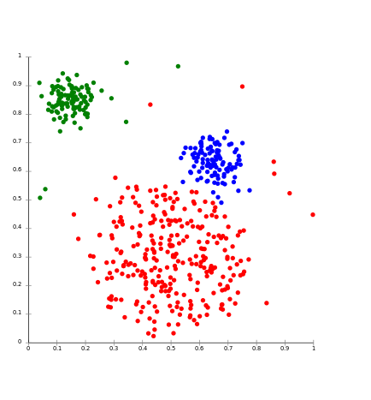
Stereotypical Clustering
Note: Points are samples plotted in feature space, e.g. 10,000-dimensional space for 100x100 images.

Slide 8
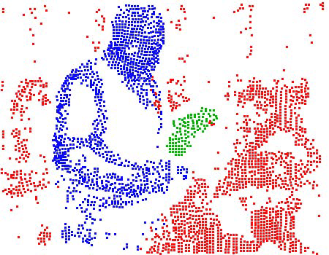
Clustering for Segmentation
Note: We break an image into regions of points with similar features (Brox and Malik, ECCV 2010).

Slide 9
Condensation/Compression
We don’t claim that clusters model underlying structure, but that they give a reduced-variance “sample” of the data.

Slide 10
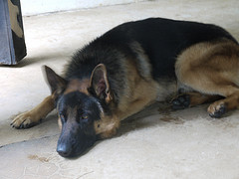

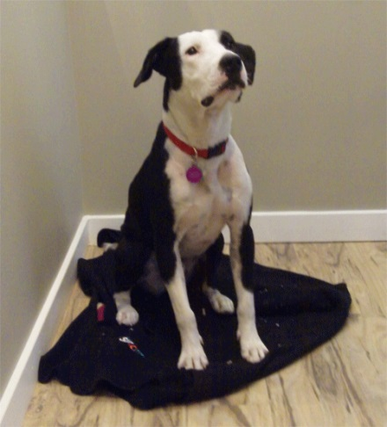
“Cluster Bias”
Human beings conceptualize the world through categories represented as examplars (Rosch 73, Estes 94).
We tend to see cluster structure whether it is there or not.
Works well for dogs, but…

Slide 11
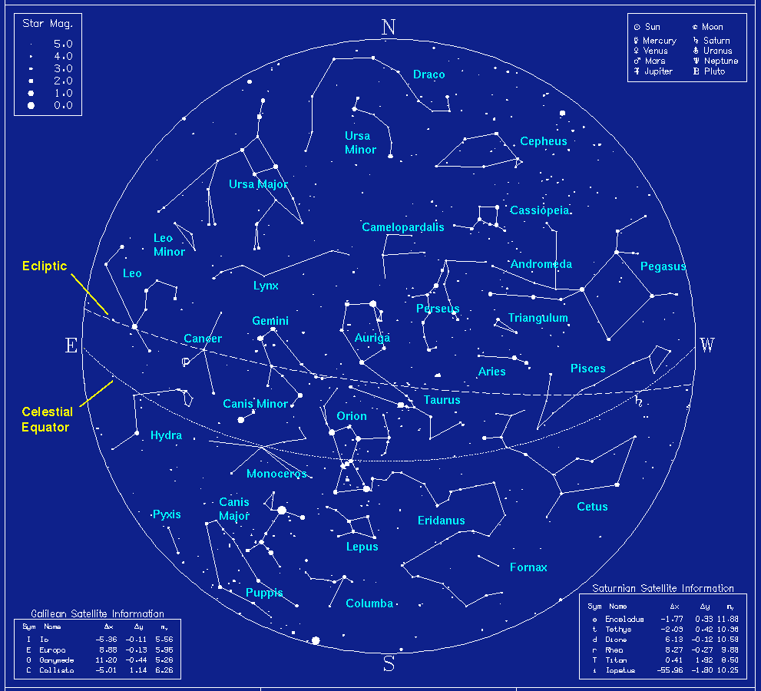
Cluster Bias

Slide 12
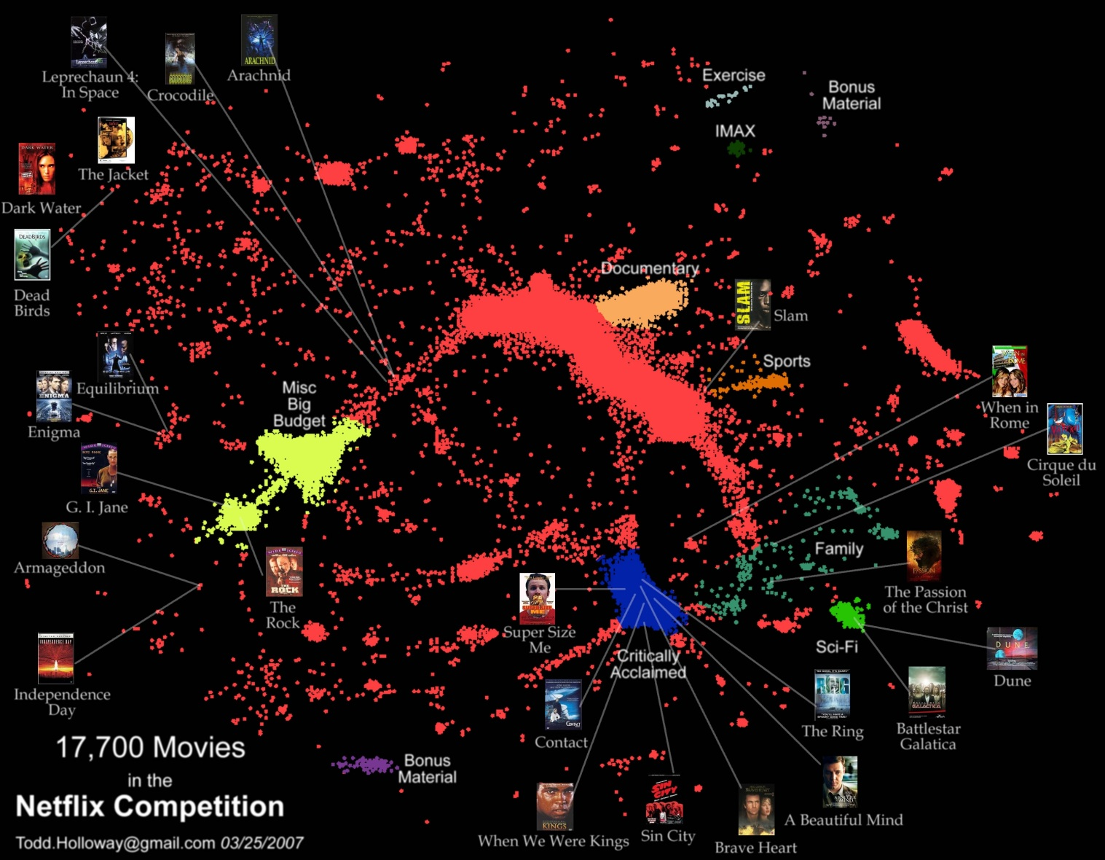
Netflix
More of a continuum than discrete clusters
Factor models, kNN do much better than discrete cluster models.

Slide 13
“Cluster Bias”
Upshot:
Clustering is used more than it should be, because people assume an underlying domain has discrete classes in it.
This is especially true for characteristics of people, e.g. Myers-Briggs personality types like “ENTP”.
In reality the underlying data is usually continuous.
Just as with Netflix, continuous models (matrix factorization, “soft” clustering, kNN) tend to do better.

Slide 14
Terminology
Hierarchical clustering: clusters form a hierarchy. Can be computed bottom-up or top-down.
Flat clustering: no inter-cluster structure.
Hard clustering: items assigned to a unique cluster.
Soft clustering: cluster membership is a real-valued function, distributed across several clusters.

Slide 15
K-means clustering
The standard k-means algorithm is based on Euclidean distance.
The cluster quality measure is an intra-cluster measure only, equivalent to the sum of item-to-centroid kernels.
A simple greedy algorithm locally optimizes this measure (usually called Lloyd’s algorithm):
Find the closest cluster center for each item, and assign it to that cluster.
Recompute the cluster centroid as the mean of items, for the newly-assigned items in the cluster.

Slide 16
K-means clustering
Cluster centers – can pick by sampling the input data.

Slide 17
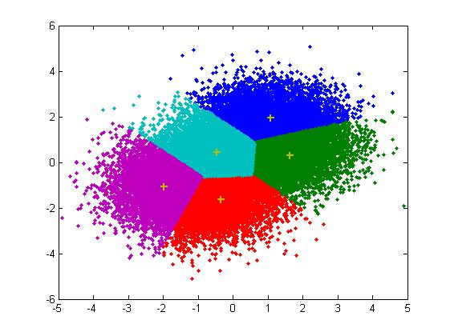
K-means clustering
Assign points to closest center

Slide 18
K-means clustering
Recompute centers (old = cross, new = dot)

Slide 19
K-means clustering
Iterate:
For fixed number of iterations
Until no change in assignments
Until small change in quality

Slide 20
K-means Initialization
We need to pick some points for the first round of the algorithm:
Random sample: Pick a random subset of k points from the dataset.
K-Means++: Iteratively construct a random sample with good spacing across the dataset.
Note: Finding an exactly-optimal k-Means clustering is NP-hard. Randomization helps avoid bad configurations.

Slide 21
K-means++
Start:
Choose first cluster center at random from the data points
Iterate:
For every remaining data point x, compute D(x) the distance from x to the closest cluster center.
Choose a remaining point x randomly with probability proportional to D(x)², and make it a new cluster center.
Intuitively, this finds a sample of widely-spaced points avoiding “collapsing” of the clustering into a few internal centers.

Slide 22
K-means properties
It’s a greedy algorithm with random setup – solution isn’t optimal and varies significantly with different initial points.
Very simple convergence proofs.
Performance is O(nk) per iteration, not bad and can be heuristically improved. n = total features in the dataset, k = number clusters
Many generalizations, e.g.
Fixed-size clusters
Simple generalization to m-best soft clustering
As a “local” clustering method, it works well for data condensation/compression.

Slide 23

Choosing clustering dimension
AIC or Akaike Information Criterion:
K=dimension, L(K) is the likelihood (could be RSS) and q(K) is a measure of model complexity (cluster description complexity).
AIC favors more compact (fewer clusters) clusterings.
For sparse data, AIC will incorporate the number of non-zeros in the cluster spec. Lower is better.

Slide 24
Outline
Unsupervised Learning
K-Means clustering
DBSCAN
Matrix Factorization
Performance

Slide 25
DBSCAN
Motivation: Centroid-based clustering methods like k-Means favor clusters that are spherical, and have great difficulty with anything else.
But with real data we have:

Slide 26
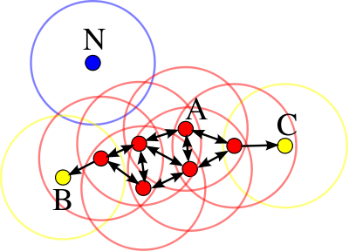
DBSCAN
DBSCAN performs density-based clustering, and follows the shape of dense neighborhoods of points.
Core points have at least minPts neighbors in a sphere of diameter ε around them.
The red points here are core points with at least minPts = 3 neighbors in an ε-sphere around them.
Figure from Wikipedia Article on DBSCAN

Slide 27
DBSCAN
Core points can directly reach neighbors in their ε-sphere.
Non-core points cannot directly reach another point.
Point q is density-reachable from p if there is a series of points p=p₁,p₂,…p_{n}=q s.t. p_{i+1} is directly reachable from p_{i}
All points not density-reachable from any other points are outliers.
Notes:
So all points on the path p1,…pn must be core points, except possibly pn

Slide 28
DBSCAN Clusters
Points, p, q are density-connected if there is a point o such that both p and q are density-reachable from o.
A cluster is a set of points which are mutually density-connected.
If a point is density-reachable from a cluster-point, it is part of the cluster as well.
For the figure above, points A are density-connected, B, C are density reachable and N is not.
Notes:
So all points on the path p1,…pn must be core points, except possibly pn

Slide 29
DBSCAN Algorithm
DBSCAN(D, eps, MinPts) {
C = 0
for each point P in dataset D {
if P is visited
continue next point
mark P as visited
NeighborPts = regionQuery(P, eps)
if sizeof(NeighborPts) < MinPts
mark P as NOISE
else {
C = next cluster
expandCluster(P, NeighborPts, C, eps, MinPts)
}
}
}
Source Wikipedia article on DBSCAN
Notes:
So all points on the path p1,…pn must be core points, except possibly pn

Slide 30
DBSCAN Performance
DBSCAN uses all-pairs point distances, but using an efficient indexing structure (and assuming there are not too many neighbors), each neighborhood query takes O(log n) time.
The algorithm overall can be made to run in O(n log n).
Fast neighbor search becomes progressively harder (higher constants) in higher dimensions.
The fast implementation also assumes data can be held in memory.
The fall-back is an O(n²) out-of-memory implementation.
Notes:
So all points on the path p1,…pn must be core points, except possibly pn

Slide 31
5-minute break

Slide 32
Outline
Unsupervised Learning
K-Means clustering
DBSCAN
Matrix Factorization
Performance

Slide 33
Matrix Factorization - Motivation
For problems with linear relationships between a response Y and feature data X we have the linear regression formula:
But as the dimension of Y grows, we quickly “run out of data” – the model has more degrees of freedom than we have data.
e.g. recommendations, information retrieval
Features and responses are the same, e.g. ratings of products, or relevance of a term to a document.
We have to deal with thousands or millions of responses, as well as thousands or millions of features.
This is one flavor of the “curse of dimensionality”.

Slide 34
Matrix Factorization - Motivation
High-dimensional data will often have simpler structure, e.g.
Topics in documents
General product characteristics (reliability, cost etc.)
User preferences
User personality, demographics
Dimensions of sentiment
Themes in discussions
“Voices” or styles in documents
We can approximate these effects using a lower-dimensional model, which we assume for now is linear.

Slide 35
Matrix Factorization - Motivation
The subspace allows us to predict the values of other features from known features:
d coordinates define a unique point on a d-dimensional plane.
From these measurements, we can predict other coordinates.
Applications: User product preferences, CTR prediction, search engine optimization

Slide 36
Matrix Factorization - Motivation
Usually, data vary more strongly in some dimensions than others. Fitting a linear model to the (k) strongest directions gives the best approximation to the data in a least-squares sense.
Notes:
This data has variation in two dimensions, but one direction is much stronger. Using a one-dimensional model may well do better than two for this data.

Slide 37
Matrix Factorization
Algebraically, we have a high-dimensional data matrix (typically sparse) S, which we approximate as a product of two dense matrices A and B with low “inner” dimension:
From the factorization, we can fill in missing values of S. This problem is often called “Matrix Completion”.
N samples (users, documents)
K latent dims
N samples
S
A
B
K
≈
M
M features
Notes:
This data has variation in two dimensions, but one direction is much stronger. Using a one-dimensional model may well do better than two for this data.

Slide 38
Matrix Factorization
Columns of B represent the distribution of topics the n^{th} sample.
Rows of A represent the distribution of topics in the m^{th} feature.
These weights allow us to interpret the latent dimensions.
N samples (users, documents)
K latent dims
N samples
S
A
B
K
≈
M
M features
Notes:
This data has variation in two dimensions, but one direction is much stronger. Using a one-dimensional model may well do better than two for this data.

Slide 39
Matrix Factorization
is a popular method for sparse, linear data (ratings, kw/URL combos, CTR on ads).
Input matrix S is sparse, and we approximate it as a low-dimensional product: S ≈ A * B. Zeros of S encode don’t know state.
Typically minimize quadratic loss on non-zeros (actual observations) of S L₂(S – A *_{S} B) and with L₂ regularizers on A and B. Here *_{S} denotes the product evaluated only at non-zeros of S.

Slide 40
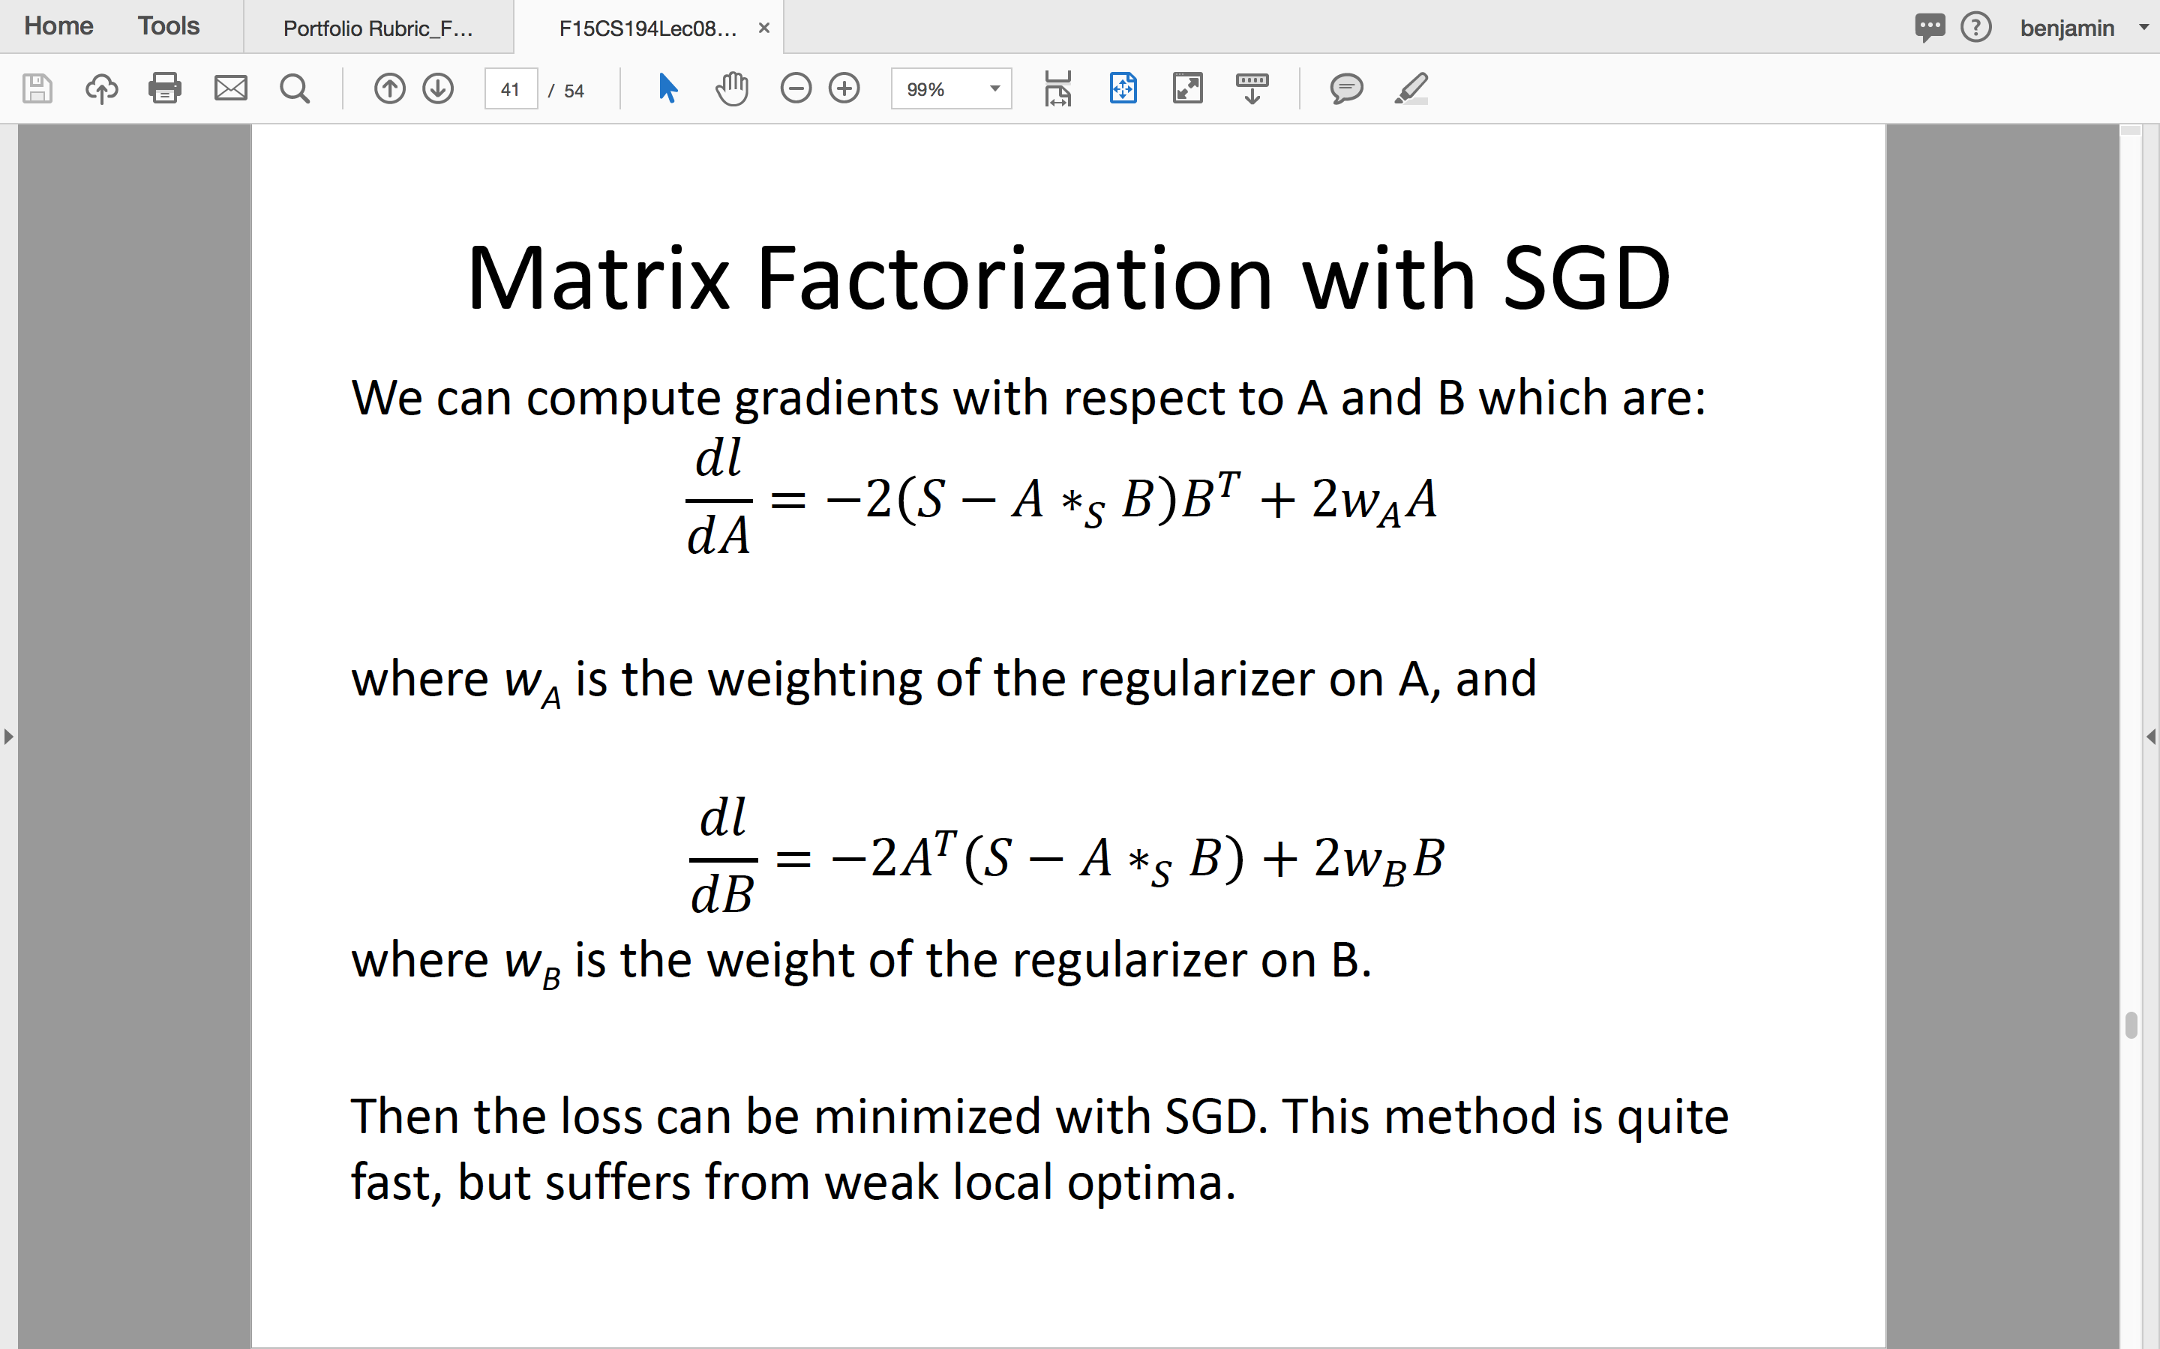
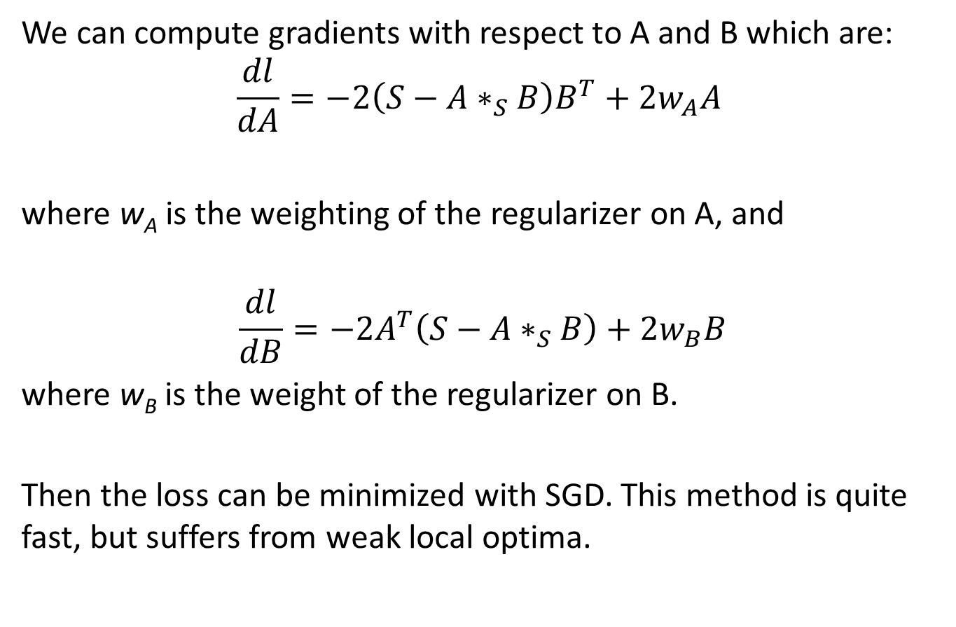
Matrix Factorization with SGD
We can compute gradients with respect to A and B which are:
$$\frac{dl}{dA}=−2\left(S−A∗_{S}B\right)B^{T}+2w_{A}A$$
where w_{A} is the weighting of the regularizer on A, and
$$\frac{dl}{dB}=−2A^{T}\left(S−A∗_{S}B\right)+2w_{B}B$$
where w_{B} is the weight of the regularizer on B.
Then the loss can be minimized with SGD. This method is quite fast, but suffers from weak local optima.

Slide 41
Matrix Factorization with MCMC
The local optima problem can be minimized by using MCMC methods (Markov-Chain Monte-Carlo).
Instead of moving only in the direction of the gradient, these methods sometimes move “down” which allows them to jump into other optima.
Changing the “energy” of the search allows “annealing” which generally finds good local optima. This is probably the most accurate method for matrix factorization right now.

Slide 42
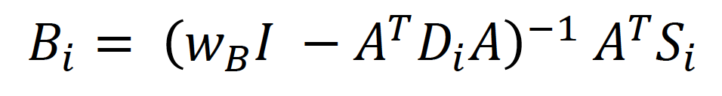
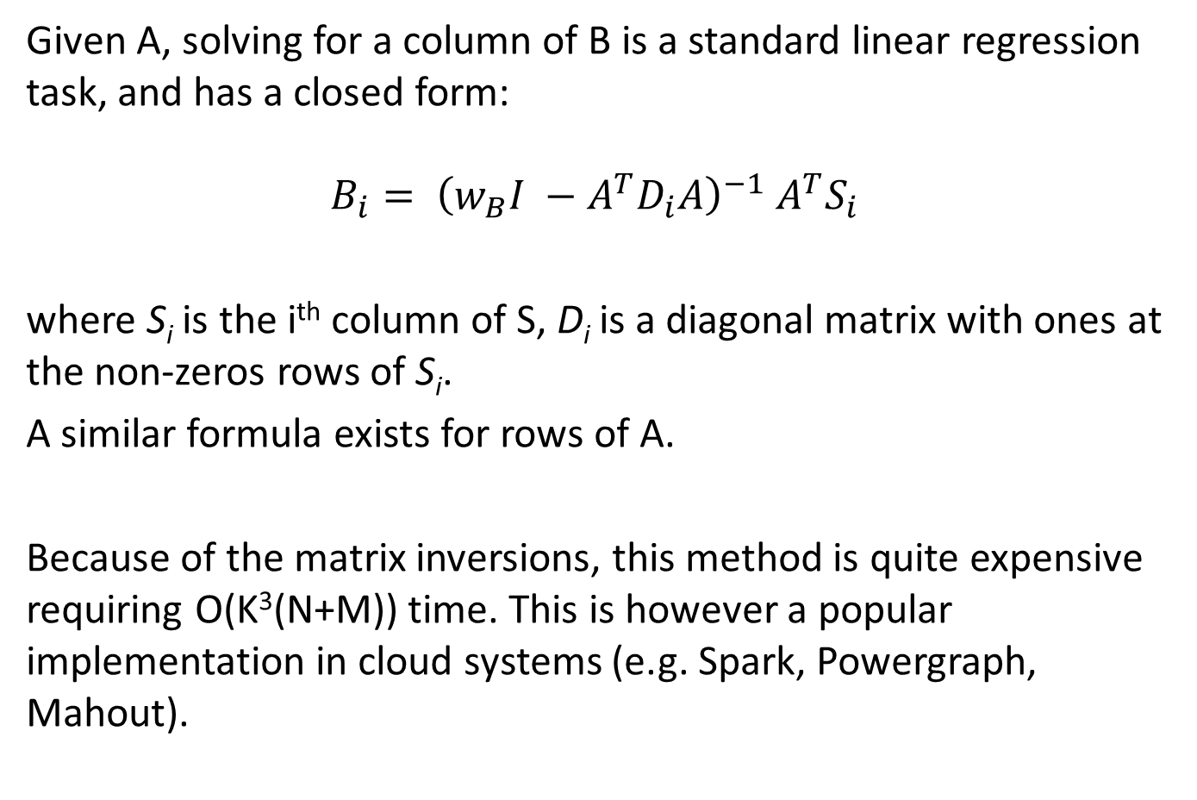
Alternating Least Squares (ALS)
Given A, solving for a column of B is a standard linear regression task, and has a closed form:
$$B_{i}= {\left(w_{B}I −A^{T}D_{i}A\right)}^{−1} A^{T}S_{i}$$
where S_{i} is the i^{th} column of S, D_{i} is a diagonal matrix with ones at the non-zeros rows of S_{i}.
A similar formula exists for rows of A.
Because of the matrix inversions, this method is quite expensive requiring O(K³(N+M)) time. This is however a popular implementation in cloud systems (e.g. Spark, Powergraph, Mahout).

Slide 43
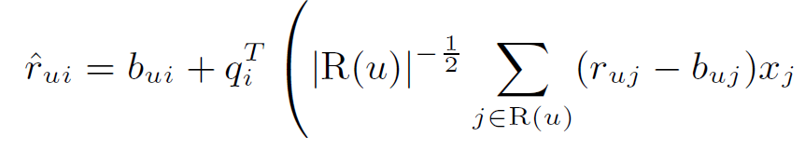
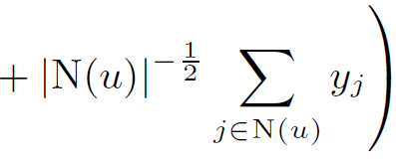
Netflix
From the first year onwards all competitive entries used a dimension reduction model.
The dimension reduction accounts for about half the algorithms’ gain over the baseline.
The winning team’s model is roughly:
r is the rating, b is a baseline, q is an item factor, the remainder is the “user factor”.
It incorporates new factor vectors x: for explicit ratings and y: for implicit ratings.

Slide 44
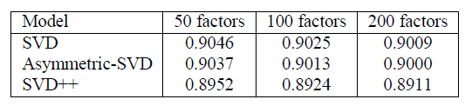

Netflix
Summary of dimension reduction models:
Dimension reduction augmented by neighborhoods:

Slide 45
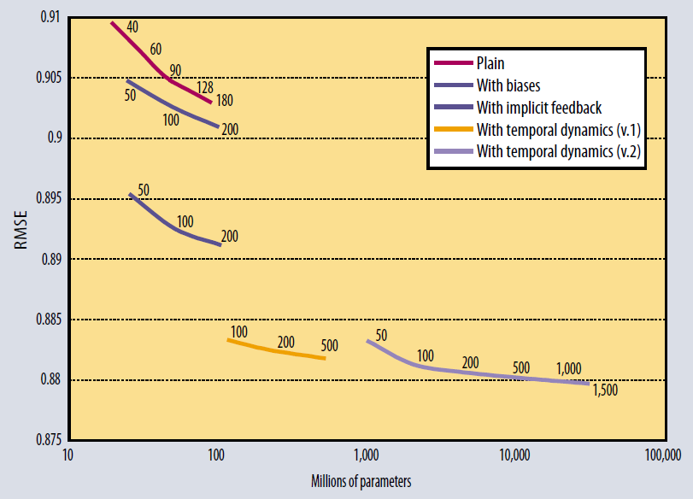
Netflix Performance
From Koren, Bell, Volinksy, “Matrix Factorization Techniques for Recommender Systems”
IEEE Computer 2009.

Slide 46
Outline
Unsupervised Learning
K-Means clustering
DBSCAN
Matrix Factorization
Performance

Slide 47
Performance
There are several reasons to design for performance:
Dataset size (assuming model quality improves with size)
Model size (bigger models generally perform better)
Both the above are true (but not obvious) for power-law datasets. Because the data “tail” is long, models also need to be long-tailed: it allows you to model less-frequent users and features.
Training long-tailed models requires more data.

Slide 48
Offline/Online Performance
There are two different dimensions of performance:
Offline: Model training. Plenty of resources. Typical goal is 1 to few days training time. Best possible model accuracy.
Online: Model prediction. Limited resources (memory and machines). Goal is usually to minimize latency, and perhaps online model size.
2. Influences 1. Models trained offline have to fit and be fast in the deployment environment.

Slide 49
Three Approaches to Performance
There are at least three approaches to improving performance:
Algorithmic improvements. e.g. adaptive SGD methods.
Computational improvements: Fully optimize code, leverage hardware (e.g. Graphics Processing Units).
Cluster scale-up: Distribute model or data across computers on a network.

Slide 50
Three Approaches to Performance
There are at least three approaches to improving performance:
Algorithmic improvements. e.g. adaptive SGD methods.
Free! Orders of magnitude improvements possible
Computational improvements: Fully optimize code, leverage hardware (e.g. Graphics Processing Units).
Cluster scale-up: Distribute model or data across computers on a network.

Slide 51
Three Approaches to Performance
There are at least three approaches to improving performance:
Algorithmic improvements. e.g. adaptive SGD methods.
Free! Orders of magnitude improvements possible
Computational improvements: Fully optimize code, leverage hardware (e.g. Graphics Processing Units).
Free! Orders of magnitude improvements possible. Compounds algorithmic improvements.
Cluster scale-up: Distribute model or data across computers on a network.

Slide 52
Three Approaches to Performance
There are at least three approaches to improving performance:
Algorithmic improvements. e.g. adaptive SGD methods.
Free! Orders of magnitude improvements possible.
Computational improvements: Fully optimize code, leverage hardware (e.g. Graphics Processing Units).
Free! Orders of magnitude improvements possible. Compounds algorithmic improvements.
Cluster scale-up: Distribute model or data across computers on a network.
Superlinear cost: a k-fold speedup requires, fn(k) > k additional cost. Usually does not compound algorithmic and computational improvements (network bottleneck).

Slide 53
Three Approaches to Performance
There are at least three approaches to improving performance:
Algorithmic improvements. e.g. adaptive SGD methods.
Free! Orders of magnitude improvements possible.
Computational improvements: Fully optimize code, leverage hardware (e.g. Graphics Processing Units).
Free! Orders of magnitude improvements possible. Compounds algorithmic improvements.
Cluster scale-up: Distribute model or data across computers on a network.
Codesign: using knowledge of the algorithms and data (power law), we can reduce network load several orders of magnitude. Network topology awareness can improve things dramatically. Linear speedup is possible this way.

