Slide 1
Final Project ECO 32500
Professor Droescher
Mohammed Fahad
Adam Sabri

Slide 2
Introduction
Our aim is to elevate this year's performance Maximum Customer Retention
Maximum Satisfaction to Existing Customers

Slide 3
How ?
Identify reasons for losing sales & bottlenecks
Identify Room for improvements

Slide 4
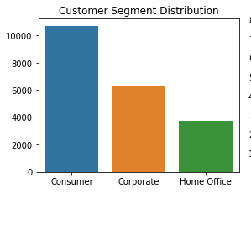
Customer Segments

Slide 5
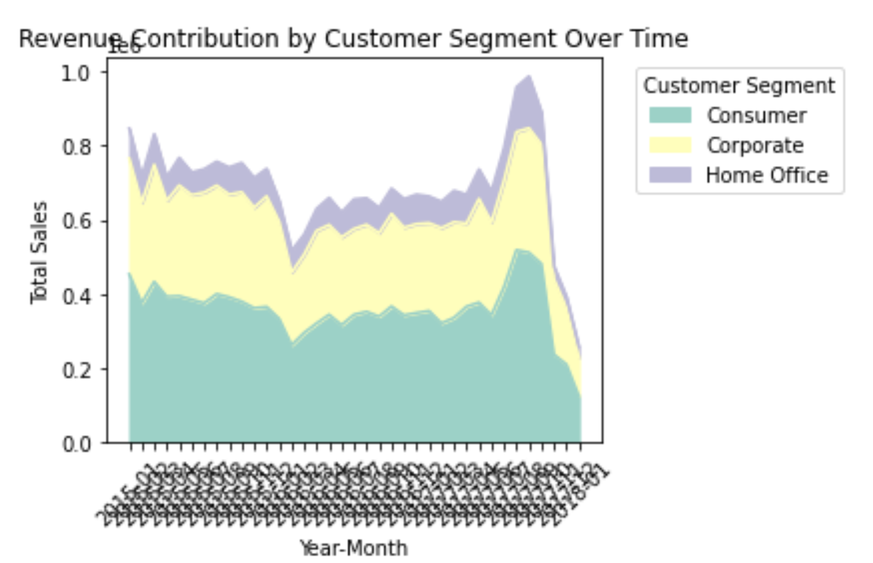
Customer Performance over time

Slide 6
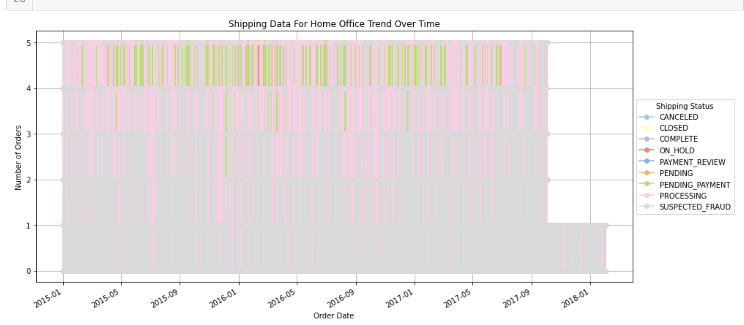
Issue With Home Office : Shipping Delays

Slide 7
Identify Issue With Corporate & Consumers
Price Hike
Lack Of Personalized Discounts
Lack Of Peak Shopping Seasons Sales Discount

Slide 8
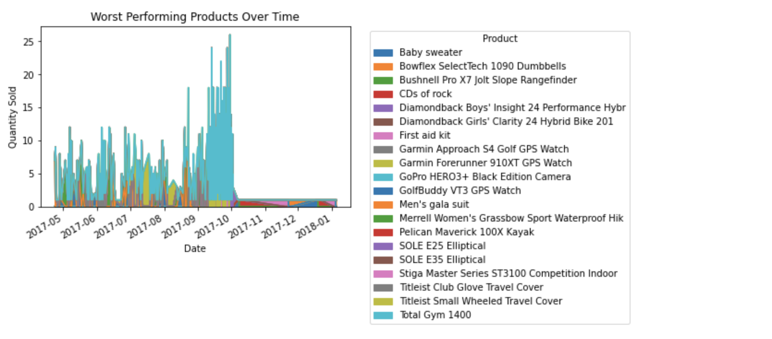
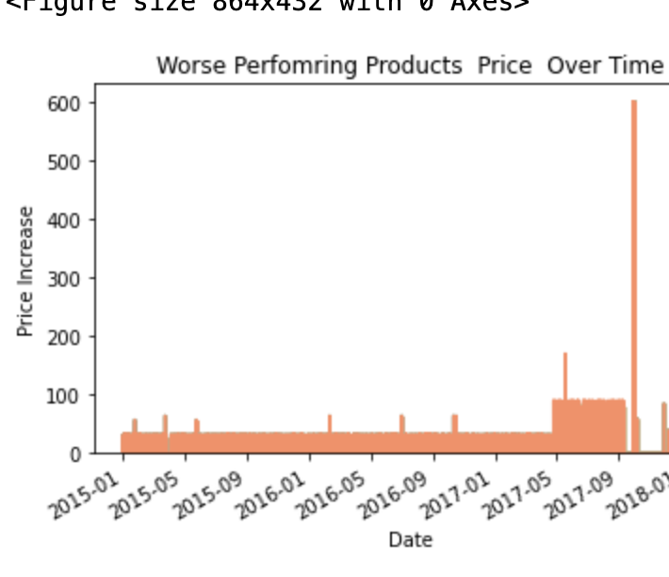

Slide 9
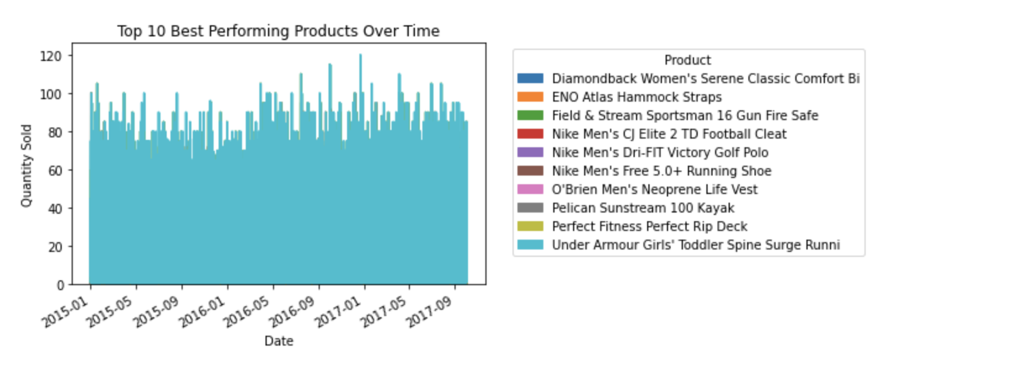
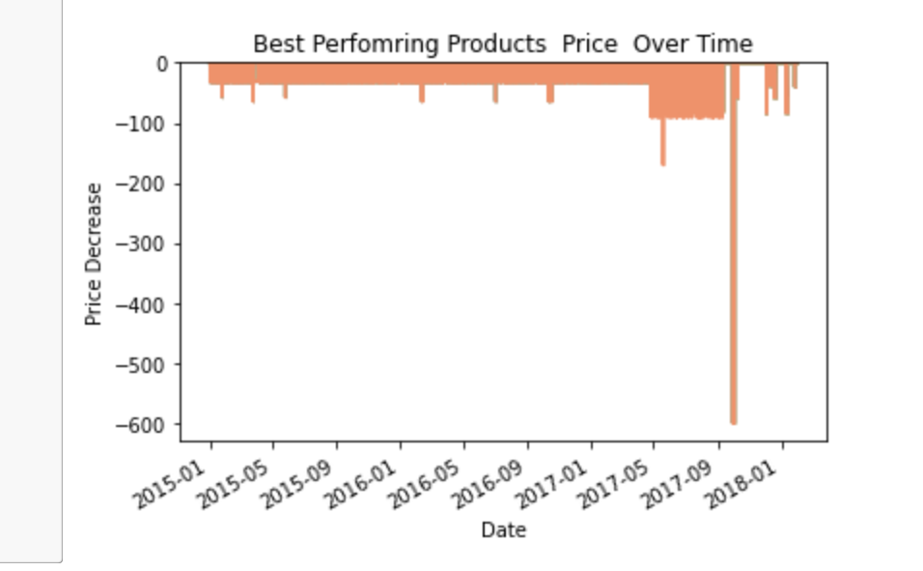

Slide 10
Room For Improvement
Personalized Marketing
Discounts During Peak Sales Season

Slide 11
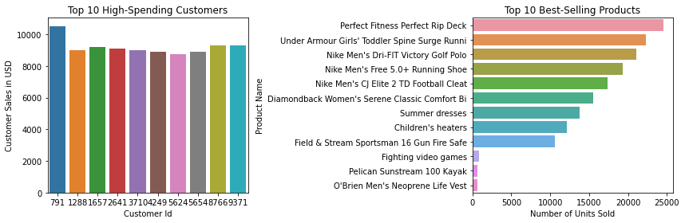
Personalized Marketing

Slide 12
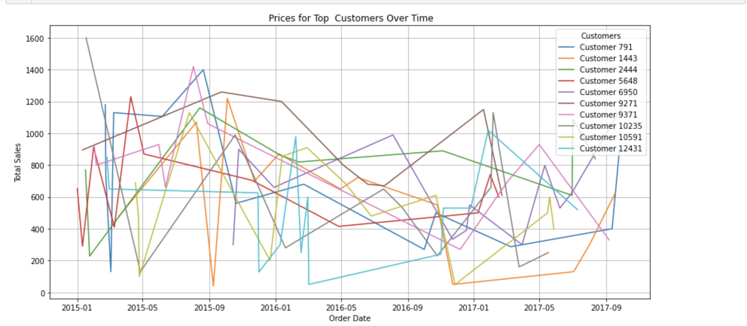
Top Products Pricing For Top Customers Over Time

Slide 13
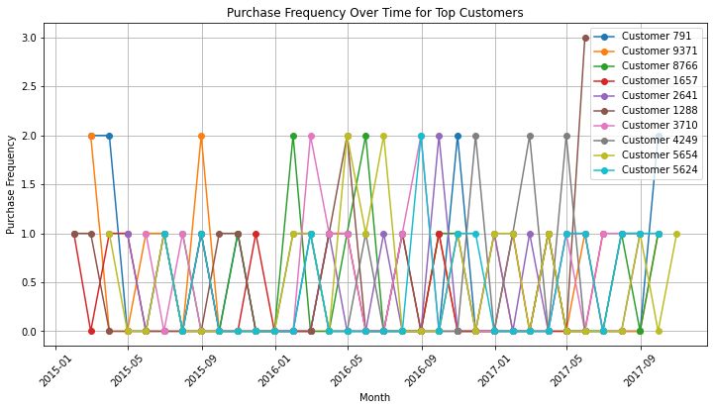
Peak Sales Seasons

Slide 14
Conclusion
Improve Shipping Time
Identify Advantageous Price Points
Identify Sales For Peak Shopping Seasons

