Slide 1
Mamma Mia’s
Opportunities for maximizing profit
Denisse Beato | Jean Batista | Lisbeth Rivera

Slide 2
Introduction
We will: Use SQL and Python Pandas to analyze comprehensive information,
Result: Show observable facts about maximizing profit.
We aim to:
Observe positive relationships in data and provide meaningful insights.

Slide 3
TABLE OF CONTENTS
Data analysis: Graphs and data
01
Data sources
Methodology of our analysis
02
Key findings: Insights and patterns
03
04
Conclusion:
Overview

Slide 4
01
Data Sources
Methodology

Slide 5
Methodology:
SQL Database: Using SQL to receive, interpret our data and import necessary fields on to Python.
Excel: Some data we found relevant was organized into Excel then imported on Python.
Python: We used Python to manipulate the data and create visualizations through extensions like Pandas and Matplotlib.
Notes:
Financial susccess for us means maximizing profit.

Slide 6
02
Key findings
Graphs & Relationships

Slide 7
Key findings:
Correlation between rain/snowfall used for predictive modeling.
There are peak hours that can be used for predictive modeling.
Specific items tend to sell more than others.
Some pizza types come in abnormal sizes ( different from Small, Medium, Large).
Notes:
Financial susccess for us means maximizing profit.

Slide 8
03
Data Analysis
Graphs & Relationships

Slide 9
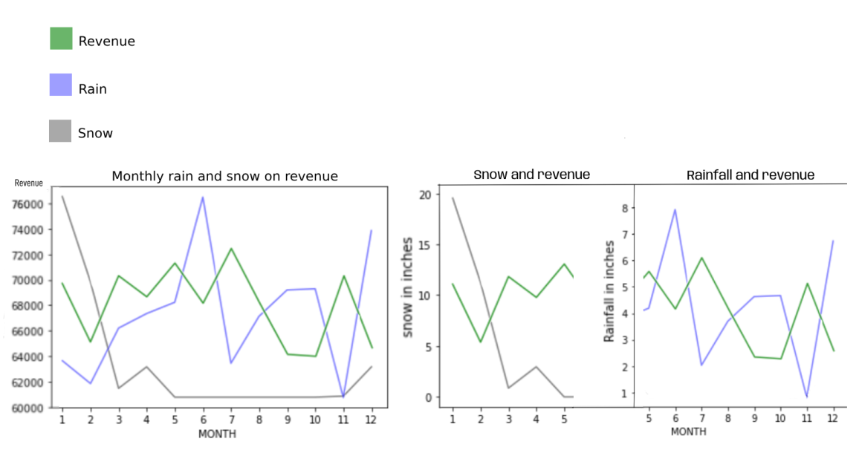
Effect of Rain and Snow on Revenue :
Notes:
The graph shows that when weather conditions are bad, the revenue is affected. Based on the graph, whenever the inches of snow and rain are high, revenue rates drop for the month.
With this data we recommend preparing in advance and taking note of the weather patterns as they do influence revenue rates (which in turn affect your profits). An example of such preparation would be not buying as much inventory during peak rainy months such as June to minimize costs. These low revenue periods can also be used to prepare for the high revenue periods.

Slide 10
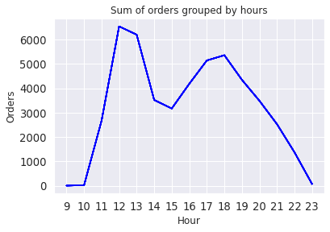
Quantity Sold by Hour :
Notes:
This graph entails the sum of all the quantity sold by hour.
Staffing during peak hours
Prep should be done before 12pm (first peak hour)
Advertisements should be ran during peak house
Lunch specials should be offered during peak hours

Slide 11
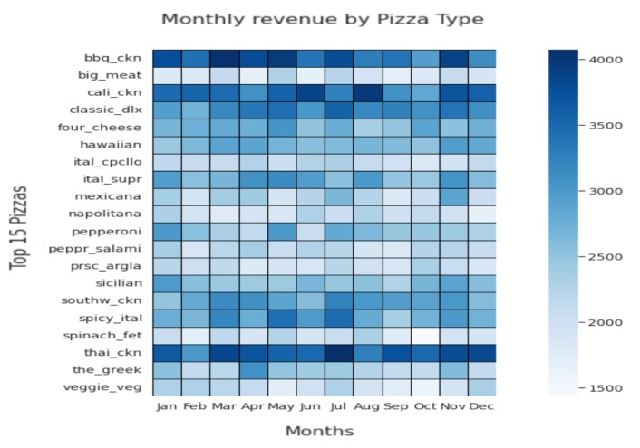
Monthly Revenue by Pizza Type :
Notes:
Top 3 sellers; good investment to buy chicken as an ingredient
Thai chicken is the best seller, so make sure to include this on the menu.

Slide 12
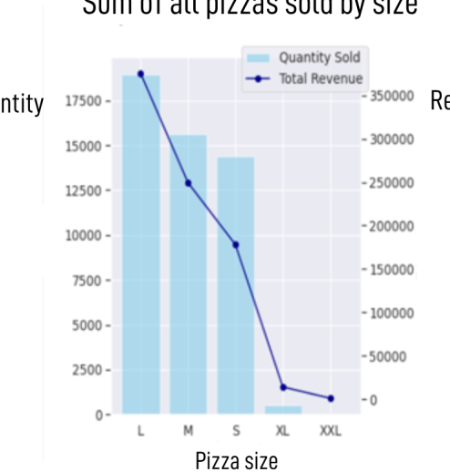
Revenue by Size : Pizzas we noticed in abnormal sizes: Big Meat – Small Brie Carre Small The Greek – XL, XXL
Sum of all Pizzas Sold by Size
Quantity
Revenue
Pizza Size
Notes:
XL and XXL revenue is only coming from 1 pizza, the greek pizza. We’re not sure why that’s the only pizza but we do think that it would be worth while to remove this size from inventory as they do not bring in significant revenue. With that being said, this pizza can be sold in different sizes as the graph shows that sizes small, medium, and large sell more and are more profitable in term. We recommend adjusting the sizes for all of the pizza’s being sold as revenue can be increased.
Summary: The pizza’s should be offered in more than one size to increase revenue/profit.

Slide 13
Part 2 Revenue by Size : Pizzas we noticed in abnormal sizes: Big Meat – Small Brie Carre Small The Greek – XL, XXL
Notes:
XL and XXL revenue is only coming from 1 pizza, the greek pizza. We’re not sure why that’s the only pizza but we do think that it would be worth while to remove this size from inventory as they do not bring in significant revenue. With that being said, this pizza can be sold in different sizes as the graph shows that sizes small, medium, and large sell more and are more profitable in term. We recommend adjusting the sizes for all of the pizza’s being sold as revenue can be increased.
Summary: The pizza’s should be offered in more than one size to increase revenue/profit.

Slide 14
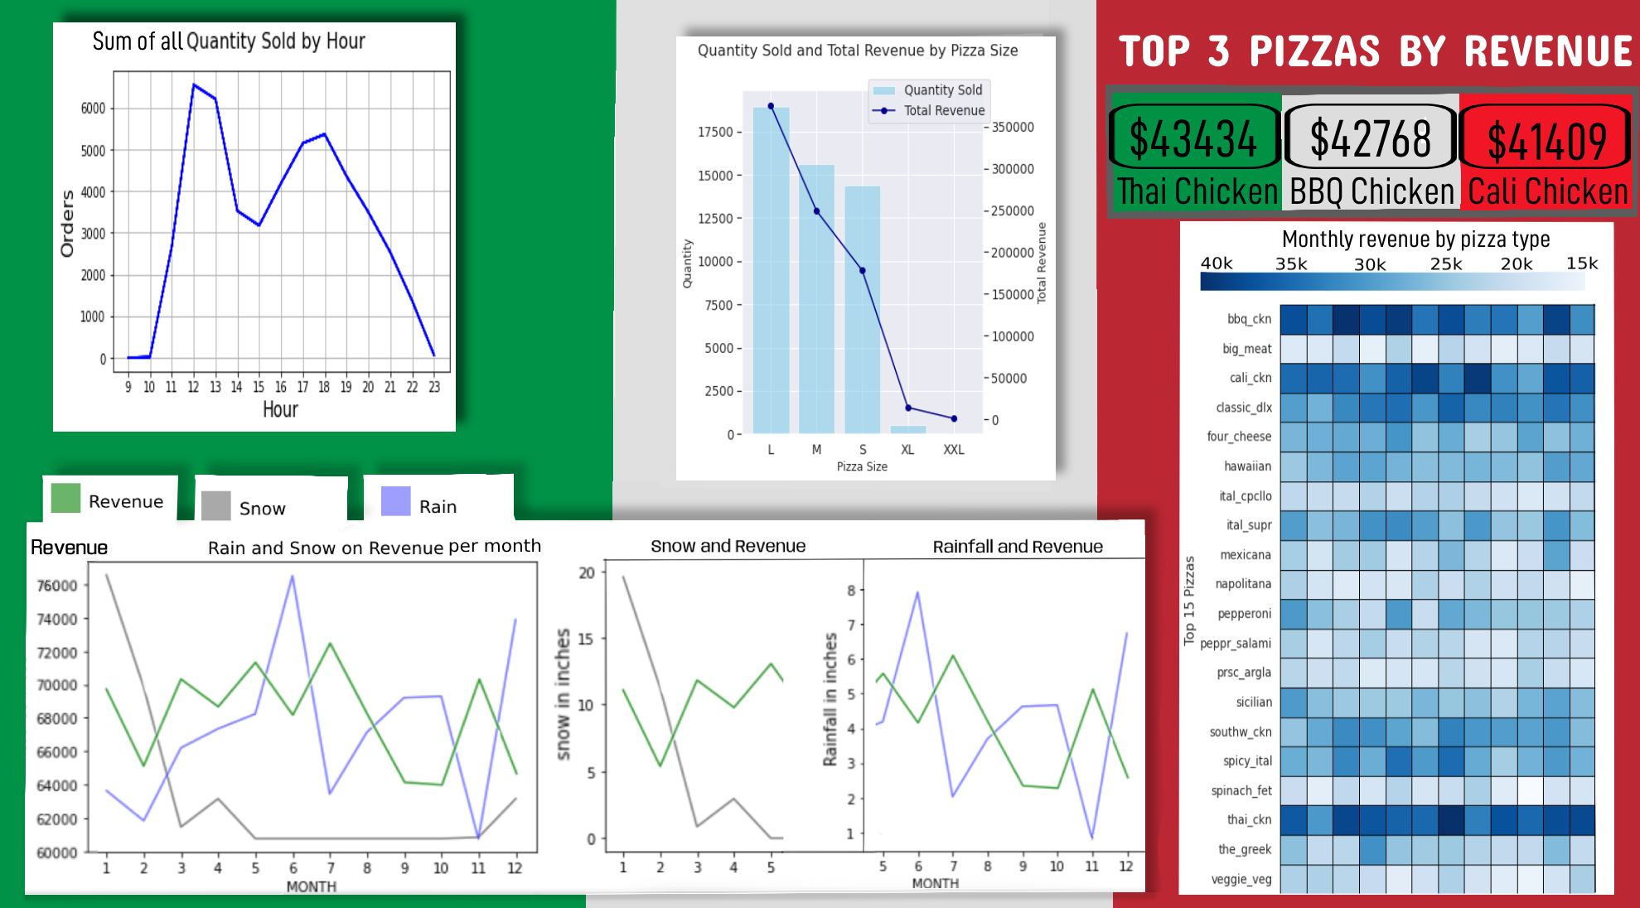
Dashboard :

Slide 15
04
Conclusion
Overview

Slide 16
Conclusion
01
02
03
Peak seasons will be those outside of rainy and snowing seasons, such as summer and fall.
On a day-to-day basis, your peak hours will be 12pm and 6pm. Operations need to be functioning at peak performance during these times.
The top 3 best selling pizza types are BBQ Chicken, California Chicken, and Thai Chicken. The ingredients for these pizzas must always be in stock.
Large is the most sold pizza size, followed by medium and small. These three sizes also make up majority of the revenue.
Therefore, sizes should be Small Medium and Large by default.

Slide 17
Thank You!
CREDITS: This presentation template was created by Slidesgo, including icons by Flaticon and infographics & images by Freepik

