Slide 1
Market Analysis & Product Optimization
By, Sunita BK, Abdourahmane Diallo, Celestino Ramirez

Slide 2
Insights
Profitability Divergence Across Sectors
Geographic Profitability Assessment
Product Profitability Review
Strategic Focus for Enhanced Performance

Slide 3
Proposal
Focus on High-Profit Markets
Optimizing Sales &Order ratios across Regions
Addressing unprofitable Areas
Mitigation of Cancelled Orders in Western Europe
Diversification of Payment Methods
Product Profitability Assessment

Slide 4
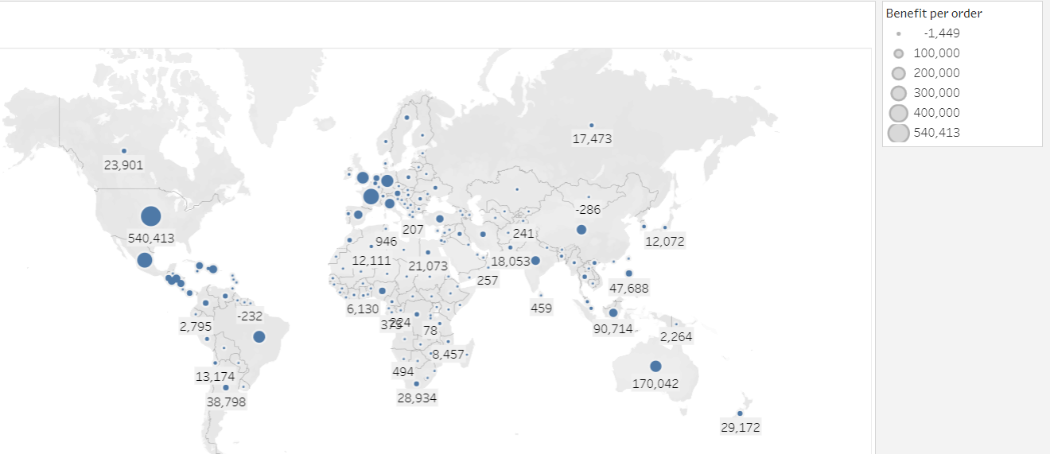
Focus on Profitable Markets
Profit per Country
Identify & Invest in top-performing countries, like the United States and France.
Explore underserved areas near profitable markets.

Slide 5
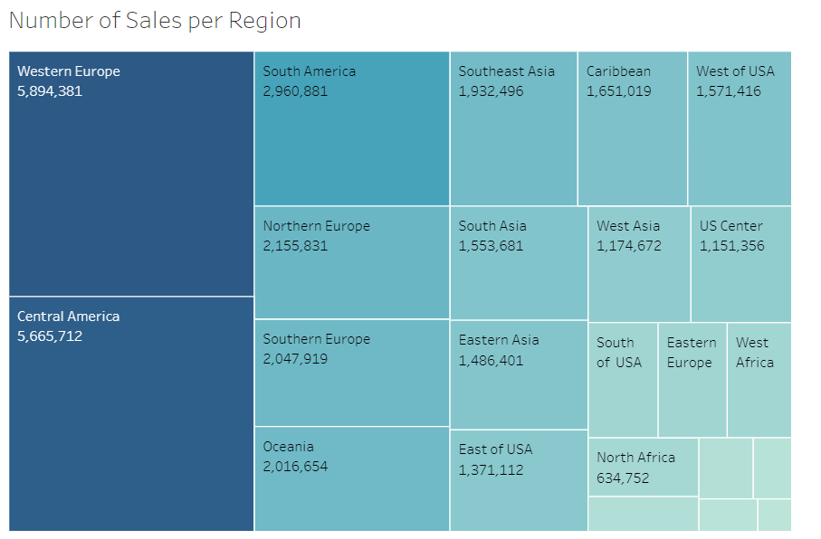
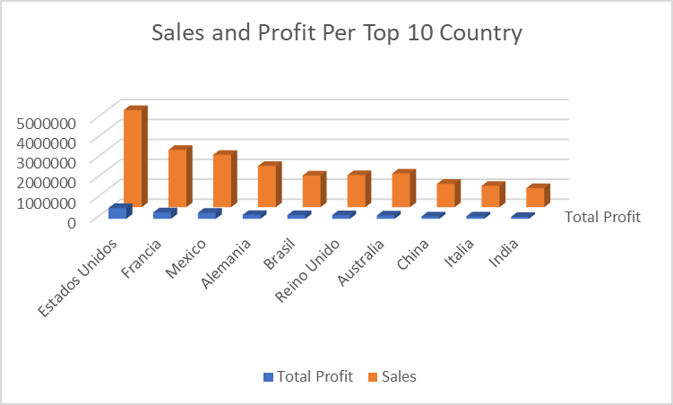
Optimizing Sales across Regions vs Countries
Sales volume dominated by Western Europe & Central America.
Highest balance of sales & profitability in the US.
Analyze & replicate factors behind US success.

Slide 6
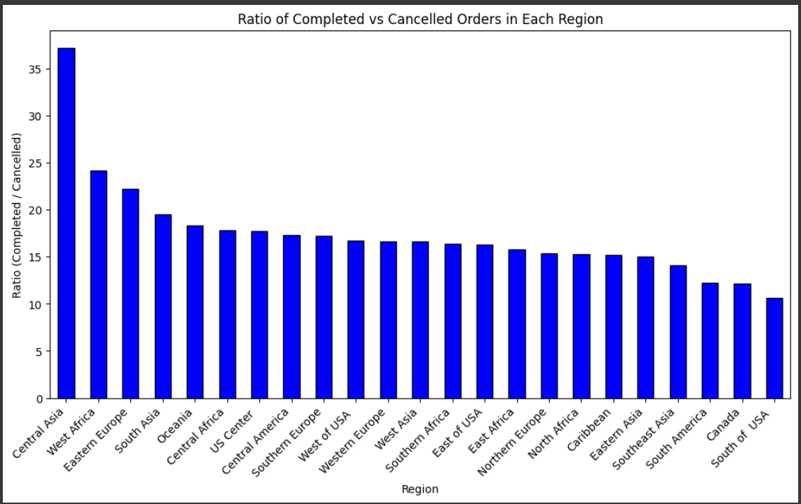
Optimizing Order ratios across Regions
Central Asia's exceptional completed vs. cancelled order ratio.
High customer satisfaction and operational excellence.
Targeting low-ratio regions for improvements.

Slide 7
Addressing unprofitable Areas
Identify top underperforming countries.
Analyzing factors contributing to unprofitability.
Propose strategic actions to mitigate losses.

Slide 8
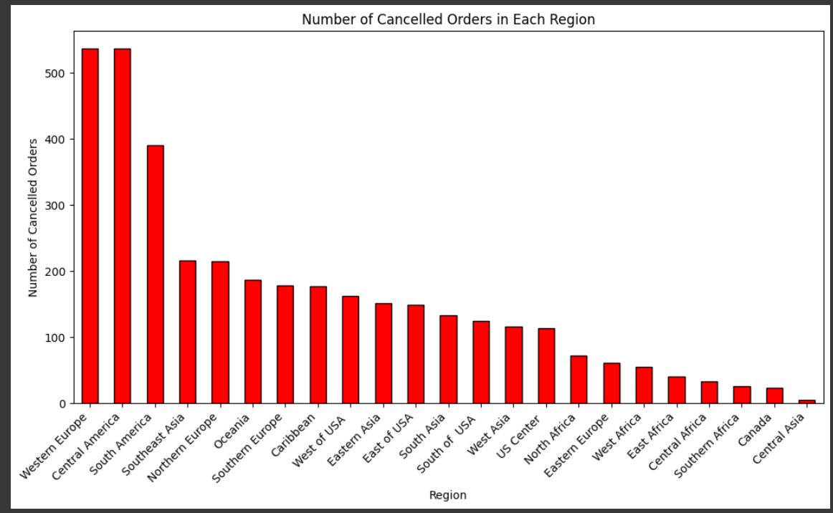
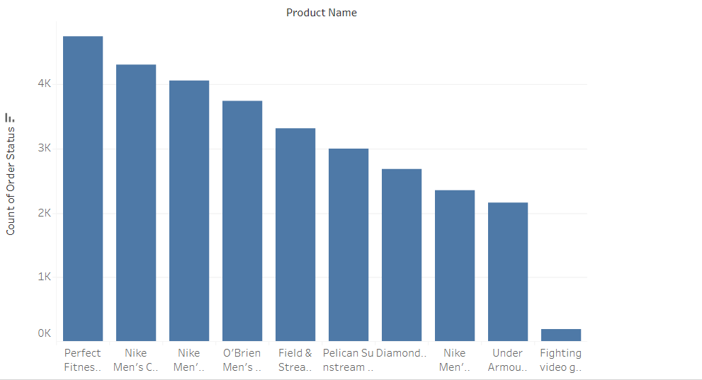
Mitigation of Cancelled Orders in Western Europe
Top 10 cancelled products
Discrepancies in Western Europe and central America
Analysis of order cancellations
Propose targeted strategies to reduce cancellations

Slide 9
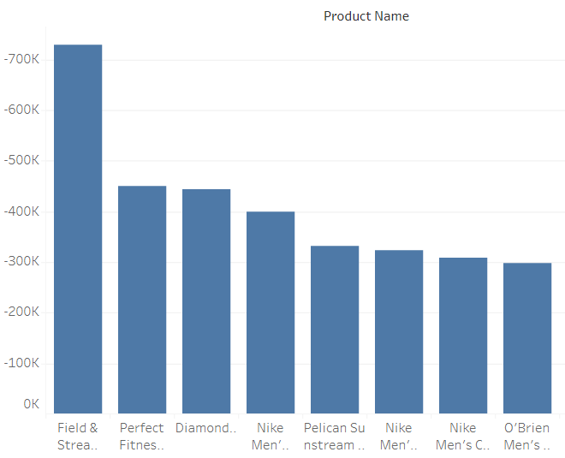
Optimize Product Line
Conduct data-driven product profitability analysis.
Sorting profit-generating and loss-inducing products.
Analyzing market trends.
Discontinuation of unprofitable products.

Slide 10
CONCLUSION
Leveraging Strong Markets for Growth
Addressing Underperforming Sectors
Enhance Customer Experience and Operational Efficiency
Adaptive Business Strategies

