Slide 1
Data Analysis for Pizza Restaurant
Junhao Chen
Eco 32500
Python for Business Analytics
Professor John Droescher

Slide 2
Table of Contents
Business Problem Statement
Business Analysis
Opportunities

Slide 3
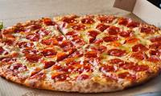
Business Problem Statement
Business suggestions for the success of a newly opened pizza restaurant

Slide 4
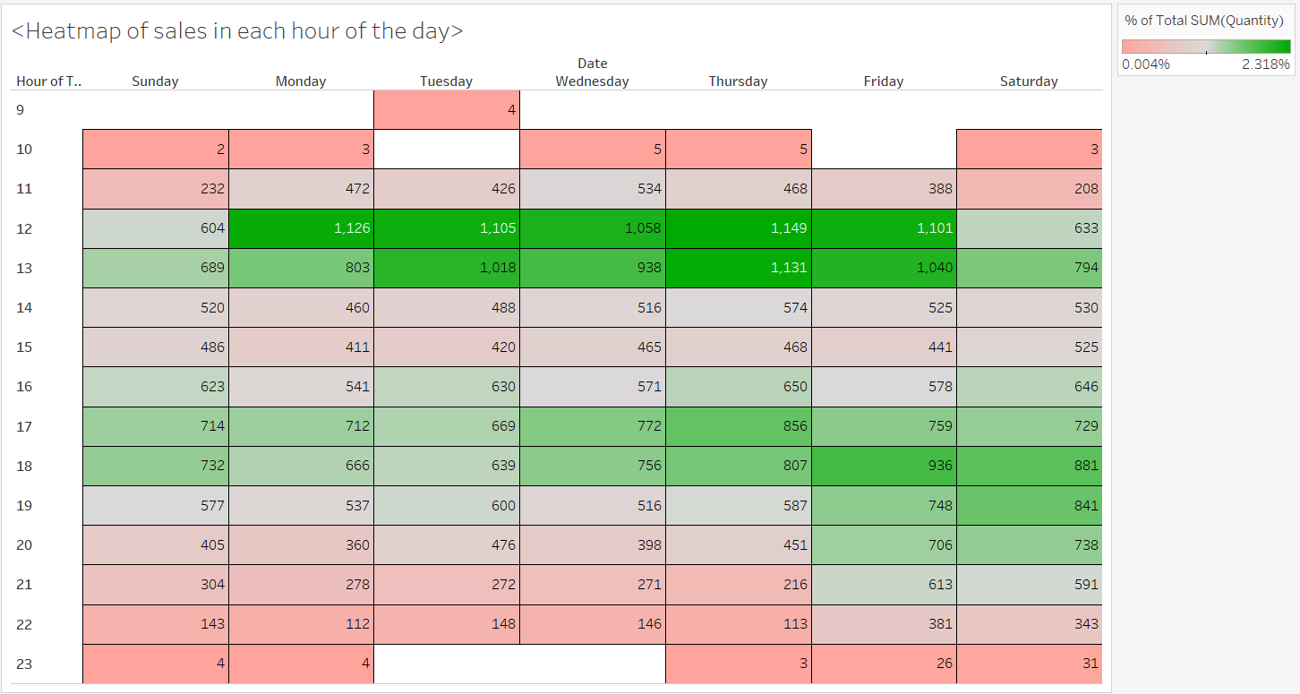
Busiest hours: 12PM – 1PM especially Mon- Fri > 4PM – 6PM, and 7pm- 8pm on Fri-Sat
- Order start to come in at 11AM. - very little after 11PM

Slide 5
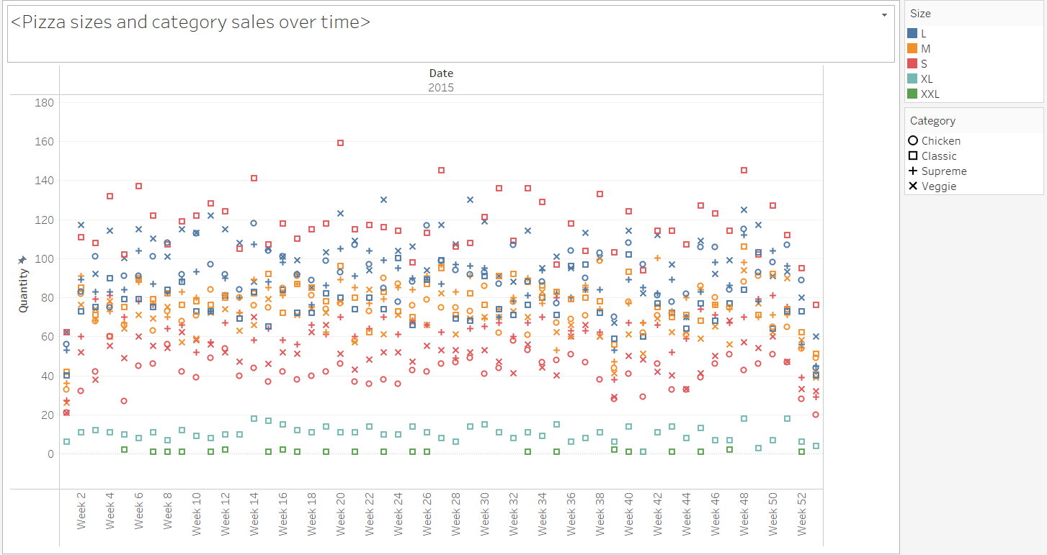
Small classic pizzas are selling way better than other categories and sizes in the same category
(cheapest price + classic)
Will investigate more
- Little to no XXL sales
- Few XL sales
Spiked sales of Large veggie and chicken pizzas and small classic pizzas during some periods

Slide 6
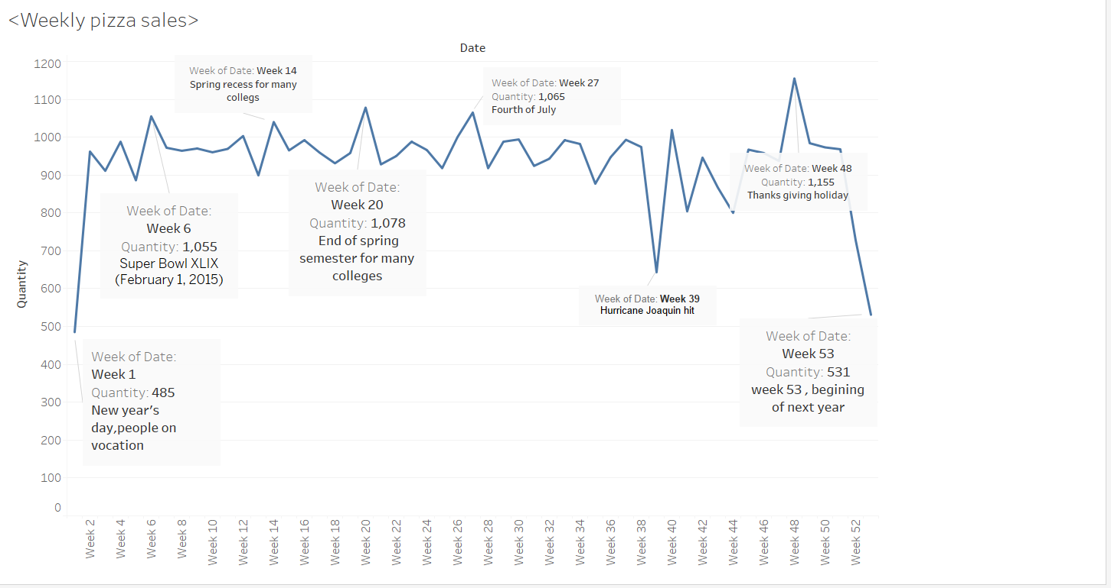
How holidays affect the sales of pizza
Some holidays like super bowl, fourth of July, and thanks giving can spike sales as well as when students/worker have recess/breaks

Slide 7
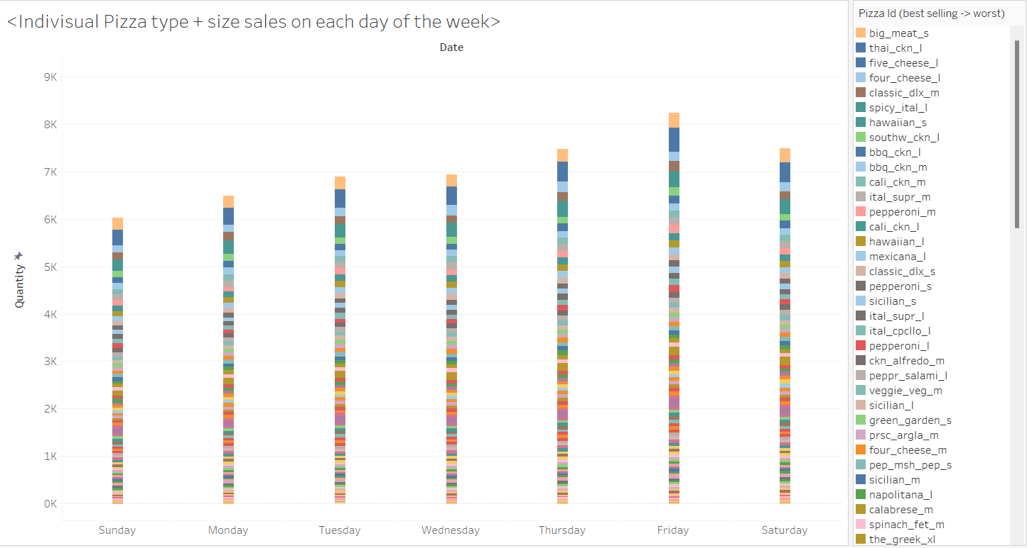
Busiest days: Thurs, Fri, Sat
Best selling pizzas: big_meat_s, cheeses pizzas , chicken pizzas, dlx, Hawaiian_s spicy_ital_l prepare more ingredients for them.

Slide 8
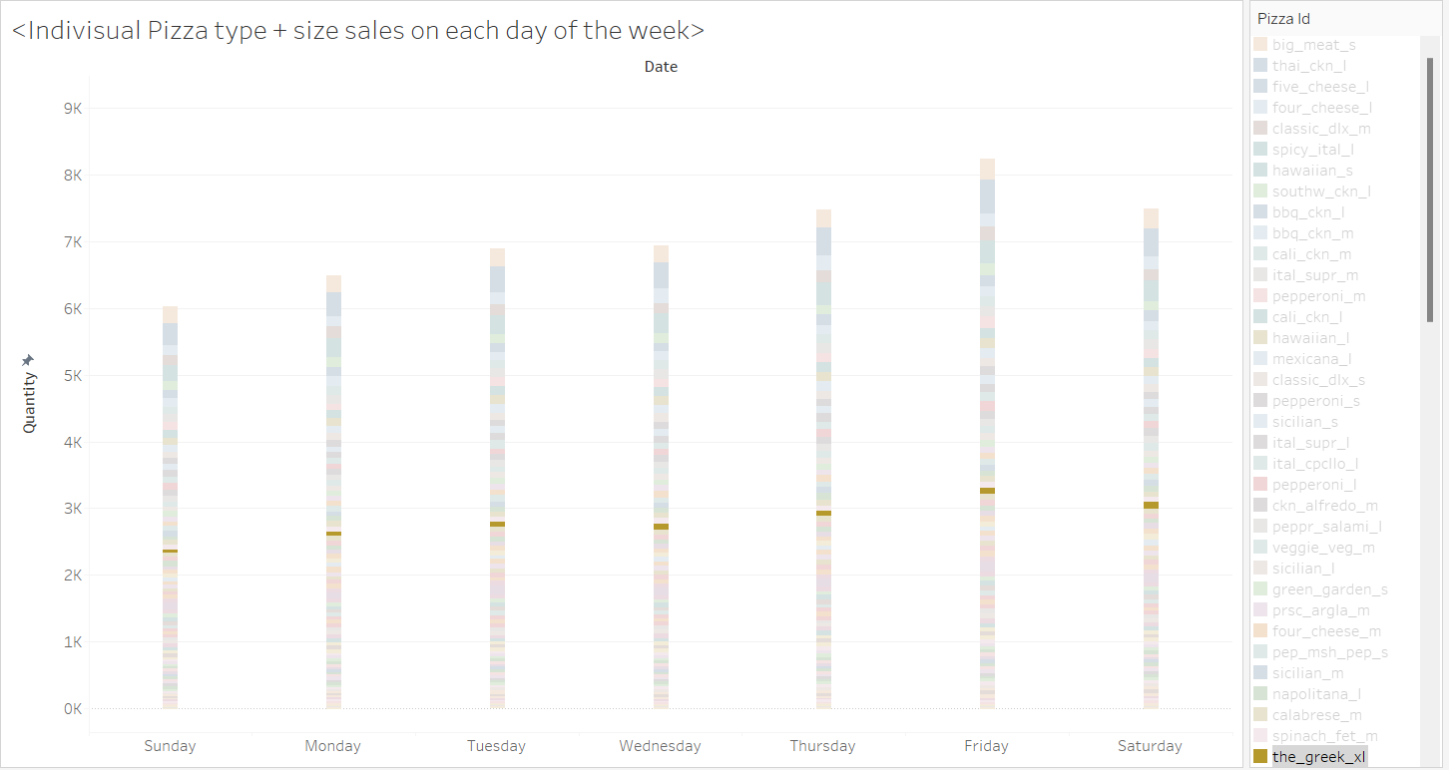
The Greek XL: the only XL size pizza and has not bad of sales numbers considering its price
Little to no XXL sales, can consider removing it

Slide 9
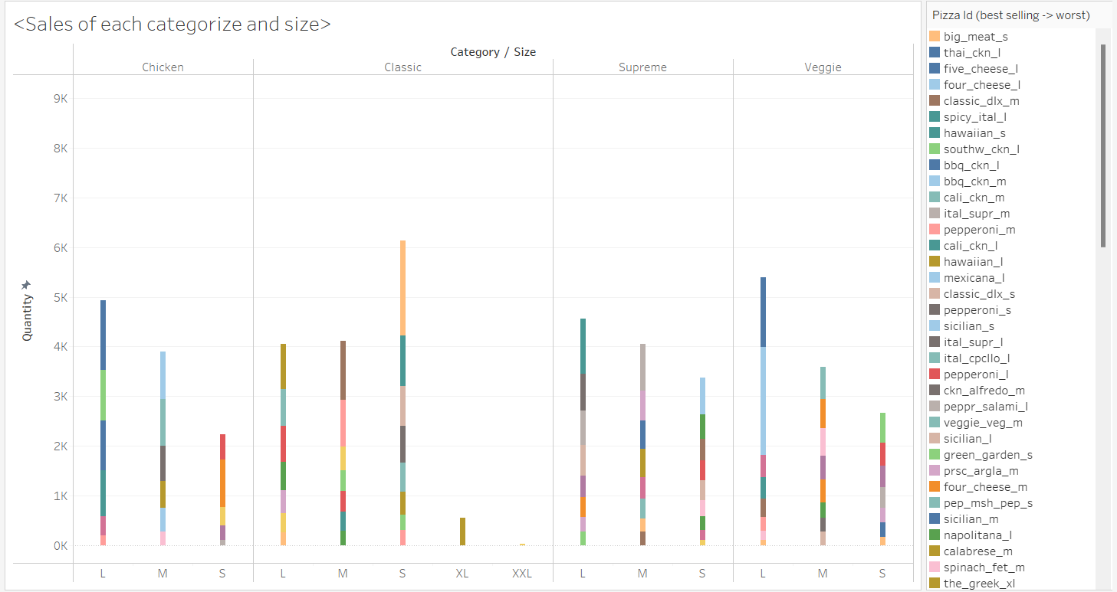
Overall best selling sizes: L > M > S >> XL >> XXL
Overall best selling category: classic > supreme > veggie = chicken

Slide 10
Opportunities
2.
Do combos, and specials for the best selling pizzas with mainly the big meat, the chicken pizzas, classic_dlx_m, Hawaiian_pizza, and spicy_ital_l
1.
Align staff and inventory (Chickens, cheeses, Pepperoni, Jalapeno peppers, galic, Thai Sweet Chill Sauce, red Onions bacons) for the busiest hours: 12PM – 1PM especially Mon- Fri > 4PM – 6PM, and 7pm- 8pm on Fri-Sat.
3:
Promotion and specials of small classic and large veggie pizza during busy periods like student recess, sport events and major holidays such as Thanksgiving and independence day

Slide 11
Thank you for watching
ANY QUESTIONS?

