Slide 1
NYC Taxi Company
Summer 2022

Slide 2
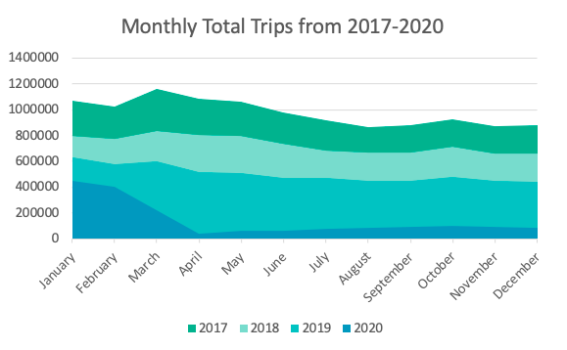
Highest number of trips in March every year
2020 declined in trip numbers due to COVID

Slide 3
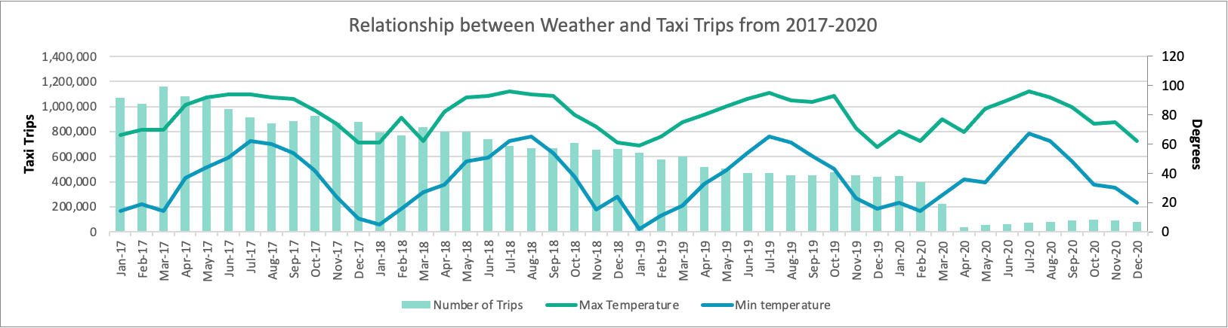
Factors influencing Taxi Companies

Slide 4
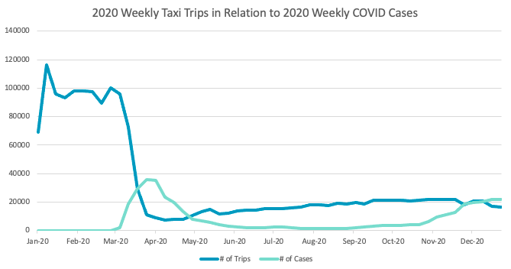
The Effects of COVID on Taxi Trips
Inverse relationship between COVID cases and Taxi Trips
Ridership declined 91% during initial COVID spike
Trips increased 58% as cases decreased

Slide 5
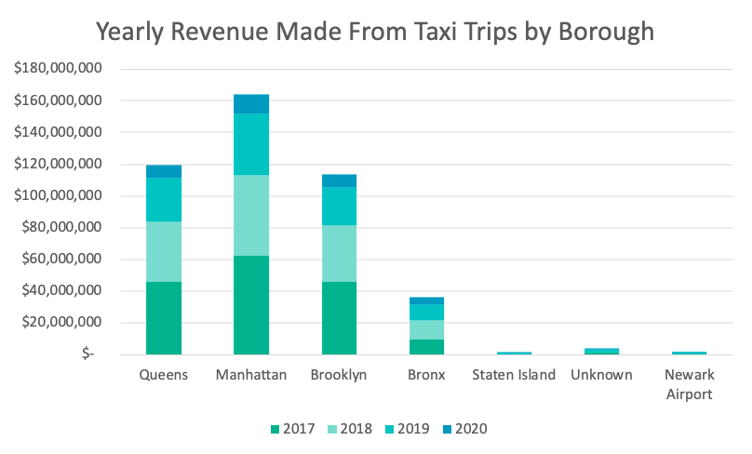
Popular Location: Manhattan and Queens

