Slide 1

Pizza Restaurant Presentation
Presented by: Pizza Enthusiasts
Notes:
Good Evening Mr.Droescher, I hope you are having an amazing day so far and I hope my team and I can make it even better. My team and I had a client who has a pizza business and the question my team and I answered based on this presentation is how can we make this a successful pizza business. So lets get started on how we accomplished that.

Slide 2
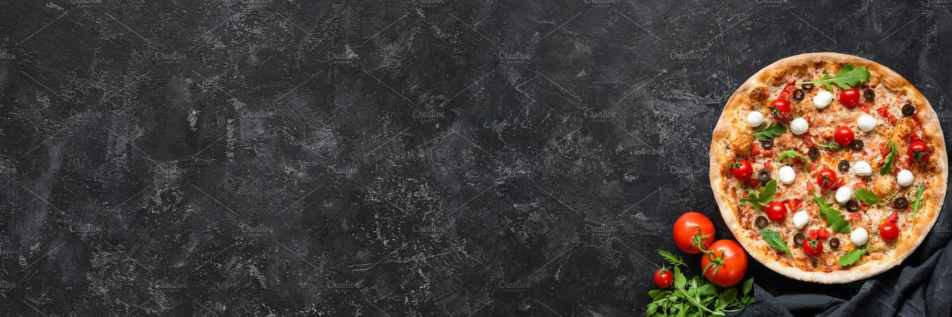
Table of Contents
Overview
Opportunity 1: Size
Opportunity 2: Ingredients
Opportunity 3: Time
Conclusion and Recommendations
Notes:
Firstly is the table of contents where I will show you everything we are going to discuss today, starting from the overview which is going to dig deeper into what specifically we are going to do, the first opportunity which is the pizza sizes, the second which is the ingredients and specifically the amount of ingredients each pizza has, the third opportunity which is the time, finally we will end it off with a conclusion and recommendations we will be giving the client.

Slide 3
Overview
To build a successful pizza business:
Figure out which types of pizza sizes generates the most revenue
Figure out which pizzas have the best balance between ingredients and revenue
Figure out which pizzas sells the most within the time frame all throughout the year
Notes:
The overview on how to answer the question of how to make the clients pizza business a successful one can be answered with three opportunities.

Slide 4
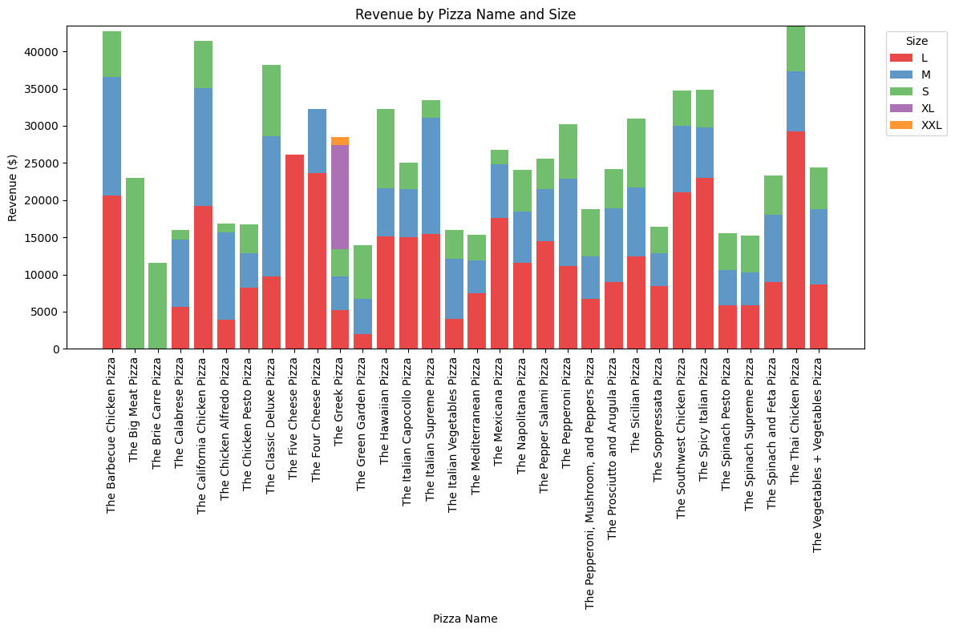
Opportunity 1: Market Demand for Large Pizzas
Notes:
As we can see in this chart, we see the best selling pizzas and the sizes within that pizza that generate the most revenue. We can see that the Barbecue chicken pizza, the thai chicken pizza, southwest chicken and spicy italian pizzas all generate the most revenue and a majority of that comes from the large pies.

Slide 5
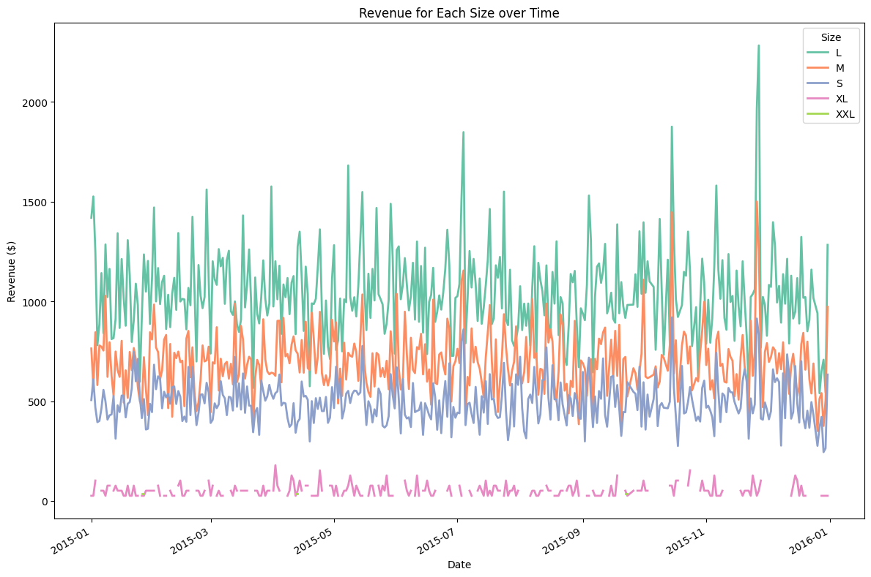
Notes:
We can see in this chart that the large sized pizza do generate the most over time throughout the year.

Slide 6
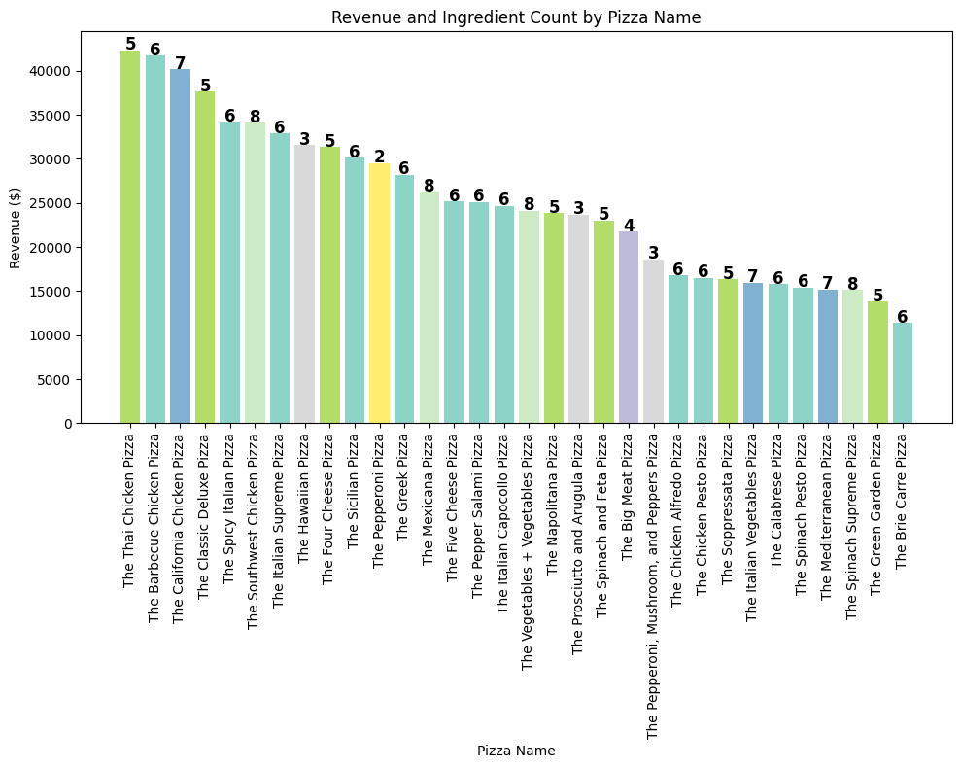
Opportunity 2: Ingredients Efficiency
Notes:
Based on the data provided we can see which pizza types include the most ingredients and the revenue that is generated with it. This also means the client needs to always have the ingredients that make up those top selling pizzas such as the thai, barbecue and california. On the other hand the hawaiian and pepperoni pizzas are generating a lot of revenue for the little amount of ingredients it has.

Slide 7
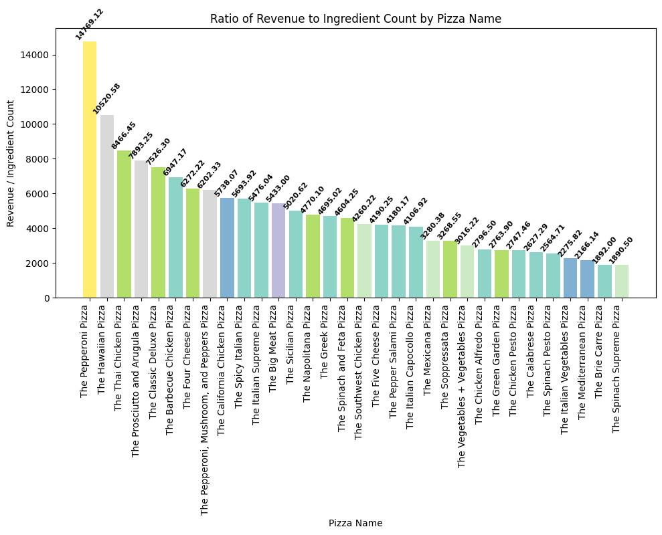
Notes:
Based on the previous slide as saw, because a pizza generates the most revenue, we also have to take into account the number of ingredients that pizza has. According to this graph we can see the ratio between the pizza and number of ingredients and see that the pepperoni pizza and hawaiian pizza have the best ingredient/revenue ratio.

Slide 8
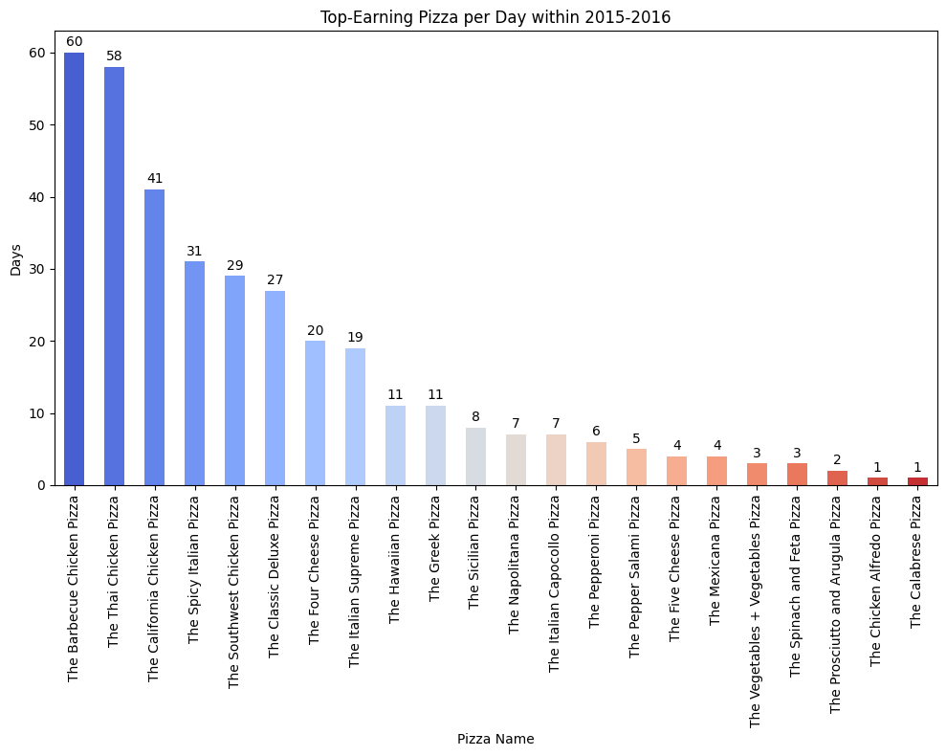
Opportunity 3: Best-Selling Pizza throughout the Year
Notes:
Based on the data above we can see which pizzas earn the most within the day all throughout the year. The barbecue chicken pizza, the thai chicken pizza, and california chicken pizza are the three most popular pizzas as they all have been the top sellings pizzas for more than 40 days within the year.

Slide 9
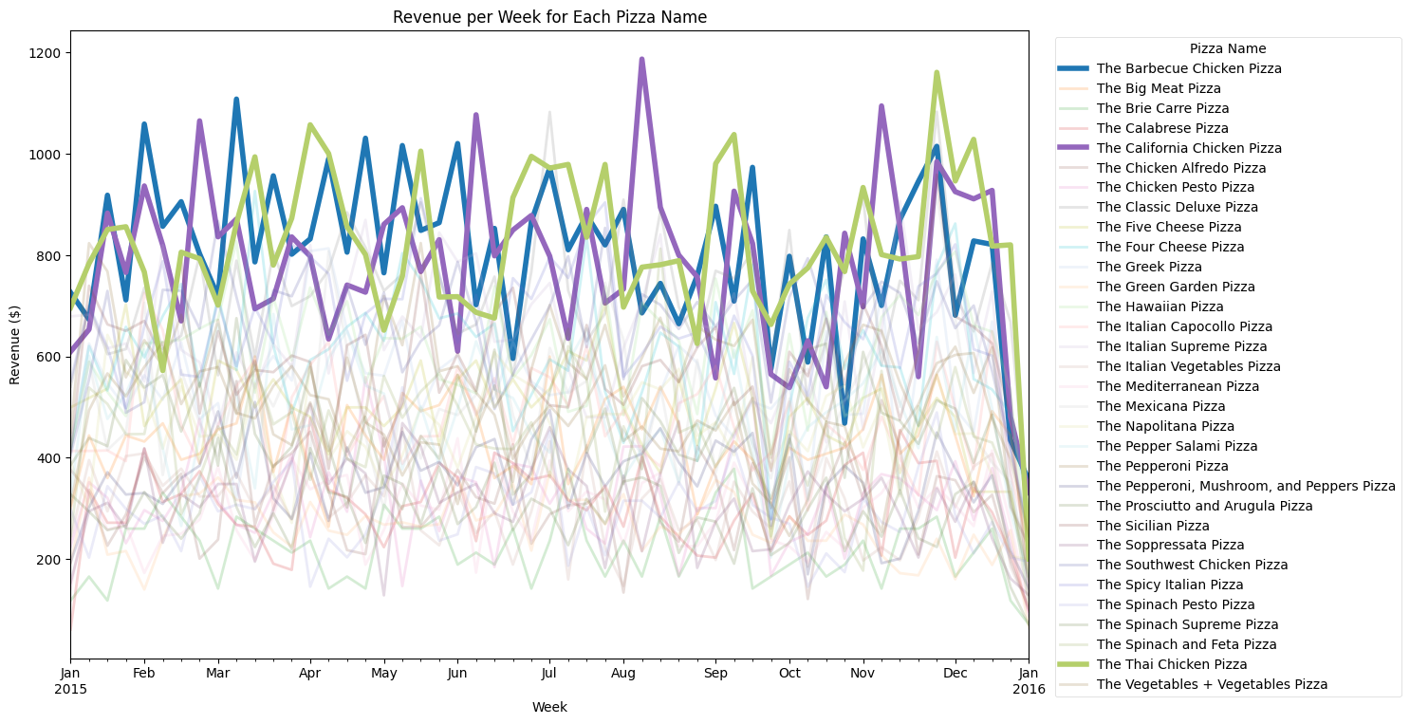
Notes:
This chart shows the trends of the best sellings pizzas throughout the entire year per month. We can see certain spikes of specific pizzas such as the california chicken pizza during mid august and we can also see the barbecue chicken pizza and thai chicken pizza generate the most revenue multiple months in a row.

Slide 10
Conclusion and Recommendations
Key Takeaways:
Suggestion 1: Keep size large available at all time as it generates the most revenue
Suggestion 2: Focus on pizzas that have good balance between ingredients and revenue
Suggestion 3: Keep the top 10 selling pizzas as an option regularly as it is the best selling pizza all year long
Notes:
To conclude the presentation, some key takeaways and suggestions are ^, for suggestion 2 we don't want pizzas with a lot of ingredients and don't generate a lot of revenue, we need a good balance.

