Slide 1
IHO B12 v3.0.0 JSON encoding and JSON schema
Brian Miles
bmiles@ccom.unh.edu
2022-12-21

Slide 2
B-12 Edition 3.0.0 entities
https://iho.int/uploads/user/pubs/Drafts/CSB-Guidance_Document-Edition_3.0.pdf

Slide 3
B-12 v3.0.0 Trusted Node Metadata and proposed JSON encoding (mandatory)
v3.0.0 Guidance Data Field | v3.0.0 JSON: /properties/trustedNode | JSON Type | Example
Provider Contact Point Organization Name | providerOrganizationName | String | Sea-ID
Provider Email | providerEmail | String | support@sea-id.org
Unique Vessel ID | uniqueVesselID | String | SEAID-e8c469f8-df38-11e5-b86d-9a79f06e9478
Convention | convention | String | GeoJSON CSB 3.0
Data License | dataLicense | String | CC0 1.0
Provider Logger | providerLogger | String | Rose Point ECS
Provider Logger Version | providerLoggerVersion | String | 1.0
CRS of navigation data | navigationCRS | String | EPSG:4326
Vertical reference of depth | verticalReferenceOfDepth | String | Transducer
Vessel Position Reference Point | vesselPositionReferencePoint | String | GNSS

Slide 4
B-12 v3.0.0 Mandatory Data and proposed JSON encoding (mandatory)
v3.0.0 Guidance Data Field | v3.0.0 JSON: /features | JSON Type | Example
Longitude | geometry{Point}/coordinates[0] | Number | 41.914832
Latitude | geometry{Point}/coordinates[1] | Number | 18.005296
Depth | properties/depth | Number | 15.8
Date & Timestamp | properties/time | String | 2016-03-03T18:41:49Z

Slide 5
B-12 v3.0.0 Vessel Information and Sensor Configuration (recommended)
v3.0.0 Guidance Data Field | v3.0.0 JSON: /properties/platform | JSON Type | Example
Vessel Type | type | String | Private vessel
Vessel Name | name | String | White Rose of Drachs
Vessel Length | length | Number | 65
ID Type | IDType | String | MMSI
ID Number | IDNumber | String | 369958000
Sensor Description | sensorDescriptions | Object | {”type”:”Sounder”, “make”:”Garmin”, “model”: “GT-50”, “position”:[4.2, 0.0, 5.4], “draft”:1.4, “draftUncert”:0.2, “frequency”:200000} {“type”:GNSS, “make”:” Litton Marine Systems”, “model”:”LMX420”}
Sound Speed Documented | soundSpeedDocumented | Boolean | true
Position Offsets Documented | positionOffsetsDocumented | Boolean | false
Data Processed | dataProcessed | Boolean | true
Contributor comments | contributorComments | String | On 2022-03-08, at 20:30 UTC, the echo sounder lost bottom tracking after the vessel crossed another vessel's wake.

Slide 6
B-12 v3.0.0 Recommended Metadata for Processed Data (recommended)
v3.0.0 Guidance Data Field | v3.0.0 JSON: /properties/processing | JSON Type | Example
Time Stamp Interpolation | timeStampInterpolation | Object | {"method":"Interpolated RMC Messages", "algorithm":"Unknown", "version": "1.0.0"}
Coordinate Change Reference | coordinateReferenceChange | Object | {"original":"EPSG:4326", "destination":"EPSG:8252", "method":"GeoTrans"}
Vertical Reduction | verticalReduction | Object | {"reference":"ChartDatum", "datum":"CANNORTH2016v1HyVSEP_NAD83v6_CD", "method":"Predicted Waterlevel", "model": "CANNORTH2016v1HyVSEP_NAD83v6_CD"}
GNSS Processing | GNSSProcessing | Object | {"algorithm":"RTKLib", "version":"1.2.0"}
Sound Speed Correction | soundSpeedCorrection | Object | {"source":"Model", "method":"CIDCO-Ocean", "version": "1.1.0"}
Data Processing | dataProcessing | Object | {"name":"Deduplicate", "parameters":null, "version":"1.0.0"}

Slide 7
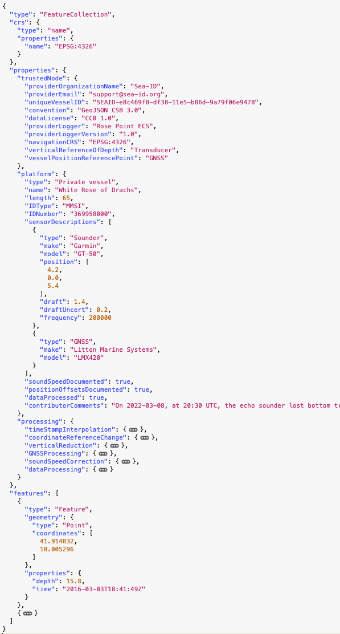
Example B-12 v3.0.0 JSON encoding
JSON encoding can express all mandatory and recommended entities and properties of B-12 v3.0.0 metadata and data
However, the JSON type system alone does not provide robust validation of B-12 v3.0.0 documents
For example:
fields defining sensor information, etc.
range of longitude and latitude values
vessel length being greater than zero
https://bitbucket.org/ccomjhc/csbschema/src/master/docs/IHO/b12_v3_example.json

Slide 8
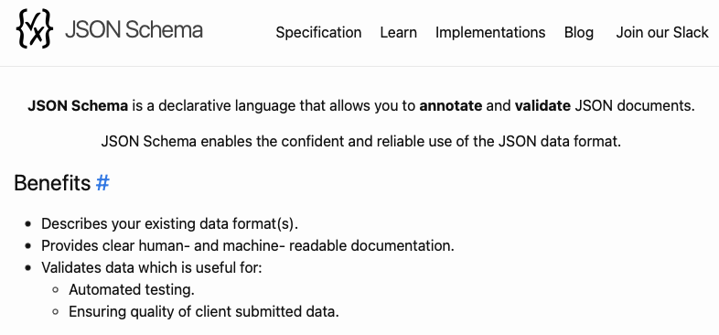
JSON Schema
https://json-schema.org

Slide 9
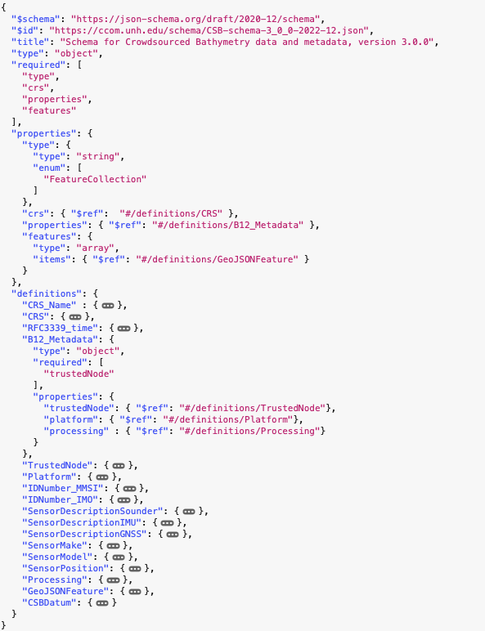
JSON Schema for B-12 v3.0.0 JSON encoding
Schema:
Document:
https://bitbucket.org/ccomjhc/csbschema/src/master/csbschema/data/CSB-schema-3_0_0-2022-12.json

Slide 10
JSON Schema for B-12 v3.0.0 JSON encoding
What are JSON Schemas and what can they do?
JSON Schema is represented as a JSON document
Can be parsed by many off-the-shelf libraries in many languages
Can be used to automate structural and limited semantic validation of JSON documents (e.g., IP address)
A schema can express:
required properties,
min/max number of items
enumerated values
regular expressions
etc.

Slide 11
JSON Schema for B-12 v3.0.0 JSON encoding
What can’t you do with JSON Schema?
“Complex” semantic validation:
i.e., validate a property of an object based on the value of another property in another object
e.g., Ensure IMO IDs start with “IMO”, but don’t allow MMSI IDs to start with “IMO”
This is where custom validation code comes into play
A custom validator runs after automatic JSON schema validation

Slide 12
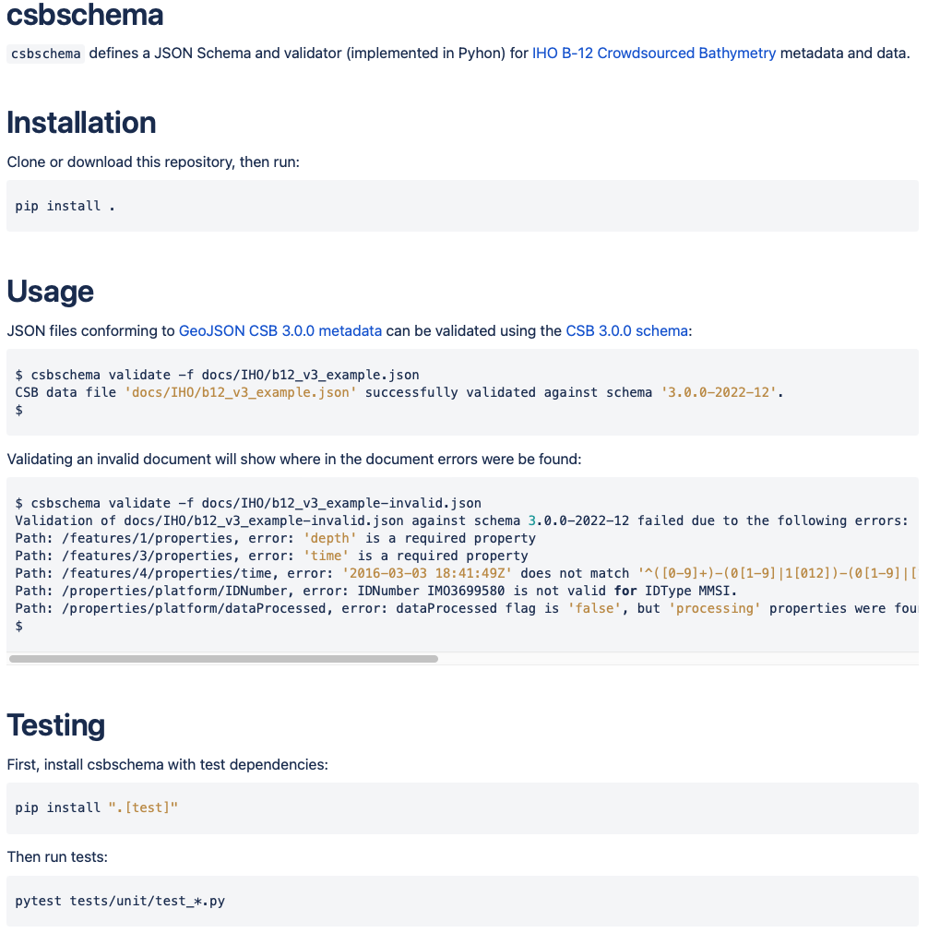
csbschema Python package
Contains draft version of B-12 v3.0.0 JSON Schema
This could also be downloaded from the canonical source (e.g., DCDB)
Provides example JSON encodings of B-12 v3.0.0 data, including invalid data
Implements a custom validator to perform “complex” semantic validation
Provides automated tests for custom validation
Provides unit tests for testing regular expressions used in the schema
Validation command line tool can be used in automated pipelines
https://bitbucket.org/ccomjhc/csbschema/

Slide 13
Questions?
Resources:
csbschema: https://bitbucket.org/ccomjhc/csbschema/
JSON Schema: https://json-schema.org

