Slide 1
Optimisation of configurations for CCP-NC
John Purton and Kane Shenton

Slide 2
Outline
Quality of MACE-MP potentials
Monte Carlo
AIRSS style calculation
Basin Hopping with modifications
Weighting of NMR spectra
Availability of the code

Slide 3
Checking mace models: LBFGS 1.0e⁻³ tol MACE-MP-0a
 | precision | Time | A=b | c | energy
small | float64 | 36.5 | 13.299 | 30.494 | -1723.176
small | float32 | 36.4 | 13.299 | 30.494 | -1723.176
medium | float64 | 121.3 | 13.297 | 30.491 | -1723.653
large | Float64 | 292.1 | 13.291 | 30.477 | -1722.755
large | Float32 | 292.1 | 13.291 | 30.477 | -1722.755
Expt a=b=13.200 c=30.267 (K₁₀)Al₁₀Si₇₂O₁₄₄
The "small" model for these systems may provide a computationally efficient approach for these systems but need new fits.
Float32 causes problems with MC selection.

Slide 4
Different model: LBFGS, medium models, float64, tol 1.0e⁻³
model | a | c | Energy eV | iterations
Mp-ob3 | 13.293 | 30.481 | -1722.690 | 161
Mpa-0 | 13.297 | 30.491 | -1724.239 | 151
Omat | 13.280 | 30.451 | -1723.921 | 167
Matpes-r2scan | 13.172 | 30.203 | -2198.468 | 264
Matpes-r2scan is closest to experiment and used in all subsequent calculations (only "large" available).
Expt a=b=13.200 c=30.267 (K₁₀)Al₁₀Si₇₂O₁₄₄

Slide 5
Note of caution
Tests on STA30 Si:Al ratio 6:1 with H counter ion
Only BFGS can find a minimum. LBFGS/FIRE fail to converge!
Problems when using MD
Off-the-shelf potentials don’t appear to be suitable. May be fitted to different materials?

Slide 6
Programming
Metropolis MC:
  Random displacement of atoms combined
  Random displacement of volume
  swap position of atoms (e.g. Si/Al) chosen at random.
All "moves" are accepted/rejected using Metropolis-Hastings
Acceptance negligible (difference in energy 1.0 to 2.0 eV)
$$acc\left(o→n\right)=min\left(1 , \exp\left(−β\left(En−Eo\right)\right)\right)$$

Slide 7
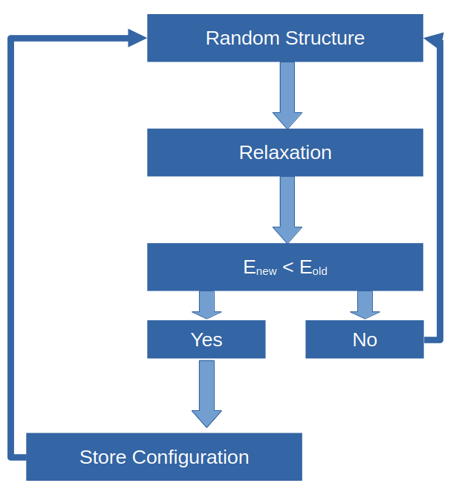
Ab initio random structure saerch
AIRSS style calculation where all Si and Al are placed randomly on appropriate crystallographic sites.
Can do this with counter ions and fictitious/"ghost" atoms.
The number of configurations is large ~10¹¹ even for single cells.
Also very inefficient!

Slide 8
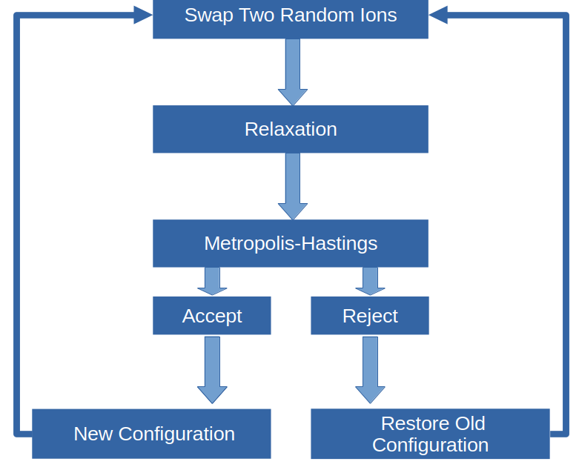
Basin Hopping
Swap positions of two atoms (e.g. Si/Al) as per MC
Unlike MC an energy minimisation/relaxation
Old and new energies used in Metropolis-Hastings acceptance.
Fictitious/ghost atoms can be swapped with real atoms

Slide 9
Basin hopping: swap moves only
STA30
Using matpes-r2scan medium model
Boltzmann sampling of relaxed energies at 1200 K
swap moves for Al/Si and K/ghost
Al/Si 3.8% moves successful (approx. 42% “downhill”, 58% “uphill”)
K/ghost 2.6% swaps successful (split approx. 50:50 downhill:uphill). Ghosts are a fictitious

Slide 10
What About Counter Ions
Do position of charge balancing counter ions, K in this instance, influence the position of Al?

Slide 11
Basin hopping: swaps with MD
Random Selection of either swap or MD.
Swap
  Swap two ions chosen at random
  Boltzmann sampling of relaxed energies
MD
  NVT MD (e.g.1000K 2fs and 500 steps but can alter)
  MD followed by relaxation.

Slide 12
Basin hopping: swaps with MD
STA30 6:1 Si:Al ratio
Using matpes-r2scan medium model
Boltzmann sampling of relaxed energies at 1200 K
Swap moves for Al/Si only
MD @1000K 2fs and 500 steps. Approx 20% moves are MD
Al/Si 6.8% moves successful (split approx. 50:50 downhill:uphill)

Slide 13
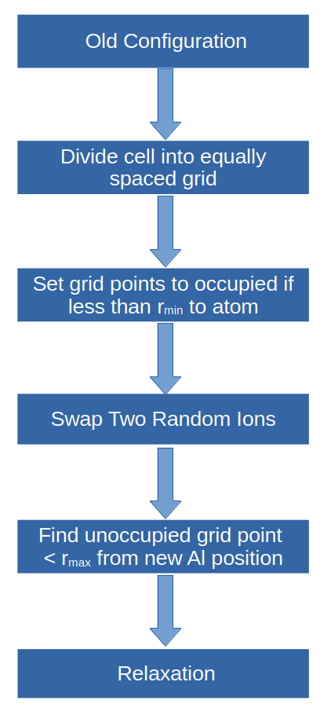
Basin hopping: combined swap
Swap protocol
Activation for K diffusion approx. 0.95 to 1.5 eV so MD unlikely to result in K diffusion.
Swap moves for Al/Si.
Space for K ion is found using grid system
NO detailed balance

Slide 14
Basin hopping: combined swap
STA30
Using matpes-r2scan medium model
Boltzmann sampling of relaxed energies at 1200 K
Activation for K diffusion approx. 0.95 to 1.5 eV
Swap moves for Al/Si. Also, K ion moved close to Al
Space for K ion is found using grid system
Finds configurations with slightly lower energy than SWAP-MD with similar efficiency to swap with MD

Slide 15
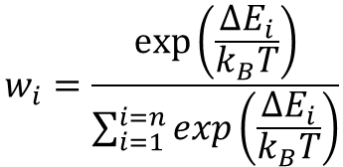
Weight for NMR spectra
$$w_{i}=\frac{exp⁡\left(\frac{∆E_{i}}{k_{B}T}\right)}{\sum_{i=1}^{i=n}{exp\left(\frac{∆E_{i}}{k_{B}T}\right)}}$$
The weights for the NMR are given by the equation.
∆E is the energy above the minimum in the convex hull.

Slide 16
Availability
The code is part of the CCP-NC software
MIT licence
Available on CCP-NC github https://github.com/CCP-NC/pymc-nmr

