Slide 1



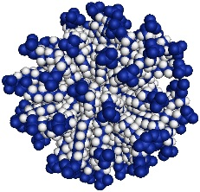
CCP SAS
CCP SAS
A Joint EPSRC-NSF Software Project
A Joint EPSRC-NSF Software Project

