Slide 1
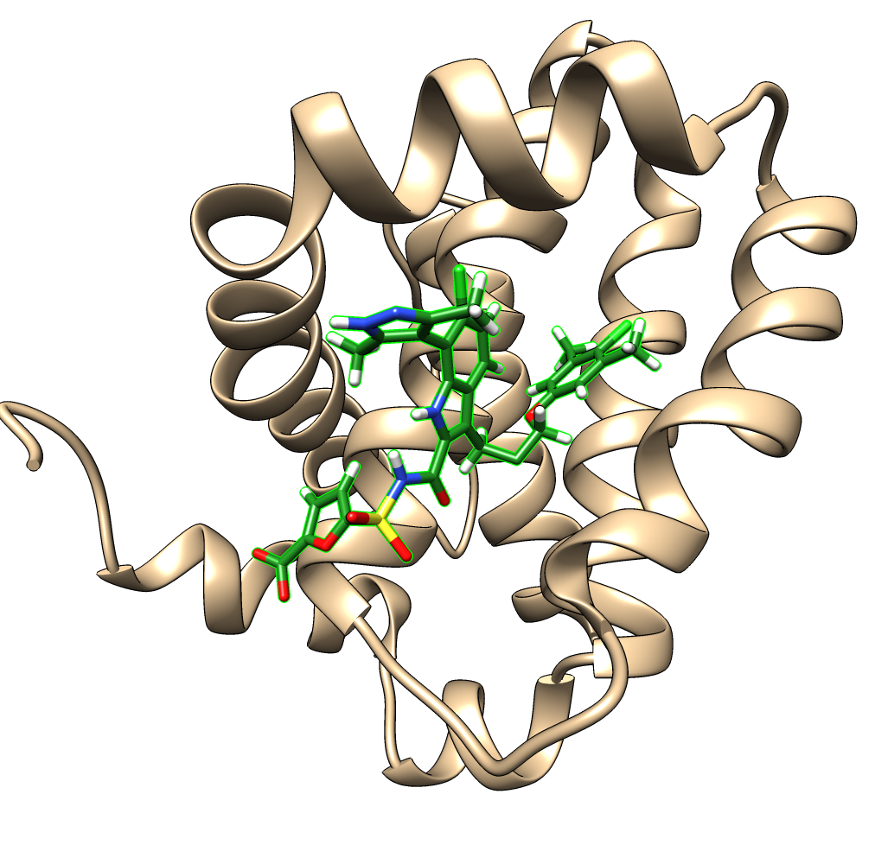
MM-GBSA Workflow
E_{c}
E_{r}
E_{l}
Mcl-1 with bound ligand 5X3 (PDB code 5FDR)
1. Strip explicit water, separate into complex, receptor, and ligand.
2. Create simulation systems with implicit water.
3. Calculate energies.
E_{bind} = E_{c} – (E_{r} + E_{l})

