Slide 1
2016
Design Document

Slide 2
Content
Part 1
Part 2
Part 3
Database Design
Specific Design
Interface Design

Slide 3
Part 1
Database Design

Slide 4
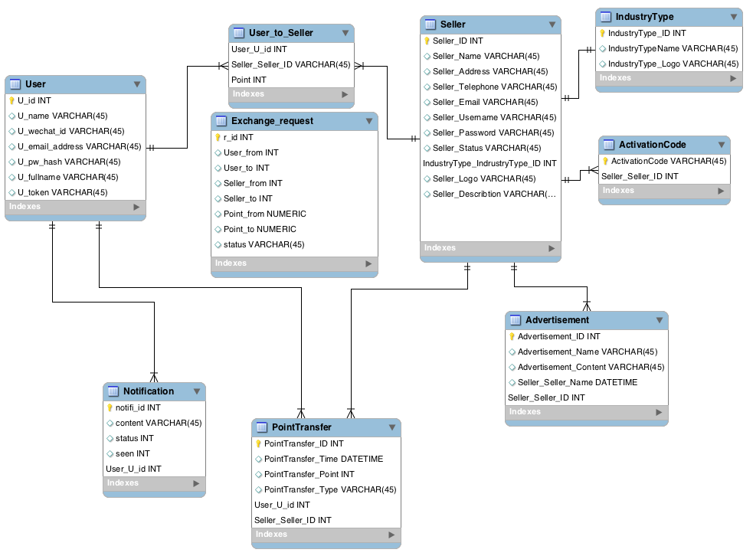

Slide 5
Table of Seller Function:
Seller
Attribute name | Data Type
Seller_ID | INT | PK
Seller_Name | VARCHAR
Seller_Address | VARCHAR
Seller_Telephone | VARCHAR
Seller_Email | VARCHAR
Seller_Username | VARCHAR
Seller_Password | VARCHAR
Seller_Status | VARCHAR
IndustryType_ID | VARCHAR | FK
Seller_Logo | VARCHAR | Store path
Seller_Description | VARCHAR
Industry Type
Attribute name | Data Type
IndustryType_ID | INT | PK
IndustryType _Name | VARCHAR
IndustryType_Logo | VARCHAR | Store path
ActivationCode
Attribute name | Data Type
ActivationCode | VARCHAR | PK
Seller_Seller_ID | INT | FK

Slide 6
Table of Seller Function:
PointTransfer
Attribute name | Data Type
PointTransfer _ID | INT | PK
PointTransfer _Time | DATETIME
PointTransfer _Point | INT
PointTransfer _Type | VARCHAR
User_U_id | INT
SellerPointSystem_Username | VARCHAR | FK
Attribute name | Data Type
Advertisement_ID | VARCHAR | PK
Seller_Seller_ID | INT | FK
Advertisement_Picture | VARCHAR | Store path
Advertisement_Content | VARCHAR

Slide 7
Table of Seller Points System:
SellerPointSystem
Attribute name | Data Type
SellerPointSystem_Username | VARCHAR | PK
SellerPointSystem_Password | VARCHAR
SellerPointSystem_Point | VARCHAR

Slide 8
Part 2
Specific Design

Slide 9
Content
1. Income and outcome points module
View Transfer Points
View Exchange Points
View exchange rate
2. Intelligence analysis module

Slide 10
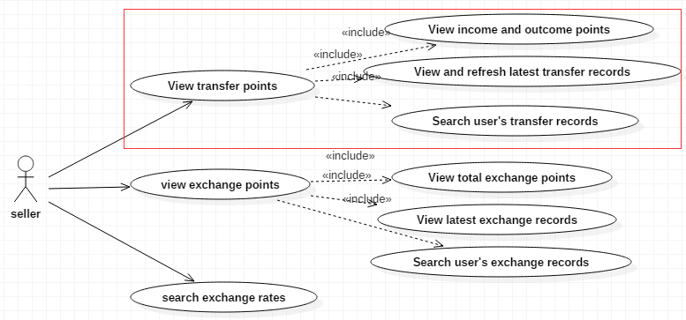
View Transfer Points
This function is for sellers to view the information about points of users transferred between our platform and seller’s points system.
The information include total income (transfer into) points and outcome (transfer out) points, latest transfer records, user’s transfer records.

Slide 11
View Transfer Points

Slide 12
View Transfer Points
Input and output
Input: Default time range, search time range, search points range, transfer type, username
Output: Income points, outcome points, latest transfer records, user’s transfer records
Constraints: The input of time range must be time format and the end time must later than start time.

Slide 13
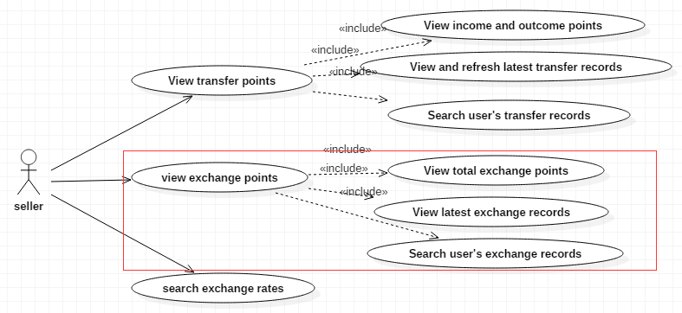
View Exchange Points
This function is to show the exchange information about the seller, the information include total points, latest exchange records, user’s exchange records.
We show the total exchange points, not income points and outcome points, because income points and outcome points for exchange are same.

Slide 14
View Exchange Points

Slide 15
View Exchange Points
Input and output
Input: Default time range, search time range, search points range, username.
Output: Total exchange points, latest exchange records, user’s exchange records.
Constraints: The input of time range must be time format and the end time must later than start time.

Slide 16
View exchange rate
Seller can input a time range to search the trend of exchange rate with another seller in a period time. The exchange rate will showed by a line chart

Slide 17
View exchange rate
Input and output description
Input: search time range, seller name
Output: line chart(exchange rate)
Constraints: The input of time range must be time format and the end time must later than start time.

Slide 18
Intelligence analysis module

Slide 19
Algorithm

Slide 20
Intelligence analysis module
Input and output
Input: Default time range, search time range, trade data type(trade times or trade points)
Output: Rank in same industry, top 5 sellers histograms, industry ratios diagram, time sequence diagram
Constraints: The input of time range must be time format and the end time must later than start time.

Slide 21
Part 3
Interface Design

Slide 22
What we provide
Function name | TransferIn()
Description | Transfer points from Seller’s Points System to our Exchange Platform
Requester | User Function
Requested para | user id, seller id, username, password, points
Responder | Seller Function
Responded data | Status: 0: Transfer success 1: Invalid username or password 2: Points are not enough 3: Client error 4: Server error
Specific process | User Function invoke TransferIn() method Send a transmission request to Seller’s Points System Get response for transmission Parse content of response Save transmission record to DB in our system Return the status to User Function
Example | public int transferIn(int userId, int sellerId, String userName, String passWord, double points)
FOR USER FUNCTION:
Transfer Point In
Transfer Points Out

Slide 23
What we provide
FOR UI:
Seller List
Industry Type
Advertisement content

Slide 24
What we need
FROM BLOCKCHAIN FUNCTION:
Get Total Exchange Points
Function name | GetToExPo()
Description | Get total exchange points about the seller in a period time from Block Chain Function
Requester | Seller Function
Requested para | Seller id, start time, end time
Responder | Block Chain Function
Responded data | Total exchange points about the seller
Example | Public double getToExPo (int sellerId, String startTime, String endTime)
Get latest Exchange Records
Function name | GetLatExRec()
Description | Get latest exchange records about the seller from Block Chain Function
Requester | Seller Function
Requested para | Seller id, record number
Responder | Block Chain Function
Responded data | A list of exchange records, each record include userA id, sellerA id, pointsA, userB id, sellerB id, pointsB, exchange timestamp
Example | Public List<ExRec> getLatExRec (int sellerId, int recordNum)

Slide 25
Get Particular Exchange Records
Function name | GetParExRec()
Description | Get particular exchange records about the seller from Block Chain Function by input search criteria
Requester | Seller Function
Requested para | Seller id, lower bound of points, upper bound of points, start time, end time, user id(all para can be empty except seller id)
Responder | Block Chain Function
Responded data | A list of exchange records, each record include userA id, sellerA id, pointsA, userB id, sellerB id, pointsB, exchange timestamp
Example | Public List<ExRec> getLatExRec(int sellerId, int userId, double lowPoints, double upPoints, String startTime, String endTime)
Get Particular Exchange Records For Intelligent Analysis
Function name | GetParExRec()
Description | Get particular exchange records about the seller from Block Chain Function by input search criteria
Requester | Seller Function
Requested para | Seller id, start time, end time
Responder | Block Chain Function
Responded data | A list of exchange records, each record include userA id, sellerA id, pointsA, userB id, sellerB id, pointsB, exchange timestamp
Example | Public List<ExRec> getLatExRec(int sellerId, String startTime, String endTime)

Slide 26
Seller Points System’s API
Basic URL and basic response format
interfaces’ format
The request URL shows like：
POST {BaseUrl}/points/{trade_type}/{seller_id}
IP=139.129.9.194
Version=v1.0.0
BaseUrl=http://{IP}/seller/{Version}/
Base response format:
{
status:0,
msg:"OK",
data:null
}
Status: means status of response 0 means everything is Ok
Msg: means alert information when having a error
Data: if get data list from seller points system.
status Information
default：0
status：
0: Transfer success 1: Invalid username or password 2: Points are not enough 3: Client error 4: Server error

Slide 27
Name | /points/{trade_type}/{seller_id}
Function | get points from seller system and transfer point from our system to seller system
Method & parameters | Method: POST @param trade_type (int) transfer type, 1:transfer points into seller own system 0:transfer points into our system @param seller_id (int) seller unique target
Request Body | @param name (String) log-in name @param password (String) log-in password @param points (String) points wanted to transfer
Response Format | { status:0, msg:"OK", }
Example 1 | POST /points/0/1001 transfer points from seller own system to our system request body: { name:ken, password:4342423, points:300 } response: { status:0, msg:"OK" } or { status:1 msg:"error invalid name and password" }
Example 2 | POST /points/1/1007 transfer points from our system to seller's system request body: { name:ken, password:4342423, points:200 } response: { status:0, msg:"OK" } or { status:1 msg:"error invalid name and password" }

Slide 28
THANK
YOU

