Slide 1
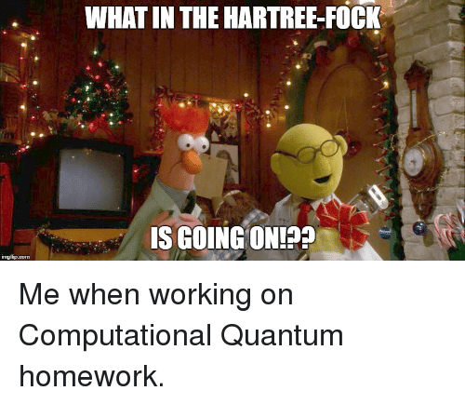
RHF and UHF
7/16/2021

Slide 2

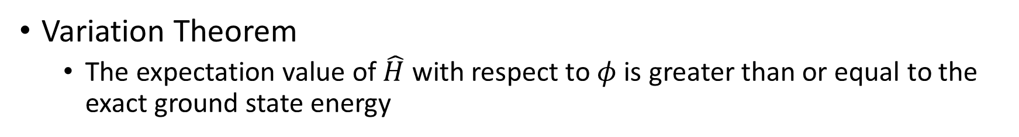
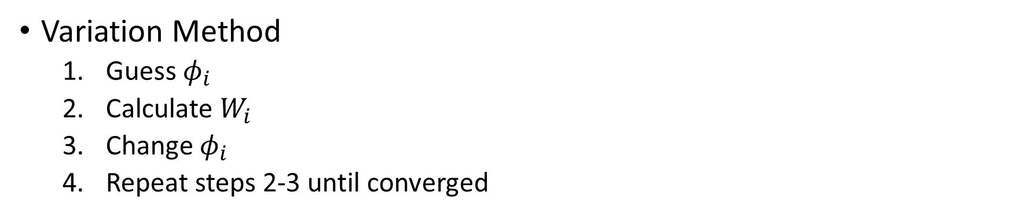
Hartree-Fock
Variation Theorem
The expectation value of $\hat{H}$ with respect to $φ$ is greater than or equal to the exact ground state energy
$$W_{1}= \frac{\left\langle φ_{1} | {\hat{H}}_{e} | φ_{1}\right\rangle }{\left\langle φ_{1} | φ_{1}\right\rangle } ≥E_{1}$$
Variation Method
Guess $φ_{i}$
Calculate $W_{i}$
Change $φ_{i}$
Repeat steps 2-3 until converged

Slide 3
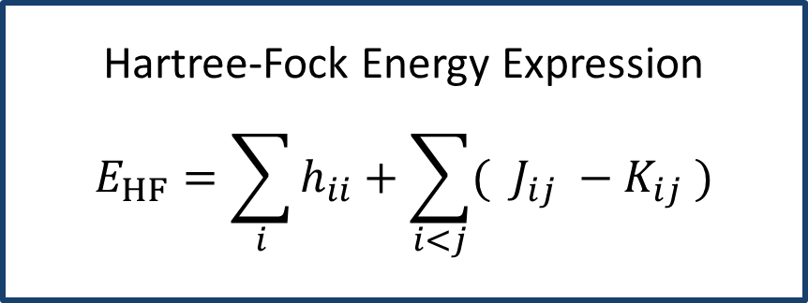
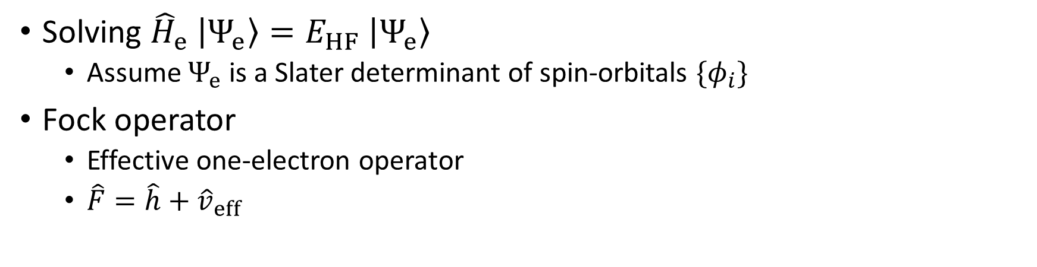
HF (cont.)
Solving ${\hat{H}}_{e} \left|\left.Ψ_{e}\right\rangle \right.=E_{HF} \left|\left.Ψ_{e}\right\rangle \right.$
Assume $Ψ_{e}$ is a Slater determinant of spin-orbitals $\{φ_{i}\}$
Fock operator
Effective one-electron operator
$\hat{F}=\hat{h}+{\hat{v}}_{eff}$
Hartree-Fock Energy Expression
$$E_{HF}=\sum_{i}{h_{ii}}+\sum_{i<j}{( J_{ij} −K_{ij} )}$$

Slide 4
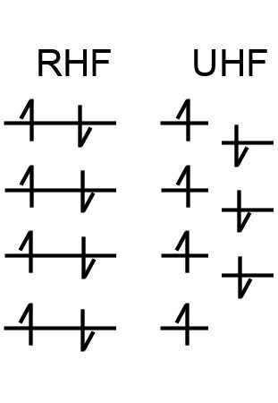
Closed Shell vs Open Shell
Closed shell
All electrons are paired
Every pair of electrons shares the same spatial orbital
Open shell
Not all electrons are paired
Different orbitals for different spins (DODS)

Slide 5
Restricted Hartree-Fock
Closed Shell

Slide 6

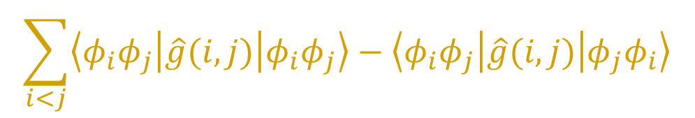
A closer look…
$$E_{HF}=\sum_{i}{h_{ii}}+\sum_{i<j}{( J_{ij} −K_{ij} )}$$
Contains a one- and two- electron operator
$$\sum_{i}{\left\langle φ_{i} | \hat{h}(i) | φ_{i}\right\rangle }$$
$$\sum_{i<j}{\left\langle φ_{i}φ_{j} | \hat{g}(i,j) | φ_{i}φ_{j}\right\rangle −\left\langle φ_{i}φ_{j} | \hat{g}(i,j) | φ_{j}φ_{i}\right\rangle }$$

Slide 7



One-Electron Operator
$$\sum_{i}{\left\langle φ_{i} | \hat{h}(i) | φ_{i}\right\rangle }$$
Spatial
Spin
$$\sum_{i}^{MO}{\sum_{ω=α,β}{\left\langle φ_{i}ω | \hat{h}(i) | φ_{i}ω\right\rangle }}≡\sum_{i}^{MO}{\sum_{ω=α,β}{ \left\langle φ_{i} | \hat{h}(i) | φ_{i}\right\rangle \left\langle ω | ω\right\rangle }}$$
$$\sum_{i}^{MO}{\left\langle φ_{i} | \hat{h}(i) | φ_{i}\right\rangle \left\langle α | α\right\rangle +\left\langle φ_{i} | \hat{h}(i) | φ_{i}\right\rangle \left\langle β | β\right\rangle }$$
$$\sum_{i}{\left\langle χ_{i} | \hat{h}(i) | χ_{i}\right\rangle }=2\sum_{i}^{MO}{\left\langle φ_{i} | \hat{h}(i) | φ_{i}\right\rangle }$$

Slide 8
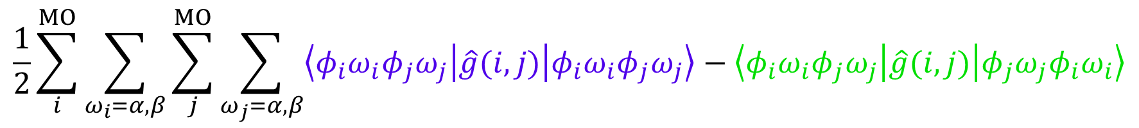
Two-Electron Operator
$$\sum_{i<j}{\left\langle φ_{i}φ_{j} | \hat{g}(i,j) | φ_{i}φ_{j}\right\rangle −\left\langle φ_{i}φ_{j} | \hat{g}(i,j) | φ_{j}φ_{i}\right\rangle }$$
$$\frac{1}{2}\sum_{i}^{MO}{\sum_{ω_{i}=α,β}{\sum_{j}^{MO}{\sum_{ω_{j}=α,β}{\left\langle φ_{i}ω_{i}φ_{j}ω_{j} | \hat{g}(i,j) | φ_{i}ω_{i}φ_{j}ω_{j}\right\rangle −\left\langle φ_{i}ω_{i}φ_{j}ω_{j} | \hat{g}(i,j) | φ_{j}ω_{j}φ_{i}ω_{i}\right\rangle }}}}$$
Coulombic Interaction
Exchange Interaction

Slide 9
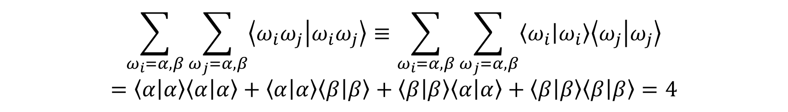


w Coulomb Term
$$\frac{1}{2}\sum_{i}^{MO}{\sum_{ω_{i}=α,β}{\sum_{j}^{MO}{\sum_{ω_{j}=α,β}{\left\langle φ_{i}ω_{i}φ_{j}ω_{j} | \hat{g}(i,j) | φ_{i}ω_{i}φ_{j}ω_{j}\right\rangle }}}}$$
$$\sum_{ω_{i}=α,β}{\sum_{ω_{j}=α,β}{\left\langle ω_{i}ω_{j} | ω_{i}ω_{j}\right\rangle }}≡\sum_{ω_{i}=α,β}{\sum_{ω_{j}=α,β}{\left\langle ω_{i} | ω_{i}\right\rangle \left\langle ω_{j} | ω_{j}\right\rangle }}$$
$$=\left\langle α | α\right\rangle \left\langle α | α\right\rangle +\left\langle α | α\right\rangle \left\langle β | β\right\rangle +\left\langle β | β\right\rangle \left\langle α | α\right\rangle +\left\langle β | β\right\rangle \left\langle β | β\right\rangle =4$$
$$\frac{1}{2}\sum_{i}^{MO}{\sum_{j}^{MO}{4\left\langle φ_{i}φ_{j} | \hat{g}(i,j) | φ_{i}φ_{j}\right\rangle }}$$

Slide 10
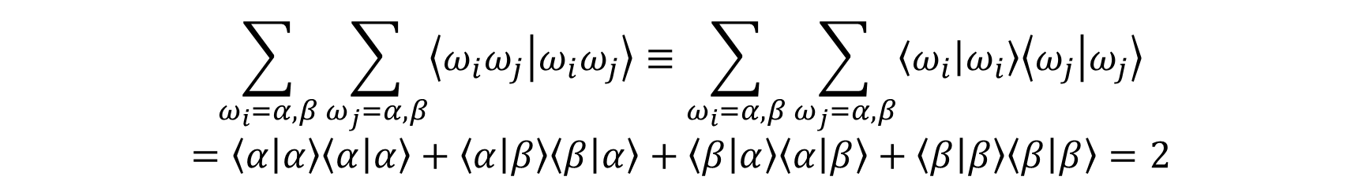


w Exchange Term
$$\frac{1}{2}\sum_{i}^{MO}{\sum_{ω_{i}=α,β}{\sum_{j}^{MO}{\sum_{ω_{j}=α,β}{\left\langle φ_{i}ω_{i}φ_{j}ω_{j} | \hat{g}(i,j) | φ_{j}ω_{j}φ_{i}ω_{i}\right\rangle }}}}$$
$$\sum_{ω_{i}=α,β}{\sum_{ω_{j}=α,β}{\left\langle ω_{i}ω_{j} | ω_{i}ω_{j}\right\rangle }}≡\sum_{ω_{i}=α,β}{\sum_{ω_{j}=α,β}{\left\langle ω_{i} | ω_{i}\right\rangle \left\langle ω_{j} | ω_{j}\right\rangle }}$$
$$=\left\langle α | α\right\rangle \left\langle α | α\right\rangle +\left\langle α | β\right\rangle \left\langle β | α\right\rangle +\left\langle β | α\right\rangle \left\langle α | β\right\rangle +\left\langle β | β\right\rangle \left\langle β | β\right\rangle =2$$
$$\frac{1}{2}\sum_{i}^{MO}{\sum_{j}^{MO}{2\left\langle φ_{i}φ_{j} | \hat{g}(i,j) | φ_{i}φ_{j}\right\rangle }}$$

Slide 11

Two-Electron Operator
$$\sum_{i<j}{\left\langle φ_{i}φ_{j} | \hat{g}(i,j) | φ_{i}φ_{j}\right\rangle −\left\langle φ_{i}φ_{j} | \hat{g}(i,j) | φ_{j}φ_{i}\right\rangle }$$
$$\sum_{i}^{MO}{\sum_{j}^{MO}{2\left\langle φ_{i}φ_{j} | \hat{g}(i,j) | φ_{i}φ_{j}\right\rangle −\left\langle φ_{i}φ_{j} | \hat{g}(i,j) | φ_{i}φ_{j}\right\rangle }}$$

Slide 12
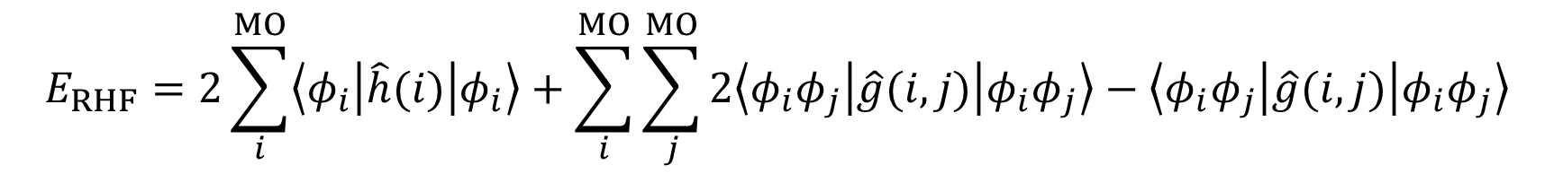
RHF Energy Expression
$$E_{RHF}=2\sum_{i}^{MO}{\left\langle φ_{i} | \hat{h}(i) | φ_{i}\right\rangle }+\sum_{i}^{MO}{\sum_{j}^{MO}{2\left\langle φ_{i}φ_{j} | \hat{g}(i,j) | φ_{i}φ_{j}\right\rangle −\left\langle φ_{i}φ_{j} | \hat{g}(i,j) | φ_{i}φ_{j}\right\rangle }}$$

Slide 13

HF Equations
Canonical HF Equations
$$\hat{F}\left|\left.φ_{i}\right\rangle \right.=ε_{i}\left|\left.φ_{i}\right\rangle \right.$$
Closed Shell Fock Operator
$$\hat{F}=\hat{h}+\sum_{j}{(2 {\hat{J}}_{j}−{\hat{K}}_{j})}$$

Slide 14

Roothaan-Hall Equations
Equations are determined by using the basis set expansion of the trial wave function
$$\left|\left.φ_{i}\right\rangle \right.=\sum_{μ}{C_{μi}\left|\left.χ_{μ}\right\rangle \right.}$$
MO
Transformation matrix from AO to MO
AO

Slide 15
Roothaan-Hall (cont.)
$$\left\langle \left.χ_{μ}\right|\right.\hat{F}\sum_{ν}{C_{νi}\left|\left.χ_{ν}\right\rangle \right.}=\left\langle \left.χ_{μ}\right|\right.ε_{i}\sum_{ν}{C_{νi}\left|\left.χ_{ν}\right\rangle \right.}$$
$$\sum_{ν}{C_{νi}\left\langle χ_{μ} | \hat{F} | χ_{ν}\right\rangle }=ε_{i}\sum_{ν}{C_{νi}\left\langle χ_{μ} | χ_{ν}\right\rangle }$$
$$\sum_{ν}{C_{νi} F_{μν}}=ε_{i}\sum_{ν}{C_{νi} S_{μν}}$$

Slide 16
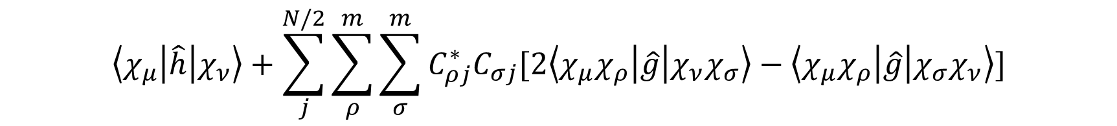


w Fock Matrix
$$\left\langle χ_{μ} | \hat{F} | χ_{ν}\right\rangle =\left\langle χ_{μ} | \hat{h} | χ_{ν}\right\rangle +\sum_{j}^{N/2}{2\left\langle χ_{μ}φ_{j} | \hat{g} | χ_{ν}φ_{j}\right\rangle −\left\langle χ_{μ}φ_{j} | \hat{g} | φ_{j}χ_{ν}\right\rangle }$$
$$\left\langle χ_{μ} | \hat{h} | χ_{ν}\right\rangle +\sum_{j}^{N/2}{\sum_{ρ}^{m}{\sum_{σ}^{m}{C_{ρj}^{∗}C_{σj}[2\left\langle χ_{μ}χ_{ρ} | \hat{g} | χ_{ν}χ_{σ}\right\rangle −\left\langle χ_{μ}χ_{ρ} | \hat{g} | χ_{σ}χ_{ν}\right\rangle ]}}}$$
$$D_{ρσ}=\sum_{j}^{N/2}{C_{ρj}^{∗}C_{σj}}$$

Slide 17
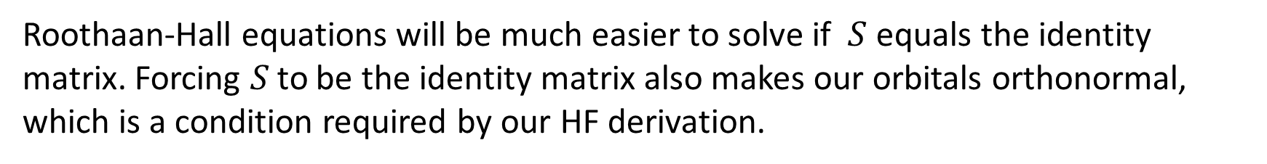
w Overlap Matrix
$$S=\left\langle χ_{μ} | χ_{ν}\right\rangle$$
Roothaan-Hall equations will be much easier to solve if $S$ equals the identity matrix. Forcing $S$ to be the identity matrix also makes our orbitals orthonormal, which is a condition required by our HF derivation.
$$U^{T}SU=1$$
Canonical Orthogonalization
Symmetric Orthogonalization
$$U=V Λ^{−1/2}$$
$$U=S^{−1/2}$$

Slide 18



Orthogonal Basis
$$S^{−1/2}FS^{−1/2}S^{1/2}C=S^{−1/2}SS^{−1/2}S^{1/2}Cε$$
$$\tilde{F}\tilde{C}=\tilde{C}ε$$
$$\tilde{F}=S^{−1/2}FS^{−1/2}$$
$$\tilde{C}=S^{1/2}C$$
$$S^{−1/2}SS^{−1/2}=1$$

Slide 19
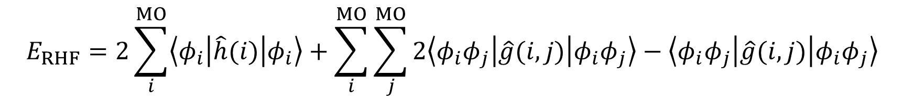
Roothaan-Hall Energy Expression
$$E_{RHF}=2\sum_{i}^{MO}{\left\langle φ_{i} | \hat{h}(i) | φ_{i}\right\rangle }+\sum_{i}^{MO}{\sum_{j}^{MO}{2\left\langle φ_{i}φ_{j} | \hat{g}(i,j) | φ_{i}φ_{j}\right\rangle −\left\langle φ_{i}φ_{j} | \hat{g}(i,j) | φ_{i}φ_{j}\right\rangle }}$$
$$E_{RHF}=2\sum_{μν}{D_{μν}\left\langle χ_{μ} | \hat{h} | χ_{ν}\right\rangle }+\sum_{μνρσ}{D_{μν}D_{ρσ}[2\left\langle χ_{μ}χ_{ρ} | \hat{g} | χ_{ν}χ_{σ}\right\rangle −\left\langle χ_{μ}χ_{ρ} | \hat{g} | χ_{σ}χ_{ν}\right\rangle }$$

Slide 20
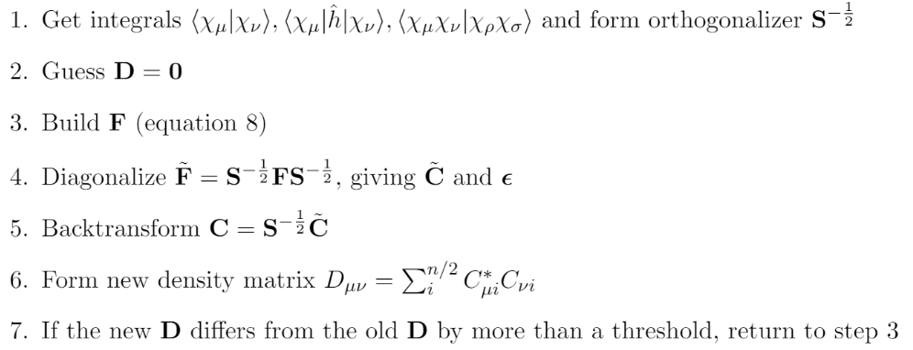

SCF Procedure

Slide 21
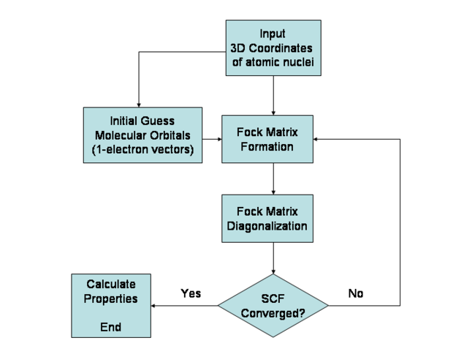

Slide 22
Unrestricted Hartree-Fock
Open Shell

Slide 23
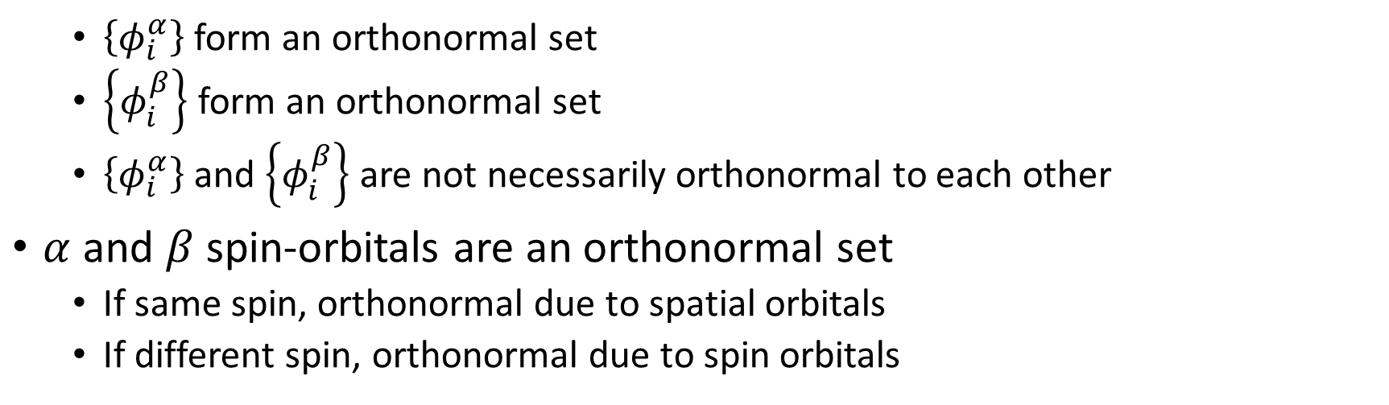

What’s different?
Different Orbitals for Different Spins (DODS)
$$χ_{i}=\left\{\begin{aligned}φ_{i}^{α} α \\ φ_{i}^{β} β\end{aligned}\right.$$
$\left\{φ_{i}^{α}\right\}$ form an orthonormal set
$\left\{φ_{i}^{β}\right\}$ form an orthonormal set
$\left\{φ_{i}^{α}\right\}$ and $\left\{φ_{i}^{β}\right\}$ are not necessarily orthonormal to each other
$α$ and $β$ spin-orbitals are an orthonormal set
If same spin, orthonormal due to spatial orbitals
If different spin, orthonormal due to spin orbitals

Slide 24

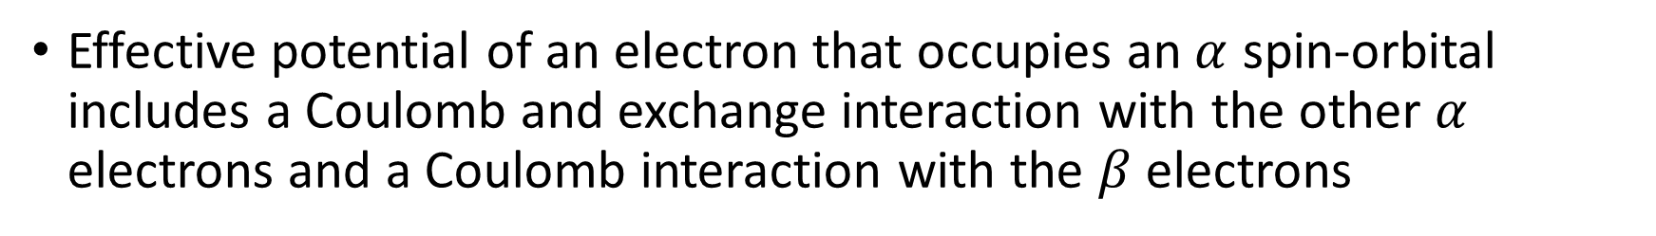

Simultaneous Equations
Effective potential of an electron that occupies an $α$ spin-orbital includes a Coulomb and exchange interaction with the other $α$ electrons and a Coulomb interaction with the $β$ electrons
$${\hat{F}}^{α}=\hat{h}+\sum_{j}^{n_{α}}{({\hat{J}}_{j}^{α}−{\hat{K}}_{j}^{α})}+\sum_{j}^{n_{β}}{{\hat{J}}_{j}^{β}}$$
$${\hat{F}}^{β}=\hat{h}+\sum_{j}^{n_{β}}{({\hat{J}}_{j}^{β}−{\hat{K}}_{j}^{β})}+\sum_{j}^{n_{α}}{{\hat{J}}_{j}^{α}}$$

Slide 25
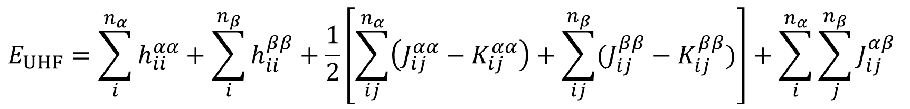
UHF Energy Expression
$$E_{UHF}=\sum_{i}^{n_{α}}{h_{ii}^{αα}}+\sum_{i}^{n_{β}}{h_{ii}^{ββ}}+\frac{1}{2}\left[\sum_{ij}^{n_{α}}{\left(J_{ij}^{αα}−K_{ij}^{αα}\right)+\sum_{ij}^{n_{β}}{(J_{ij}^{ββ}−K_{ij}^{ββ})}}\right]+\sum_{i}^{n_{α}}{\sum_{j}^{n_{β}}{J_{ij}^{αβ}}}$$

Slide 26

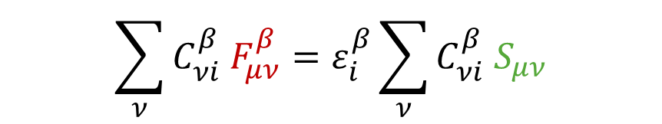




Pople-Nesbet Equations
Equivalent to Roothaan-Hall equations of RHF
$$\left|\left.φ_{i}^{α}\right\rangle \right.=\sum_{μ}{C_{μi}^{α}\left|\left.χ_{μ}\right\rangle \right.}$$
$$\left|\left.φ_{i}^{β}\right\rangle \right.=\sum_{μ}{C_{μi}^{β}\left|\left.χ_{μ}\right\rangle \right.}$$
$$\sum_{ν}{C_{νi}^{α} F_{μν}^{α}}=ε_{i}^{α}\sum_{ν}{C_{νi}^{α} S_{μν}}$$
$$\sum_{ν}{C_{νi}^{β} F_{μν}^{β}}=ε_{i}^{β}\sum_{ν}{C_{νi}^{β} S_{μν}}$$
$$F^{α}C^{α}=SC^{α}ε^{α}$$
$$F^{β}C^{β}=SC^{β}ε^{β}$$

Slide 27
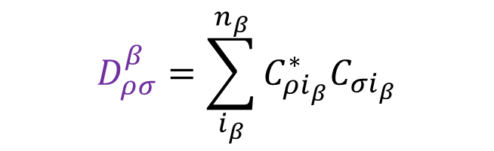
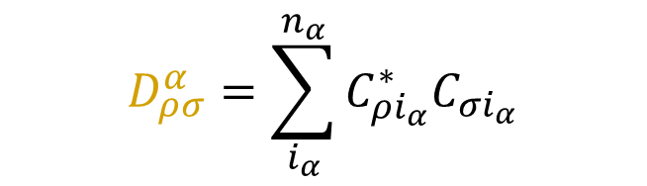
w Fock Matrices
Must solve for $α$ and $β$ equations simultaneously
$$F_{μν}^{α}=\left\langle χ_{μ} | \hat{h} | χ_{ν}\right\rangle +\sum_{ρσ}{D_{ρσ}^{α}\left\langle χ_{μ}χ_{ρ} | | χ_{ν}χ_{σ}\right\rangle }+\sum_{ρσ}{D_{ρσ}^{β}\left\langle χ_{μ}χ_{ρ} | χ_{ν}χ_{σ}\right\rangle }$$
$$F_{μν}^{β}=\left\langle χ_{μ} | \hat{h} | χ_{ν}\right\rangle +\sum_{ρσ}{D_{ρσ}^{β}\left\langle χ_{μ}χ_{ρ} | | χ_{ν}χ_{σ}\right\rangle }+\sum_{ρσ}{D_{ρσ}^{α}\left\langle χ_{μ}χ_{ρ} | χ_{ν}χ_{σ}\right\rangle }$$
$$D_{ρσ}^{α}=\sum_{i_{α}}^{n_{α}}{C_{ρi_{α}}^{∗}C_{σi_{α}}}$$
$$D_{ρσ}^{β}=\sum_{i_{β}}^{n_{β}}{C_{ρi_{β}}^{∗}C_{σi_{β}}}$$

Slide 28
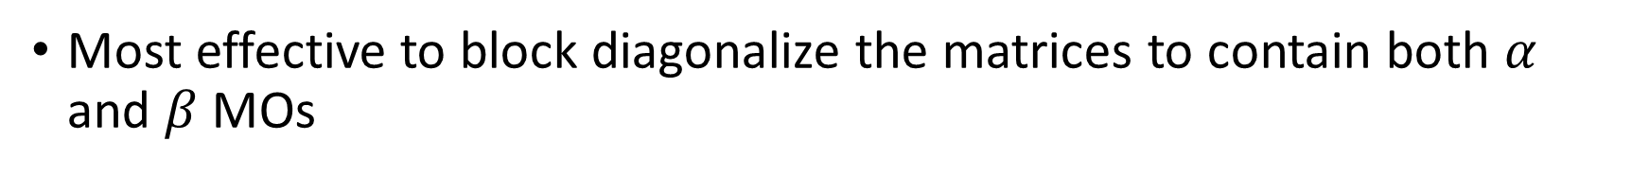
How do we solve these simultaneously?
Most effective to block diagonalize the matrices to contain both $α$ and $β$ MOs

Slide 29
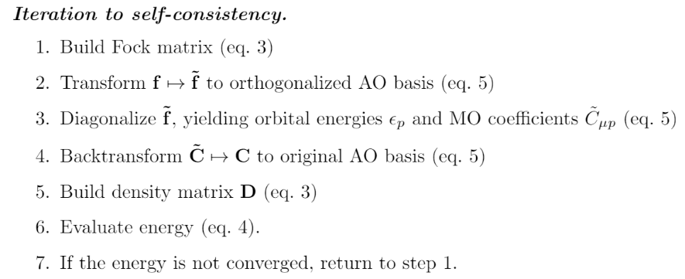
SCF Procedure

Slide 30
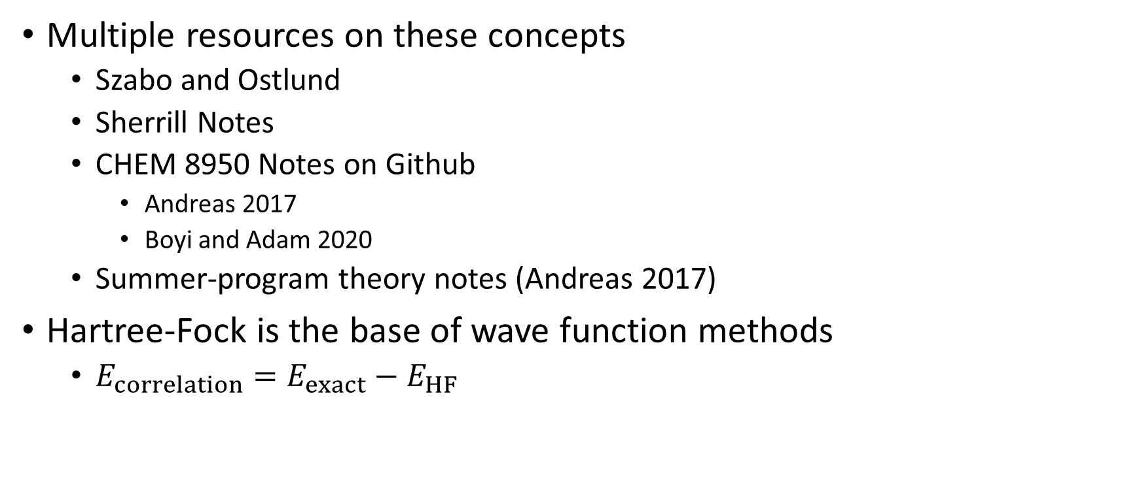
The End!
Multiple resources on these concepts
Szabo and Ostlund
Sherrill Notes
CHEM 8950 Notes on Github
Andreas 2017
Boyi and Adam 2020
Summer-program theory notes (Andreas 2017)
Hartree-Fock is the base of wave function methods
$E_{correlation}=E_{exact}−E_{HF}$

