Slide 1
Focal Point Approach (FPA)
Carson Tang
CCQC Summer lecture
7 July 2025

Slide 2
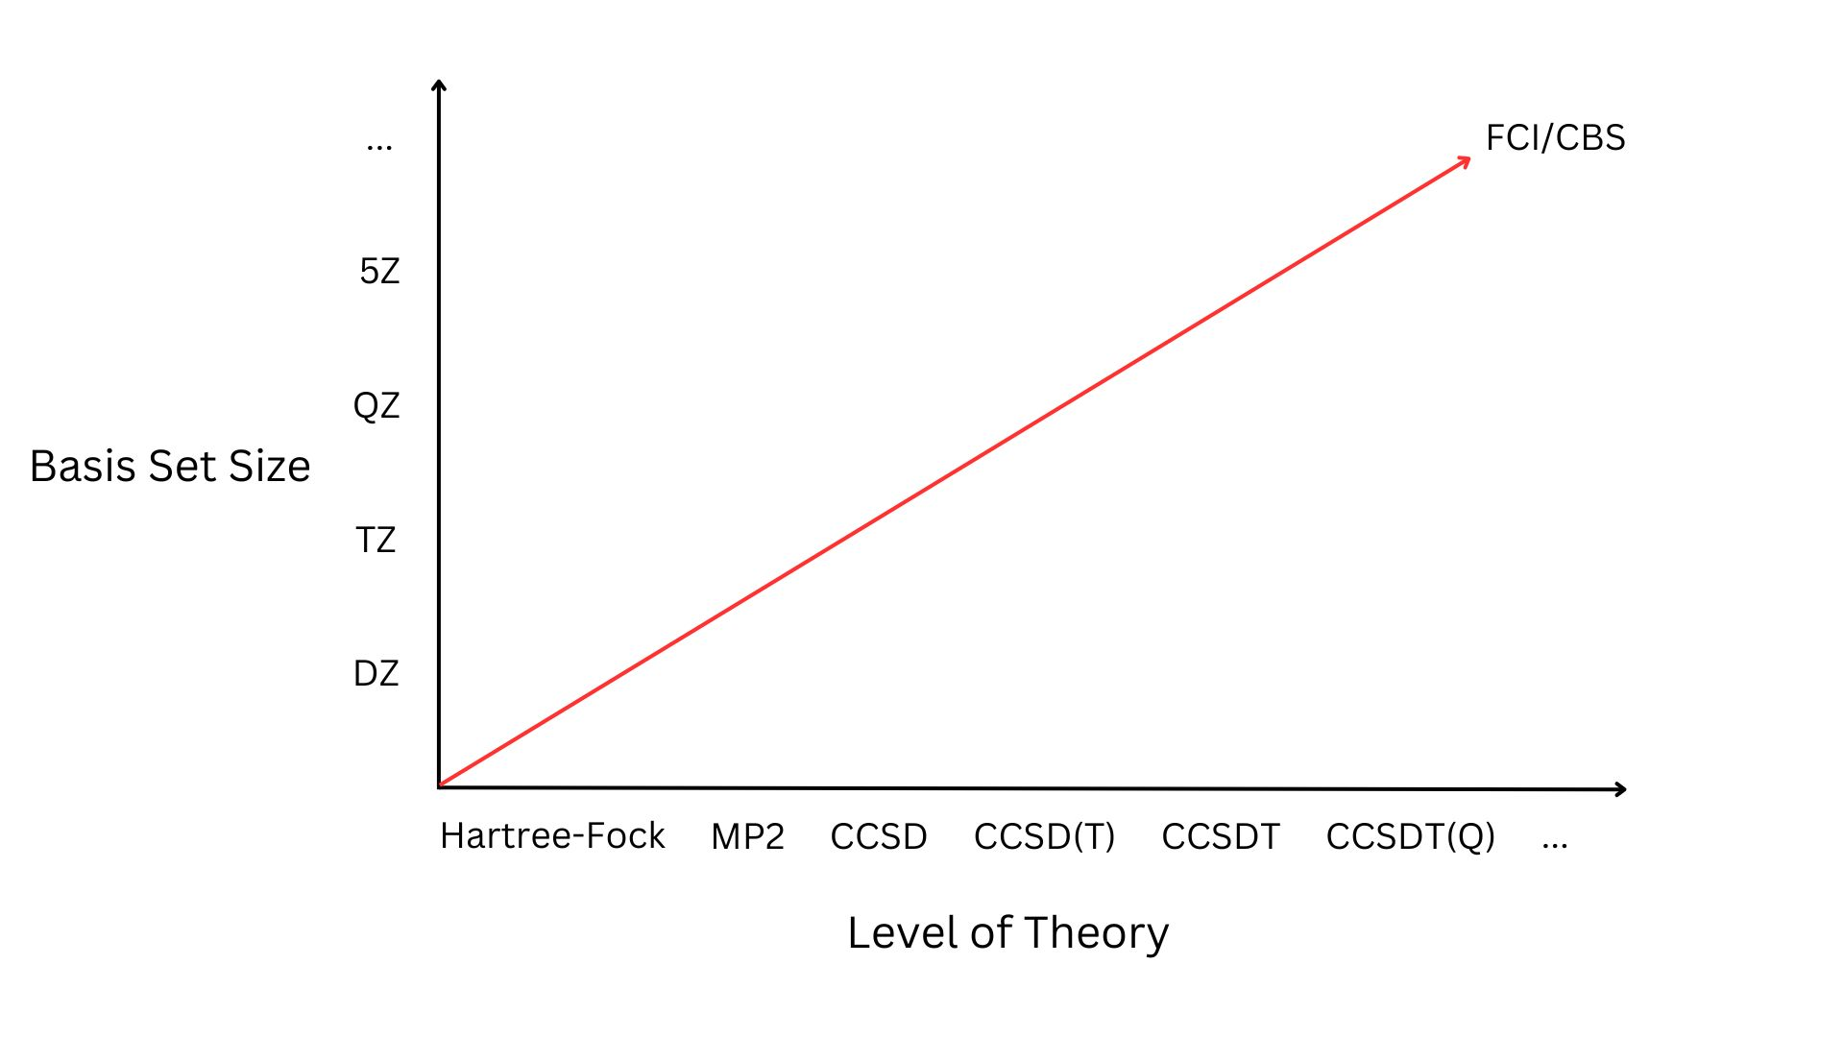
Background
We often report energies in our work for thermochemistry, reaction barriers, etc.
Accuracy is desired to compare with experiment
How accurate can we get with current methods?
HF is not accurate but very fast, CCSD(T) is accurate but very slow
Notes:
Way to target FCI/CBS in a systematic and affordable approach

Slide 3
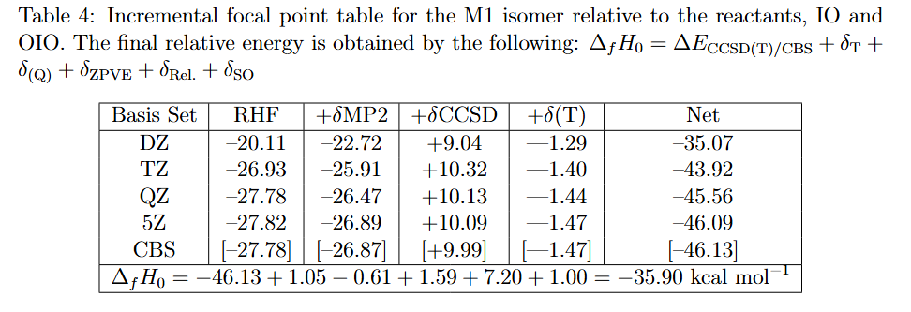

What is it?
In short, a correction scheme to approach the exact answer using basis set extrapolations
$E_{HF}=A+Be^{−CX}$
$E_{corr}=A+BX^{−3}$

Slide 4
How do you use it?
1. Optimize geometries at your highest level of theory
2. Compute energies
3. Extrapolate energies
4. Put them in a table
5. Add corrections

Slide 5
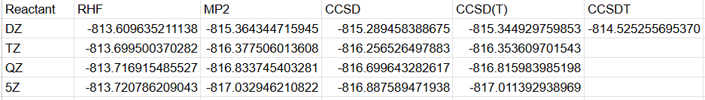
Example: Computing Energies

Slide 6
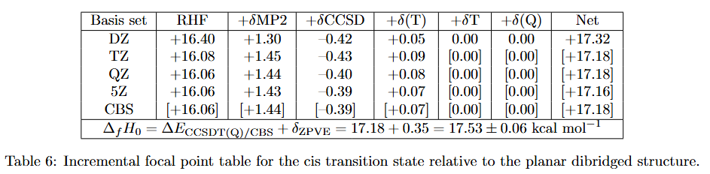
Final Product

Slide 7
Higher Order Correlation

Slide 8
Additional Corrections
Zero Point Vibrational Energy (ZPVE)
Accounts for the fact that molecules are not perfectly still at 0 K
Harmonic Approximation
Anharmonic ZPVE
More realistic approximation of harmonic ZPVE
VPT2
Usually small changes, but required for extreme accuracy
Diagonal Born-Oppenheimer Correction (DBOC)
Accounts for coupling of nuclear and electronic motion
HF is usually sufficient

Slide 9
Additional Corrections
Frozen Core (FC)
Energy difference between all electrons correlated vs. frozen core
Often required for heavier elements, but ECPs can take care of this
Relativistic Effects (Z>36)
Scalar relativistic effects without inclusion of spin-orbit coupling
Spin-orbit coupling
Scalar Relativity (Rel.)
Includes relativistic corrections
X2C1E, X2CMF, DKH, ZORA, MVD1, MVD2, DPT2, etc.

Slide 10
Additional Corrections
Spin-Orbit Coupling (SO or SOC)
Accounts for splitting of electronic states due to spin-orbit interactions
Multireference methods
Heavy elements or open-shell systems
Basis Set Superposition Errors (BSSE)
Intermolecular interactions, weakly bound systems, van der Waals complexes
Counterpoise method
Thermal Corrections
Computing energy above 0 K

Slide 11

What do you report?
$Δ_{f}H_{0}=ΔE_{CCSD\left(T\right)/CBS}+δ_{T}+δ_{(Q)}+δ_{ZPVE}+δ_{FC}+δ_{DBOC}+δ_{Rel}+δ_{SO}$

Slide 12
Cite These Papers
@article{fpa1,
title = {{The heat of formation of NCO}},
author = {East, Allan L. L. and Allen, Wesley D.},
year = 1993,
month = {09},
journal = {J. Chem. Phys.},
volume = 99,
number = 6,
pages = {4638--4650},
doi = {10.1063/1.466062},
issn = {0021-9606},
}

Slide 13
Cite These Papers
@article{fpa2,
title = {{In pursuit of the ab initio limit for conformational energy prototypes}},
author = {Császár, Attila G. and Allen, Wesley D. and Schaefer, Henry F.,},
year = 1998,
month = {06},
journal = {J. Chem. Phys.},
volume = 108,
number = 23,
pages = {9751--9764},
doi = {10.1063/1.476449},
issn = {0021-9606},
}

Slide 14
Cite These Papers
@inbook{fpa3,
title = {Dream or Reality: Complete Basis Set Full Configuration Interaction Potential Energy Hypersurfaces},
author = {Cs{\'a}sz{\'a}r, Attila G. and Tarczay, Gy{\"o}rgy and Leininger, Matthew L. and Polyansky, Oleg L. and Tennyson, Jonathan and Allen, Wesley D.},
year = 2001,
booktitle = {Spectroscopy from Space},
publisher = {Springer Netherlands},
address = {Dordrecht},
pages = {317--339},
doi = {10.1007/978-94-010-0832-7_19},
isbn = {978-94-010-0832-7},
url = {https://doi.org/10.1007/978-94-010-0832-7_19},
}

Slide 15
Cite These Papers
@article{fpa4,
title = {Model identity SN2 reactions CH3X + X- (X = F, Cl, CN, OH, SH, NH2, PH2): Marcus theory analyzed},
author = {Gonzales, Jason M and Allen, Wesley D and Schaefer, Henry F},
year = 2005,
month = {November},
journal = {J. Phys. Chem. A},
volume = 109,
number = 46,
pages = {10613—10628},
doi = {10.1021/jp054734f},
issn = {1089-5639},
}

Slide 16
Questions?

