Slide 1
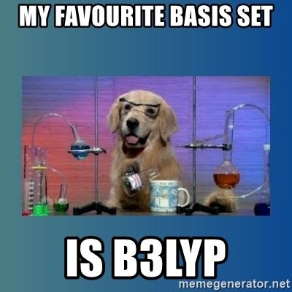
Basis Sets
6/15/2022

Slide 2

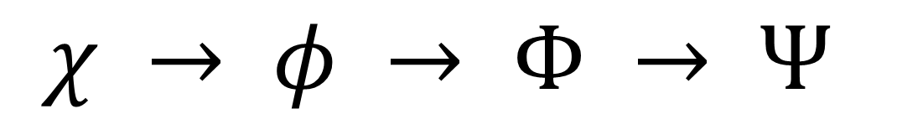
Overall Goal: How do we get from basis functions to a many electron wave function?
$$χ → φ → Φ → Ψ$$
AO $→$ MO $→$ SD $→$ ME

Slide 3
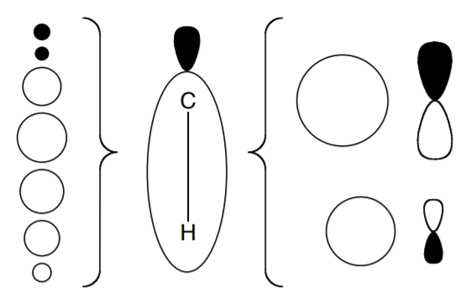

Basis Functions
Collection of one-electron functions through which we can expand the molecular orbitals of a system
Three properties
Can be systematically extended to the CBS limit
Rapid convergence for any electronic state
Easy to evaluate molecular integrals
$φ_{p}$ $\left(r\right)$ $=\sum_{μ}{c_{μp}χ_{μ}}$ $\left(r\right)$

Slide 4
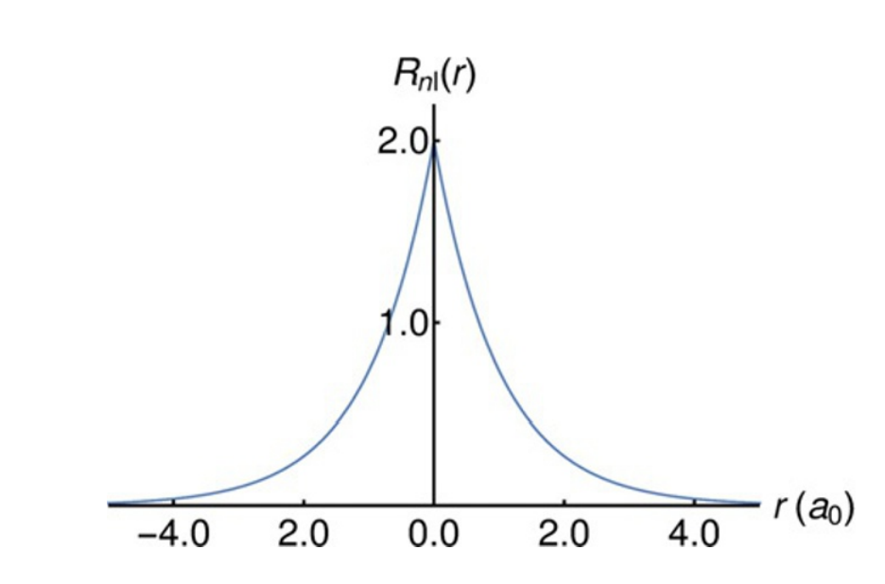
Slater-Type Orbitals
$χ_{abc}^{STO}$ $\left(x,y,z\right)$ $=$ $N x^{a}y^{b}z^{c} e^{−ζr}$
Pros
Satisfies the nuclear cusp conditions
Decays exponentially away from the nucleus
Can form a minimal basis
Cannot do 2-electron integrals analytically!

Slide 5
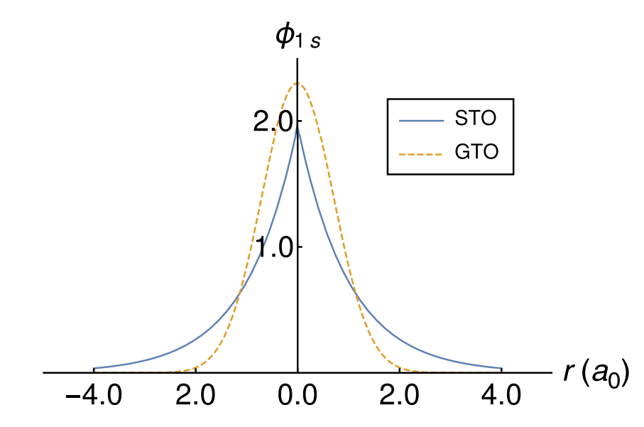
Gaussian-Type Orbitals
$χ_{abc}^{GTO}$ $\left(x,y,z \right)$ $=$ $N x^{a}y^{b}z^{c} e^{−ζr^{2}}$
Pros
Decays exponentially away from the nucleus
Much more computationally tractable!
Cons
Slow convergence due to the number of functions needed to represent the nuclear cusp

Slide 6
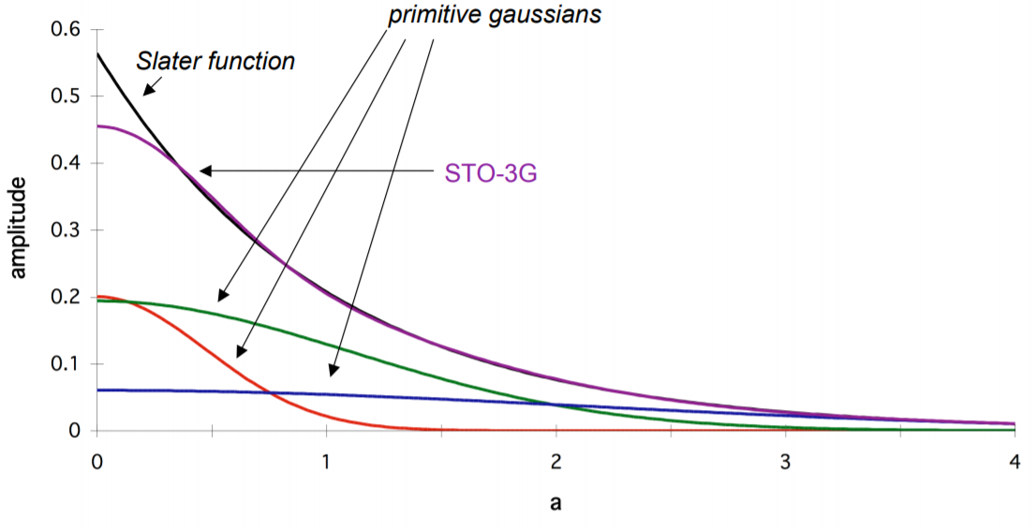


Molecular Orbitals
Linear combination of contracted GTOs
Contracted GTOs are made of a linear combination of what are called primitive GTOs
Primitive GTOs have fixed coefficients and exponents
$χ_{μ}\left(r\right)$ $=\sum_{i}{d_{iμ} χ_{i}^{GTO}}$ $\left(r\right)$
$φ_{p}$ $\left(r\right)$ $=\sum_{μ}{c_{μp}χ_{μ}}$ $\left(r\right)$

Slide 7
Minimal Basis Set
One function for each inner- and valence- shell AO of each atom
Ex) STO-3G

Slide 8
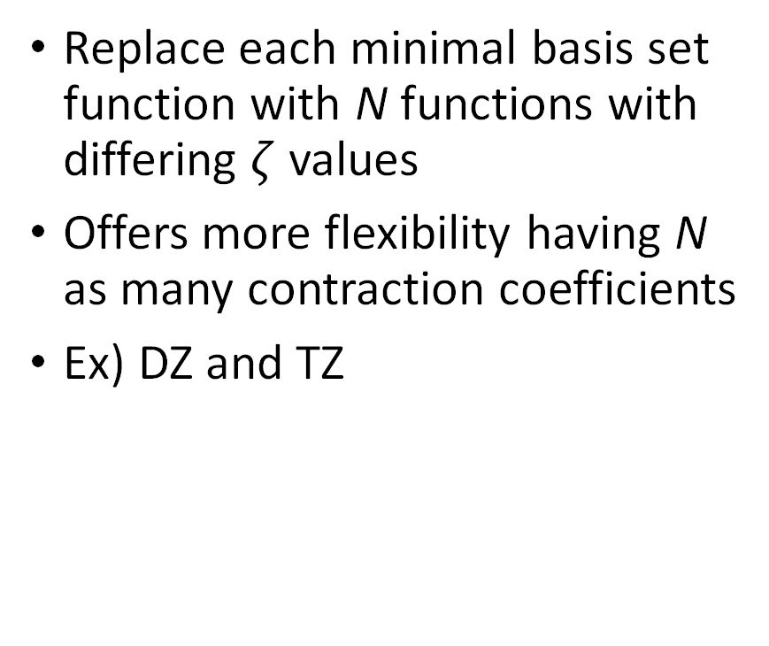
N-Zeta Basis Set
Replace each minimal basis set function with N functions with differing $ζ$ values
Offers more flexibility having N as many contraction coefficients
Ex) DZ and TZ

Slide 9
Split-Valence Basis Set
Uses two or more functions for each valence AO
Keeps only one functions on each core AO
Ex) Ahlrichs (SV, TZV, …),
Karlsruhe (def2-…), and
Pople (6-31G, 3-21G, …)

Slide 10
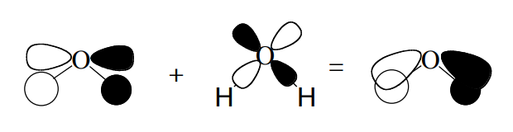
Polarization
Adds functions whose ang. mom. are greater than the ang. mom. of the ground state atom
Uncontracted GTO
Can better describe electron distribution

Slide 11
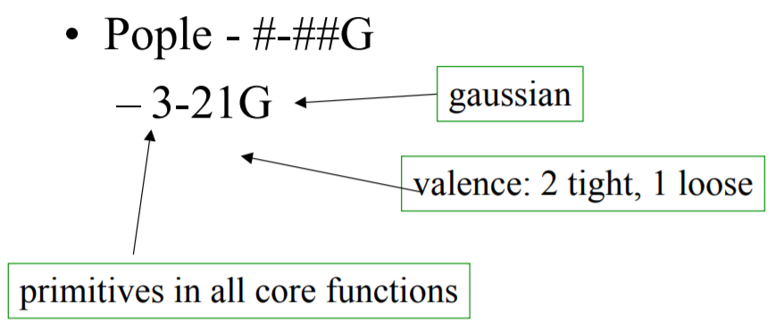
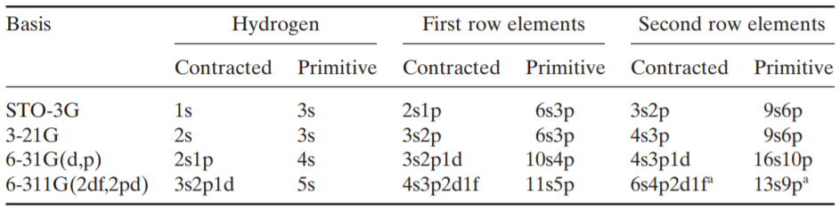
Pople's Basis Sets
Popular split valence basis sets
Polarization is expressed with terms in parentheses or stars (*)

Slide 12
Dunning's Basis Sets
Dunning pointed out basis sets optimized at the HF level may not be ideal for correlated computations
Each step up (X) increases each type of basis function by one and adds a new type of higher-order polarization function
Specifically designed to converge smoothly
Second-row atoms Al – Ar need to use the “alternative” cc-pV(X+d)Z basis
Augments the (1d) and (2d) sets with a high-exponent function and by replacing the (3d) set by the (4d) set and the (4d) set by the (5d) set and so on

Slide 13
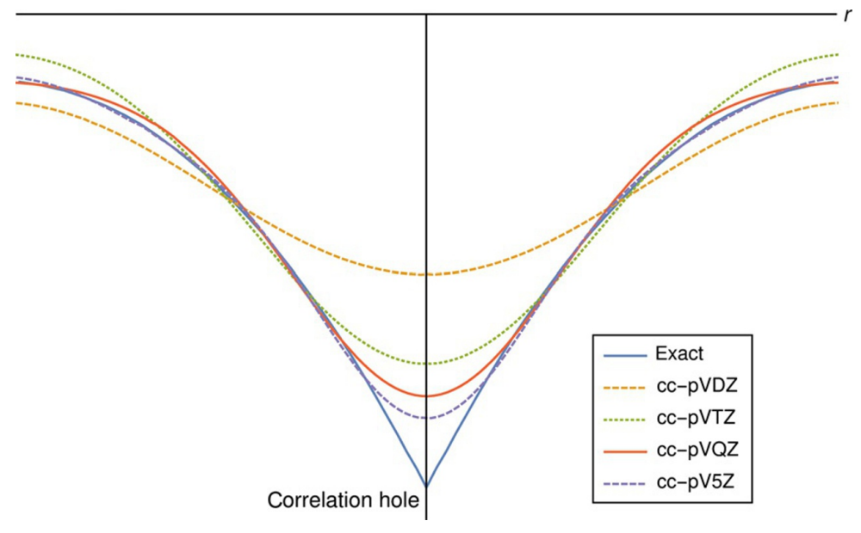
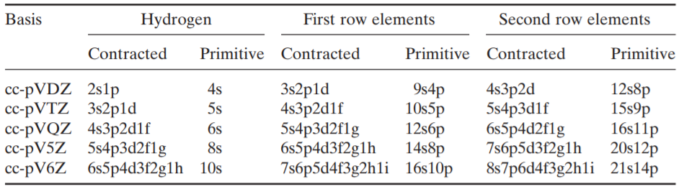
Systematic Convergence

Slide 14
Diffuse Functions
Have small exponents that represent an electron far away from the nucleus
Uncontracted GTO
Necessary for
Anions
Excited states
Rydberg states
Polarizabilities
Binding energies of van der Waals complexes
Ex) aug-cc-pVTZ, 6-31++G

Slide 15
Truhlar’s Calendar Basis Sets
Diffuse functions add to the computational complexity of the problem, so it is best to use minimal augmentation when possible
Systematically deletes diffuse functions
jul- removes all diffuse functions on H and He
jun- removes the highest ang. mom. subshell on all atoms
may- removes the two highest ang. mom. subshells on all atoms
apr- removes the three highest ang. mom. subshells on all atoms

Slide 16
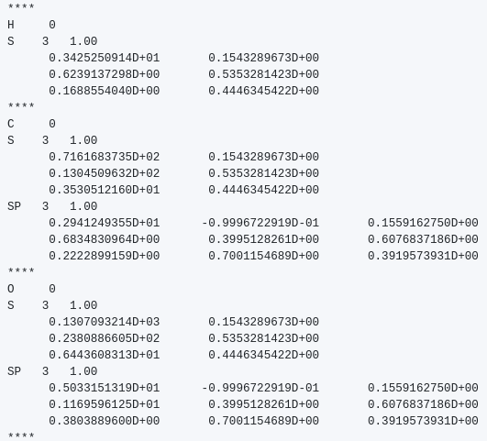
Basis Function Files
Different format for different programs
Contain the exponents and coefficients of the primitive GTOs
Most are on Basis Set Exchange
https://www.basissetexchange.org/
Others have to be made from the source paper

Slide 17
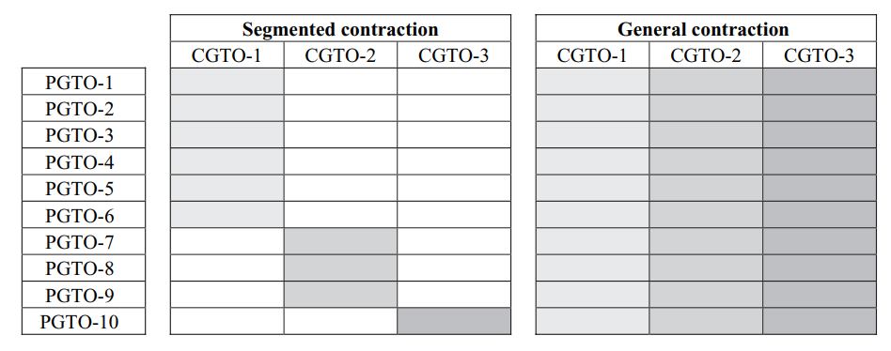
Other Basis Set Things
Contraction Schemes
Segmented vs. general
Various other families of basis sets
Ex) ANO, pc-n, ...
Relativistic effects
Core-valence basis sets
Ex) cc-pCVTZ, cc-pwCVTZ
Effective-core potentials (ECPs)
Aka psuedopotentials
Ex) Stuttgart-Dresden
Basis Set Superposition Error
Counterpoise Correction

Slide 18
The End
Friday 6/17: Hartree-Fock Theory with Stephen
Resources:
Molecular Electronic Structure Theory, Ch. 6 - 9
Introduction to Computational Chemistry, Ch. 5
Essentials of Computational Chemistry, Ch. 6
Mathematical Physics in Theoretical Chemistry, Ch. 2
Jensen, F. Atomic orbital basis sets. Wiley Interdisciplinary Reviews: Computational Molecular Science 2013, 3(3), 273–295.
CHEM 8950 Notes on CCQC github
Etc.

