Slide 1
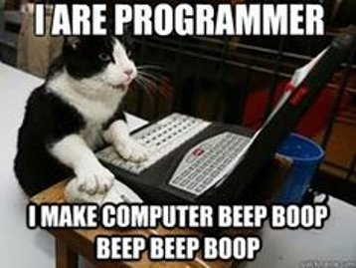
Python3: The Basics
6/11/2021

Slide 2

How to Think Like a Computer Scientist
Maintainability
Dependability
Efficiency
Usability

Slide 3
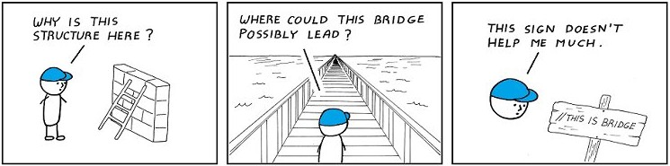
Best Practices
Know what the code block must perform.
Maintain naming conventions which are uniform throughout.
Indicate a brief description of what a variable is for (commenting).
Correct errors as they occur.
Keep your code simple.
Design code with scalability and reuse in mind.

Slide 4

Breaking a Big Task into Small Tasks
Algorithm: Brush Teeth
Grab toothbrush
Open toothpaste
Put toothpaste on toothbrush
Close toothpaste
Brush top teeth
Brush bottom teeth
Continue brushing for 2 min
Rinse toothbrush
Put toothbrush away

Slide 5
Data Types
int
float
complex
str
list
tuple
dict
bool
None
5
15.32
3.5500j
"Hello world"
["apple", 55, ["orange", 3]]
("O", 0.000, 0.000, 0.000)
{"location": "CCQC", "month": "June"}
True
None

Slide 6
Variables
x = 5
print(x)
a = x
print(a)
x = 7
print(x)
print(a)
5
5
7
5

Slide 7
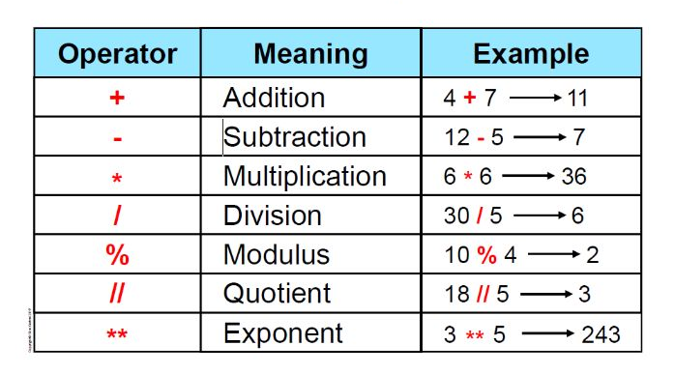
Operators and Operands
Addition ( + )
Subtraction ( - )
Multiplication ( * )
Division ( / )
Integer Division ( // )
Remainder or Modulus ( % )
Exponents ( ** )

Slide 8

Functions
Always start by defining the function with a straightforward name
Consider what parameters are necessary for the function
All variables within a function are local
Not all functions return values
def distance(x1, y1, x2, y2): dx = x2 - x1 dy = y2 - y1 dsquared = dx*dx + dy*dy result = dsquared ** 0.5 return result

Slide 9
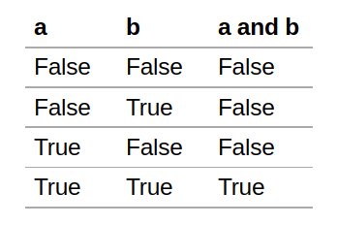
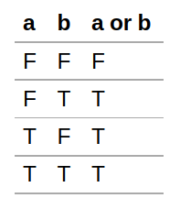
Booleans
Comparison Operators
Equal ( == )
Not equal ( != )
Greater than ( > )
Less than ( < )
Greater than or equal to ( >= )
Less than or equal to ( <= )
Logical Operators
and
or
not

Slide 10
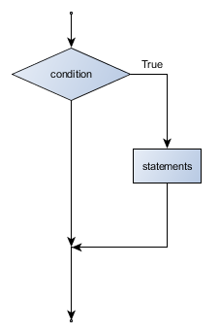
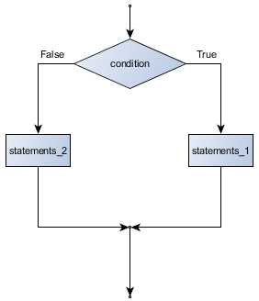
Conditionals
if x < 0:
print("x is less than zero")
print("x is ", x)
if x < 0:
print("x is less than zero")
else:
print("x is greater than or \
equal to zero")

Slide 11
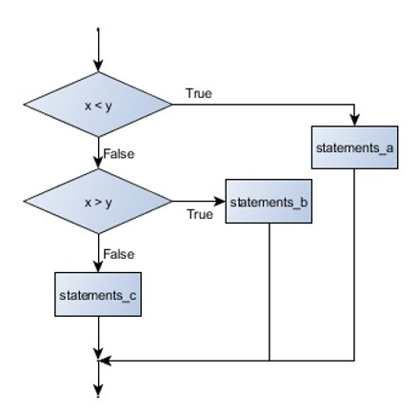
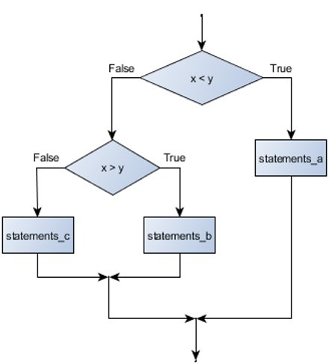
if choice == "a": function_one() elif choice == "b": function_two() elif choice == "c": function_three() else: print("Invalid choice.")
if x < y: STATEMENTS_A else: if x > y: STATEMENTS_B else: STATEMENTS_C

Slide 12
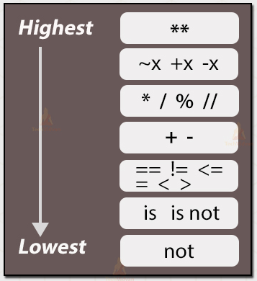
Precedence

Slide 13
Looping
i = 0
while i < 5:
print(i)
i += 1
for i in range(5):
print(i)
0
1
2
3
4

Slide 14
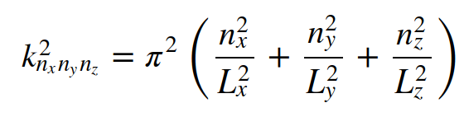
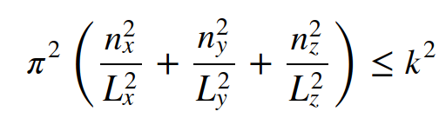
def loop(a,b,c):
triplets = []
k2 = []
nx = 1
nxok = True
while nxok != False:
ny = 1
nyok = True
while nyok != False:
nz = 1
nzok = True
while nzok != False:
k2var = (np.pi ** 2) * ( ((nx ** 2) * (( c / (b ** 2) )**(2/3))) + ((ny ** 2) * (( b / (c ** 2) )**(2/3))) \
+ ((nz ** 2) * ((b * c) ** (2/3))) )
if k2var > (a ** 2): # Condition assuring that kappa^2 is smaller than kappa_max^2
nzok = False
if nz == 1:
nyok = False
if ny == 1:
nxok = False
else:
nx += 1
else:
ny += 1
else:
temp = [nx,ny,nz]
triplets.append(temp)
k2.append(round(k2var,7)) # rounding helps the pairGen routine identify degeneracies
nz += 1
triplets = np.array(triplets)
k2 = np.array(k2)
return [triplets,k2] # List of lists containing 1) nx, ny, and nz values and 2) kappa^2 values

Slide 15
Lists
# Accesses an element of a list
fruits = ["apple", "banana", "orange", "kiwi"]
print(fruits[2])
# Removes element at position given and returns it
item = fruits.pop(1)
print(item)
print(fruits)
# Adds elements to our original list
fruits.insert(1, "cherry")
fruits.append("strawberry")
print(fruits)
# Returns only a section of the list
print(fruits[1:4])
# Concatenates two lists
veggies = ["potato","corn","kale"]
print(fruits + veggies)
orange
banana
["apple", "orange", "kiwi"]
["apple", "cherry", "orange", "kiwi", "strawberry"]
["cherry", "orange", "kiwi"]
["apple", "cherry", "orange", "kiwi", "strawberry",
"potato", "corn", "kale"]

Slide 16
# Aliasing
num1 = [0,1,2,3,4,5]
num2 = num1
num2[0] = 1
print("List 1: ", num1)
print("List 2: ", num2)
# Tuples
month1 = ("Jan", 1, "Feb", 2)
month2 = month1
month2[0] = "Dec"
List 1: [1, 1, 2, 3, 4, 5]
List 2: [1, 1, 2, 3, 4, 5]
Traceback (most recent call last):
File "<stdin>", line 1, in <module>
TypeError: 'tuple' object does not support item assignment

Slide 17
Pass
Pass
Fail
Fail
Fail
0
1
2
3
4
5
6
7
8
5
# For Loops
grades = [99, 98, 87, 82, 90]
for i in grades:
if i >= 93:
print("Pass")
else:
print("Fail")
# List of lists
matrix = [[0,1,2],[3,4,5],[6,7,8]]
for row in matrix:
for element in row:
print(element)
# Accessing elements of a list of lists
print(matrix[1][2])

Slide 18
Dictionaries
car = { "brand": "Ford", "model": "Mustang", "year": 1964 }
# Accessing values of a dictionary
print(car["model"])
# Adding a new key and value pair
car["miles"] = 120000
print(car)
# Overwriting a value
car["miles"] = 125000
print(car)
Mustang
{'brand': 'Ford', 'model': 'Mustang', 'year': 1964, 'miles': 120000}
{'brand': 'Ford', 'model': 'Mustang', 'year': 1964, 'miles': 125000}

Slide 19
Files
# Write a file
f = open("new_file.txt","w")
f.write("Hello World\n")
f.write("What's up?")
f.close()
# Turns each line into a list
f = open("new_file.txt","r")
for i in f.readlines():
print(i)
f.close()
# Make file into list of lists
with open("new_file.txt) as f:
lines = [line.split() for line in f]
print(lines)
Hello World
What's up?
[['Hello', 'World'], ["What's", 'up?']]

Slide 20
Recursion
A function that's defined in terms of itself
Example: Factorials
n! = n * (n-1) * (n-2) * … * 2 * 1
n! = n * (n-1)!
n! = n * (n-1) * (n-2)!
n! = n * (n-1) * (n-2) * (n-3)!
n! = n * (n-1) * (n-2)!
n! = n * (n-1) * (n-2)!
4
3
2
1
24
# Factorial
def factorial(n):
if n == 1:
print(n)
return 1
else:
print(n)
return n * factorial(n-1)
print(factorial(4))
n! = n * (n-1) * (n-2)!

Slide 21
You've made it to the end!
We will work on summer-program Project 2: Hessian next week.
Other ideas for things to learn this summer:
Basis functions to many-electron wave functions
Difference between RHF, ROHF, and UHF
Computer implementation of SCF
Do Project 3: RHF before July 16th

