Slide 1
Density Functional Theory: Friend or Foe?
July 2023
CCQC Summer Program
Erica Mitchell

Slide 2
Outline
Review of Past Topics
WFT and DFT
Hohenberg-Kohn Theorem
Thomas-Fermi(-Dirac) Formalism
Kohn-Sham Formalism
Jacob’s Ladder
LSDA
GGA
Meta-GGA
Hybrid GGA/Meta-GGA
Double Hybrid

Slide 3
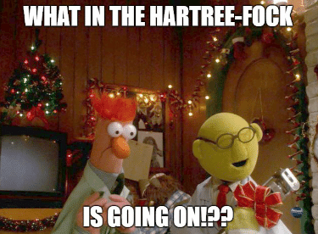
Brief Review

Slide 4
Brief Review
Born-Oppenheimer Approximation (BOA)
Potential Energy Surface (PES)
Basis Sets
Hartree-Fock Theory
Slater Determinants
Variation Theorem
Self-Consistent Field Theory
Correlation Energy

Slide 5
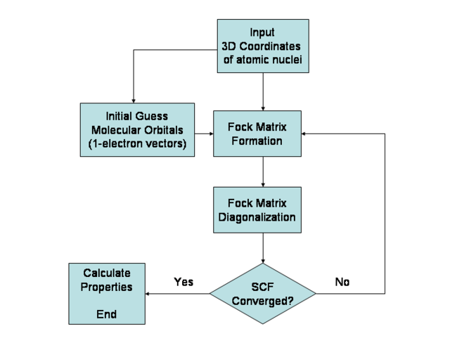

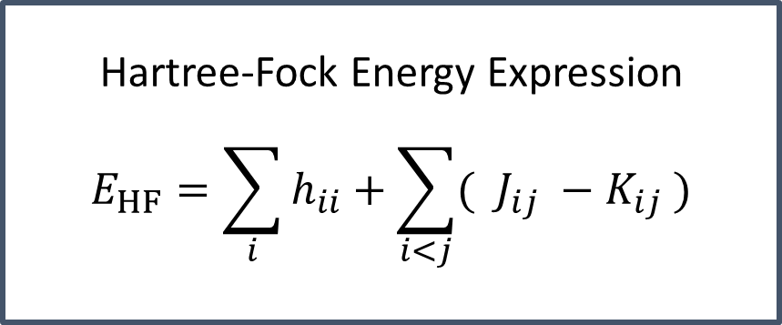
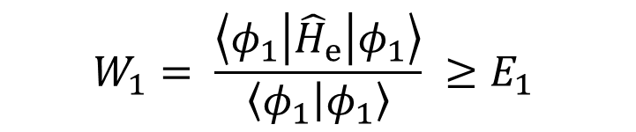
Brief Review: Hartree-Fock Theory
$$W_{1}= \frac{\left\langle φ_{1} | {\hat{H}}_{e} | φ_{1}\right\rangle }{\left\langle φ_{1} | φ_{1}\right\rangle } ≥E_{1}$$
Hartree-Fock Energy Expression
$$E_{HF}=\sum_{i}{h_{ii}}+\sum_{i<j}{( J_{ij} −K_{ij} )}$$
$$E_{correlation}=E_{exact}−E_{HF}$$

Slide 6
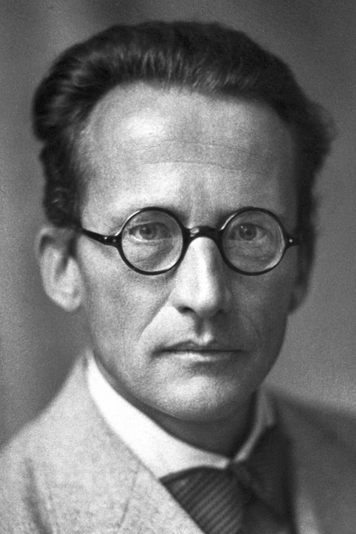

Wave Function Theory (WFT)
Est. 1926
Notes:
Wave function theory was first conceived of by Erwin Schroedinger in 1925 and published in1926. In this formalism, we can view the wave function as an oracle such that, if we ask it questions about a system, it can reveal to us all information about said system. Overall, in wave function theory we state that the wave function contains all information about the electronic structure of atoms and molecules.

Slide 7
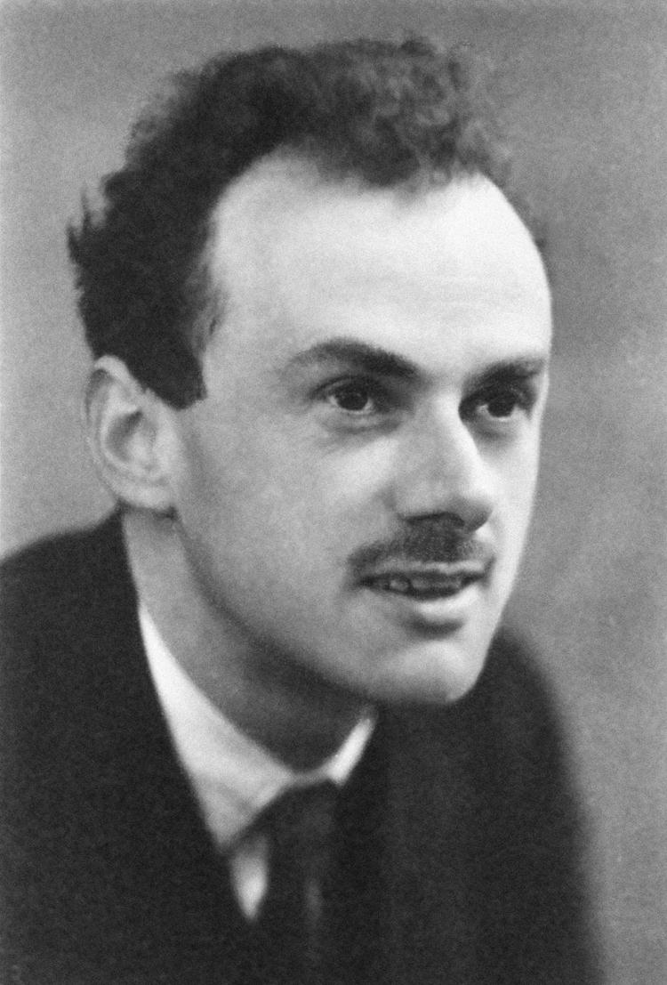
Wave Function Theory (WFT)
Notes:
Because the wave function contains all information about the electronic structure, in oral tradition, it is said that after the wide success of wave function theory for two electron systems, Paul Dirac declared that “chemistry has come to an end”. Sadly, wave function theory was less successfully applied to larger systems, so maybe chemistry is still open which is good for us.

Slide 8
A wave function contains all the information of the electronic structure of atoms an molecules.
But…
Notes:
Focusing on the wave function, we’ve stated now multiple times, “the wave function contains all the information of the electronic structure of atoms and molecules.” But, what actually is a wave function?

Slide 9
A wave function contains all the information of the electronic structure of atoms an molecules.
What really is a wave function?
Notes:
The meaning of the wave function has been debated over the years, but many find solace with Born’s interpretation where the square of the absolute value of the amplitude of the wave function is the probability density. Thinking about quantum mechanics though, we assign all our operators to a physical observable; something more tangible than the complex, multidimensional wave function.

Slide 10
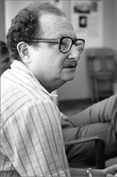
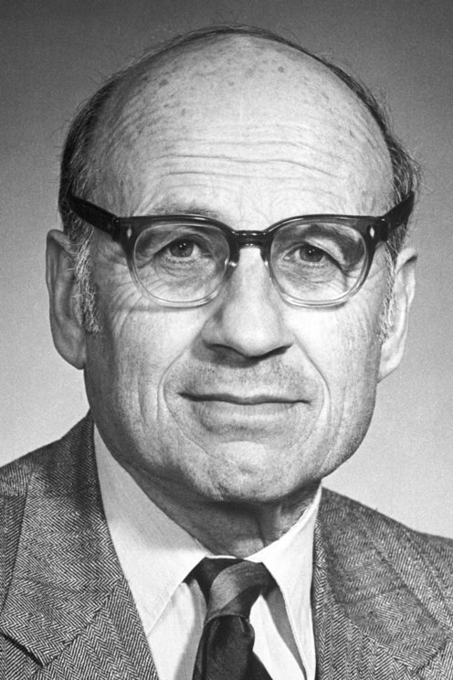
Density Functional Theory (DFT)
All of the information for an atom or molecule is contained in its electron density.
Notes:
From past work, Hohenberg and Kohn then put forth that instead of all the electronic structure information being contained in some 3N variable wave function, all the information is contained in the electron density, which is only 3 variables.

Slide 11
Hohenberg-Kohn Theorems

Slide 12
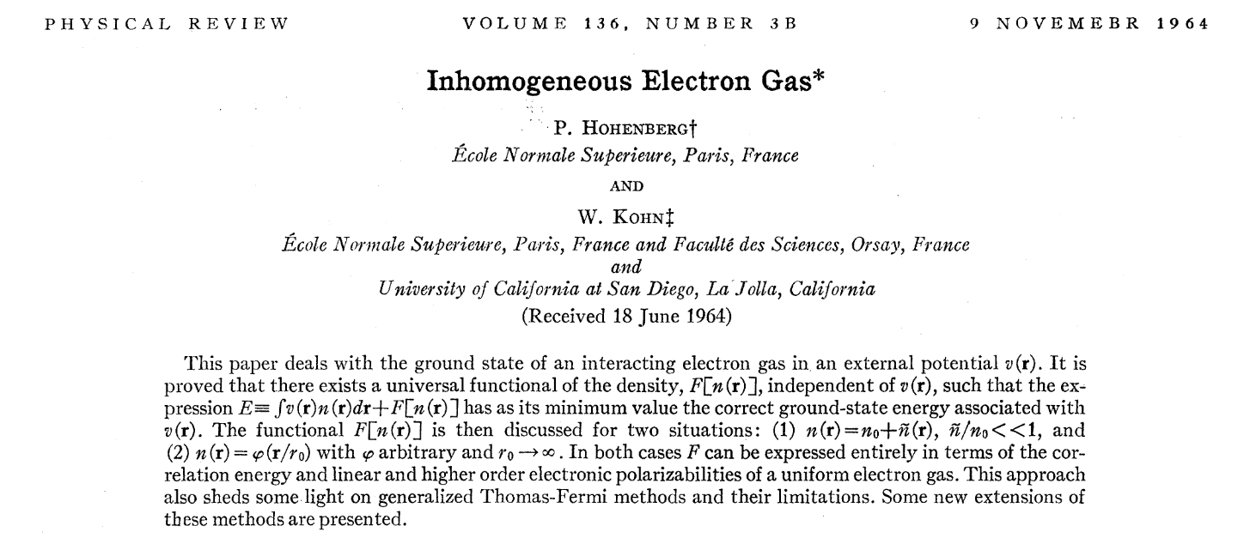
Notes:
Modern DFT was founded in 1964 with the seminal paper by Hohenberg and Kohn titled an “Inhomogenous Electron Gas.” In this paper, they prove the existence of two theorems.

Slide 13
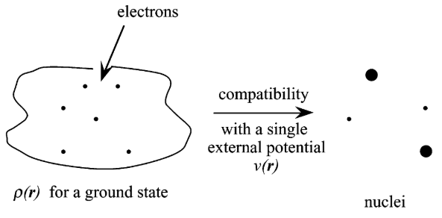

Theorem 1
The ground-state electron density, $ρ(r)$, uniquely determines the external potential, $v_{ext}(r)$.
Notes:
The first theorem states that the ground-state electron density, $ρ(r)$, uniquely determines the external potential, $v_{ext}(r)$. To better understand this concept, Geerlings and coworkers give a quick thought experiment. “Suppose one gives to an observer a visualization of the function $ρ\left(r\right)$, telling them that this function corresponds to the ground-state electron density of an atom or a molecule. The first HK theorem then states that this function corresponds to a unique number of electrons N and constellation of nuclei.”

Slide 14
Theorem 1
$$F_{HK}\left[ρ\left(r\right)\right]=T\left[ρ\left(r\right)\right]+V_{ee}\left[ρ\left(r\right)\right]$$
There exists a universal functional that is independent of the external potential.
Proof by contradiction or reductio ad absurdum
It’s universal because it is the same for all electronic structure problems
Notes:
Furthermore, in their proof by contradiction or reductio ad absurdum, Hohenberg and Kohn show that there exists a universal functional independent of the external potential, the electrostatic field of the nuclei. This universal functional, also called the Hohenberg-Kohn functional, is “universal” due to its independence from the external potential. The problem with this functional is that Hohenberg and Kohn only proved that it can and does exist, we don’t actually know the form of it! It is stated by Schuch and Verstraete that “it is among the hardest problems in the complexity class Quantum Merlin Arthur”, which means that even quantum computers would struggle in solving this problem.

Slide 15
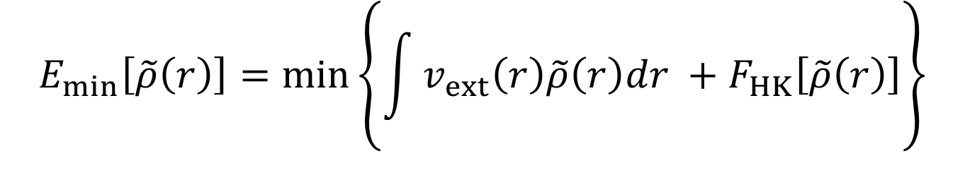
Theorem 2
The ground-state electron density can be used to attain the minimum energy by variationally solving the universal functional.
$$E_{min}\left[\tilde{ρ}\left(r\right)\right]=min\left\{\int{v_{ext}\left(r\right)\tilde{ρ}\left(r\right)dr} +F_{HK}\left[\tilde{ρ}\left(r\right)\right]\right\}$$
Notes:
The second Hohenberg-Kohn theorem uses the variation principle, like in Hartree-Fock, to show that if we start with some trial density, then we can minimize the energy such that it is greater than or equal to the energy as if we had the exact density. In more formal terms, we state the ground-state electron density can be used to attain the minimum energy by variationally solving the universal functional.

Slide 16
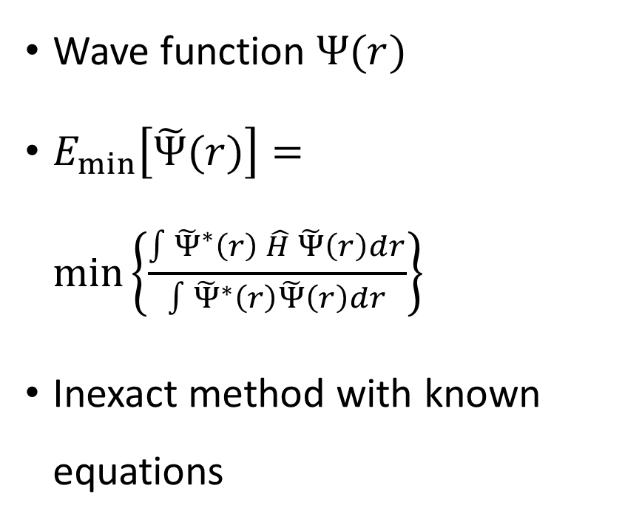
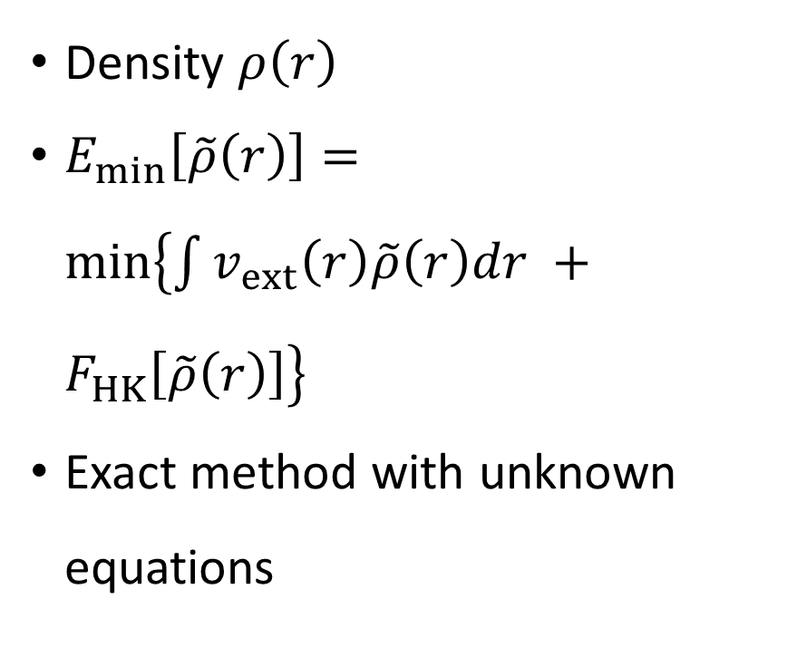
WFT
DFT
Wave function $Ψ(r)$
$E_{min}\left[\tilde{Ψ}(r)\right]=min\left\{\frac{\int{{\tilde{Ψ}}^{∗}\left(r\right) \hat{H} \tilde{Ψ}\left(r\right)dr}}{\int{{\tilde{Ψ}}^{∗}\left(r\right)\tilde{Ψ}\left(r\right)dr}}\right\}$
Inexact method with known equations
Density $ρ\left(r\right)$
$E_{min}\left[\tilde{ρ}\left(r\right)\right]=min\left\{\int{v_{ext}\left(r\right)\tilde{ρ}\left(r\right)dr} +F_{HK}\left[\tilde{ρ}\left(r\right)\right]\right\}$
Exact method with unknown equations
Notes:
To bring us back to something more familiar, let’s look at the differences between wave function theory and DFT. In wave function theory, we obviously use wave functions while in DFT we obviously use the electron density. In both, we rely on the variation principle to obtain the minimum energy given a trial function to approximate our exact one. The differences manifest that wave function theory is an inexact theory while DFT is a formally exact theory. In wave function theory we start with assuming no correlation and then work to recover this correlation energy through different approximations such as coupled cluster. The exact result in wave function theory is then the full configuration interaction (FCI) limit which is unattainable for almost all systems but does exist. In density functional theory, correlation is included in the energy through the universal functional, but we do not know the exact form of this functional. We then use various approximations to determine this functional.
To further push this, in wave function theory, we have an inexact theory with known equations while in DFT, we have an exact theory with unknown equations.

Slide 17
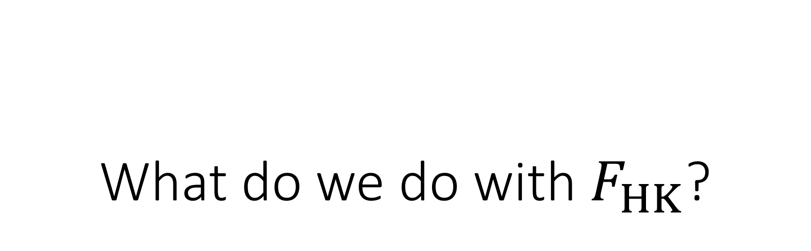
What do we do with $F_{HK}$?

Slide 18
A Throwback to 1927: Thomas-Fermi Formalism
Notes:
Before we discuss exactly how modern DFT dealt with the elusive universal functional, it is of use to look back at the beginnings of density functional theory.

Slide 19
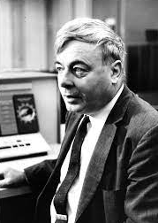
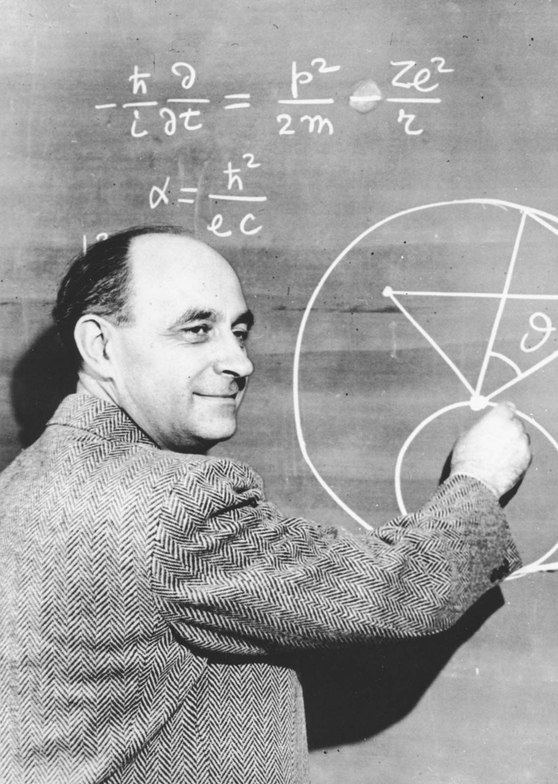
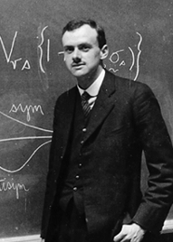
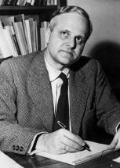
Thomas, Fermi, Dirac, and von Weizsäcker… oh my!
Notes:
There were four key figures in early DFT: Thomas, Fermi, Dirac, and von Weizsacker.

Slide 20

TF Theory
$$E_{TF}\left[ρ\left(r\right)\right]=T_{TF}\left[ρ\left(r\right)\right]+E_{ne}\left[ρ\left(r\right)\right]+J\left[ρ\left(r\right)\right]$$
Discarded for modern quantum chemistry because all molecules dissociate
Used statistical theory to approximate the energy in terms of the density
Forerunner to modern DFT
Notes:
Thomas-Fermi theory was conceived in 1927, but a major problem prevented it from use in modern quantum chemistry, namely it predicted that all molecules dissociate to their constituent atoms! Yet, there is still much we can garner from these early beginnings. In this theory, Thomas and Fermi show the energy as a functional of the electron density but never formalized why this is valid. Despite that, they split the energy into kinetic, nuclear-electron attraction, and Coulombic energies and then used statistical mechanics to derive the kinetic energy assuming a uniform electron gas.

Slide 21
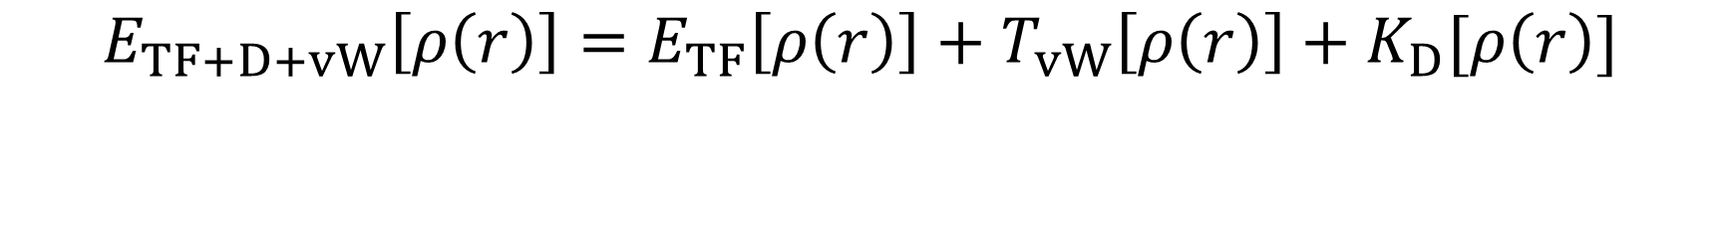
Thomas, Fermi, Dirac, and von Weizsäcker
$$E_{TF+D+vW}\left[ρ\left(r\right)\right]=E_{TF}\left[ρ\left(r\right)\right]+T_{vW}\left[ρ\left(r\right)\right]+K_{D}[ρ\left(r\right)]$$
In 1930, Dirac added a term to describe exchange energy
In 1935, von Weizsäcker added a correction for the kinetic energy of the electrons
Corrections still do not predict bonding in the TF model!
Notes:
With their pioneering work to define the energy as a functional of the density, others joined to help improve the equations. In 1930, Dirac introduced a term for the exchange energy also based off statistical theory for a uniform electron gas. The still poor performance of Thomas-Fermi-Dirac theory prompted von Weizsäcker to include a correction for the kinetic energy from a Taylor expansion of the kinetic energy. This improved TFD theory in that it now predicted bonding, but it still was unable to compete with wave function theory due to its large errors.

Slide 22
How can we better approximate the kinetic energy?
Notes:
The largest major problem in TFD theory lies in its treatment of the kinetic energy. So, how can we better approximate the kinetic energy?

Slide 23
Fast-forward to 1965: Kohn-Sham Formalism
Notes:
To answer our two questions: 1) what do we do we with the universal functional and 2) how can we better approximate the kinetic energy? We turn to Kohn-Sham formalism which takes generous cues from Hartree-Fock theory.

Slide 24
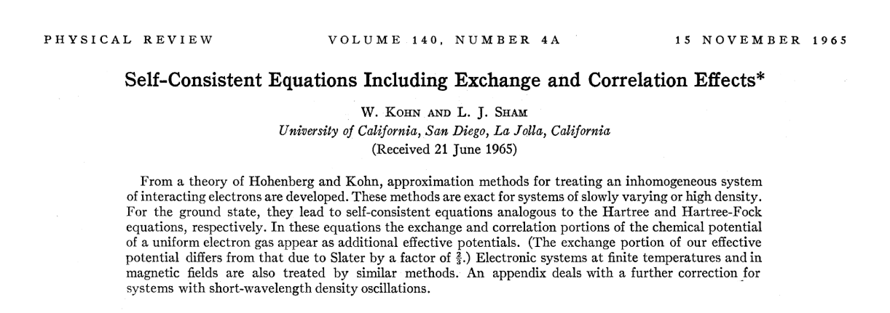
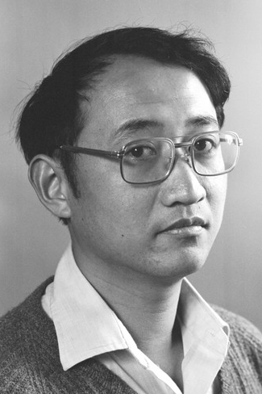
Notes:
In 1965, Kohn and Sham created the base of what we commonly think of when we say “DFT”. To be precise in this talk, we’ll keep the general theory of density functional theory as “DFT” and refer to the Kohn-Sham formalism as “KS-DFT”.

Slide 25
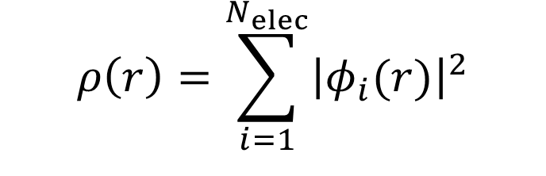
KS-DFT
$$E_{KS−DFT}=T_{S}\left[ρ\left(r\right)\right]+E_{ne}\left[ρ\left(r\right)\right]+J\left[ρ\left(r\right)\right]+E_{xc}\left[ρ\left(r\right)\right]$$
Assume a fictitious non-interacting system has the same electron density as the interacting one
Use a single Slater determinant to describe the non-interacting system
$$ρ\left(r\right)=\sum_{i=1}^{N_{elec}}{{\left|φ_{i}(r)\right|}^{2}}$$
Notes:
KS-DFT breaks the energy into components like TFD theory but treats the kinetic energy exactly by assuming a non-interacting system. This fictious non-interacting system is assumed to have the same electron density as the interacting one. To describe this fictious system, the density is can be written using the one-electron orbitals of single Slater determinant wave function. To be very plain, the energy of KS-DFT is the sum of the kinetic energy of the non-interacting system, the nuclear-electron attraction, the classical Coulombic energy, and what we call the exchange-correlation energy where each component depends upon the electron density formed from a single Slater determinant. The first three terms are all solvable. The only unknown is this exchange-correlation energy.

Slide 26
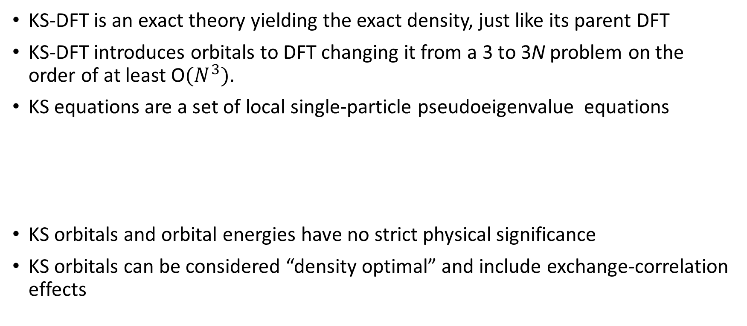
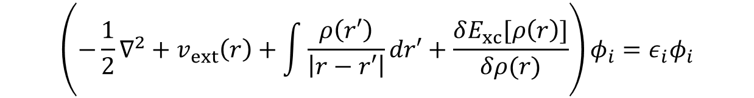
Some notes on KS-DFT…
KS-DFT is an exact theory yielding the exact density, just like its parent DFT
KS-DFT introduces orbitals to DFT changing it from a 3 to 3N problem on the order of at least O$(N^{3})$.
KS equations are a set of local single-particle pseudoeigenvalue equations
KS orbitals and orbital energies have no strict physical significance
KS orbitals can be considered “density optimal” and include exchange-correlation effects
$$\left(−\frac{1}{2}∇^{2}+v_{ext}\left(r\right)+\int{\frac{ρ\left(r′\right)}{\left|r−r′\right|}dr′}+\frac{δE_{xc}[ρ\left(r\right)]}{δρ(r)}\right)φ_{i}=ε_{i}φ_{i}$$
Notes:
Before discussing the exchange-correlation functional, some notes on KS-DFT. First and foremost, KS-DFT is an exact theory just like its parent DFT, but it introduces orbitals to the picture to better approximate the kinetic energy in an SCF way. With the introduction of orbitals, we change from a 3-variable problem to a 3N-variable problem where we have N coupled 3-dimensional equations for N spin-orbitals scaling on the order of at least O$(N^{3})$. These equations are the Kohn-Sham equations, and they are meant to be solved self-consistently just like in Hartree-Fock theory. In other similarities to Hartree-Fock, the Kohn-Sham equations are a set of local single-particle pseudoeigenvalue equations. The orbitals and orbital energies obtained from solving the Kohn-Sham equations have no strict physical significance but are still of value even more so than Hartree-Fock energies and wave functions due to their inclusion of correlation effects.

Slide 27

KS Equations and the Total Energy
$$E_{KS−DFT}=\sum_{i=1}^{N_{elec}}{ε_{i}}−J\left[ρ\left(r\right)\right]+E_{xc}\left[ρ\left(r\right)\right]−\int{\frac{δE_{xc}\left[ρ\left(r\right)\right]}{δρ\left(r\right)}}ρ\left(r\right)dr$$
The effective potential in the KS equations will reproduce the exact density
SCF procedure determines the orbital coefficients
Essentially replacing the Fock operator in HF theory
Notes:
The total KS-DFT energy written in terms of orbital energies is then given as… This is equivalent to the KS-DFT energy expression from earlier. The orbital energies and the density are the optimized parameters in the SCF procedure. Implementation-wise KS-DFT gained popularity because of its relation to Hartree-Fock which made it easy to modify existing code to complement KS-DFT.

Slide 28
Exchange-Correlation Functional
$$E_{xc}\left[ρ\left(r\right)\right]=\left(T\left[ρ\left(r\right)\right]−T_{s\left[ρ\left(r\right)\right]}\right)+\left(E_{ee}\left[ρ\left(r\right)\right]−J\left[ρ\left(r\right)\right]\right)$$
Includes:
Quantum mechanical exchange and correlation effects
Correction for self-interaction energy
Difference between kinetic energy of interacting and non-interacting system
Notes:
Now, we’re back to the exchange-correlation functional. The exchange-correlation functional is the only unknown in the KS-DFT energy. Despite being unknown we assert that it includes quantum mechanical exchange and correlation effects, correction for self-interaction energy, and the difference between the kinetic energy of the interacting system and our fictious non-interacting system. The self-interaction error is intrinsic only to KS-DFT and not to HF due to error cancellation. It can be defined as the error due to the classical interaction of an electron with the entire electron density, although part of that density is its own.

Slide 29
What is the form of the exchange-correlation functional?
Notes:
So, with what information we do have about the exchange-correlation functional, there still remains a problem. What is the form of the exchange-correlation functional?

Slide 30


We don’t know!
Notes:
We don’t know!

Slide 31
Approximate Functionals
Notes:
The unknown form for the exchange-correlation functional leads to great misunderstandings of DFT as a theory and presents a great challenge for researchers in KS-DFT. Before moving on, let’s address the great misunderstanding. KS-DFT is a formally exact theory, any “failings of the theory” are not coming from the theory but rather shortcomings of our approximations to the form of the exchange-correlation functional. The use of approximate functionals does not mean KS-DFT is not worth our time and consideration; we still invest much time in wave function theory despite truncation of our chosen wave function ansatz. It does mean that one must be very judicious and careful in the choice of approximate functional since results heavily depend on this functional’s ability to describe the system of interest. Think of it like picking a basis set, we want to choose an approximate functional that balances describing our system well and computational cost.

Slide 32
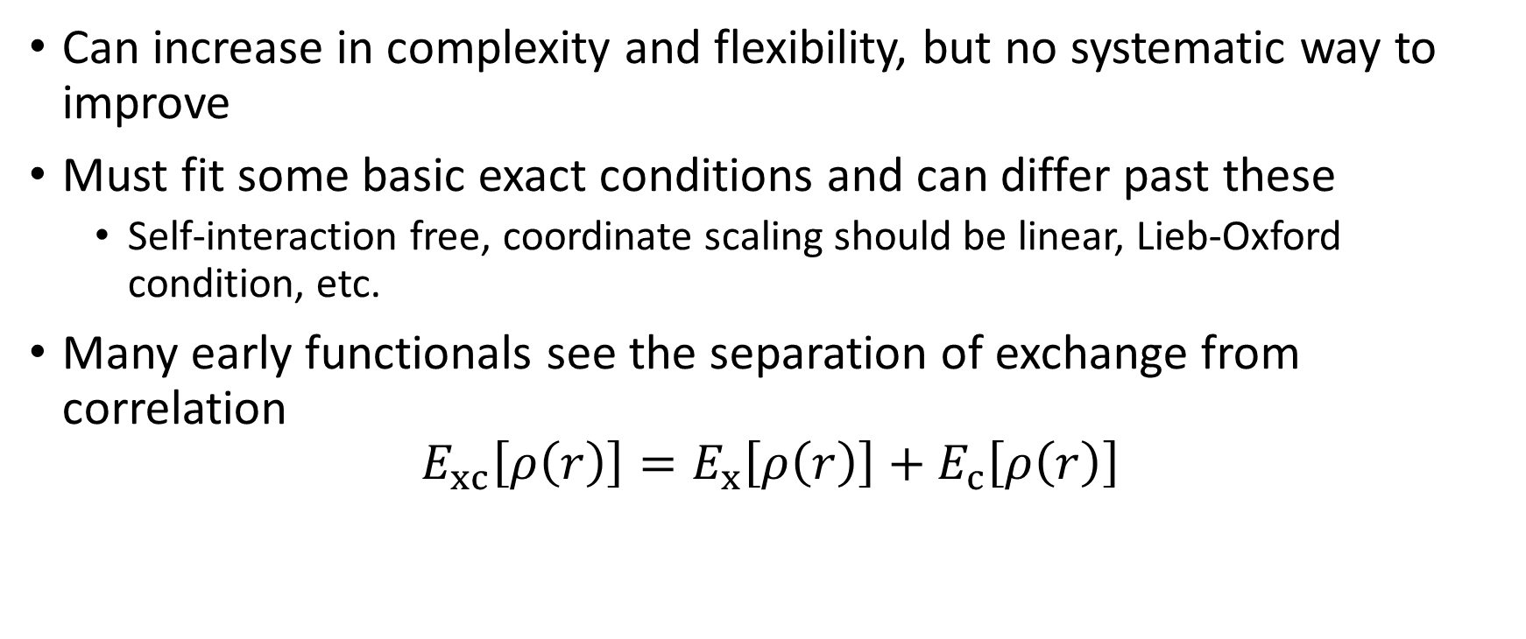
Notes
Can increase in complexity and flexibility, but no systematic way to improve
Must fit some basic exact conditions and can differ past these
Self-interaction free, coordinate scaling should be linear, Lieb-Oxford condition, etc.
Many early functionals see the separation of exchange from correlation
$$E_{xc}\left[ρ\left(r\right)\right]=E_{x}\left[ρ\left(r\right)\right]+E_{c}\left[ρ\left(r\right)\right]$$
Notes:
Some basic things to understand about approximate functionals, which I’ll just call functionals moving forward, is that although we often observe a more complex and flexible functional will perform better than a more rigid one, there is no way to systematically improve our functional. Unlike in wave function methods like coupled cluster or configuration interaction, we do not know how to arrive at approximations which are closer to the exact functional since it is for the most part unknown. We can and typically do impose some exact conditions which must be fulfilled by the functional such as it should be self-interaction free, it should scale linearly with its coordinates, it should fulfill the Lieb-Oxford condition which imposes a lower bound for the exchange-correlation energy, and many others. The difficulty in designing new functionals lies in the fact that although certain exact conditions may be met, this does not mean it will perform better or worse than other functionals with different exact conditions.
Furthermore, many early functionals separate the exchange energy from the correlation energy following the idea of the exchange and correlation holes, which will not be discussed in depth. The definitions of the exchange and correlation energies differ from that of wave function theory such that the exchange energy in KS-DFT is the exchange energy of the Slater determinant of the KS orbitals and the correlation energy is everything else. It is common to see in early functionals a splitting of the exchange energy from the correlation energy regardless of whether they are separable or not.

Slide 33
Semi-empirical
“Non-empirical”
Empirical parameters introduce some kinetic energy correction based on experiment
Early parameterization used atomization energies
Ex) G2/97 benchmark of Pople and coworkers used experiments with better than 1 kcal mol⁻¹ precision
Uses selected mathematical constraints
Ex) Uniform electron gas
Many functionals today do not design functionals using experimental data but rather use exact conditions
Ex) Cusp conditions
Notes:
To speak more on functionals and their design, we have all heard about the parameterization KS-DFT utilizes to design new functionals. But we’ve never really clarified what this parameterization is. Many early functionals actually used experimental data to introduce empirical parameters to their functional. A common experimental result used was atomization energies. These experiments were trusted to be within a precision of better than 1 kcal mol⁻¹. Today, not many functionals use actual experimental data to parameterize their functional. Instead, they use exact conditions where they will mathematically form their functional to fit a certain boundary condition. An old example is the use of the uniform electron gas where researchers would then ensure that their functional would be exact for a uniform electron gas and set their parameters accordingly. Exact conditions provide a more “non-empirical” approach to the design of functionals but again, this does not mean it will perform better or worse than other functionals with different exact conditions.

Slide 34
Ranking Approx. Functionals: Jacob’s Ladder
Notes:
Now, that we’ve covered the general idea of functionals. We can move into ranking them. So, due to the low computational cost and good results gained repeatedly with KS-DFT, a tremendous number of functionals entered the field and are still entering the field today. In an effort to rank these, Perdew and Schmidt created a ranking system, which they called Jacob’s ladder.

Slide 35
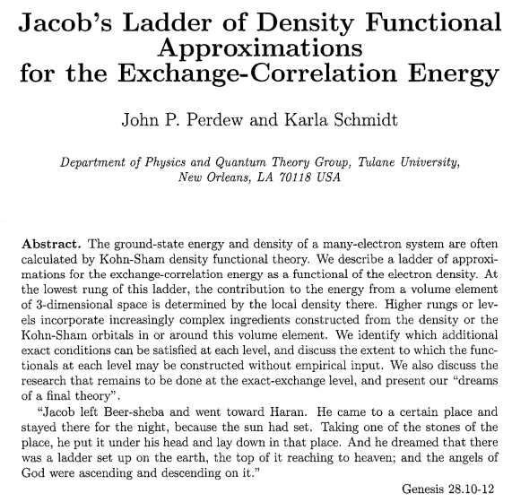
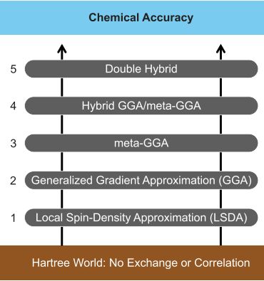
Notes:
Jacob’s ladder ranks the DFT functionals based somewhat on the complexity of the functionals. So, the lowest rung uses very simple approximations and is much less flexible than those higher on the ladder. They also identify which exact conditions can be satisfied at each rung.

Slide 36

Notes:
This was shown at MQM by one pioneer of DFT, Kieron Burke. As we’ll state again, although we have this ladder, this does not mean that lower rung functionals will necessarily provide worse results than higher rung results. The effectiveness and reliability of a functional still needs to be rigorously benchmarked and tested for a wide a variety of databases to determine which systems it will work best for.

Slide 37
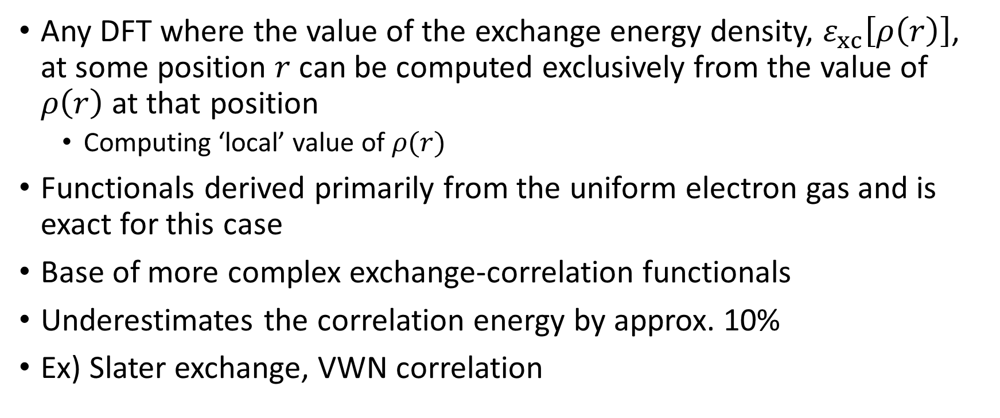
Local Density Approx. (LDA)
Any DFT where the value of the exchange energy density, $ε_{xc}\left[ρ\left(r\right)\right]$, at some position $r$ can be computed exclusively from the value of $ρ\left(r\right)$ at that position
Computing ‘local’ value of $ρ(r)$
Functionals derived primarily from the uniform electron gas and is exact for this case
Base of more complex exchange-correlation functionals
Underestimates the correlation energy by approx. 10%
Ex) Slater exchange, VWN correlation
Notes:
The local spin density approximation separates the spin densities into “up” and “down” or “alpha” and “beta” spins. It is size consistent and exact for the case of an infinite uniform electron gas. Perdew and Schmidt call it the “mother of all approximations” as it is the base of the higher rungs on Jacob’s ladder. Local density approximation typically is observed to overbind for diatomics and is expected to underestimate the correlation energy by about 10%. It is rarely used in quantum chemistry today but the Slater exchange functional and VWN correlation functional were great bases for future density functional approximations.

Slide 38
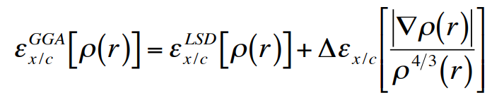
Generalized Gradient Approx. (GGA)
Includes the gradients of the spin densities
Electron density is not spatially uniform
Does not have to parameterize to experiment
Taylor expansion is used to justify importance of the gradient
Ex) PBE exchange, B88 exchange, LYP correlation, P86 correlation

Slide 39
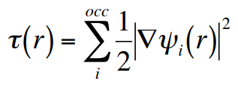
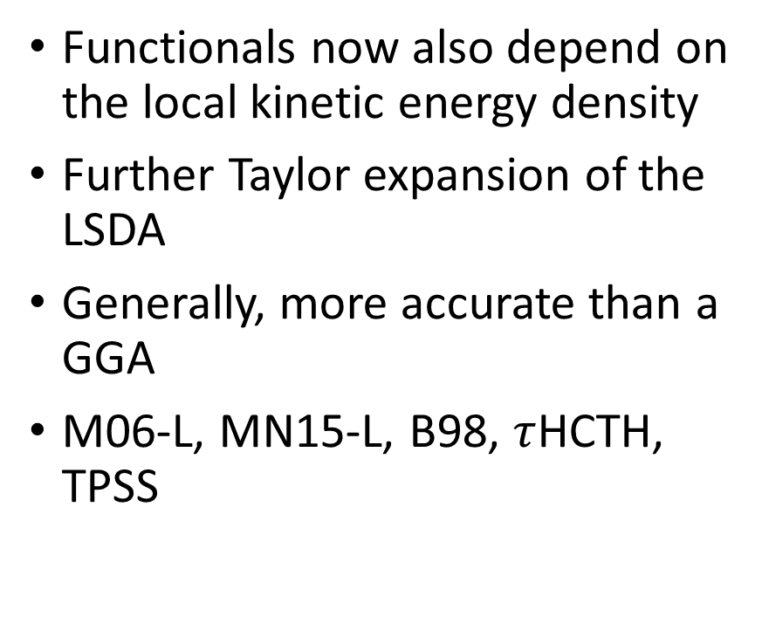
Meta-GGA
Functionals now also depend on the local kinetic energy density
Further Taylor expansion of the LSDA
Generally, more accurate than a GGA
M06-L, MN15-L, B98, $τ$HCTH, TPSS

Slide 40
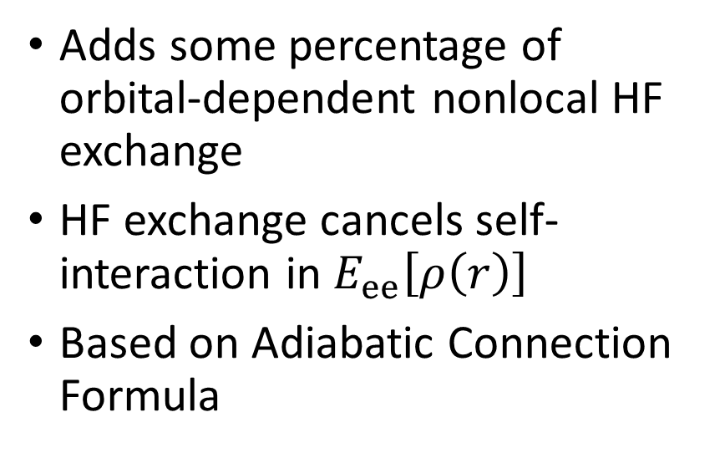
Hybrid (meta-)GGA
Adds some percentage of orbital-dependent nonlocal HF exchange
HF exchange cancels self-interaction in $E_{ee}\left[ρ\left(r\right)\right]$
Based on Adiabatic Connection Formula
Can be subclassified
Global Hybrids (B3LYP)
Global Meta-hybrid (M06-2X)
Long-range Corrected (M11)
Coulomb-attenuated Hybrid (CAM-B3LYP)
Screened-exchange Hybrid (HSE06)

Slide 41

Double Hybrid
Includes a virtual KS orbital contribution to take nonlocal electron correlation effects into account
Allow a better implicit description of static correlation

Slide 42
References
http://pollux.chem.umn.edu/8021/Lectures/DFT_10.pdf
Yu, H. S.; Li, S. L.; Truhlar, D. G. Perspective: Kohn-Sham Density Functional Theory Descending a Staircase. Journal of Chemical Physics 2016, 145 (13), 130901. https://doi.org/10.1063/1.4963168.
Kohn, W. Nobel Lecture: Electronic Structure of Matter—Wave Functions and Density Functionals. Reviews of Modern Physics 1999, 71 (5), 1253–1266. https://doi.org/10.1103/RevModPhys.71.1253.

