Slide 1
Linux and Bash Scripting
Connor Briggs

Slide 2
Brief History of Linux
Linux was the spiritual successor to Unix, an operating system made by AT&T Bell Labs
Created by Linus Torvalds in 1990 to be an open-source alternative to Minix,a Unix-like operating system
Since its creation, there have been many operating systems based on the Linux kernel. Major examples:
Fedora-based (Red Hat/RHEL, CentOS, Fedora)
Arch Linux and derivatives (SteamOS)
Debian and derivatives (Ubuntu, Linux Mint)
Android
And many more
Linux and Bash Scripting

Slide 3
Linux
Windows
Open-source
Anyone can view and suggest edits to the source code
User-end programming friendly
Lots of open-source projects target it
Proprietary
Only Microsoft can modify the source
Driver-side programmer friendly
Supported by almost all major software companies
Linux and Bash Scripting

Slide 4
Common Linux Tools
Bash is a scripting language widely used on Linux systems
GNU (GNU is Not Unix) is a set of programs that sit on top of the Linux kernel and make your computer useable
APT is the software manager on Ubuntu and Debian-based systems, which is what we mostly use
vi, Emacs, nano, and gedit are common editors for text files
Anaconda and Miniconda allow for easier management of dependencies for programs
Linux and Bash Scripting

Slide 5
Common Linux Commands
ls lists the contents of a directory
cd changes the current directory
sh and bash execute a script file
ssh connects to a remote host and allows you to interact with it
This is how you talk to Vulcan and Sapelo2
There is a way to skip entering your password using encrypted keys
less reads a file
man opens the manual page for a command
help and info give information on bash constructs
echo prints information to the screen
Linux and Bash Scripting

Slide 6
Common Linux Commands Cont.
clear clears the terminal
history shows you commands you have previously typed
mkdir makes a directory
pwd prints the current directory
rm deletes a file or directory
mv moves or renames a file, cp copies a file
touch creates a file or updates its modification time if it exists
zip, unzip, tar, gzip are all compression tools
valgrind checks your code for memory errors. Very useful for C/C++
chmod changes file properties. Using chmod +x filename will mark a script file as an executable
Linux and Bash Scripting

Slide 7
Common Linux Commands Cont.
rsync copies files over ssh. Very useful when interacting with Vulcan and Sapelo2
sed is a powerful stream editor which can search and modify text
grep is a fast way of searching through files for matching text
find finds a file with a given name
sudo (pronounced soo-doo) runs a command as superuser, or administrator in Windows terminology
exit exits your shell. If using SSH, it disconnects your session and returns you to a local terminal
cat prints the contents of a file to stdout
top and htop show user processes. htop is prettier, but top is always installed
Can also be done using ps –eap, but it doesn't update
Linux and Bash Scripting

Slide 8
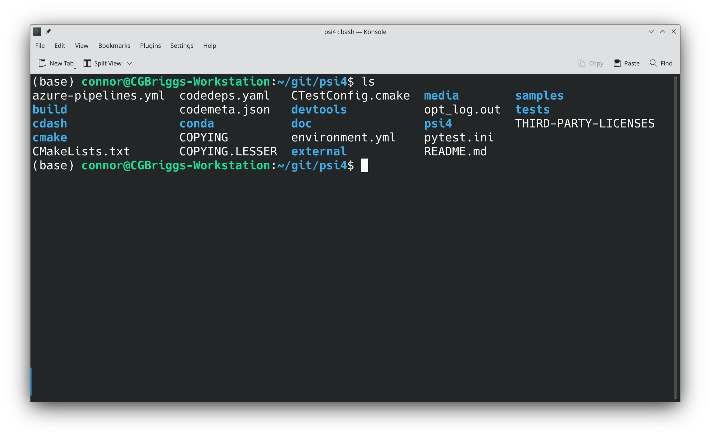
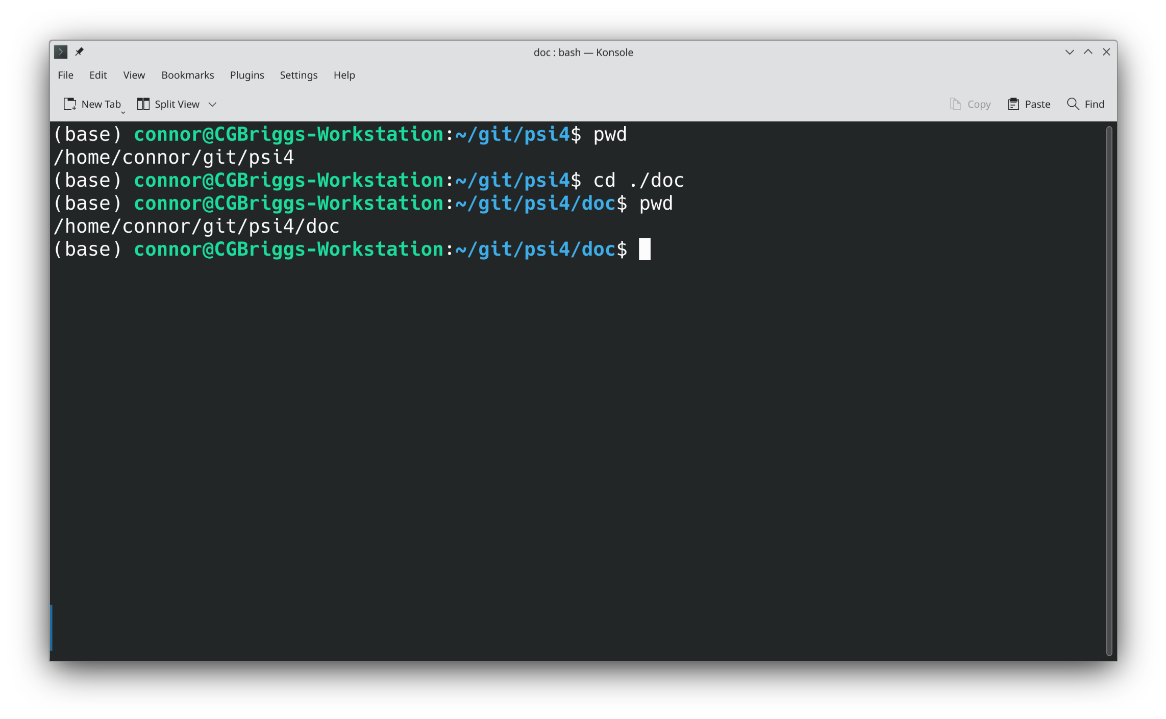
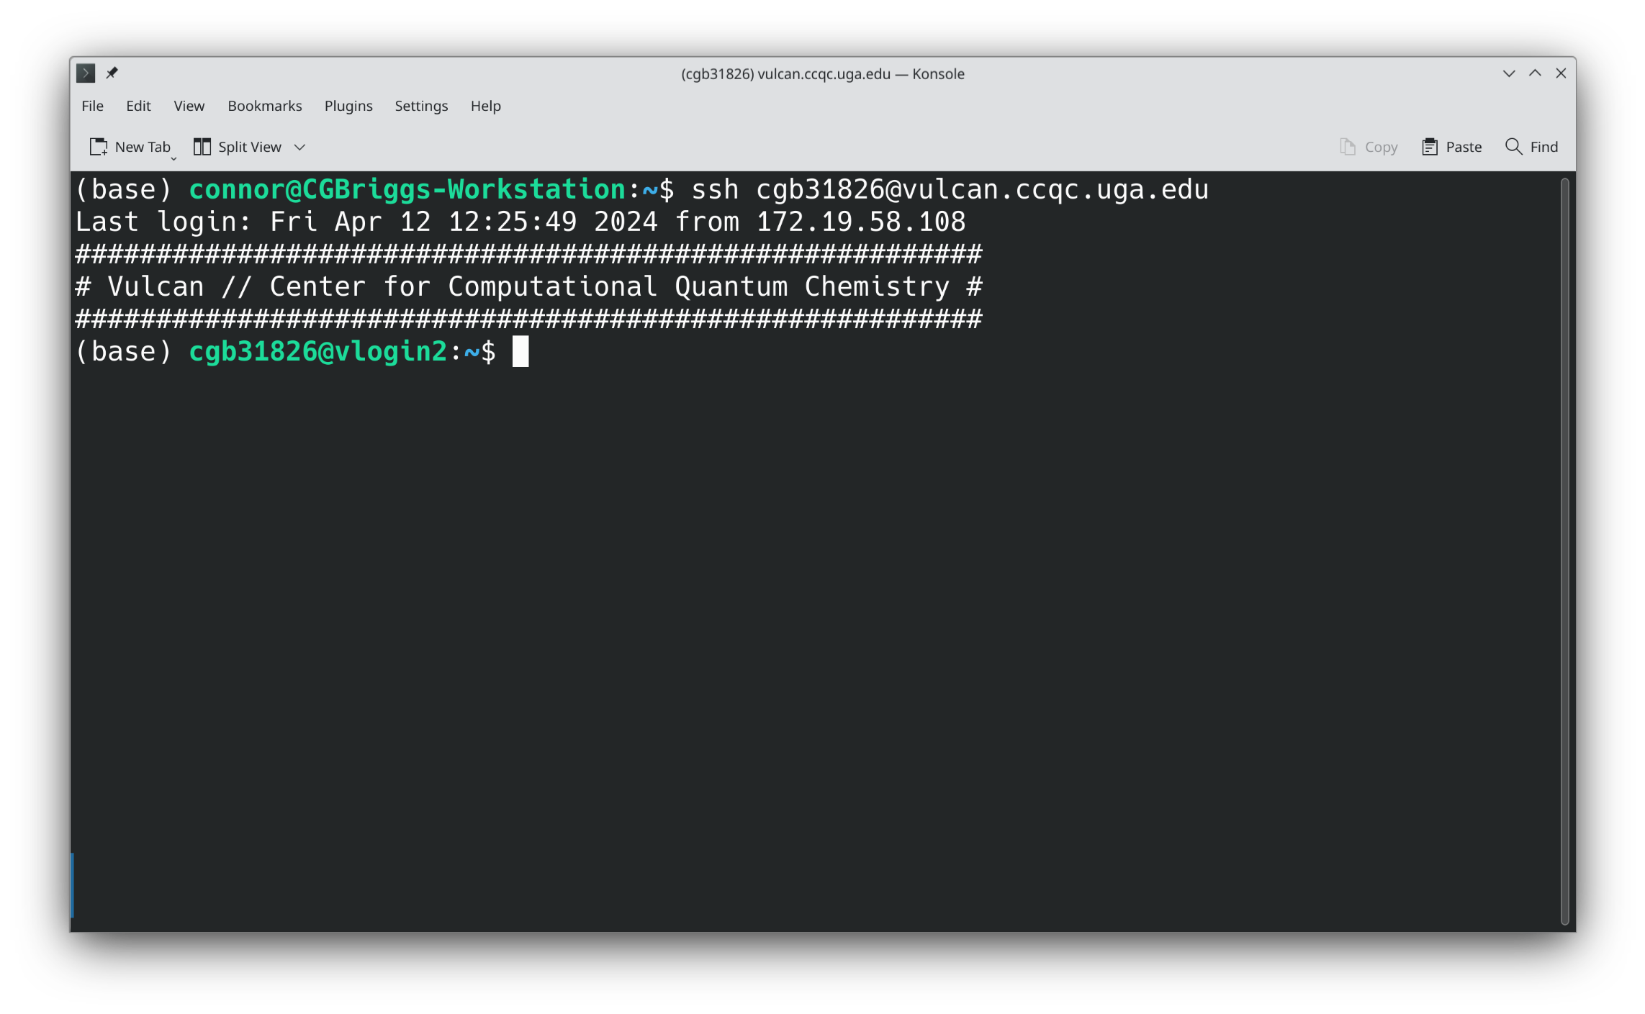
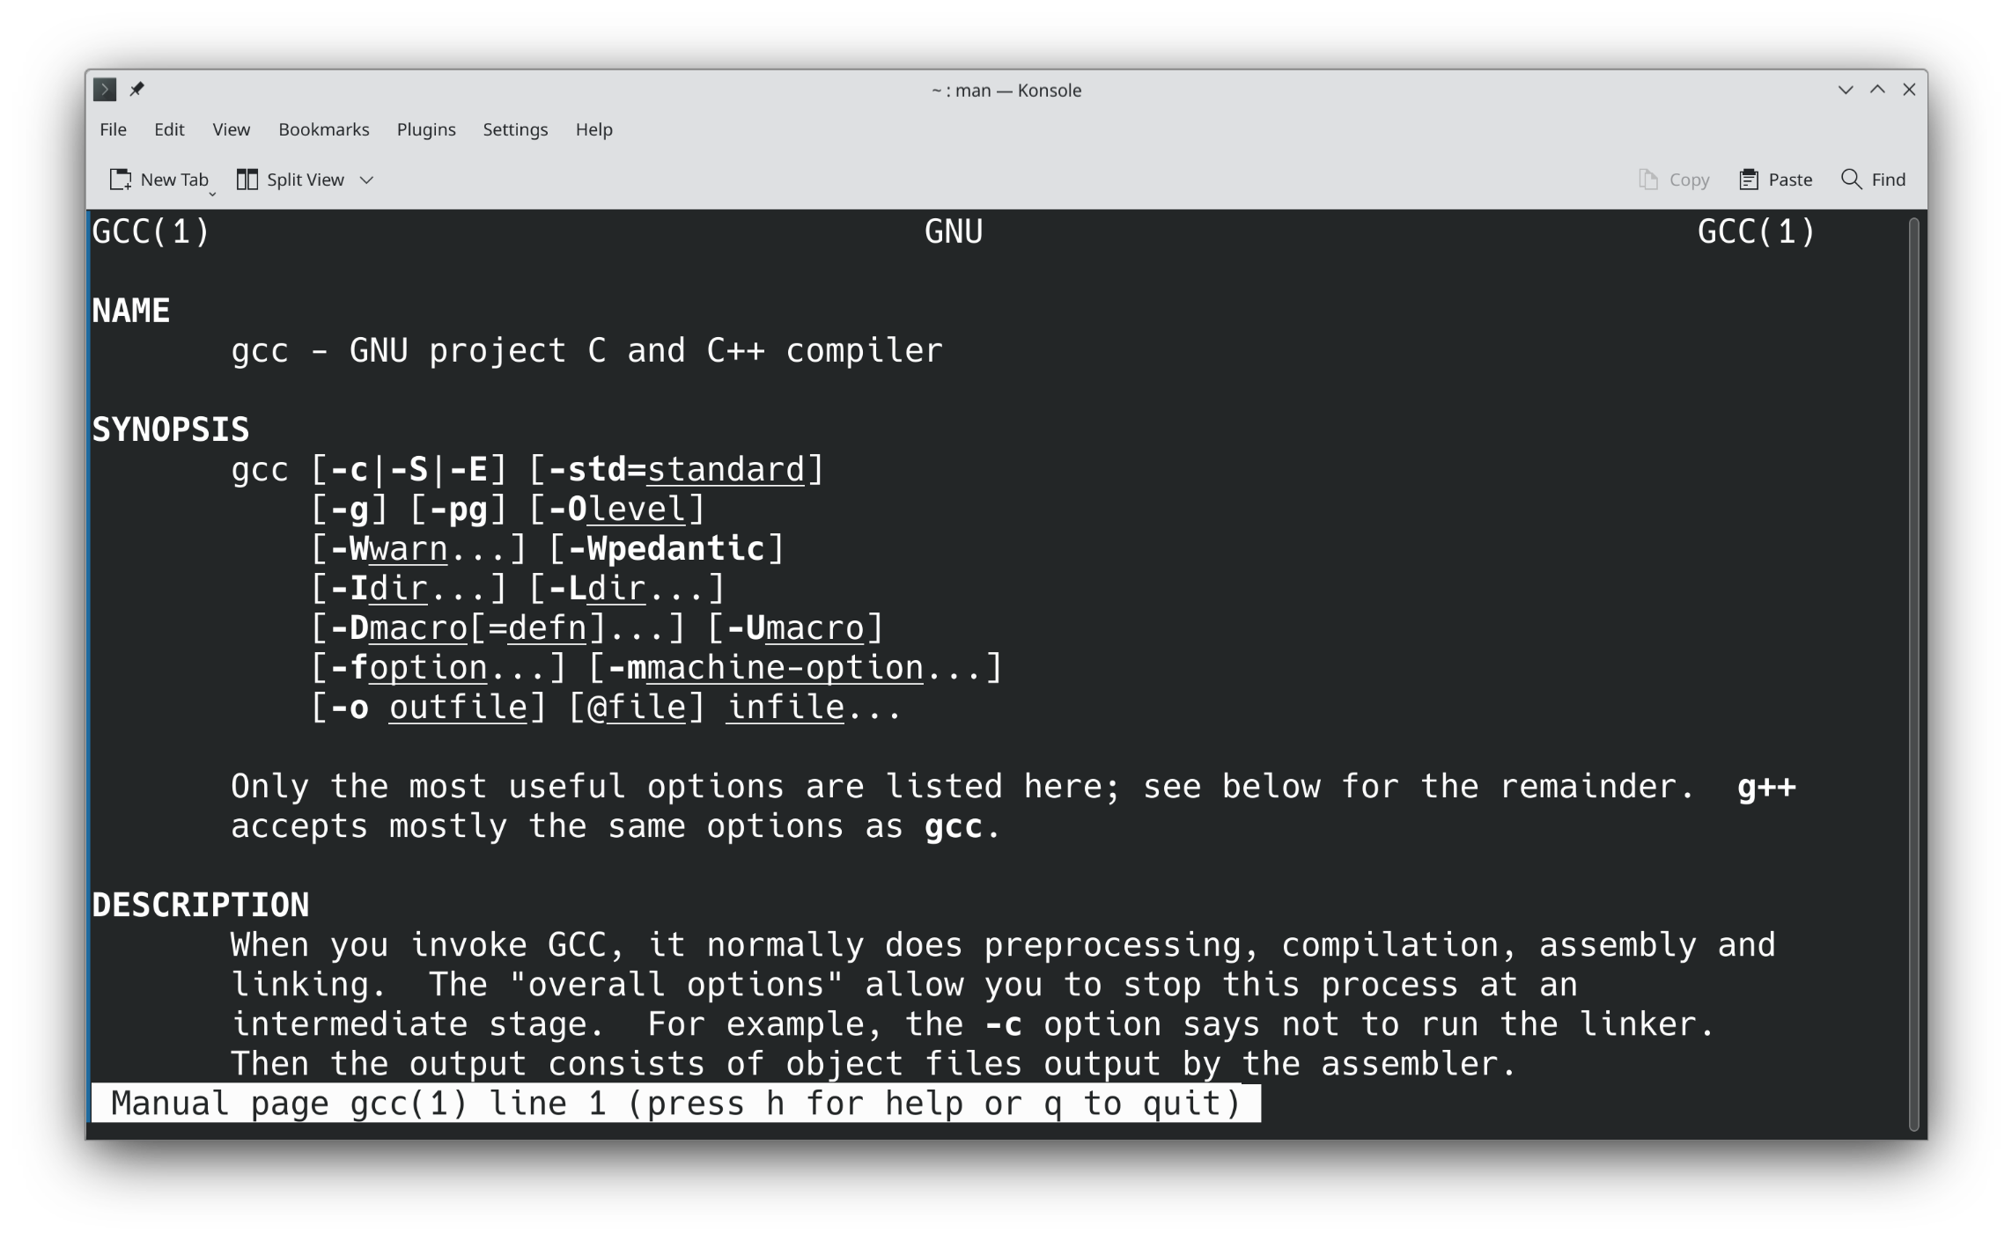
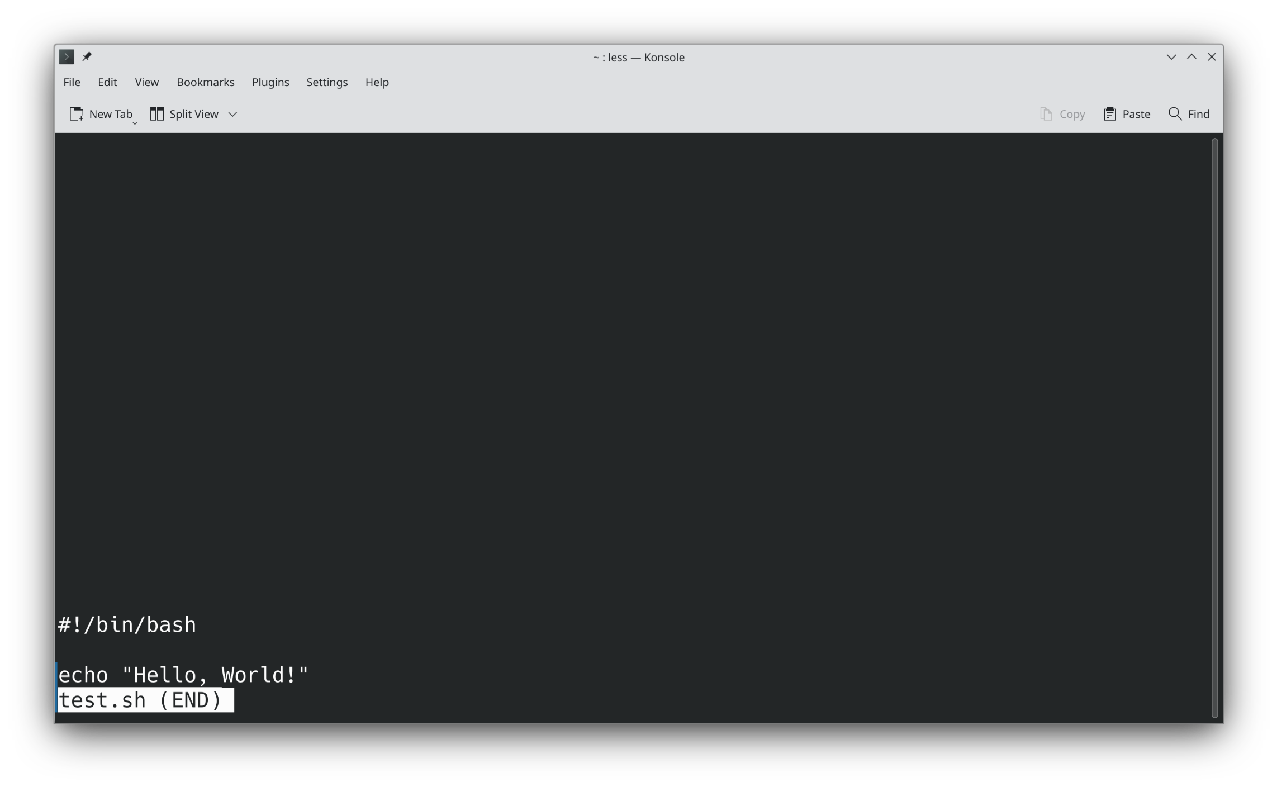
Command Screenshots
Linux and Bash Scripting

Slide 9
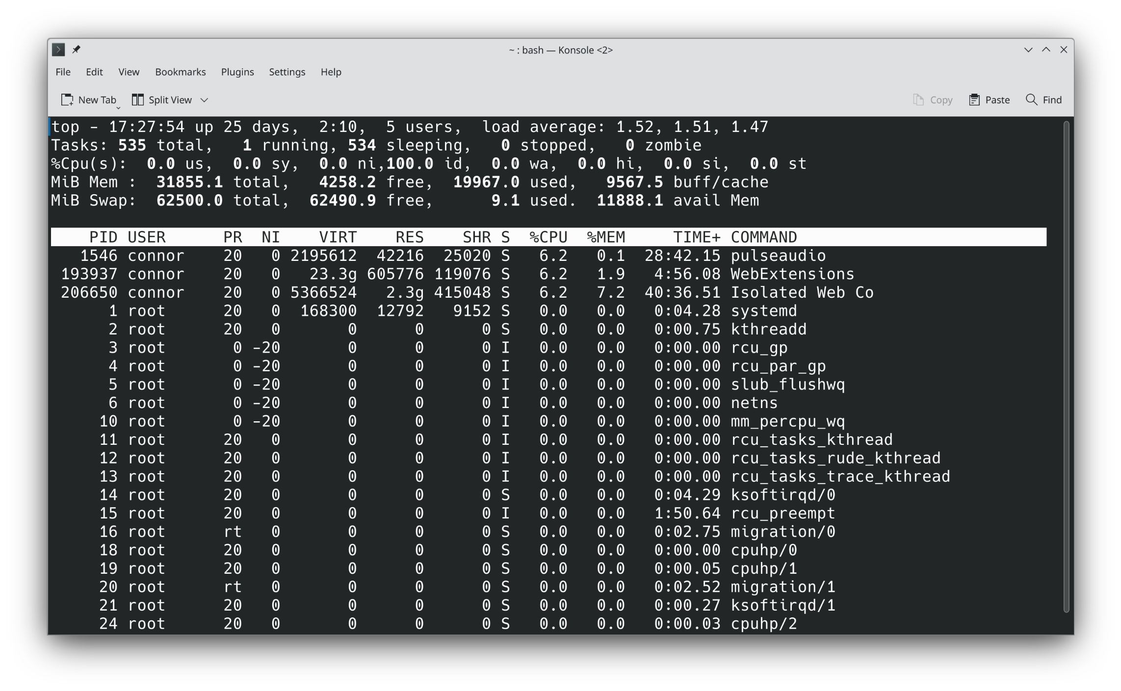
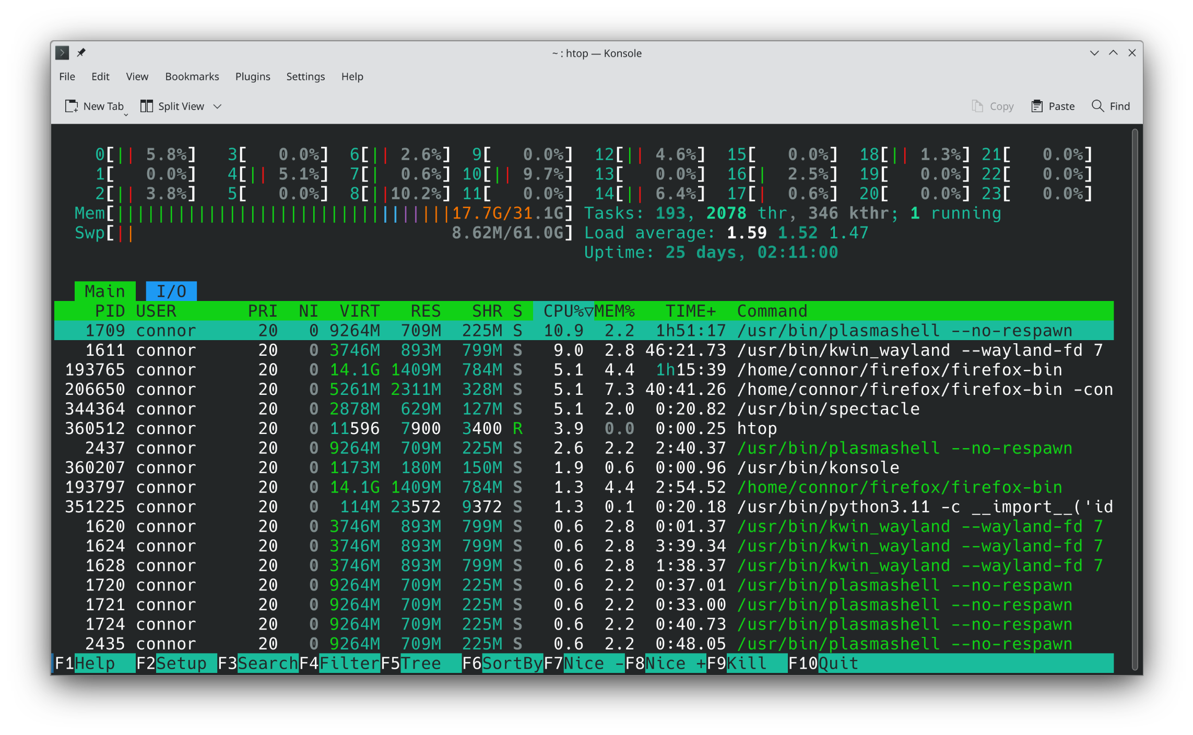
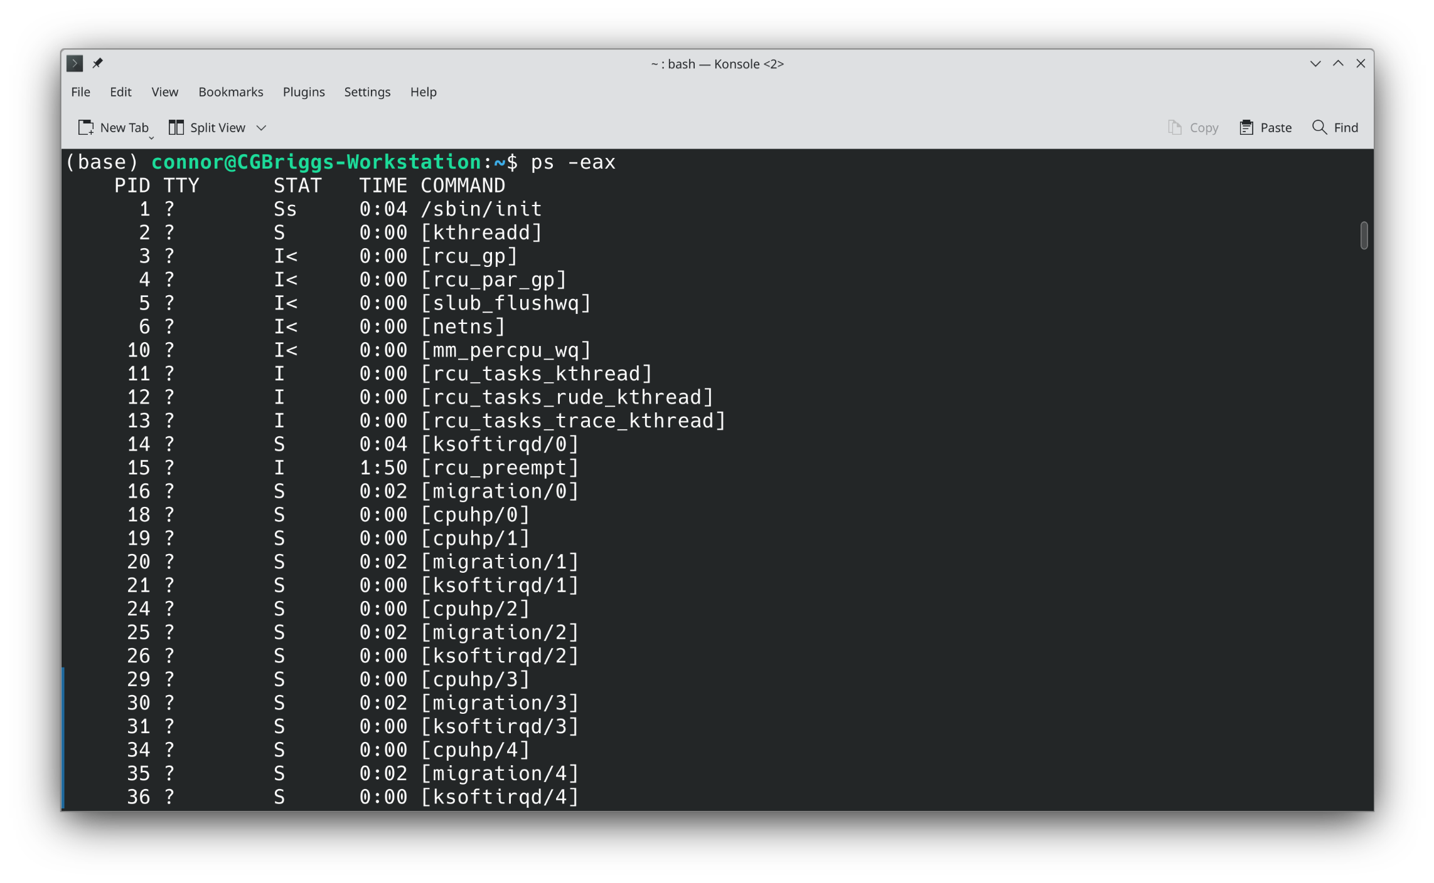
More Screenshots
Linux and Bash Scripting

Slide 10
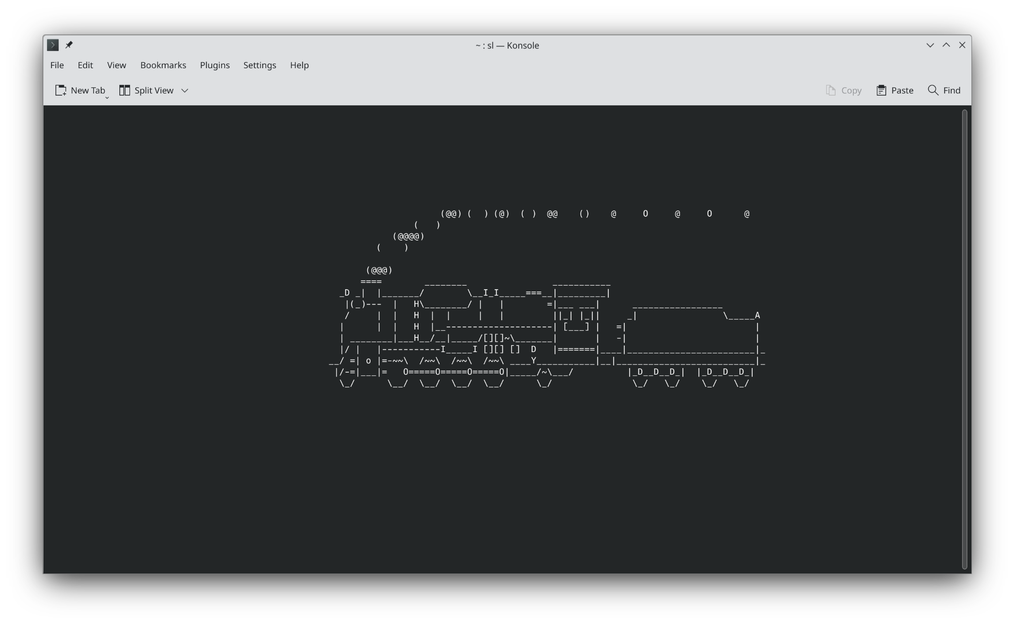
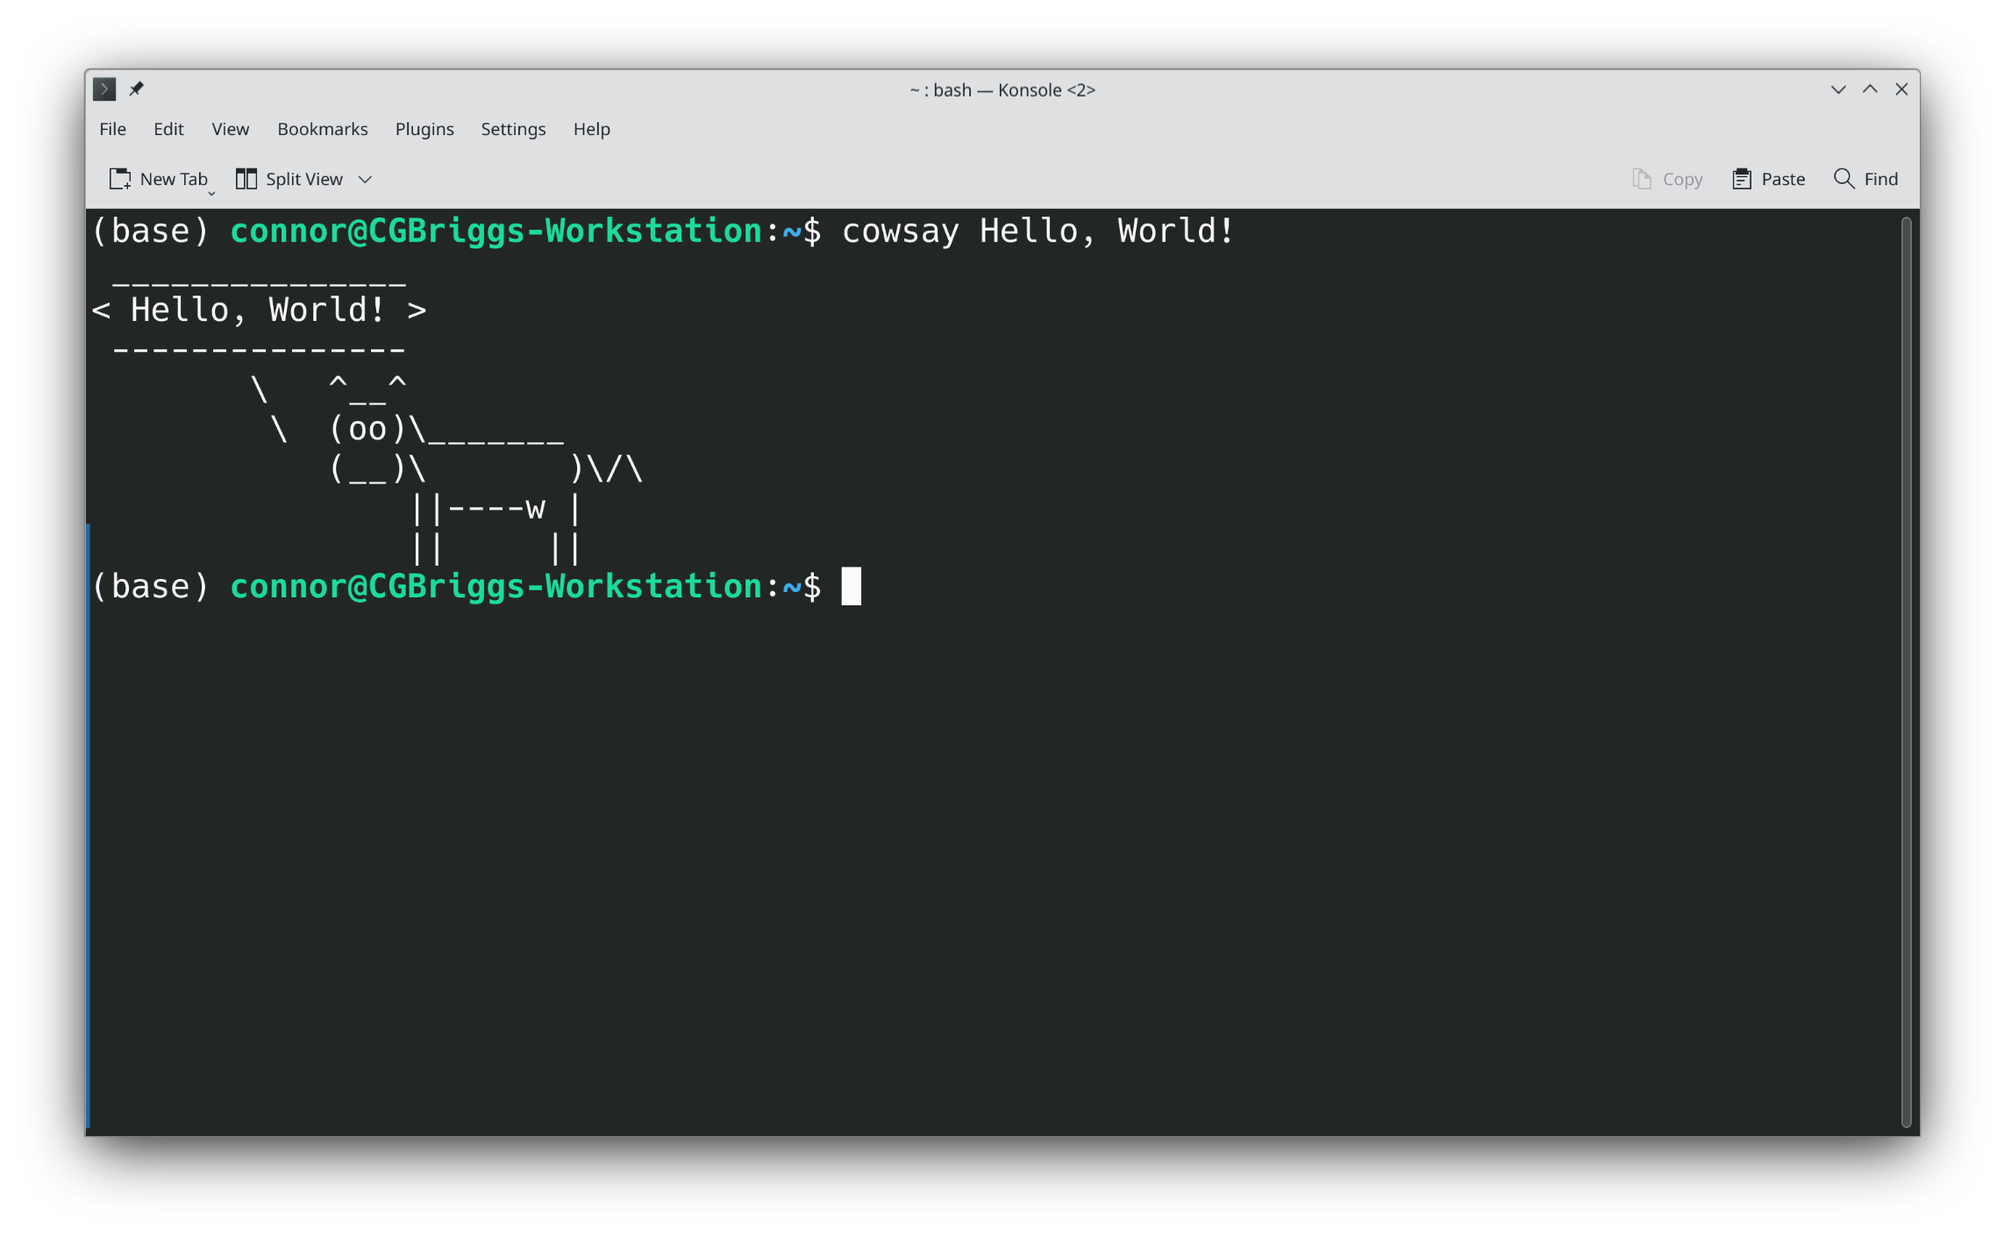
Less Common Linux Commands
sl gives a steam locomotive
cowsay is like echo, but a cow says your message
Linux and Bash Scripting

Slide 11
Special Directories
When typing directories, there are three special directories that are always available
A single period (.) represents the current directory. It can be used to distinguish between directories like /bin, a system directory, and ./bin, a directory of the same name, but within the current directory
Two periods (..) represents the directory one level up. For instance, if you are in /usr/lib, then cd .. will place you into /usr
The tilde (~) represents your home directory, no matter where you are. For instance, you can access your documents from ~/Documents
There is also a single slash (/) which refers to the top-level, or root directory. It contains system directories like /bin, /dev, /home, /etc
Linux and Bash Scripting

Slide 12
Running Commands
To run a command, simply type the name of the command, followed by any arguments that command takes
To view the possible arguments, use man to pull up the manual page for the command. Another common way is to pass either -h, --help, or -? which are common help flags
To stop a command:
Ctrl+z pauses the execution. It can be continued with either fg or bg
Ctrl+x politely asks a program to stop, but is often ignored
Ctrl+c kills a program dead
Linux and Bash Scripting

Slide 13
Advanced Command Execution
Pipes are a way to transfer the output from one command to the input of another. This is done using the vertical bar (|)
The output of a command can be interpreted as text on the shell by surrounding the command either by back-ticks (`) or a dollar sign and parentheses. The back-tick is different from the apostrophe. Examples will be given
Typing exclamation points recalls previous commands and inserts them into the shell
Commands can be run in the background by placing a single ampersand at the end of the line
Linux and Bash Scripting

Slide 14
Advanced Command Execution cont.
The output of a command can be placed into a file by using the greater-than symbol and can be read from a file by using the less-than symbol.
The special device /dev/null acts like a trash can for command output if you want to silence a command. Reading from it always gives null bytes
The special devices /dev/random and /dev/urandom provide a random stream of bytes. The difference between the two is not important now
Commands can be strung together using && or ||
&& continues on to the next command on success
|| continues on to the next command on failure
Linux and Bash Scripting

Slide 15
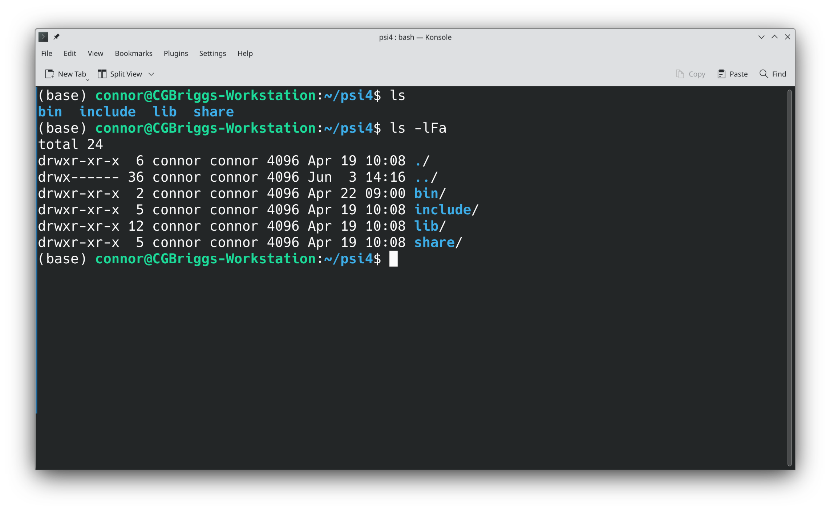
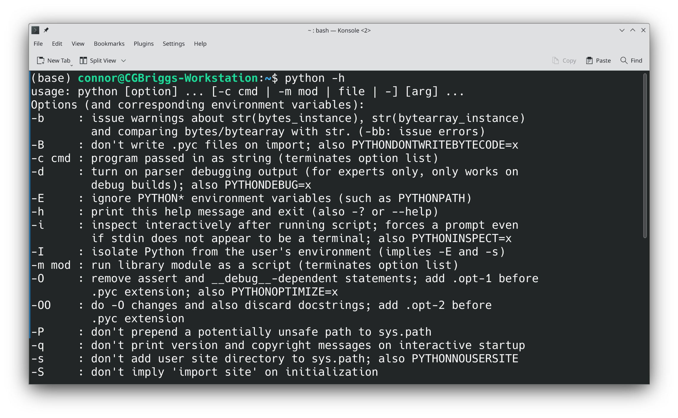
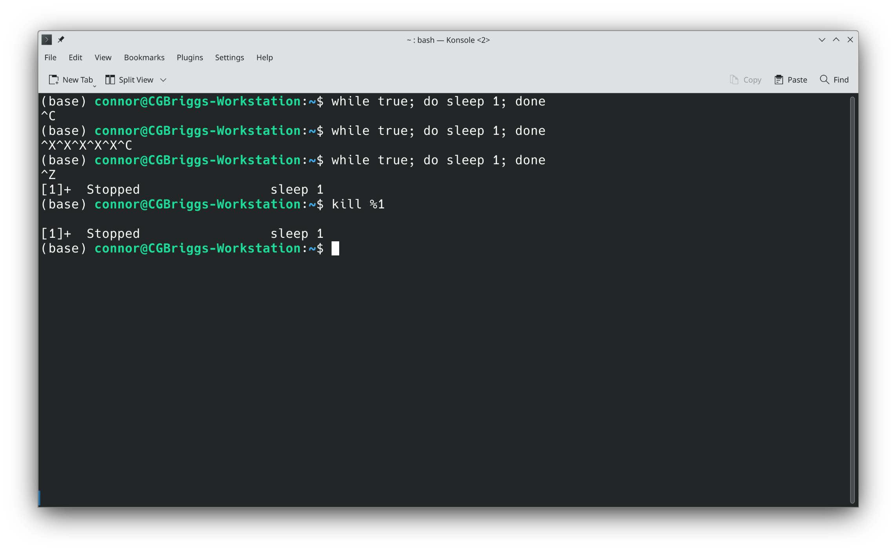
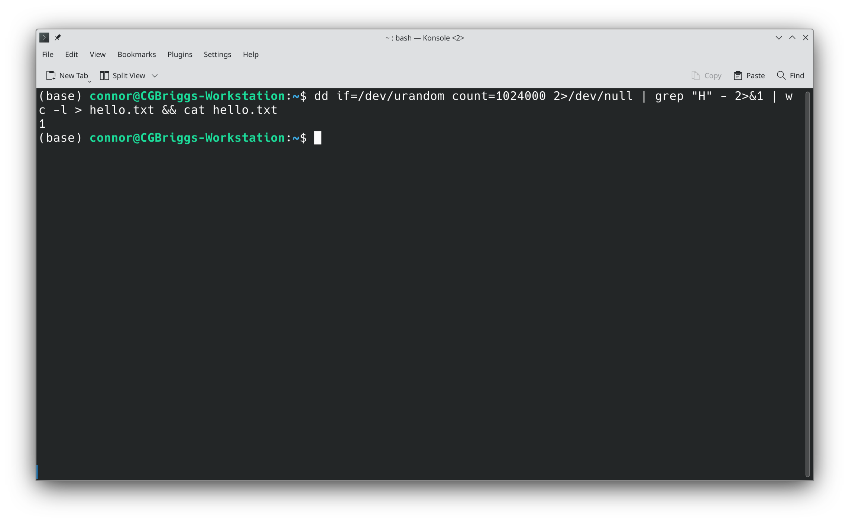
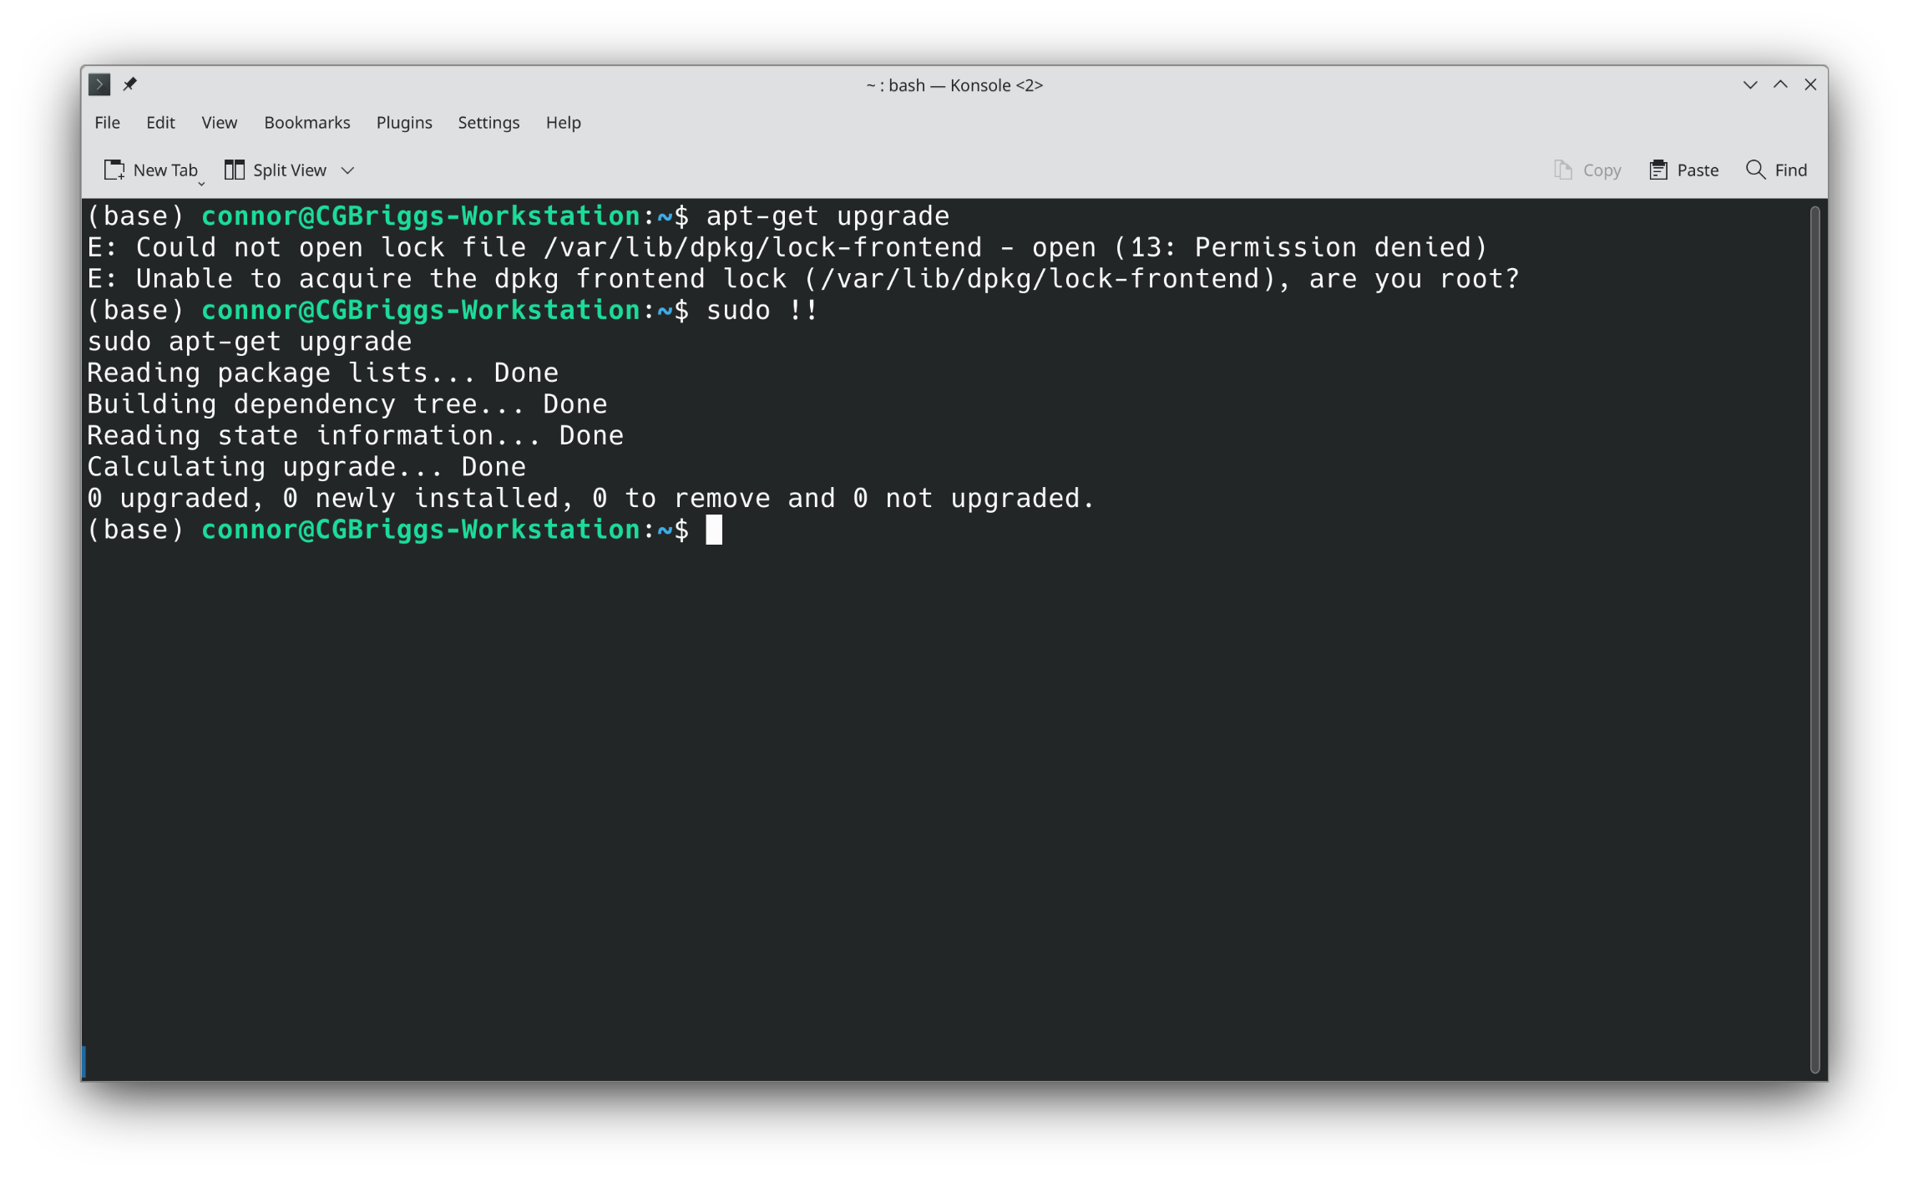
Examples
Linux and Bash Scripting

Slide 16
Advanced Command No-No's
Never leave yourself logged in as root. If you ever use the su command or sudo –s, always remember to type exit when you are finished.
Avoid commands like yes. It may make installations faster, but you will skip all messages meant to avoid accidentally borking your system
Never use the dd command unless you are absolutely sure you know what you are doing and are at peace if you overwrite your main hard drive
Linux and Bash Scripting

Slide 17
Git
When we develop code, we will often use software known as Git to manage changes and versioning.
Git has a client-side program, which can be accessed from the command line using the git command.
There are also several websites that can store remote Git repositories. Popular ones are:
GitHub: free, good choice for individuals and small organizations.
GitLab: paid, better tools than GitHub, better for large organizations.

Slide 18
Terminology
A collection of code is called a repository.
Repositories can have many concurrent versions called branches. Some branches contain older versions of the code, while others are for changes to the main codebase.
Every repository has a main branch (previously called the master branch) where the current form of the code is stored.
To make changes to a repository, you should first make a fork of it. This is a personal copy of the repository that is separate from the main repository.
Then, you can make a branch to add your changes.
Once you have made your changes, you can create a pull request (or PR) to merge your changes into the main branch of the parent repository.

Slide 19
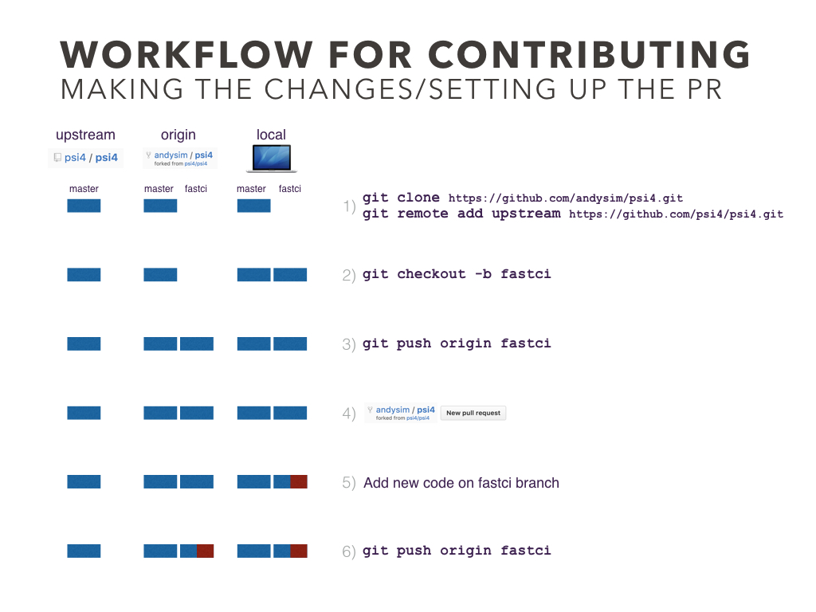
Git Workflow
From https://psicode.org/psi4manual/master/build_obtaining.html

Slide 20
Git Workflow
To make a change to a repository, start by making a fork.
If it's your own repo, then this step is not necessary.
Then, make a branch on your fork for the change. Never push directly to main.
Clone your repository on your local machine.
Add your changes with commits.
Push those commits to the upstream branch on GitHub, GitLab, etc.
To merge your changes into main, make a pull request.
As you add commits to your branch, your pull request will update.
Once your changes have been merged, you can delete your branch.

Slide 21
Git Commands
Use git add to mark changes as commitable.
Use git blame to see who made certain changes.
Use git checkout to switch to a branch.
Use git branch to manage branches. You can set the branch to mirror one on GitHub using this command.
Use git cherry to apply a commit from one branch onto another. This is great for fixing bugs in multiple releases of a large project.
Use git clone to download a repository to make your own changes to, or to build for yourself.

Slide 22
Git Commands
Use git commit to apply your changes to your local branch. This creates a sort of save point.
Use git fetch to get changes from the upstream branch. Apply them with git merge/rebase, depending on how you want to apply the changes.
Use git log to see a history of changes on the current branch.
When looking at the commits in the log, they will be given a long string of hexadecimal numbers. You can refer to a unique commit with the first 5 or 6 of these digits.
Use git merge to mix changes within files.
Use git push to send your commits to GitHub.
Use git rebase to rebase.
Use git rm to delete a file from the Git tree.

Slide 23
Git Commands
Use git stash push to save your changes without commiting them. Useful for updating your branch between commits.
Use git stash pop to apply stashed changes.
Use git status to see which files have been changed, which changes have been added to the index, and other information.

Slide 24
Merging vs. Rebasing

Slide 25
Bash Scripting
We will go over the basics of Bash scripting here
Start with a simple Hello, World! Program
Comments
Go over variables
Go over control structures
If-else, for loops, while loops, functions
Talk about regular expressions
Linux and Bash Scripting

Slide 26
Hello, World!
#!/bin/bash
echo "Hello, World!"
Create a new file. Give it any name you want but end it with .sh
First line of the file should be #!/bin/bash
On a new line, type echo "Hello, World!"
Save the file and run it.
This will print the string to the terminal
Linux and Bash Scripting

Slide 27
Comments
Comments allow us to write documentation for our code
In bash and many other scripting languages, comments start with a #
Everything after that # in a line will be ignored
Sometimes, comments can have special meaning.
The #!/bin/bash is a comment which tells the computer where to find the script interpreter. This is for a bash file, but you can put #!/usr/bin/python3 at the top of a Python file
For many job submission programs, rich comments will be used for job parameters, such as #SBATCH --time 7-00:00:00
Linux and Bash Scripting

Slide 28
Variables
Variables are a convenient way of storing information
In some languages, variables have type. In bash, they are all stored as text, even if they are numbers.
Variables in bash are referenced by placing a dollar sign before the name
There are some special variables, such as $0 - $9, which reference arguments passed into your script
There are also some special ways to reference variables, such as ${} to do string operations and $() to run a command and save its output
Linux and Bash Scripting

Slide 29
Environment Variables
Your computer also has some pre-defined variables
These are called environment variables
Here are some commonly used variables
$PATH tells the computer where it can find core utilities
$USER is your username
$PWD is the current working directory
$RANDOM gives a random number every time it is accessed
Linux and Bash Scripting

Slide 30
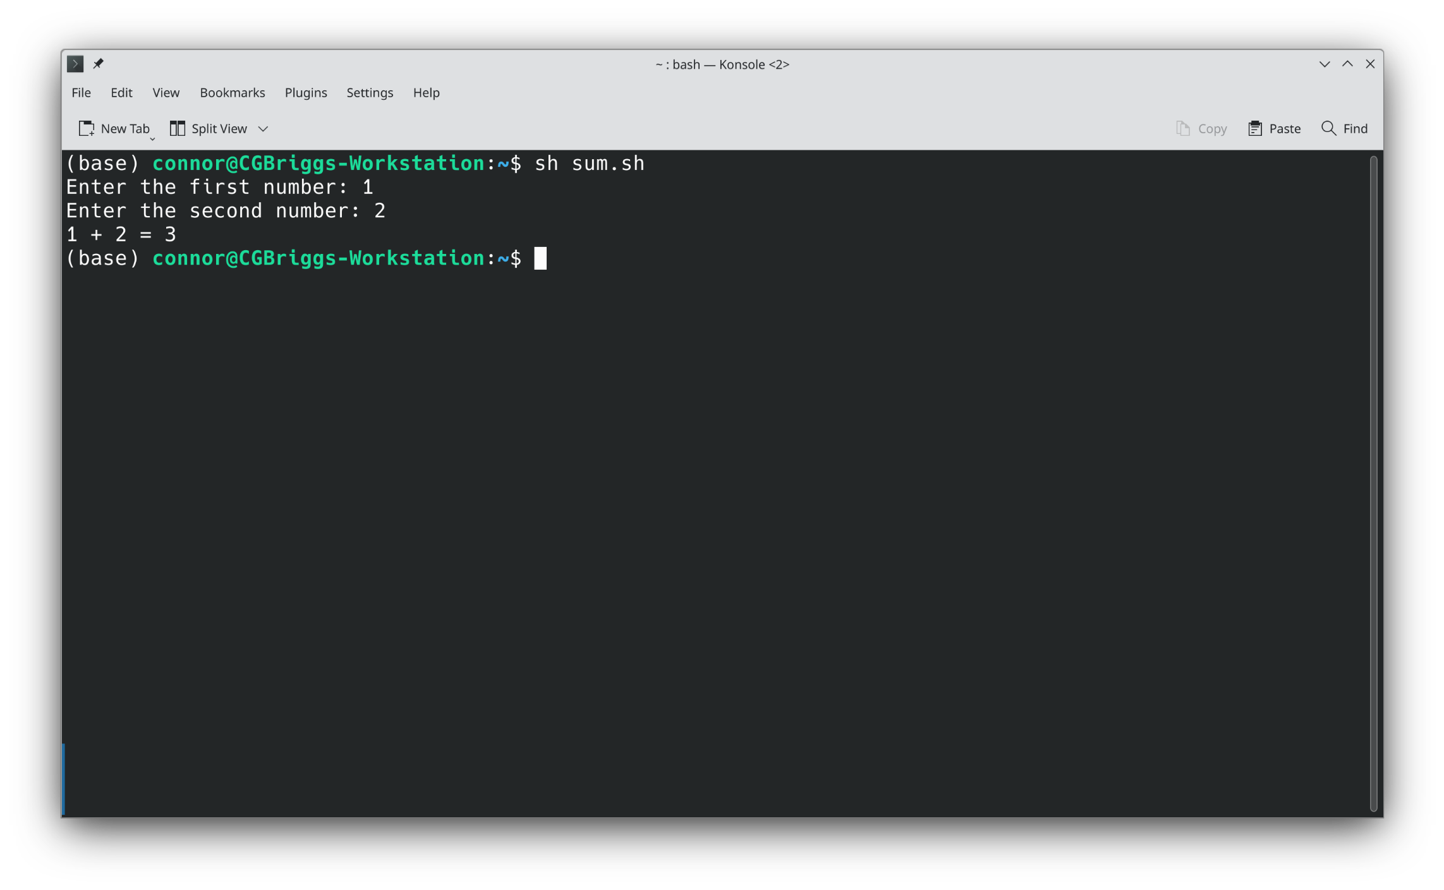
Example: Adding two numbers
#!/bin/bash
read –p "Enter the first number: " FIRST
read –p "Enter the second number: " SECOND
echo "$FIRST + $SECOND = $((FIRST + SECOND))"
Linux and Bash Scripting

Slide 31
If Statements
If statements perform different things depending on whether a condition is true or false
If statements can have an else statement, which executes when the condition is false
They can also have an elseif statement, which checks another condition if all previous conditions are false
Don't get too used to this syntax. It is not used in other more common languages like C, C++, and Python
None of these require the then
The relational operators for equality are different. Bash uses =, while the rest use ==.
Linux and Bash Scripting

Slide 32
Example: Rock-Paper-Scissors
#!/bin/bash
read –p "What is your choice? " CHOICE
echo "You chose $CHOICE."
if [ "$CHOICE" = "rock" ]; then
echo "I choose paper."
elif [ "$CHOICE" = "paper" ]; then
echo "I choose scissors."
elif [ "$CHOICE" = "scissors"]; then
echo "I choose rock."
else
echo "I don't know what that means."
fi
Linux and Bash Scripting

Slide 33
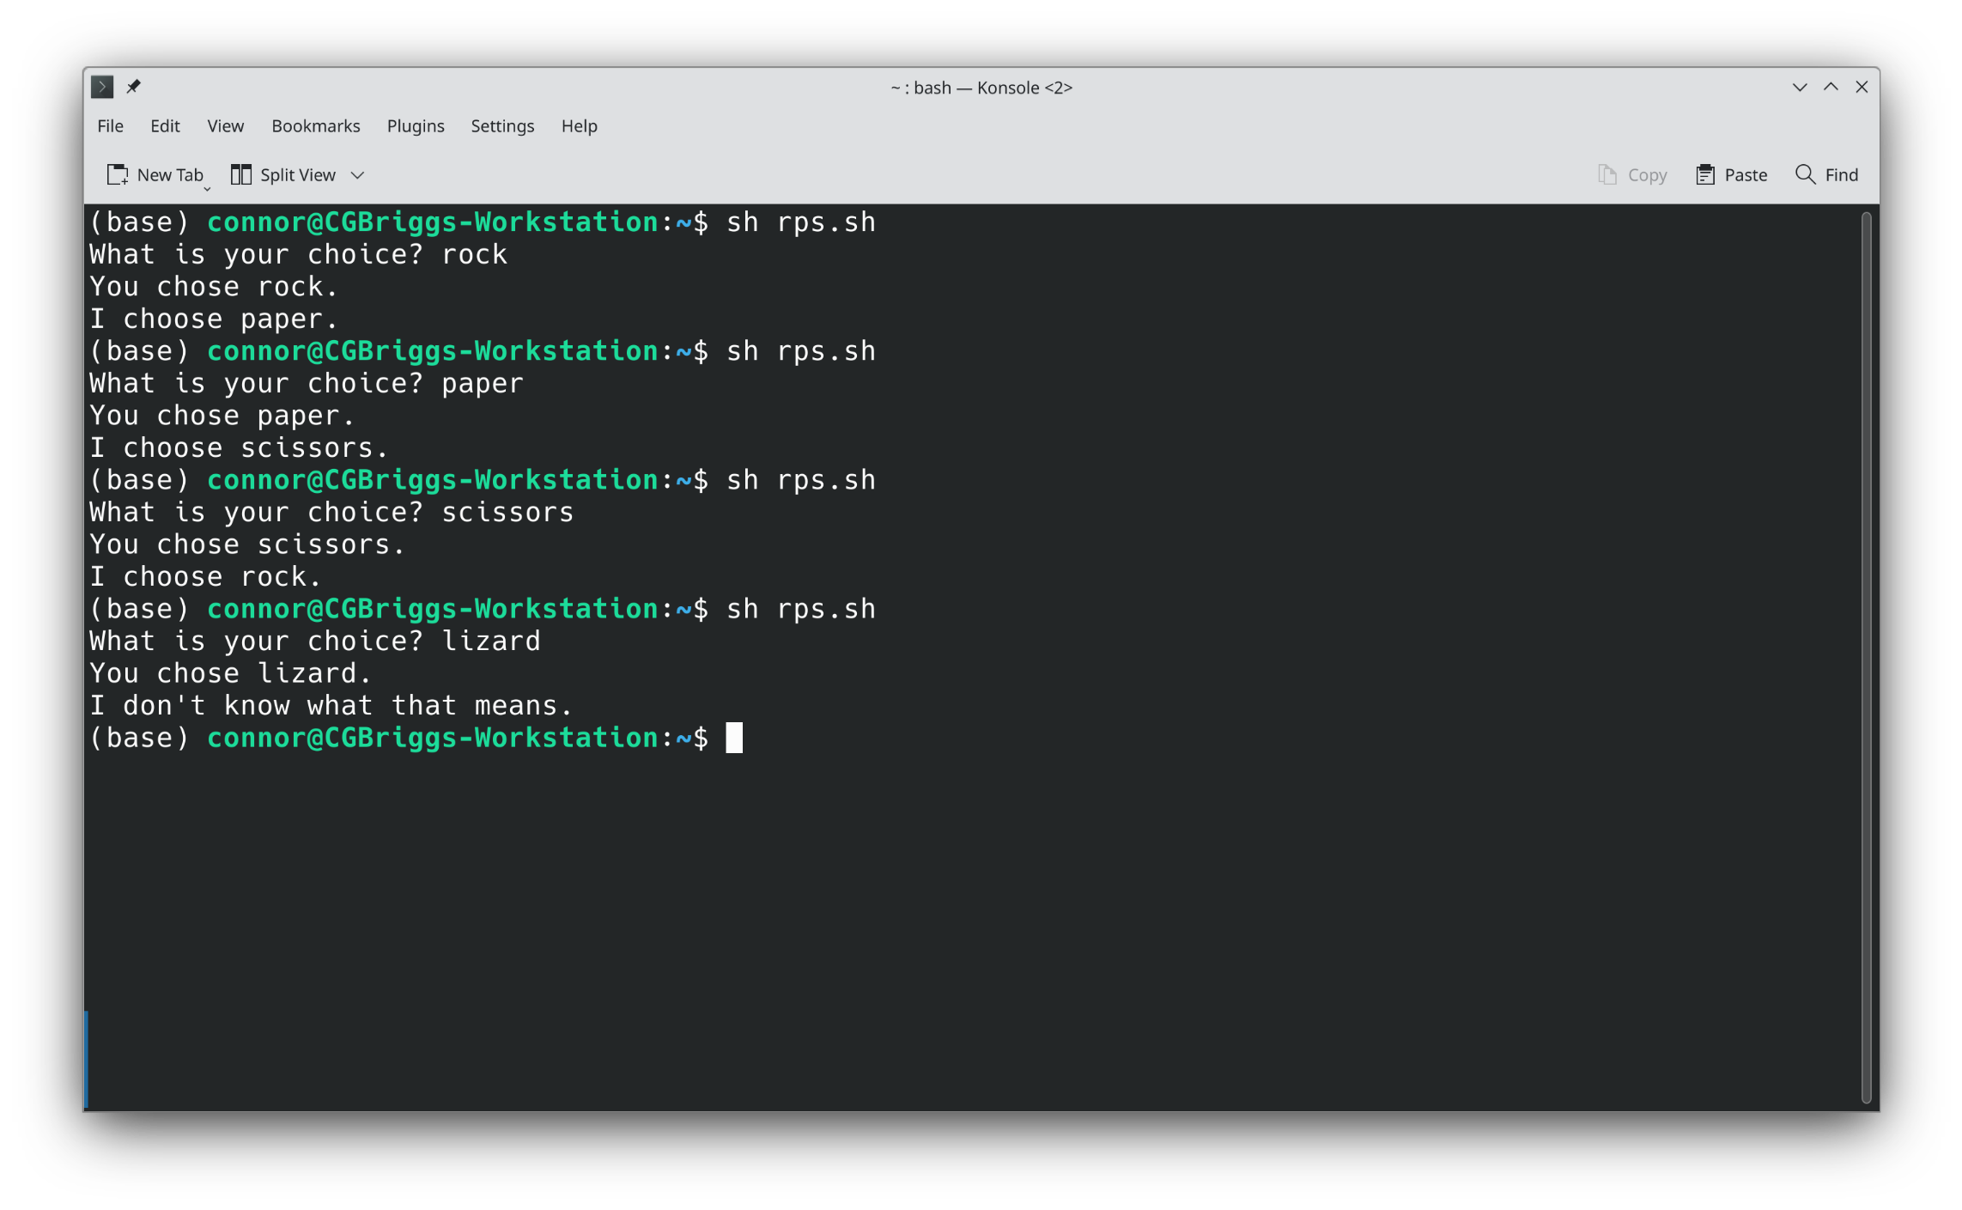
Rock-Paper-Scissors Output
Linux and Bash Scripting

Slide 34
For loops
For loops allow you to run code multiple times for different inputs
These can be over ranges or over multiple pieces of text
Ranges look like {1..10}, giving numbers 1 to 10, or {1..10..3}, giving numbers 1 to 10, but only every third: 1, 4, 7, 10
Multiple pieces of text might look like the output from ls or a wildcard glob
There is also a method using C-style syntax: for ((i=1;i<=10;i++))...
Linux and Bash Scripting

Slide 35
For loop example: Potatoes
#!/bin/bash
for I in {1..8}; do
if [ "$I" = "4" ]; then
echo "4"
elif [ "$I" = "8"]; then
echo "More!"
else
echo "$I potato"
fi
done
Linux and Bash Scripting

Slide 36
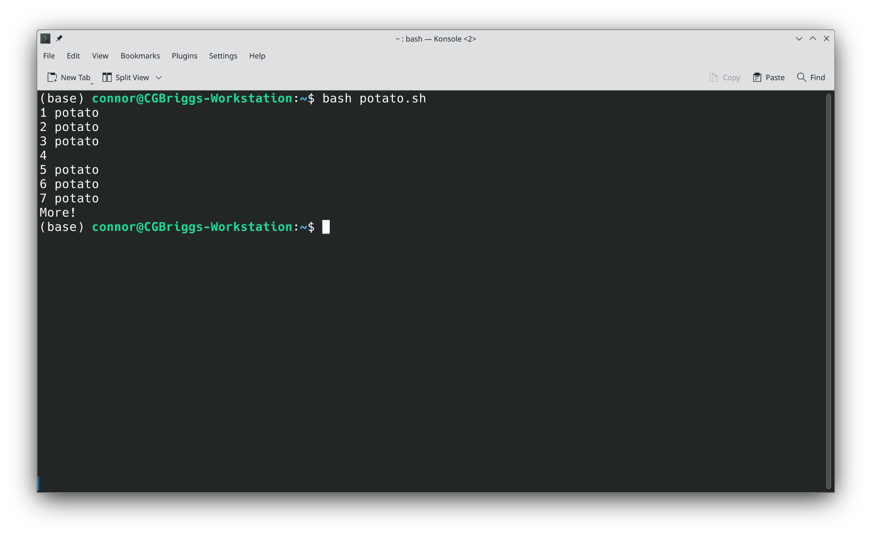
Potatoes Output
Linux and Bash Scripting

Slide 37
While Loops
While loops take a condition and execute a block of code for as long as the condition is true
Both while loops and for loops can be exited early by using the break command, or the rest of the body of the loop can be skipped and control returned to the top of the loop using the continue command.
Linux and Bash Scripting

Slide 38
Example: Guess the Code
#!/bin/bash
code="secret"
guess=""
while [ "$guess" != "$code" ]; do
read –p "What's the password? " guess
if [ "$guess" = "$code" ]; then
echo "Correct!"
else
echo "Wrong!"
fi
done
Linux and Bash Scripting

Slide 39
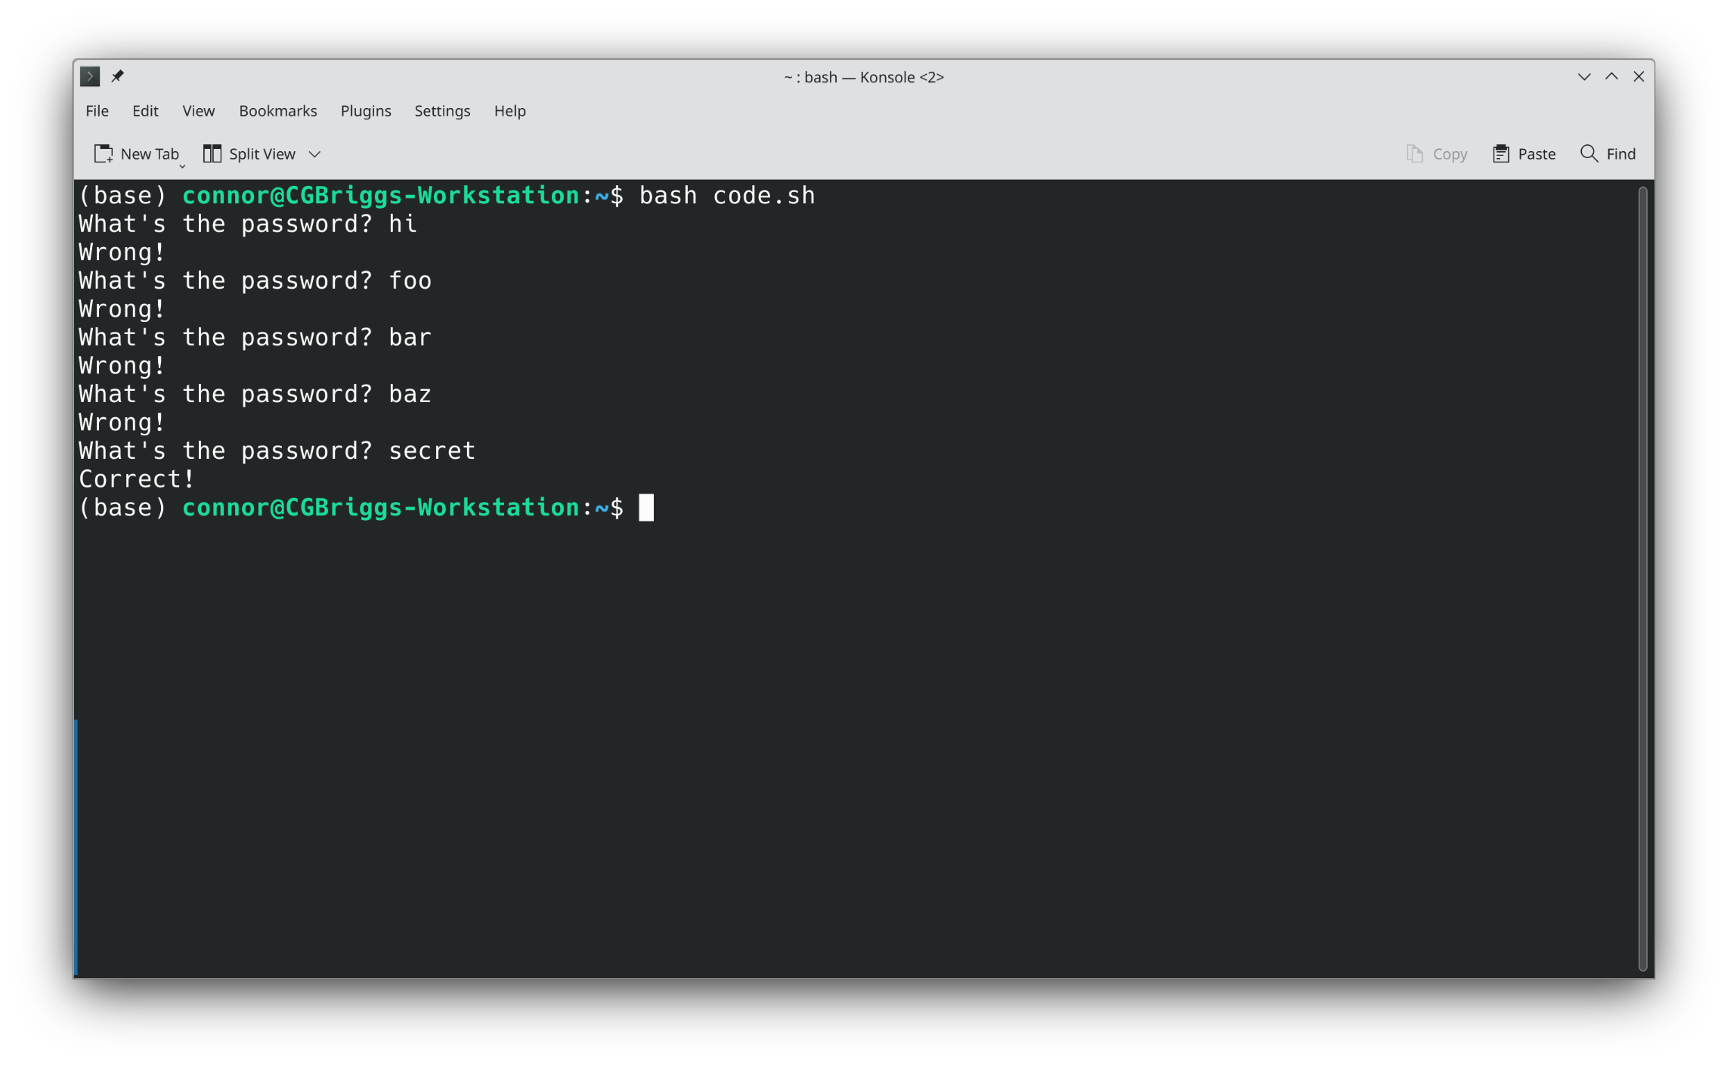
Guess the Code Output
Linux and Bash Scripting

Slide 40
Functions
Functions allow for a piece of code to be reused in many different places
Functions can take arguments that can change their behavior, or not
Functions can return values if they choose, or not
Functions can call other functions, and even call themselves
There are two equivalent ways to define a function
function foo { commands; }
foo () { commands; }
Linux and Bash Scripting

Slide 41
Example: Edit Distance
local min=$replace
if [ "$append1" -le "$min" ]; then
min=$append1
fi
if [ "$append2" -le "$min" ]; then
min=$append2
fi
echo $((min + 1))
fi
}
read –p "Enter two strings: " first second
edit_dist "$first" "$second"
#!/bin/bash
edit_dist () {
local first=$1
local second=$2
if [ "$first" = "$second" ]; then
echo "0"
elif [ "$first" = "" ]; then
echo "${#second}"
elif [ "$second" = "" ]; then
echo "${#first}"
elif [ "${first:0:1}" = "${second:0:1}" ]; then
edit_dist "${first:1}" "${second:1}"
else
local replace=$(edit_dist "${first:1}" "${second:1}")
local append1=$(edit_dist "${first:1}" "$second")
local append2=$(edit_dist "$first" "${second:1}")
Linux and Bash Scripting

Slide 42
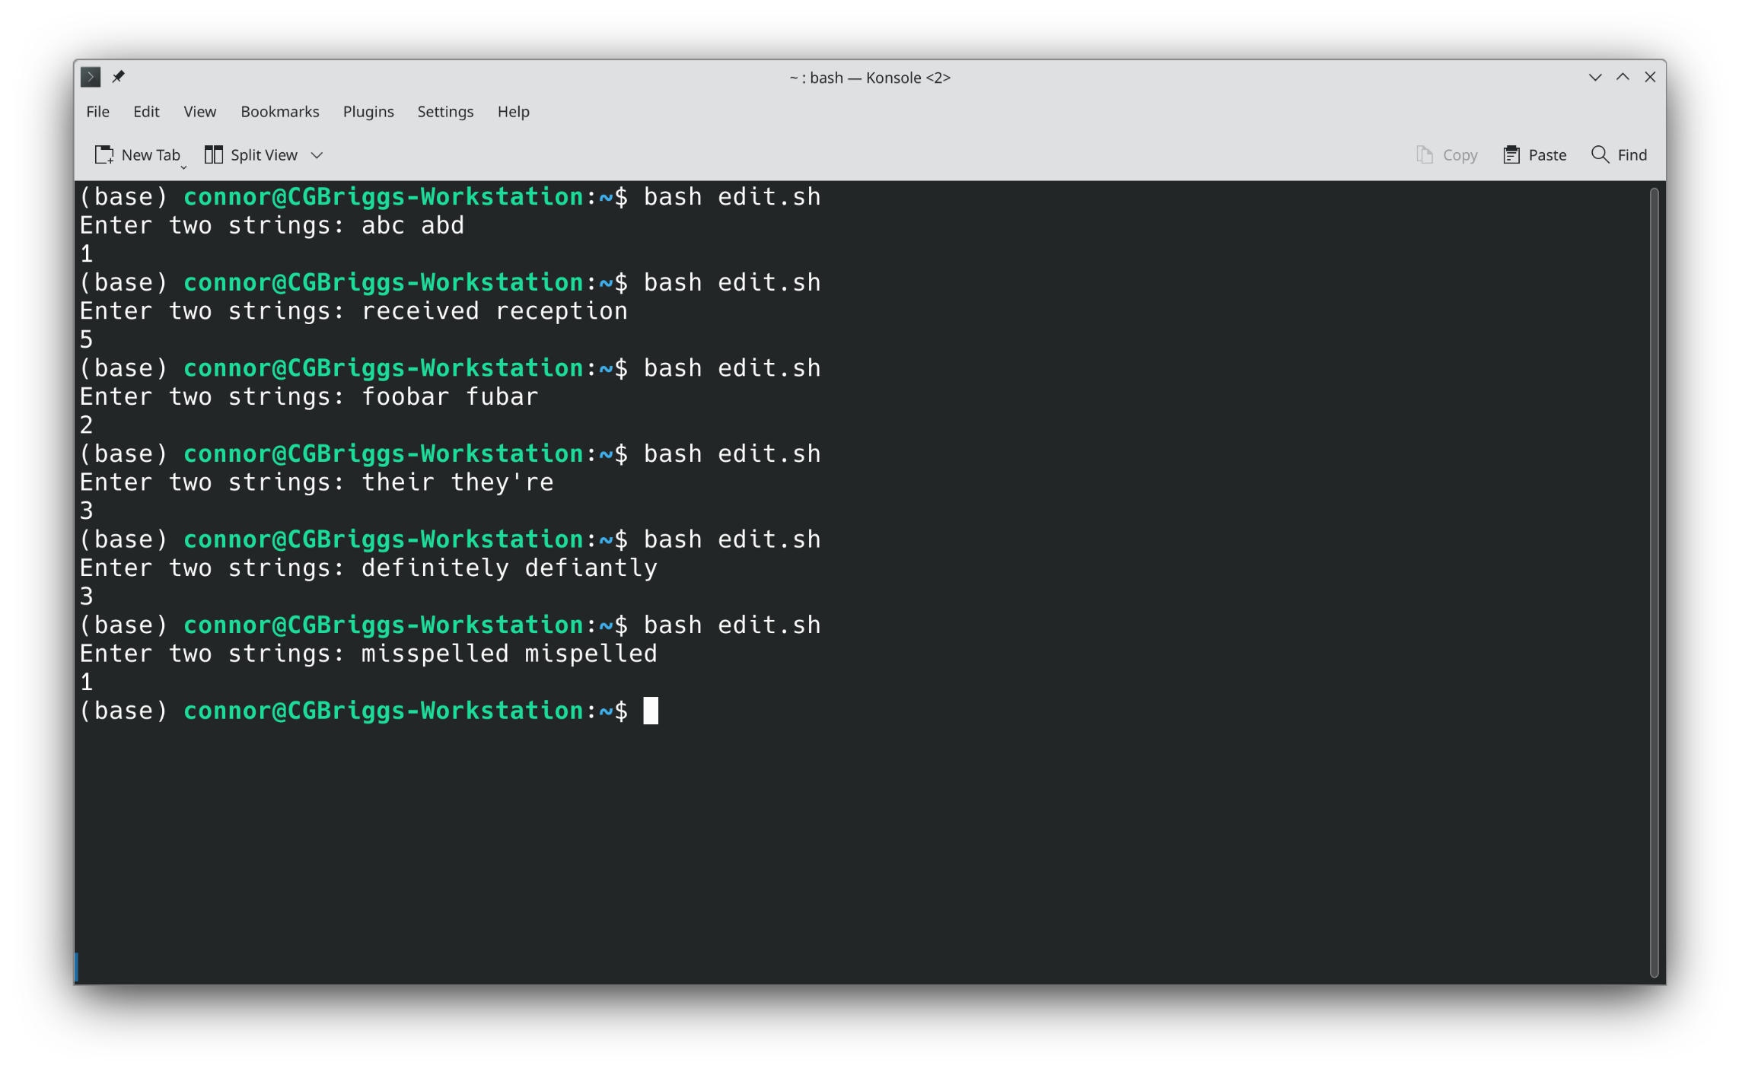
Edit Distance Output
Linux and Bash Scripting

Slide 43
Regular Expressions
Regular expressions are strings of arcane symbols used for finding things in a file
Here's an example from StackOverflow that checks for email addresses: (?:[a-z0-9!#$%&'*+/=?^_`{|}~-]+(?:\.[a-z0-9!#$%&'*+/=?^_`{|}~-]+)*|"(?:[\x01-\x08\x0b\x0c\x0e-\x1f\x21\x23-\x5b\x5d-\x7f]|\\[\x01-\x09\x0b\x0c\x0e-\x7f])*")@(?:(?:[a-z0-9](?:[a-z0-9-]*[a-z0-9])?\.)+[a-z0-9](?:[a-z0-9-]*[a-z0-9])?|\[(?:(?:(2(5[0-5]|[0-4][0-9])|1[0-9][0-9]|[1-9]?[0-9]))\.){3}(?:(2(5[0-5]|[0-4][0-9])|1[0-9][0-9]|[1-9]?[0-9])|[a-z0-9-]*[a-z0-9]:(?:[\x01-\x08\x0b\x0c\x0e-\x1f\x21-\x5a\x53-\x7f]|\\[\x01-\x09\x0b\x0c\x0e-\x7f])+)\])
These are commonly used with programs like find and grep, but are common in Python as well
Linux and Bash Scripting

Slide 44
Basic Regexes
A regex can contain a list of characters to match, as well as special groups that affect matching, and a few special characters.
A regex like "abc" will only match the string "abc"
Special characters include
The period, which matches all characters except line terminators and file terminators
The +, ?, and *, which specify repetitions
Brackets [], which specify selections
Braces {}, which specify repetitions more precicely
Parentheses (), which group sub-expressions
Linux and Bash Scripting

Slide 45
Regexes Cont.
More special characters
The dollar sign $, which matches the end of the string
The caret ^, which matches the start of the string
The caret has another use, which is when it is inside braces [^], it matches everything not inside the braces.
The dash indicates a range of numbers or letters
There are also special groups, but the exact form they take depends on the program
For instance, digits can be indicated by [[:digit:]], \d, \p{Digit}, or more directly by [0-9]
Linux and Bash Scripting

Slide 46
Regex Examples
To extract the energy values from a Molpro file:
[RU]HF(-[RU]CCSD)?
Matches RHF, UHF, RHF-RCCSD, RHF-UCCSD, UHF-RCCSD, and UHF-UCCSD, though not all are possible outputs of Molpro
To find out if Psi4 finished:
Buy a developer a (beer|coffee)!
To match any string:
.*
This means match any character zero or more times
Linux and Bash Scripting

