Slide 1
Web Scraping Tool for Critical & High-Severity OEM Vulnerabilities
PIP4004-University Project
Review-2
Batch Number: CCS-G08
Roll Number | Student Name
20211CCS0053 | Shesha Venkat Gopal K
20211CCS0065 | Chandrashekhar S
20211CCS0067 | Shubha K A
20211CCS0104 | Augustian P B
Under the Supervision of,
Dr. Nihar Ranjan Nayak
Assistant Professor
School of Computer Science and Engineering
Presidency University
Name of the Program: B.Tech
Name of the HoD: Dr. Anandaraj S P
Name of the Program Project Coordinator: Dr. Sharmasth Vali Y
Name of the School Project Coordinators: Dr. Sampath A K / Dr. Abdul Khadar A / Mr. Md Ziaur Rahman

Slide 2
Introduction
Background
Rising cybersecurity threats require constant monitoring of vendor security advisories
Organizations manage multiple OEM products, each with their own security portals
Current manual processes lead to delayed vulnerability detection and response
Security teams spend excessive time monitoring multiple sources
Problem Statement
Need for automated tracking of vulnerabilities across multiple OEM websites
Challenge of processing diverse notification formats from different vendors
Risk of missing critical vulnerabilities due to manual monitoring
Difficulty in maintaining consistent monitoring across all OEM sources
Time lag between vulnerability publication and organizational awareness

Slide 3
Introduction
Scope
Development of an intelligent web scraping system for multiple OEM websites
Implementation of smart classification for vulnerability severity assessment
Creation of standardized notification system with customizable alerts
Integration with existing security workflows
Support for major OEM security advisory pages

Slide 4
Literature Review
Research Area | Paper/Publication | Author(s) & Year | Key Findings | Relevance to Project
Software Vulnerability Detection | "Deep Learning for Software Vulnerabilities Detection Using Code Metrics" | M. Zagane, M. K. Abdi, M. Alenezi (2020) IEEE | - Deep learning applied to vulnerability detection - Code metrics analysis - Improved accuracy in identifying software vulnerabilities | - AI/ML implementation for classification - Enhanced detection accuracy - Automation of security assessments
Web Scraping Methods | "Development and implementation of effective Web Scraping methods for automated data collection and processing using Python" | Sichkariuk et al. (2024) | - Python-based scraping techniques - Automated data collection - Optimization strategies for large-scale scraping | - Direct application to the crawler and scraper module - Optimization of scraping efficiency - Handling of structured/unstructured data
Information System Vulnerabilities | "A General Framework to Understand Vulnerabilities in Information Systems" | X. Zhang et al. (2020) IEEE | - Classification of system vulnerabilities - Risk assessment strategies - Methods for mitigating security risks | - Categorization of vulnerabilities - Framework for risk assessment - Policy integration for mitigation
Web Scraping Techniques | "Web Scraping Techniques and Applications: A Literature Review" | Lotfi et al. (2021) | - Overview of web scraping methodologies - Ethical considerations - Application in cybersecurity | - Ethical and legal compliance - Performance optimization - Avoidance of scraping restrictions

Slide 5
Literature Review
Research Area | Paper/Publication | Author(s) & Year | Key Findings | Relevance to Project
Software Vulnerability Classification | "Automatic Classification Method for Software Vulnerability Based on Deep Neural Network" | G. Huang et al. (2019) IEEE | - Deep neural network for vulnerability classification - Automatic assessment models - High accuracy in severity detection | - ML-based severity classification - Automated assessment for vulnerabilities - Integration into monitoring systems
Web Crawling & Scraping | "Web Crawling and Scraping: A Survey" | G. Sharma (2024) | - Web crawling methodologies - Handling rate limiting & anti-scraping measures - Large-scale data extraction | - Scalability implementation - Avoidance of blocking mechanisms - Performance improvements
Web Scraping & Crawling | "Web Scraping or Web Crawling: State of Art, Techniques, Approaches and Application" | International Journal of Advances in Soft Computing and its Applications (2021) | - Different approaches to web crawling - Applications of web scraping in various fields - Security concerns with data collection | - Adaptation of the best web scraping techniques - Secure data collection methodologies
Security Alert Systems | "A New Surveillance and Security Alert System Based on Real-Time Motion Detection" | Al-Slemani & ZENGİN (2023) | - Real-time alert system for security - Motion-based anomaly detection - Automated notification handling | - Real-time alerting system - Automated notifications - Event-driven monitoring

Slide 6
Literature Review
Research Area | Paper/Publication | Author(s) & Year | Key Findings | Relevance to Project
Security Notification Systems | "Network Security Monitoring System Via Notification Alert" | Muwardi et al. (2021) | - Automated alert system for network security - Reduction in manual intervention - Real-time monitoring of network vulnerabilities | - Automated alert management - Priority-based notification system - Integration with monitoring dashboard
API Security | "The Role of API Security in Modern Enterprise Platforms" | International Journal for Research in Applied Science and Engineering Technology (2024) | - API security challenges - Best practices for secure API implementation - Authentication and authorization techniques | - Secure API design - Protection against API-related vulnerabilities - Access control implementation

Slide 7
Existing Methods
Manual Monitoring Systems
Direct website monitoring by security teams
Email subscription to vendor security newsletters
RSS feed monitoring for updates
Security mailing list subscriptions
Manual vulnerability database checks
Commercial Vulnerability Management Tools
Nessus: Network vulnerability scanning
Qualys: Cloud-based security solution
Rapid7: Vulnerability assessment platform
Tenable: Security exposure management
IBM Security: Enterprise vulnerability management

Slide 8
Existing Methods
3. Public Vulnerability Databases
National Vulnerability Database (NVD)
Common Vulnerabilities and Exposures (CVE)
Vendor-specific security advisories
CERT vulnerability notes
Security focus vulnerability database
Automated Solutions
OVAL-based scanners
Network vulnerability scanners
Configuration compliance tools
Patch management systems

Slide 9
Drawbacks
Time and Resource Constraints
Manual monitoring requires dedicated personnel
Significant time delay in vulnerability detection
Resource-intensive processes
Information Management Issues
Information overload from multiple sources
Inconsistent notification formats
Difficulty in prioritizing vulnerabilities
Technical Limitations
Lack of customization options
Limited OEM coverage
High cost of commercial solutions

Slide 10
Proposed Method
Automated Web Scraping Engine
Custom scrapers for each OEM website
Intelligent content extraction
Regular monitoring intervals
Data Processing System
Vulnerability classification algorithm
Severity assessment
Duplicate detection
Notification Framework
Standardized email format
Severity-based prioritization
Customizable alert settings

Slide 11
Objectives
Create an Efficient Monitoring System
Automated website scanning
Real-time vulnerability detection
Minimal manual intervention
Implement Smart Classification
Accurate severity assessment
Relevant vulnerability filtering
Priority-based categorization
Develop User-Friendly Interface
Easy OEM website management
Customizable notification settings
Intuitive dashboard

Slide 12
Methodology
Research and Analysis
OEM website structure analysis
Data extraction pattern identification
Security requirement assessment
Technology stack evaluation
Architecture planning
System Design
Web scraper architecture
Database schema design
API endpoint planning
User interface wireframes
Security framework design

Slide 13
Methodology(cont..)
Implementation
Iterative development approach
Continuous testing and validation
Performance optimization
Security implementation
Integration testing
Deployment and Maintenance
System deployment
Monitoring setup
Backup configuration
Documentation
Training materials

Slide 14
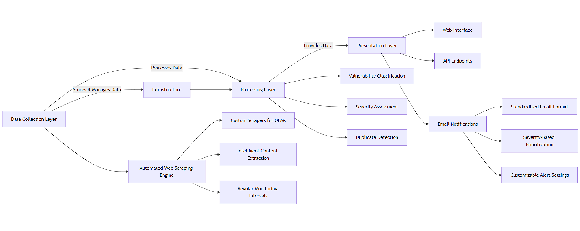
Architecture

Slide 15
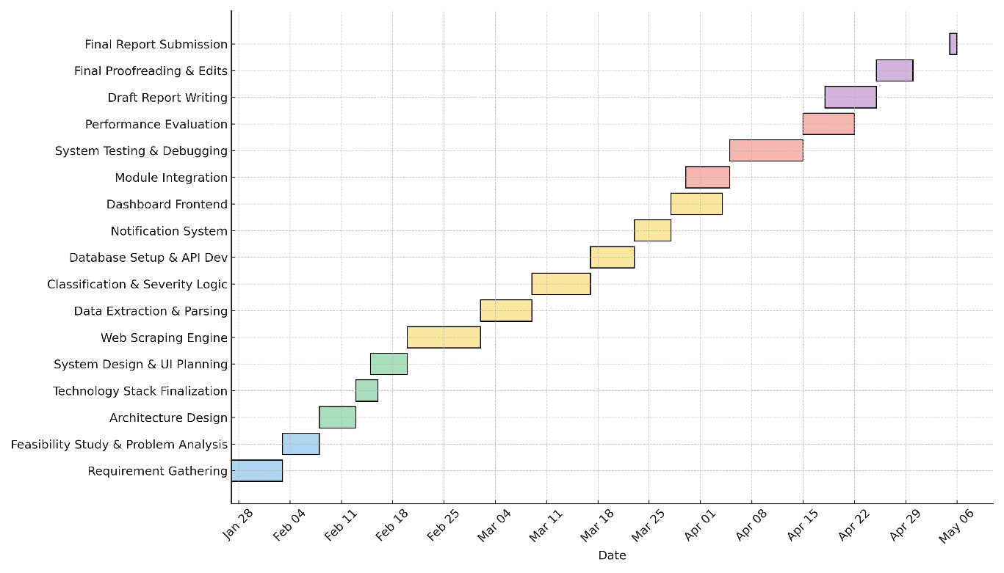
Timeline of Project

Slide 16
Outcomes
Technical Outcomes
Built a modular vulnerability monitoring system using Scrapy, Selenium, spaCy, and PostgreSQL.
Automatically scrapes and classifies advisories from static and dynamic OEM websites.
Reduces false positives using CVSS score extraction and ML-based context analysis.
Operational Outcomes
Cuts down manual workload; critical advisories processed in ~3 minutes.
Real-time alerts via email and Slack improve security response times.
Modular components allow easy updates and continuous monitoring.

Slide 17
Outcomes
Strategic Outcomes
Shifts focus from reactive to proactive cybersecurity.
Supports compliance with ISO 27001, NIST, and GDPR.
Scalable design supports new OEMs and future growth.
User & Documentation Outcomes
User-friendly interface with quick adaptation and effective alerting.
Complete documentation with APIs and setup guides ensures easy maintenance.
Exportable reports (PDF/CSV/JSON) improve decision-making and transparency.

Slide 18
Conclusion
The Web Scraping Tool for Critical & High-Severity OEM Vulnerabilities represents a significant advancement in automated security vulnerability management. This project directly addresses the critical challenge of timely vulnerability detection and notification by implementing an intelligent web scraping system that continuously monitors multiple OEM security advisory pages. Through its automated approach, the system dramatically reduces the time and resources required for vulnerability tracking, while ensuring higher accuracy and consistency in detection. The implementation of machine learning-based classification and severity assessment ensures that security teams receive relevant, prioritized notifications, effectively reducing alert fatigue and enabling faster response times. The system's modular architecture, built using modern technologies such as Python for web scraping, React for the user interface, and advanced data processing pipelines, ensures scalability and maintainability. Furthermore, the customizable notification system and user-friendly dashboard provide organizations with the flexibility to adapt the tool to their specific needs. With potential future enhancements including AI/ML capabilities, additional OEM support, and advanced analytics, this project not only solves current vulnerability management challenges but also establishes a foundation for future security automation needs. The significant reduction in manual effort, combined with improved detection accuracy and response times, makes this tool a valuable asset for organizations seeking to enhance their security posture in an increasingly complex cyber threat landscape.

Slide 19
References
[1] M. Zagane, M. K. Abdi and M. Alenezi, "Deep Learning for Software Vulnerabilities Detection Using Code Metrics," in IEEE Access, vol. 8, pp. 74562-74570, 2020, doi: 10.1109/ACCESS.2020.2988557.
[2] Sichkariuk, Ruslan & Kornilovskа, Natalia & Lurie, Iryna & Voronenko, Maria. (2024). Development and implementation of effective Web Scraping methods for automated data collection and processing using Python. Informatics. Culture. Technology. 1. 62-68. 10.15276/ict.01.2024.08.
[3] X. Zhang, H. Xie, H. Yang, H. Shao and M. Zhu, "A General Framework to Understand Vulnerabilities in Information Systems," in IEEE Access, vol. 8, pp. 121858-121873, 2020, doi: 10.1109/ACCESS.2020.3006361.
[4] Lotfi, Chaimaa & Srinivasan, Swetha & Ertz, Myriam & Latrous, Imen. (2021). Web Scraping Techniques and Applications: A Literature Review. 10.52458/978-93-91842-08-6-38.
[5] G. Huang, Y. Li, Q. Wang, J. Ren, Y. Cheng and X. Zhao, "Automatic Classification Method for Software Vulnerability Based on Deep Neural Network," in IEEE Access, vol. 7, pp. 28291-28298, 2019, doi: 10.1109/ACCESS.2019.2900462.

Slide 20
References
[6] G. Sharma, "Web Crawling and Scraping: A Survey," 2024 International Conference on Healthcare Innovations, Software and Engineering Technologies (HISET), Karad, India, 2024, pp. 190-192, doi: 10.1109/HISET61796.2024.00063.
[7] Web Scraping or Web Crawling: State of Art, Techniques, Approaches and Application. International Journal of Advances in Soft Computing and its Applications. 13. 145-168. 10.15849/IJASCA.211128.11.
[8] Al-Slemani, Ahmed & ZENGİN, Ahmet. (2023). A New Surveillance and Security Alert System Based on Real-Time Motion Detection. Journal of Smart Systems Research. 4. 31-47. 10.58769/joinssr.1262853.
[9] Muwardi, Rachmat & Gao, Hongmin & Ghifarsyam, Harun & Yunita, Mirna & Arrizki, Andika & Andika, Julpri. (2021). Network Security Monitoring System Via Notification Alert. Journal of Integrated and Advanced Engineering (JIAE). 1. 113-122. 10.51662/jiae.v1i2.22.
[10] The Role of API Security in Modern Enterprise Platforms. International Journal for Research in Applied Science and Engineering Technology. 12. 1384-1390. 10.22214/ijraset.2024.64365.

Slide 21

Project work mapping with SDG

Slide 22
Project work mapping with SDG
Goal 9: Industry, Innovation, and Infrastructure
Your tool enhances cybersecurity in Original Equipment Manufacturer (OEM) industries by identifying high-severity vulnerabilities.
It contributes to building resilient infrastructure by preventing cyber threats.
Goal 16: Peace, Justice, and Strong Institutions
By detecting and reporting vulnerabilities, your tool strengthens institutional security.
It helps governments, companies, and organizations maintain strong cybersecurity measures.
Goal 12: Responsible Consumption and Production
Your tool promotes responsible cybersecurity practices by ensuring that OEMs address critical vulnerabilities before exploitation.
It supports sustainable digital ecosystems by reducing cyber risks.
Goal 8: Decent Work and Economic Growth
Enhancing cybersecurity encourages business continuity and economic stability.
Secure digital environments protect companies and employees from cyber-related financial losses.

Slide 23
Thank You

