Slide 1
CS 417/CS 505 Design Patterns Motivation and UML Modeling
Dr. Chad Williams
Central Connecticut State University

Slide 2
Topics
Motivation
Challenges
Development activities
Object orientation
Quality system
UML

Slide 3
Motivation
Software is backbone of all major services
Initial design/development occur
Maintenance and enhancement cycle dominates cost & time
Requirements change
Functionality added
Error correction
Each change has the potential to make the system more fragile
Errors can cause serious issues
1990, AT&T had 8+ hour outage due to misplaced break statement in C program
1996, communication satellite exploded on liftoff due to number conversion error
2001, software error caused NYSE to shutdown trading floor for over an hour

Slide 4
Challenges
Complexity
Longevity and evolution
High user expectations
Iterative development compresses these

Slide 5
Development activities
Requirements analysis
Design
Implementation & unit testing
Integration & system testing
Maintenance

Slide 6
Goals of software systems
Usefulness
Timeliness
Reliability
Maintainability
Reusability
Efficiency
User friendliness

Slide 7
Factors of maintainability
Flexibility
Simplicity
Readability
How does object oriented paradigm attempt to address each of these?

Slide 8
Iterative development
Conceptualization
Establish core requirements for this iteration
OO analysis and modeling
OO design
Implementation and testing
Critical to refactor and look for emerging places where patterns make sense each iteration

Slide 9
OO analysis and modeling
Build models of system's desired behavior
Identify relevant aspects with real world
Define services provided/problems to be solved
Model is simplification of reality used to better understand the system
UML used to create use cases, class diagrams, etc. to describe these relationships precisely

Slide 10
Object-oriented design
Goal – create architecture for implementation
Represent objects, classes and relationships among them
Purpose of design ensure:
Satisfy requirements and provide desired services
Design flexible enough to accommodate future changes and enhancements
Feasible and efficient

Slide 11
Implementation
F16
Converting design into working program
Involves coding, unit testing, debugging
Concerns include
Is implementation correct?
Is implementation efficient and maintainable?
Is implementation robust, tolerate faults and recover from failures?

Slide 12
Maintenance
Goal - manage post-delivery evolution
Maintenance tasks
Removing bugs
Enhancing functionality
Adapting system to evolving needs and environments

Slide 13
Key features of iterative development
Each iteration relatively small can be completed in short period of time
Each iteration results in a release of an executable product or component, which is part of the final product
Must try to avoid the temptation to only add on. Refactoring to take advantage of design patterns is critical to avoiding code becoming increasingly fragile and greatly improves the maintainability and ease at which enhancements can be made in the future.

Slide 14
Rational Unified Process (RUP)
Guidelines for carrying out development activities
Key practices
Iterative development
Systematically elicit, organize, and manage changing requirements
Component based architecture
Visually model using UML
Continuously verify software quality
Control changes to software

Slide 15
RUP
Build models rather than paper documents
Business model: abstraction of organization
Domain model: establishes context
Use case model: functional requirements
Analysis model (optional): idea design
Design model: core model for driving implementation mapping models to solutions
Process model (optional): concurrency and synchronization
Deployment model: hardware topology
Implementation model: parts used to assemble release of physical system
Test model: paths to validate and verify system
We will cover some aspects of this

Slide 16
Modeling using UML

Slide 17
Topics
Principles and concepts
Modeling relationships and structures
Modeling requirements with use cases

Slide 18
Unified Modeling Language (UML)
Graphical notation for describing OO models
Provides standards used across projects
Notation is precise and descriptive
Allows visual models to largely replace text based documentation

Slide 19
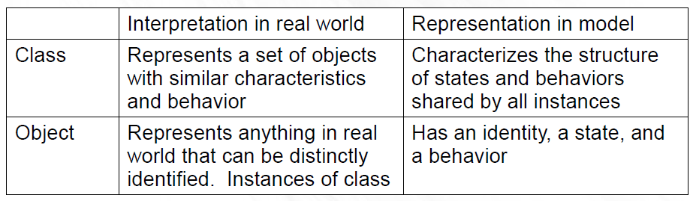
Class vs Object
Both can be viewed in terms of:
Interpretation of real world, and
Representation in model

Slide 20
Class
Defines template for creating instances/objects
Defines attributes, methods, behaviors
Names and types of all attributes
Method names, arguments (name, type), implementation
Allows all instances to be treated in a uniform fashion

Slide 21
Object
Object and instance used interchangeably
Represent a specific instance of its class
Ex. Chad is an instance of Person
Each object has its own set of attribute values or state

Slide 22
Terminology
Objects are equal if states are the same
Objects are identical if refer to same object
Accessor is a method that allows you to read the state of an object (does not change the state)
Mutator is a method that changes the state of an object
Immutable object is an object whose state may never be modified by any of its methods – i.e. state is constant

Slide 23
UML notation for classes
ClassName
field1
field2
.
.
method1
method2
.
.

Slide 24
UML notation cont.
Syntax of variable names is:
[visibility]name[[multiplicity]][type][=initial value]
Syntax of methods is:
[visibility] name([parameters]) [type]

Slide 25
Visibility
Public – Feature is accessible to any class
Protected – Feature available in the class itself, all classes in its same package, and all its subclasses
Package – Feature is accessible to the class and all classes in the same package
Private – Feature is only accessible within the class itself

Slide 26
Language syntax
Keyword | C# | C++ | Java
private | class | class | class
protected internal | same assembly and derived classes | - | -
protected | derived classes | derived classes | derived classes and/or within same package
package | - | - | within its package
public internal | same assembly | - | -
public | everybody | everybody | everybody

Slide 27
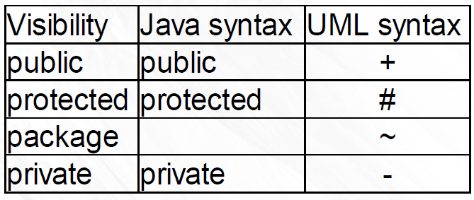
UML notation visibility

Slide 28
Simple Java class
public class Point {
private int x;
private int y;
Point(int x, int y){}
protected void move(int dx, int dy){}
public int getX(){return x;}
public int getY(){return y;}
}
Visibility will be key!

Slide 29
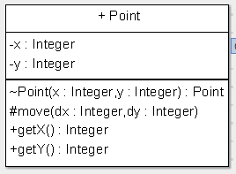
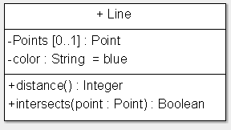
UML of Point class

Slide 30
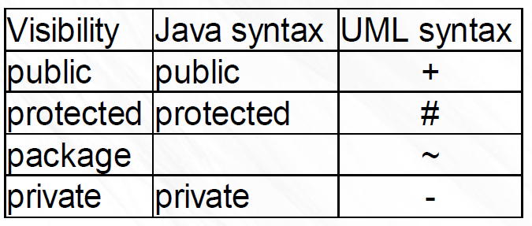
Group work
Split into groups 3 to 5 people
Make up 3 classes for 2D geometric shapes. Draw UML for them, particularly think of attributes and methods that would require different visibilities – think moving, reshaping/manipulation, calculations, checks

