Slide 1



Analysis of Algorithms
Input
Algorithm
Output

Slide 2
Running Time
Most algorithms transform input objects into output objects.
The running time of an algorithm typically grows with the input size.
Average case time is often difficult to determine.
We focus on the worst case running time.
Easier to analyze
Crucial to applications such as games, finance and robotics

Slide 3
2 lines at the grocery store
Line A:
The wait is at least 10 seconds
Line B:
The wait is at most one minute
Which line would you choose?

Slide 4
2 lines at the grocery store
Line A:
The wait is at least 10 seconds (best case)
Could be a few hours
Line B:
The wait is at most one minute (worst case)
Could be a few seconds

Slide 5
Experimental Studies
Write a program implementing the algorithm
Run the program with inputs of varying size and composition, noting the time needed:
Plot the results
#include <time.h>
clock_t start, end;
double cpu_time_used;
start = clock(); …
/* Do the work. */
end = clock();
cpu_time_used = ((double) (end - start)) / CLOCKS_PER_SEC;

Slide 6

Limitations of Experiments
implement the algorithm, which may be difficult
results may not be indicative of the running time on other inputs not included in the experiment.
compare two algorithms--same hardware and software environments must be used

Slide 7
Theoretical Analysis
Uses a high-level description of the algorithm instead of an implementation
Characterizes running time as a function of the input size, n
Takes into account all possible inputs
independent of the hardware/software environment

Slide 8
Pseudocode
High-level description of an algorithm
More structured than English prose
Less detailed than a program
Preferred notation for describing algorithms
Hides program design issues

Slide 9
Pseudocode Details
Control flow
if … then … [else …]
while … do …
repeat … until …
for … do …
Indentation replaces braces
Method declaration
Algorithm method (arg [, arg…])
Input …
Output …
Method call
method (arg [, arg…])
Return value
return expression
Expressions:
Assignment
Equality testing
n² Superscripts and other mathematical formatting allowed

Slide 10
The Random Access Machine (RAM) Model
A RAM consists of
A CPU
An potentially unbounded bank of memory cells, each of which can hold an arbitrary number or character
Memory cells are numbered and accessing any cell in memory takes unit time
2
1
0

Slide 11
Seven Important Functions (Time complexity classes)
Seven functions that often appear in algorithm analysis:
Constant ≈ 1
Logarithmic ≈ log n
Linear ≈ n
N-Log-N ≈ n log n
Quadratic ≈ n²
Cubic ≈ n³
Exponential ≈ 2^{n}
In a log-log chart, the slope of the line corresponds to the growth rate

Slide 12
Log-log chart/plot
y = xª
log y = a log x
Slope is a

Slide 13
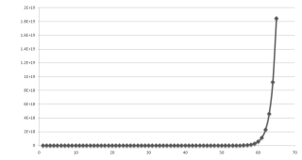
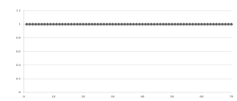
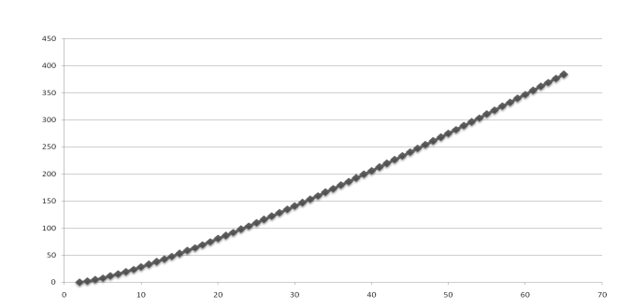
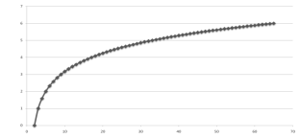
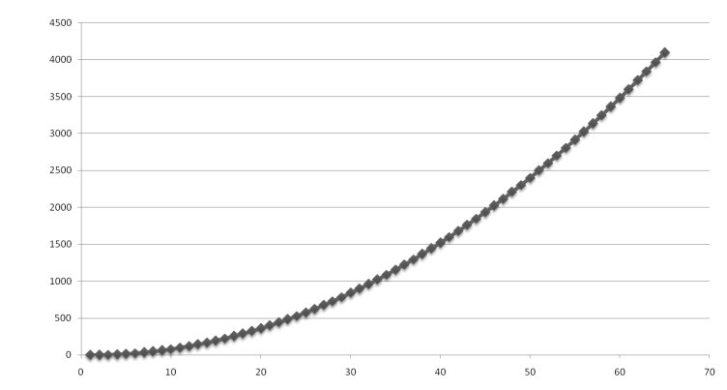
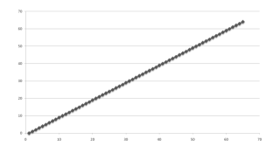
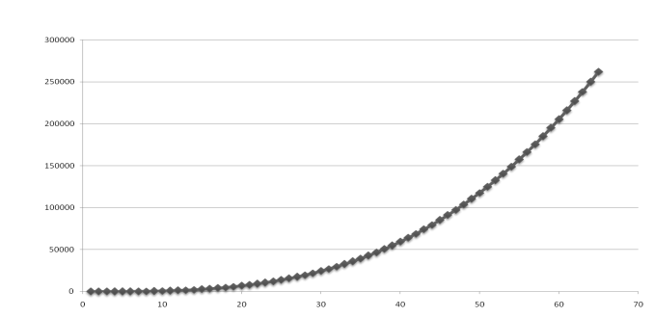
Functions Graphed Using “Normal” Scale
Slide by Matt Stallmann included with permission.
g(n) = n lg n
g(n) = 1
g(n) = 2^{n}
g(n) = n²
g(n) = lg n
g(n) = n
g(n) = n³

Slide 14
Primitive Operations
Basic computations performed by an algorithm
Identifiable in pseudocode
Largely independent from the programming language
Exact definition not important (we will see why later)
Assumed to take a constant amount of time in the RAM model
Examples:
Evaluating an expression
Assigning a value to a variable
Indexing into an array
Calling a method
Returning from a method

Slide 15
Counting Primitive Operations
determine the maximum number of primitive operations executed by an algorithm, as a function of the input size
/* returns the max value of data */
double arrayMax(double data[], int n)
{
double currentMax = data[0];
for (int i = 1; i < n; i++)
if (data[i] > currentMax)
currentMax = data[i];
return currentMax;
}
Line 4: 2 ops, 5: 2n ops, 6: 2n ops, 7: 0 to n ops, 8: 1 op

Slide 16
Estimating Running Time
Algorithm arrayMax executes 5n + 3 primitive operations in the worst case, 4n + 3 in the best case. Define:
a = Time taken by the fastest primitive operation
b = Time taken by the slowest primitive operation
Let T(n) be running time of arrayMax. Then a (4n + 3) ≤ T(n) ≤ b(5n + 3)
Hence, the running time T(n) is bounded by two linear functions

Slide 17
Growth Rate of Running Time
Changing the hardware/ software environment
Affects T(n) by a constant factor, but
Does not alter the growth rate of T(n)
The linear growth rate of the running time T(n) is an intrinsic property of algorithm arrayMax

Slide 18
Why Growth Rate Matters
Slide by Matt Stallmann included with permission.
if runtime is... | time for n + 1 | time for 2 n | time for 4 n
c lg n | c lg (n + 1) | c (lg n + 1) | c(lg n + 2)
c n | c (n + 1) | 2c n | 4c n
c n lg n | ~ c n lg n + c n | 2c n lg n + 2cn | 4c n lg n + 4cn
c n² | ~ c n² + 2c n | 4c n² | 16c n²
c n³ | ~ c n³ + 3c n² | 8c n³ | 64c n³
c 2^{n} | c 2 ^{n+1} | c 2 ^{2n} | c 2 ^{4n}
runtime
quadruples
when problem
size doubles

Slide 19
Counting Key Operations
Comparison: line 6
Input size: n
/* returns the max value of data */
double arrayMax(double data[], int n)
{
double currentMax = data[0];
for (int i = 1; i < n; i++)
if (data[i] > currentMax)
currentMax = data[i];
return currentMax;
}
How many comparisons?

Slide 20
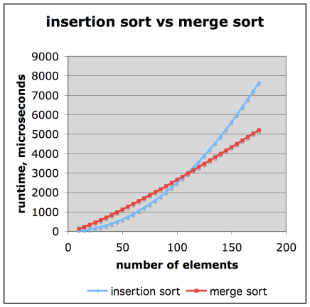
Comparison of Two Algorithms
Slide by Matt Stallmann included with permission.
insertion sort is
n² / 4
merge sort is
2 n lg n
sort a million items?
insertion sort takes
roughly 70 hours
while
merge sort takes
roughly 40 seconds
This is a slow machine, but if
100 x as fast then it’s 40 minutes
versus less than 0.5 seconds

Slide 21
Constant Factors
The growth rate is not affected by
constant factors or
lower-order terms
Examples
10²n + 10⁵ is a linear function
10⁵n² + 10⁸n is a quadratic function

Slide 22
Big-Oh Notation
Given functions f(n) and g(n), we say that f(n) is O(g(n)) if there are positive constants K and n₀ such that
f(n) ≤ Kg(n) for n ≥ n₀

Slide 23
Big-Oh Notation
Given functions f(n) and g(n), we say that f(n) is O(g(n)) if there are positive constants K and n₀ such that
f(n) ≤ Kg(n) for n ≥ n₀
Example: 2n + 10 is O(n)
2n + 10 ≤ Kn
10 ≤ Kn - 2n
10/(K − 2) ≤ n
10≤ n (if K is 3)
Pick K = 3 and n₀ = 10

Slide 24
Big-Oh Notation
Given functions f(n) and g(n), we say that f(n) is O(g(n)) if there are positive constants K and n₀ such that
f(n) ≤ Kg(n) for n ≥ n₀
Example: 2n + 10 is O(n)
2n + 10 ≤ Kn
10 ≤ Kn - 2n
10/(K − 2) ≤ n
10≤ n (if K is 3)
Pick K = 3 and n₀ = 10
What is the significance of K and n₀?

Slide 25
Big-Oh Example
Example: the function n² is not O(n)
n² ≤ Kn
n ≤ K
The above inequality cannot be satisfied since K must be a constant

Slide 26
More Big-Oh Examples
7n - 2
7n-2 is O(n)
need c > 0 and n₀ ≥ 1 such that 7 n - 2 ≤ K n for n ≥ n₀
this is true for K = 7 and n₀ = 1

Slide 27
More Big-Oh Examples
7n - 2
7n-2 is O(n)
need K > 0 and n₀ ≥ 1 such that 7 n - 2 ≤ K n for n ≥ n₀
this is true for K = 7 and n₀ = 1
3 n³ + 20 n² + 5
3 n³ + 20 n² + 5 is O(n³)
need K > 0 and n₀ ≥ 1 such that 3 n³ + 20 n² + 5 ≤ K n³ for n ≥ n₀
this is true for K = 4 and n₀ = 21

Slide 28
More Big-Oh Examples
7n - 2
7n-2 is O(n)
need K > 0 and n₀ ≥ 1 such that 7 n - 2 ≤ K n for n ≥ n₀
this is true for K = 7 and n₀ = 1
3 n³ + 20 n² + 5
3 n³ + 20 n² + 5 is O(n³)
need K > 0 and n₀ ≥ 1 such that 3 n³ + 20 n² + 5 ≤ K n³ for n ≥ n₀
this is true for K = 4 and n₀ = 21
3 log n + 5
3 log n + 5 is O(log n)
need K > 0 and n₀ ≥ 1 such that 3 log n + 5 ≤ K log n for n ≥ n₀
this is true for K = 8 and n₀ = 2

Slide 29
Big-Oh and Growth Rate
The big-Oh notation gives an upper bound on the growth rate of a function
The statement “f(n) is O(g(n))” means that the growth rate of f(n) is no more than the growth rate of g(n)
We can use the big-Oh notation to rank functions according to their growth rate
 | f(n) is O(g(n)) | g(n) is O(f(n))
g(n) grows more | Yes | No
f(n) grows more | No | Yes
Same growth | Yes | Yes

Slide 30
Big-Oh Shortcuts
If is f(n) a polynomial of degree d, then f(n) is O(n^{d}), i.e.,
Drop lower-order terms
Drop constant factors

Slide 31
Big-Oh Shortcuts
If is f(n) a polynomial of degree d, then f(n) is O(n^{d}), i.e.,
Drop lower-order terms
Drop constant factors
Use the smallest possible class of functions
Say “2n is O(n)” instead of “2n is O(n²)”
tighter upper bound

Slide 32
Big-Oh Shortcuts
If is f(n) a polynomial of degree d, then f(n) is O(n^{d}), i.e.,
Drop lower-order terms
Drop constant factors
Use the smallest possible class of functions
Say “2n is O(n)” instead of “2n is O(n²)”
tighter upper bound
Use the simplest expression of the class
Say “3n + 5 is O(n)” instead of “3n + 5 is O(3n)”

Slide 33
Asymptotic Algorithm Analysis
The asymptotic analysis of an algorithm determines the running time in big-Oh notation
To perform the asymptotic analysis
We find the worst-case number of key operations executed as a function of the input size
We express this function with big-Oh notation
Example:
We say that algorithm arrayMax “runs in O(n) time”
Since constant factors and lower-order terms are eventually dropped anyhow, we can disregard them when counting key operations

Slide 34
Computing Prefix Averages
two algorithms for prefix averages
The i-th prefix average of an array X is
average of the first (i + 1) elements of X:
A[i] = (X[0] + X[1] + … + X[i])/(i+1)
Computing the array A of prefix averages of another array X has applications to financial analysis

Slide 35
Prefix Averages (Quadratic)
The following algorithm computes prefix averages in quadratic time by applying the definition
/*calculate an array a such that for all j, a[j] is the average of x[0], …, x[j]*/
void prefixAverage(double x[], int n, double a[])
{
for (int j = 0; j < n; j++)
{
double total = 0;
for (int i = 0; i <= j; i++)
total += x[i];
a[j] = total / (j + 1);
}
}

Slide 36
Arithmetic Progression
The running time of prefixAverage1 is O(1 + 2 + …+ n)
The sum of the first n integers is n(n + 1) / 2
There is a simple visual proof of this fact
Thus, algorithm prefixAverage1 runs in O(n²) time

Slide 37
Prefix Averages 2 (Linear)
The following algorithm uses a running summation to improve the efficiency
/*calculate an array a such that for all j, a[j] is the average of x[0], …, x[j]*/
void prefixAverage2(double x[], int n, double a[])
{
double total = 0;
for (int j = 0; j < n; j++)
{
total += x[j];
a[j] = total / (j + 1);
}
}
Algorithm prefixAverage2 runs in O(n) time!

Slide 38
Math you need to Review
Summations
Powers
Logarithms
Proof techniques
Basic probability
Properties of powers:
a^{(b+c)} = a^{b}a ^{c}
a^{bc} = (a^{b})^{c}
a^{b} /a^{c} = a^{(b-c)}
b = a ^{log}_{a}^{b}
b^{c} = a ^{c*log}_{a}^{b}
Properties of logarithms:
log_{b}(xy) = log_{b}x + log_{b}y
log_{b} (x/y) = log_{b}x - log_{b}y
log_{b}xa = alog_{b}x
log_{b}a = log_{x}a/log_{x}b

Slide 39
Relatives of Big-Oh
big-Omega
f(n) is Ω(g(n)) if there is a constant K > 0 and an integer constant n₀ ≥ 1 such that
f(n) ≥ K g(n) for n ≥ n₀

Slide 40
Relatives of Big-Oh
big-Omega
f(n) is Ω(g(n)) if there is a constant K > 0 and an integer constant n₀ ≥ 1 such that
f(n) ≥ K g(n) for n ≥ n₀
big-Theta
f(n) is Θ(g(n)) if there are constants K’ > 0 and K’’ > 0 and an integer constant n₀ ≥ 1 such that
K’g(n) ≤ f(n) ≤ K’’g(n) for n ≥ n₀

Slide 41
Intuition for Asymptotic Notation
big-Oh
f(n) is O(g(n)) if f(n) is asymptotically less than or equal to g(n)
big-Omega
f(n) is Ω(g(n)) if f(n) is asymptotically greater than or equal to g(n)
big-Theta
f(n) is Θ(g(n)) if f(n) is asymptotically equal to g(n)

Slide 42
Example Uses of the Relatives of Big-Oh
5n² is Ω(n²)
5n² is Ω(n²) if there is a constant K > 0 and an integer constant n₀ ≥ 1 such that 5n² ≥ K n² for n ≥ n₀
let K = 5 and n₀ = 1

Slide 43
Example Uses of the Relatives of Big-Oh
5n² is Ω(n²)
f(n) is Ω(g(n)) if there is a constant K > 0 and an integer constant n₀ ≥ 1 such that 5n² ≥ K n² for n ≥ n₀
let K = 5 and n₀ = 1
5n² is O(n²)
5n² is O(n) if there is a constant K’ > 0 and an integer constant n₀ ≥ 1 such that 5n² ≤ K’ n² for n ≥ n₀
let K’ = 5 and n₀ = 1

Slide 44
Example Uses of the Relatives of Big-Oh
5n² is Ω(n²)
f(n) is Ω(g(n)) if there is a constant K > 0 and an integer constant n₀ ≥ 1 such that 5n² ≥ K n² for n ≥ n₀
let K = 5 and n₀ = 1
5n² is O(n²)
5n² is Θ(n²)
5n² is O(n) if there is a constant k > 0 and an integer constant n₀ ≥ 1 such that 5n² ≤ K’ n² for n ≥ n₀
let K’ = 5 and n₀ = 1
5n² is Θ(n²) if 5n² is Ω(n²) and O(n²).
let K = 5, K’ = 5 and n₀ = 1

Slide 45
Example of Big-Oh and Relatives
2n + 10 is O(n)
2n + 10 ≤ Kn
10 ≤ Kn - 2n
10/(K − 2) ≤ n
10 ≤ n (let K be 3)
K = 3 and n₀ = 10

Slide 46
Example of Big-Oh and Relatives
2n + 10 is O(n)
2n + 10 ≤ Kn
10 ≤ Kn - 2n
10/(K − 2) ≤ n
10 ≤ n (let K be 3)
K = 3 and n₀ = 10
2n + 10 is Ω(n)
2n + 10 ≥ K’n
(2-K’)n + 10 ≥ 0
n + 10 ≥ 0 (let K’ be 1)
n ≥ -10
K’ = 1 and n₀ = 1

Slide 47
Example of Big-Oh and Relatives
2n + 10 is O(n)
2n + 10 ≤ Kn
10 ≤ Kn - 2n
10/(K − 2) ≤ n
10 ≤ n (let K be 3)
K = 3 and n₀ = 10
2n + 10 is Ω(n)
2n + 10 ≥ K’n
n ≥ -10 (let K’ be 1)
K’ = 1 and n₀’ = 1
2n + 10 is Θ(n)
K = 3, K’ = 1
n₀ = 10 (larger of the two n₀’s)

Slide 48
Example of Big-Oh and Relatives
2n + 10 is O(n)
2n + 10 ≤ Kn
10 ≤ Kn - 2n
10/(K − 2) ≤ n
10 ≤ n (let K be 3)
K = 3 and n₀ = 10
2n + 10 is Ω(n)
2n + 10 ≥ K’n
n ≥ -10 (let K’ be 1)
K’ = 1 and n₀’ = 1
2n + 10 is Θ(n)
K = 3, K’ = 1
n₀ = 10 (larger of the two n₀’s)

Slide 49
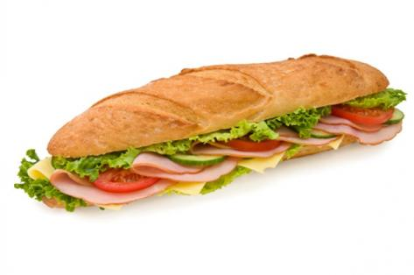
Summary
O(g(n)) [upper bound]
Original function
f(n) [time, space]
Ω(g(n)) [lower bound]

