Slide 1
Introduction

Slide 2
What is object Oriented Analysis and Design?
Object–Oriented Analysis and Design (OOA/D)
identifying software engineering requirements and
developing software specifications
software system’s object model,
    comprises of interacting objects.
Notes:
OOA/D focuses on the mapping of the requirements to the design in terms of representing objects that interact with each other. So as we design we will start thinking in terms of objects that need to be developed.

Slide 3
How do we work towards a structured OOA/D approach?
How to utilize a graphical approach to representing the software design using Unified Modeling Language (UML)?
What are some of the principles and patterns?
What kind of a process encompasses these elements?
Notes:
The feature that I like best about the Unified Process is that it proceeds in small steps from requirements to design. There is very little need for a “moment of inspiration”. Every other methodology that I have used has had some sort of disconnect between requirements and design and/or between design and code. For example, in structured analysis and design, there are heuristics to guide you in going from the data flow diagrams to code, but actually doing it requires a certain amount of inspiration. I think you will appreciate the relative ease in moving from step to step in the Unified Process.

Slide 4
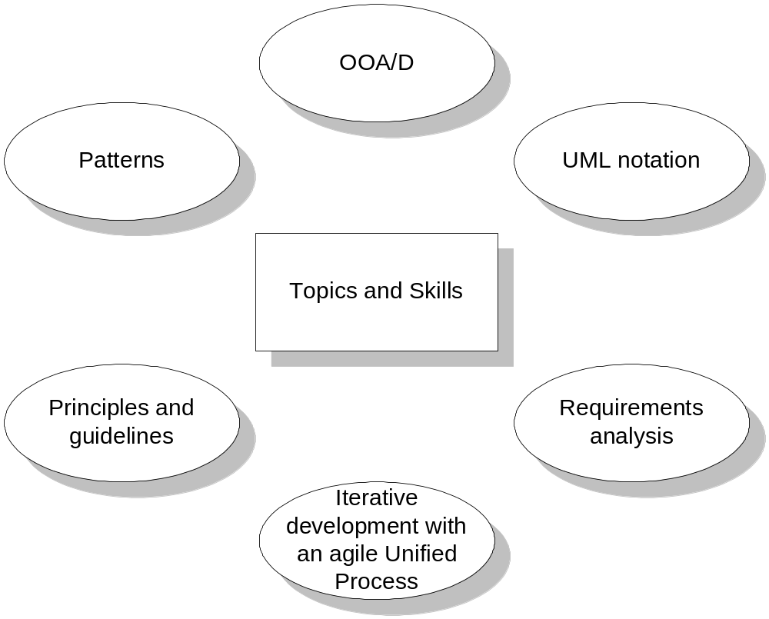
Focus on topics covered in this approach
Notes:
As we design software our focus will be on applying UML and patterns which allows to represent software objects to specify what the software will accomplish as the objects interact, assigning responsibility to the software objects. The process that we will be utilizing will be iterative development which is focused on incremental development at each iteration. Requirements analysis is conducted by writing use cases.

Slide 5
Skills required for OOA/D
Critical capability in understanding the required functionalities and assigning it to software objects
Investigation of the problem and requirements: Analysis
Conceptual solution to meet the requirements: Design

Slide 6
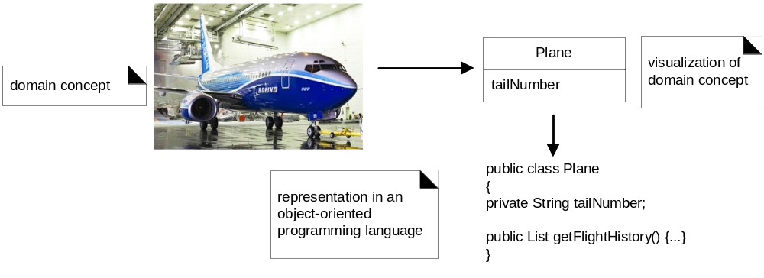
Representation of Objects for OOA/D as in Avionics
Notes:
Identify the objects or components, then the design where you represent the architecture with the connections or interactions

Slide 7
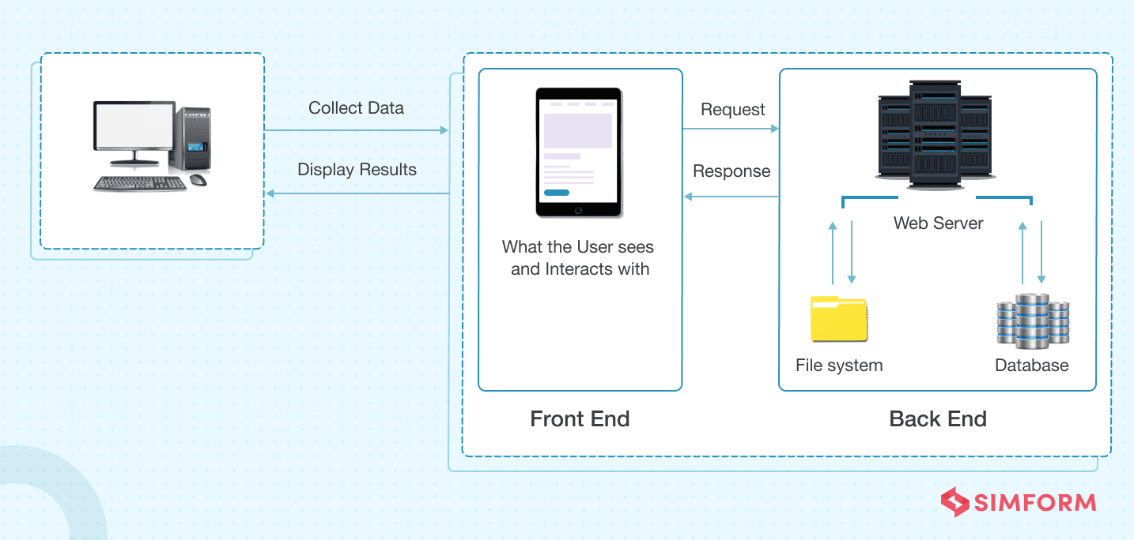
Representation of Objects for OOA/D as in Web Architecture
https://www.simform.com/blog/web-application-architecture/

Slide 8
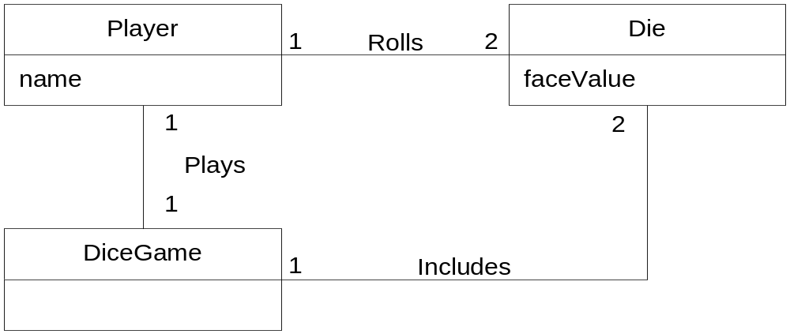
Domain Model of Dice Game
Notes:
The Domain Model is a sketch that you make in order to verify that you understand the problem. IT IS NOT SOFTWARE! We use UML Class Diagrams to represent Conceptual Classes, those entities that are in the real world. We also capture any simple attributes that the classes possess, e.g., the Player has a name. Your least computer savvy friend should be able to understand this diagram. Later, we select some of these conceptual class names as names of our actual software classes.

Slide 9
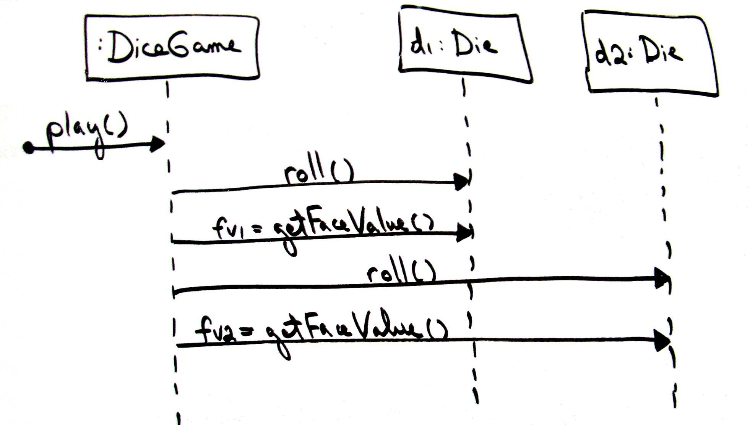

Sequence Diagram of Dice Game
Notes:
Once we have our Use Cases (not shown here) and our Domain Model, we can begin to design our software. Here we have picked up the names DiceGame and Die from our Domain Model. From the Use Case, we know that the Player (Not Included) rolls two dice. That sequence is show in this Sequence Diagram. (Note: most of us would return the value rolled from the roll() method. The getFaceValue is included to add just a little complexity.)
Notation: the object class name is found to the right of the colon. If the object name is important it is included to the left of the colon. The method names are annotated on the arrowed line. In this case, the object class Die contains a roll() method and a getFaceValue() method.

Slide 10
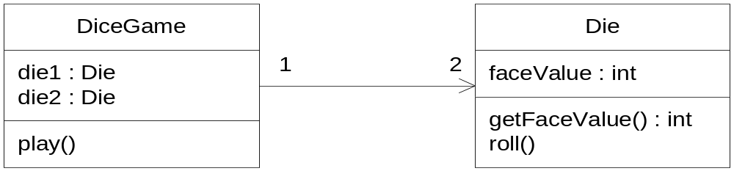
Design Class Diagram of Dice Game
Notes:
We may now collect all of our information into a Design Class Diagram to be used as a basis for coding. Notice that a skeleton program could be prepared from this diagram. We only have to add the code for the methods.

Slide 11
What is UML?
A visual language for specifying the objects/components a software or system requires that will help accomplish the required task.
UML profiles: Extension mechanism
Model drive architecture

Slide 12
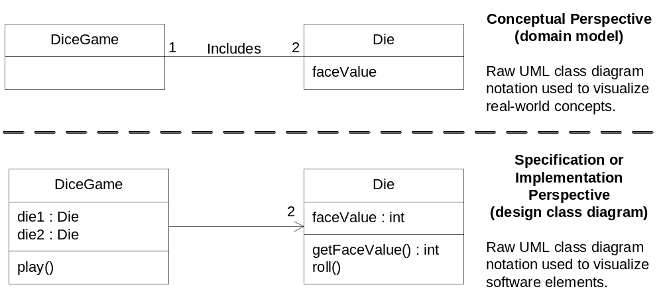
Different Perspectives with UML
Notes:
To compare: We begin with a Domain Model that explains the Conceptual Objects and their Associations in the real world. Using that “what” information we produce the specification for our program in the form of a Design Class Diagram.

