Slide 1
Chapter 2: Iterative, Evolutionary and Agile

Slide 2
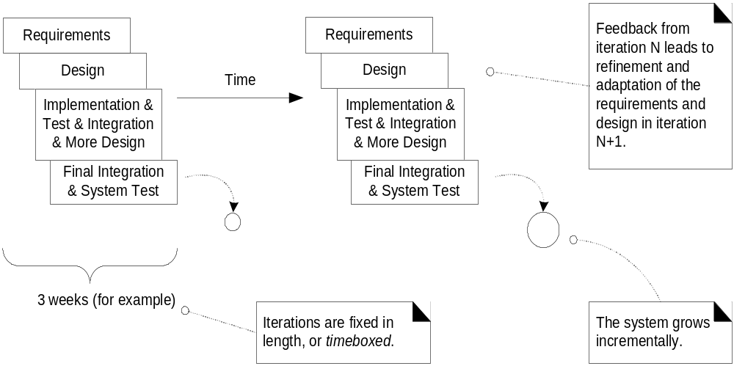
Iterative Development
Notes:
In the Software Engineering Course you studied a number of software lifecycle models. The Unified Process is an Iterative Development model. Basically, in a short period of time you develop requirements and design, implement and integrate code, perform system test and create a baseline iteration or build. You then repeat the steps adding to the former build to create a new build.

Slide 3
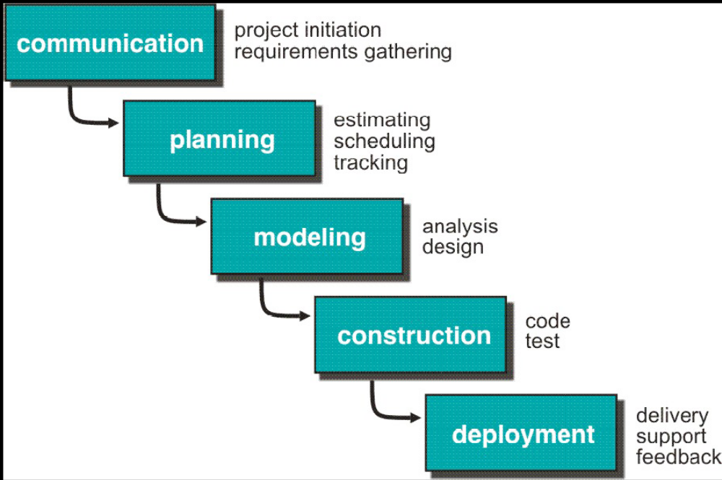
The Waterfall Model

Slide 4
What is Unified Process?
An iterative and incremental software development process
Risk driven development
Architecture centric
A customizable, extensible framework
Rational Unified Process was trademarked and formalized by IBM
Notes:
Early detection of “Is the product being built the right product” needed by the customer.

Slide 5
Iterative and incremental process is adaptive
Each iteration focuses on small subset of requirements:
  Design, implement, test
    Quick testing allows quick feedback
    Less project failure
    Early mitigation of risk
    Early visible progress
    Managed complexity
    Process improvement feedback

Slide 6
Evolving Iteration
Timeboxed → fixed in length
If difficult to meet deadline
  De-scope
  Prioritize requirements
  Include the missed requirements (tasks or subtasks) in the next iteration
Change is the constant
  Waterfall process is failure prone

Slide 7
Agile Methods
Timeboxed iterative and evolutionary development
Incremental delivery
Adaptive planning
Agile modeling
  UML to understand the requirements
Notes:
Responding to change, communicating progress and changes to customers, make customers collaborators providing requirements

Slide 8
Agile UP
UP activities and artifacts
  Optional only perform if it adds value
  Early programming
UP is iterative and evolutionary
  Requirements and design not completed before implementation
UML with agile practices
Plan for the project
  Phase plan
  Iteration plan

Slide 9
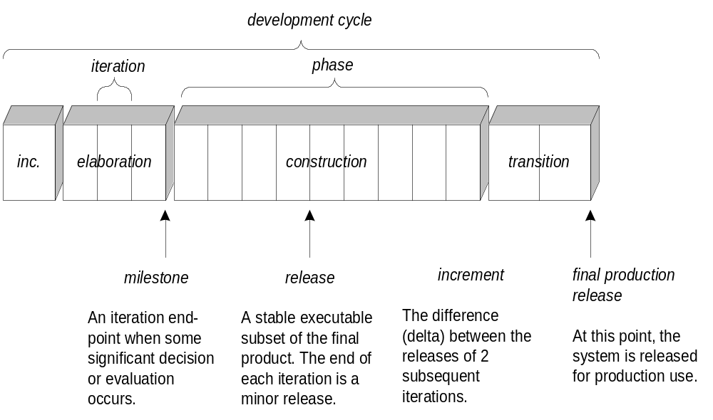
Schedule oriented terms in UP
Notes:
Many people think that the UP is a waterfall process since it is composed of 4 serial phases: Inception, Elaboration, Construction, and Transition. That is not the case, since each phase is composed of some number of shorter iteration. The idea is that you start with some concept (Inception), think through the concept in greater detail, maybe to determine whether or not to continue (Elaboration), then build the system in short iterations (Construction) and prepare to deliver it in some way (Transition).

Slide 10
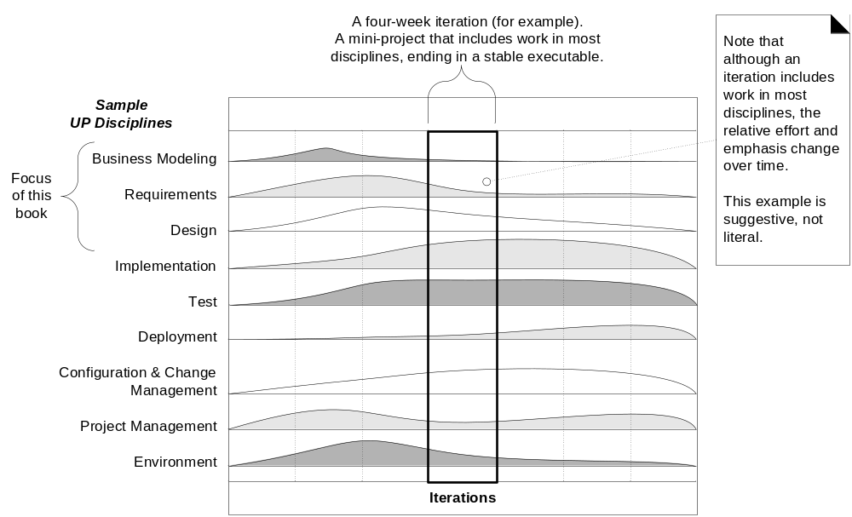
UP disciplines
Notes:
The key is the second dimension of the model: the application of the various UP disciplines. The curves in this illustration represent the relative labor involved in each discipline by phase. Notice that the heavy requirements activity occurs during the early phases, but continues throughout the lifecycle. In other words, there is no attempt to freeze a complete set of requirements prior to beginning coding.

Slide 11
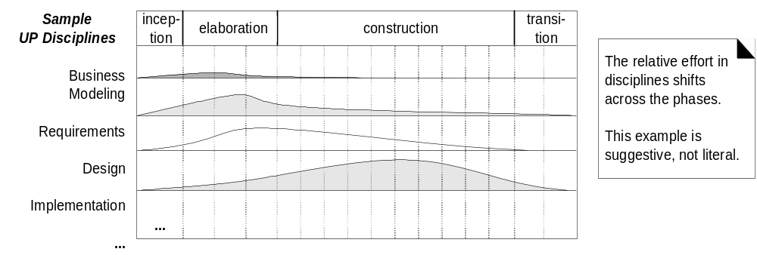
Disciplines and Phases
Notes:
Our main focus is on Design; however, we will work just enough Business (Domain) Modeling and Requirements to have a foundation for our design. We will also code just enough to prove out our designs.

Slide 12
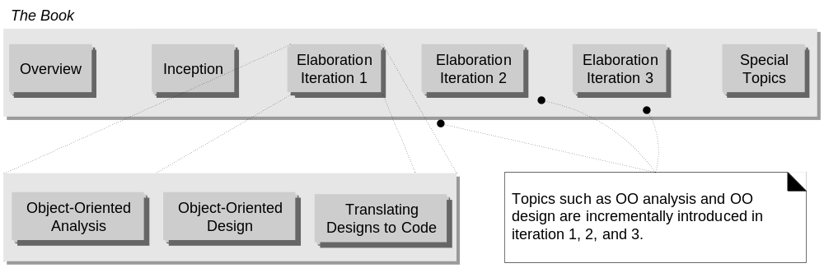
UP Phases and Iteration

Slide 13
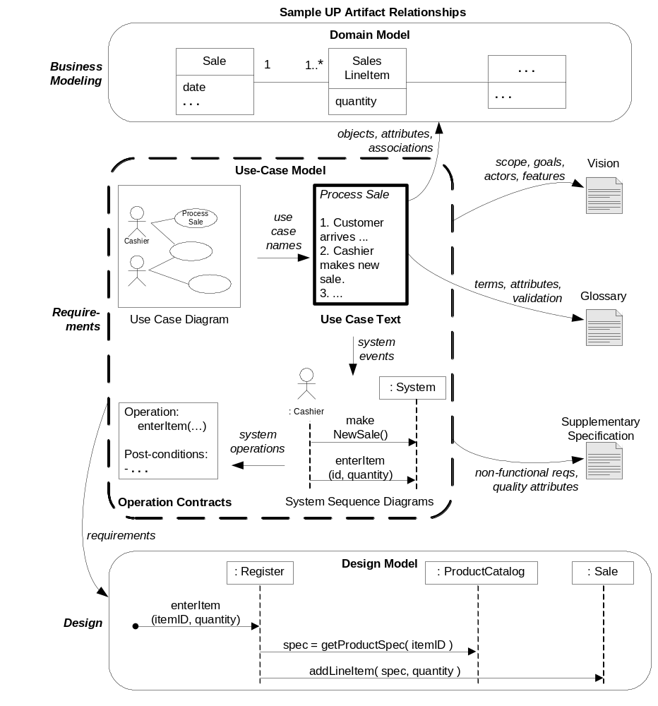
Notes:
This diagram occurs throughout our textbook and you should refer to it frequently. Notice that Use Cases fall under the Requirements Discipline. The role of Use Cases is to help us understand the behavior of the system in terms that the customer/user can understand. We then develop a Domain Model that helps us understand the “things” that are in the real world problem and the associations among those “things”. This is the main tool in the Business Modeling Discipline. Again, these products are developed iteratively, but with most of the effort occurring during the early phases of the lifecycle.
Once we have a set of Use Cases and additions to the Domain Model for a given iteration, we have a pretty good idea of what we have to design.

