Slide 1
Case Studies
Chapter 3

Slide 2
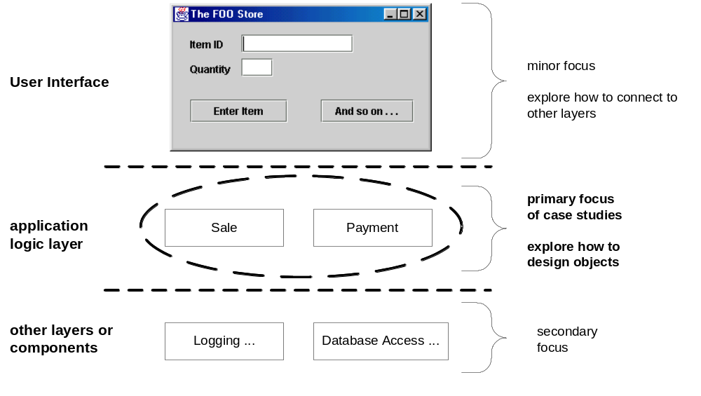
Object Oriented System Case Study

Slide 3
Why focus OOA/D on Application Logic Layer
Other layers are technology/platform dependent
OO design is similar across layers in core logic layer
  Reusability
  Maintainability

Slide 4
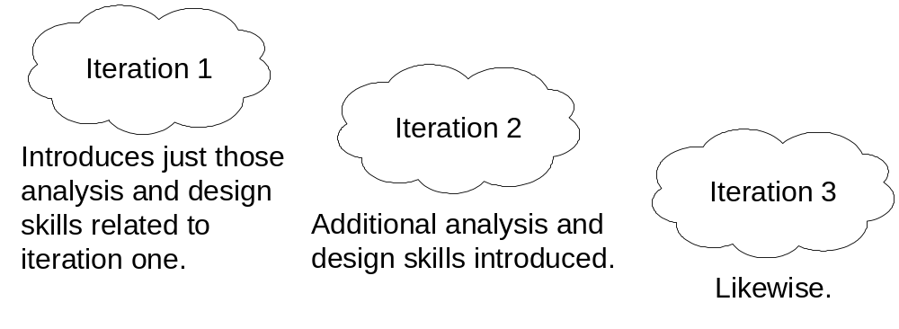
Case Study: Iterative Development

Slide 5
Case Study
Next Generation Point of Sale
  Record sales
  Handle payments
  Interfaces to service applications
Monopoly Game System

