Slide 1
Chapter 4
Inception

Slide 2
Inception is a short initial step
What is the vision or business case for this project?
Is it feasible?
Buy and/or build?
Rough estimate of cost, Rough Order of Magnitude (ROM): Is it $10K to $100K or in the millions?
Should we proceed or stop?

Slide 3
Inception Definition
Inception in one sentence: Envision the product scope, vision and business case.
The main problem solved in one sentence: Do the stakeholders have basic agreement on the vision of the project, and is it worth investing in serious investigation?

Slide 4
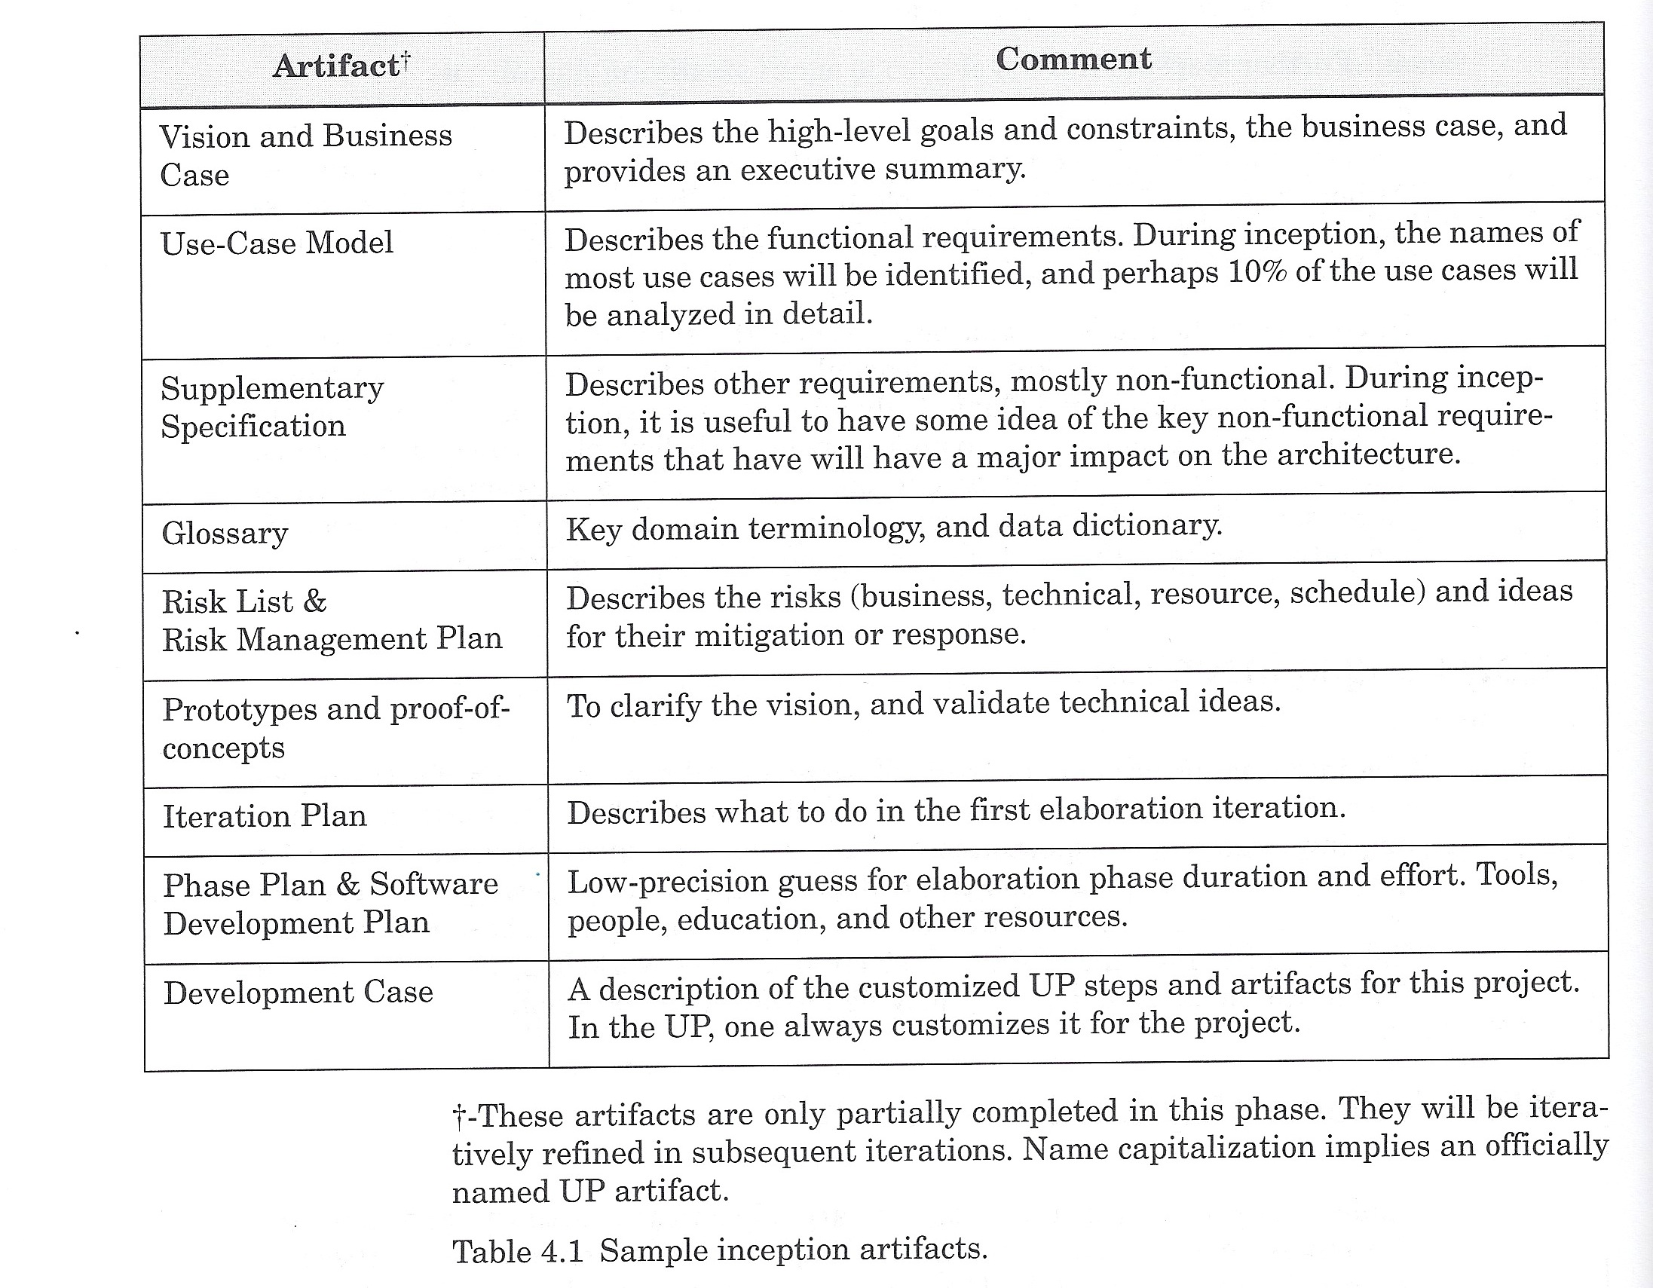
Inception artifacts

