Slide 1
Chapter 13
Logical Architecture

Slide 2
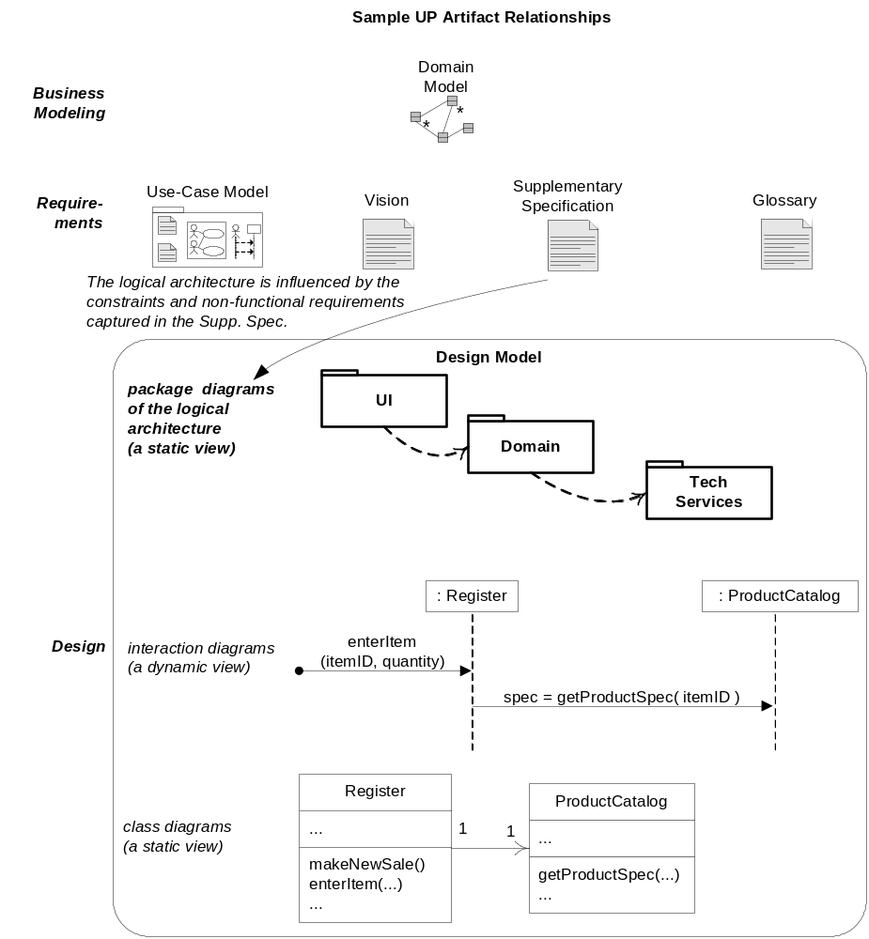
Sample UP Artifacts

Slide 3
Logical architecture
Large scale organization of software classes into packages
Higher layers calls for services from the lower layers
  UI
  Application Logic and Domain Objects
  Technical Services

Slide 4
Software architecture
Organization of Software Systems
Selection of structural elements
Interfaces by which system is composed
Behavior as specified in collaborations

Slide 5
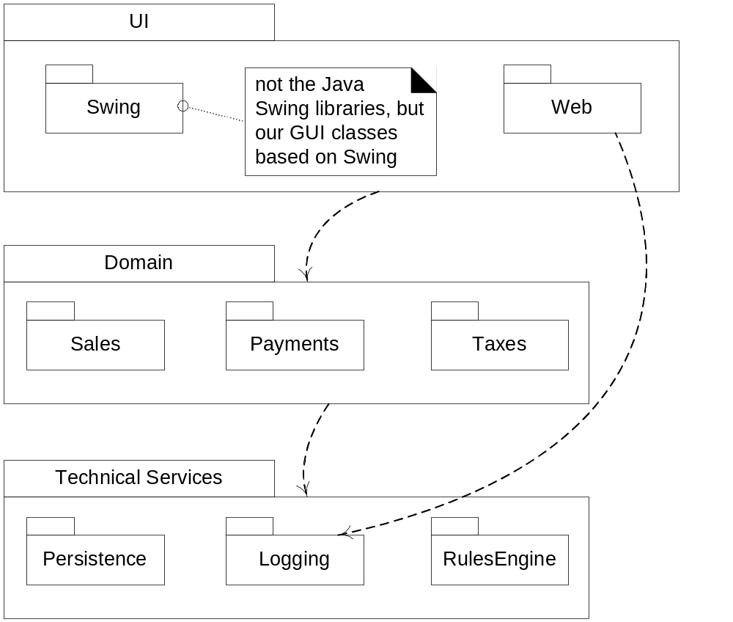
Layers in package diagram
Notes:
Higher layers calls upon services from lower layers

Slide 6
Dependency between packages
Coupling among packages are shown as dependency in UML diagrams
UML dependency line is a dashed arrow pointing towards the depended on package

Slide 7
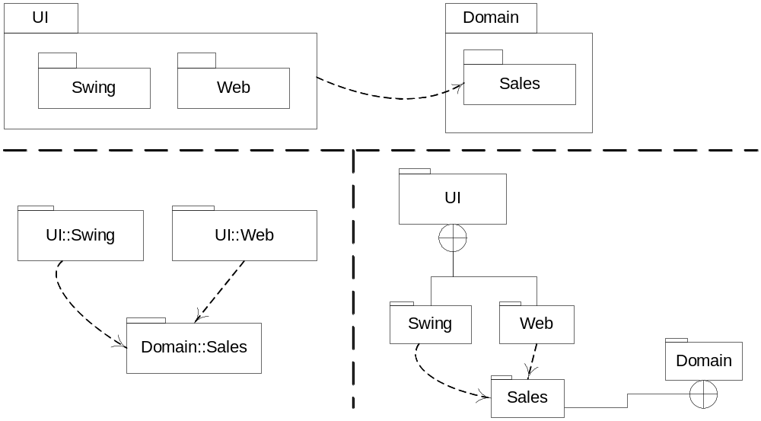
Alternate UML approaches

Slide 8
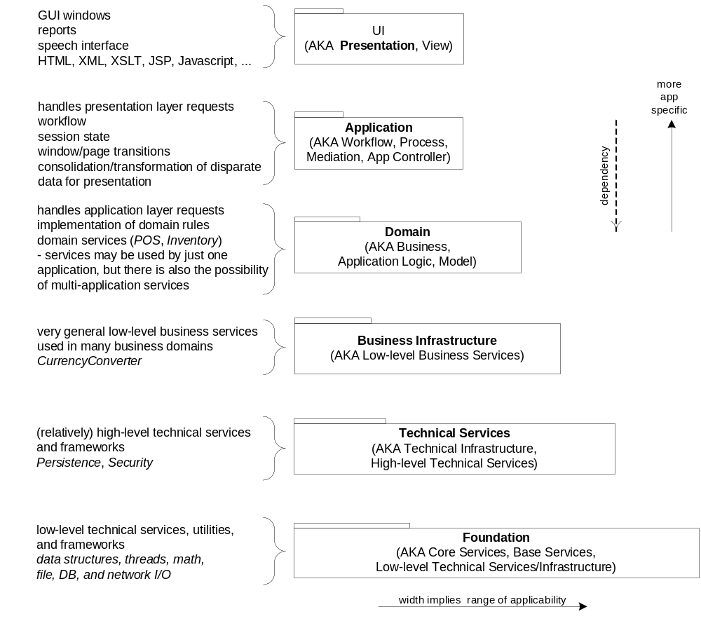
Common layers in information systems logical architecture

Slide 9
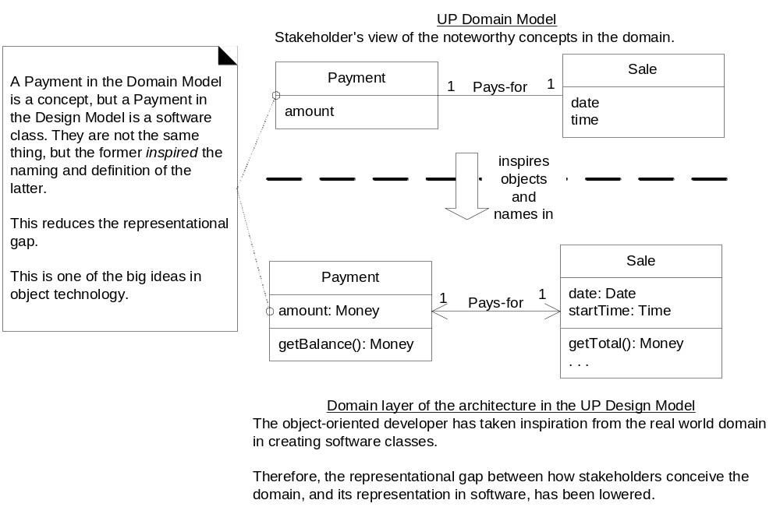
Common layers in information systems LA

Slide 10
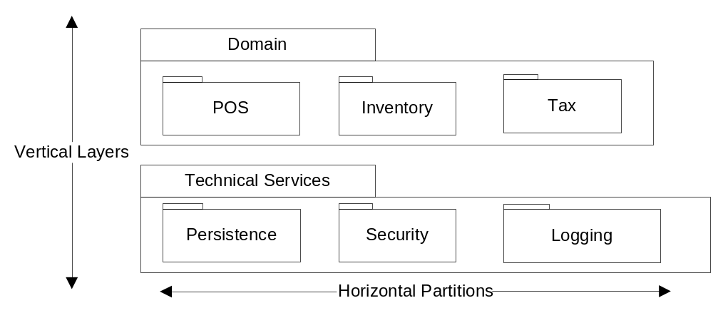
Layers and Partition

Slide 11
What is architecture?
Architecture of a specific system is a collection of components together with a description of the interactions between these components the connectors.
An abstract architectural description is a graph in which the nodes represent the components and the arcs represent the connectors

Slide 12
Architectural Style
What is the structural pattern—the components, connectors, and constraints?
What is the underlying computational model?
What are the essential invariants of the style?
What are some common examples of its use?
What are the advantages and disadvantages of using that style?
What are some of the common specializations?

Slide 13
Software Architecture
What is an architecture?
What does that mean for software?
Two definitions
  User interface (product architecture)
  Highest level logic/component design (software architecture)

Slide 14
Software Architecture Goals
Extensibility: adding new features
  Tradeoff of generality and time
  How might it be extended?
Changeability: requirements changes
Simplicity: ease of understanding and implementing
Efficiency: speed and size

Slide 15
Key Characteristics
Cohesion
  degree to which communication takes place within the module
Coupling
  degree to which communication takes place between modules
Min-max problem:
minimize coupling; maximize cohesion

Slide 16
Categorizing Software Architectures
(Shaw and Garlan)
Model-View-Controller
Object Oriented architecture
Data flows/Pipe filters
  Viewed as data flowing among processes
Independent components
  Components operating in parallel and communicating occasionally
Virtual machines
  Treats an application as a program written in a special-purpose language
Layered architectures
  Packages of function with a strong hierarchical uses relationship
Repository
  Application built around data

Slide 17
Why Categorize?
Recognize patterns
Reuse designs
Learn from other similar applications
Reuse classes
Simplify communication

Slide 18
Examples of Use (real quotes)
… is based on the client-server model and uses remote procedure calls ...
Abstraction layering and system decomposition provide the appearance of system uniformity to clients …
The architecture encourages a client server model …
We have chosen a distributed, object-oriented approach
The easiest way … is to pipeline the execution …

Slide 19
Well-known Architectures
Model-View Controller
Data flows/Pipe filters
Independent components
Virtual machines
Layered architectures
Repository

Slide 20
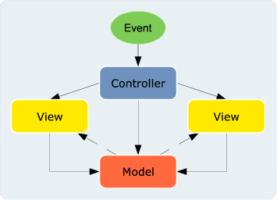
Model-View-Controller
Originally designed for SmallTalk
  Early OO language (1970’s)
Steve Burbeck, 1987
First paper

Slide 21
Model-View Separation Principle
Model refers to the domain layer of objects
View refers to the UI objects
  Do not embed application logic in UI objects
  Do not connect non-UI object directly with UI object

Slide 22
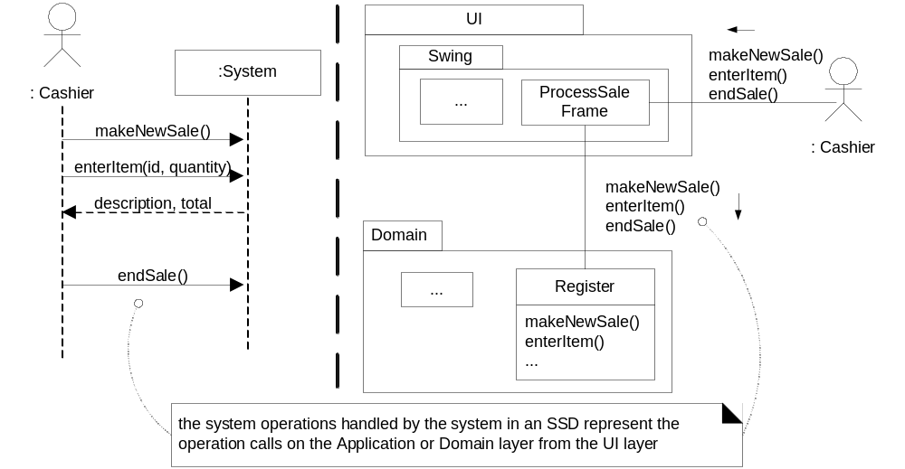
System operations in SSD and in terms of layers

Slide 23
Object Oriented Design/ Component Based design (AADL)
Source: Bhattacharyya et. al DASC 2014

Slide 24
Data Flow Design
Data flowing among processes
Two categories:
  Pipes and filters
    Filters: processes
    Pipes: input streams
  Batch sequential
    Pipe and filter where input streams are batches of data
filter
filter
filter
pipe
filter
filter
filter
filter
filter
filter
filter
filter
filter
filter
filter
filter
pipe
filter
filter
filter
pipe
Collect
mortgage funds
Mortgage
pool
Account
balances
Collect
unsecured funds
Unsecured
pool

Slide 25
Independent Components
Components
  operating in parallel
  communicating occasionally
Different types
  Client-server
  Parallel communicating processes
  Event systems
  Service Oriented Architecture
Notes:
Client-server
Browser-web server most familiar example
Separate systems with narrow interface
Sometimes expanded to three tiers (why?)
Façade pattern (single unified interface)
Parallel communicating processes
Several processes executing at the same time
Typically modeled with sequence diagrams
Observer pattern (one-to-many dependencies)
Event systems
Set of components waiting for input
Example: word processor waiting for user input
State transition diagrams
State pattern (alter behavior depending on state)
Service Oriented Architecture

Slide 26
Client-Server and Facade
Façade
«exposed»
    Browser-web server most familiar example:
    Separate systems with narrow interface
1
Client
2
Key concept: limit exposed interface
«not exposed»
«not exposed»
P
«not exposed»
«not exposed»
«not exposed»
Adapted from Software Engineering: An Object-Oriented Perspective by Eric J. Braude (Wiley 2001), with permission.

Slide 27
Parallel Communicating Processes
processes
Session:
session m
Session:
session k
Account:
customer n
checking
Customer:
customer n
actions
Customer:
customer n+1
create
Account:
customer
n+1 saving
retrieve
create
retrieve
deposit
withdraw
Duration of process
3 types of processes, 2 instances of each
    sequence diagram
Adapted from Software Engineering: An Object-Oriented Perspective by Eric J. Braude (Wiley 2001), with permission.

Slide 28
Observer Design Pattern
Client of this
system
Single source of data with a number of clients that need to be updated
1
Request others be notified
1..n
Source
notify()
Observer
update()
2
Notify all observers
ConcreteObserver
observerState
update()
ConcreteSubject
state
3
Determines if change needed
Gamma et al

Slide 29
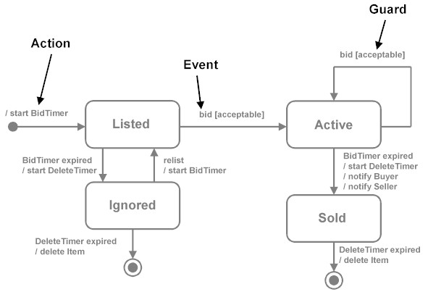
Event Systems and State Transition Diagrams
    Set of components waiting for input
    Set of components waiting for input

Slide 30
Services Oriented Architecture
Collection of services
  Direct communication
  Coordinating service
Different technologies
  Early ones: DCOM CORBA (brokers)
  Web Services
    Lots of different models and tools: REST (REpresentational State Transfer using HTTP just one)

Slide 31
Virtual machines
Treats an application as a program written in a special language
Payoff is that the interpreter code is the basis for multiple applications
Two types
  Interpreters (JVM)
  Rule-based systems (AI)

Slide 32
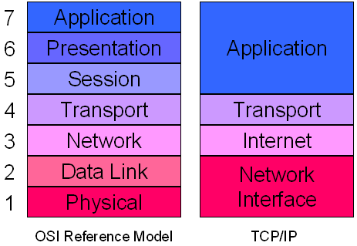
Layered Architecture: Network
OSI
TCP/IP

Slide 33
Repository
A system built around data
Two types
  Databases
  Hypertext systems

Slide 34
A Typical Repository System
GUI
Analysis
process
1
Analysis
process
n
Control
…...
…...
DBMS
Database
Adapted from Software Engineering: An Object-Oriented Perspective by Eric J. Braude (Wiley 2001), with permission.

Slide 35
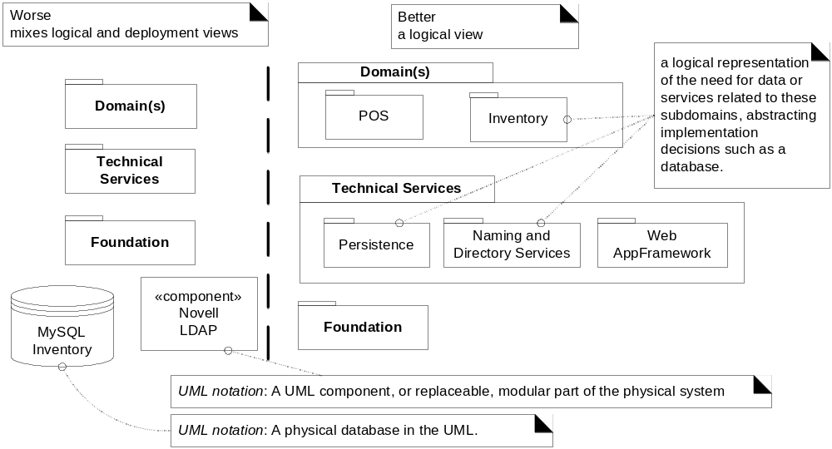
Mixing views of architecture (Avoid)

