Slide 1
Chapter 1

Slide 2
What is object Oriented Analysis and Design?
Object–Oriented Analysis and Design (OOA/D)
identifying software engineering requirements and
developing software specifications
software system’s object model,
Object Oriented Design using the Unified Process
Notes:
OOA/D focuses on the mapping of the requirements to the design in terms of representing objects that interact with each other. So as we design we will start thinking in terms of objects that need to be developed.
<number>

Slide 3
Focus on topics covered in this approach
Notes:
As we design software our focus will be on applying UML and patterns which allows to represent software objects to specify what the software will accomplish as the objects interact, assigning responsibility to the software objects. The process that we will be utilizing will be iterative development which is focused on incremental development at each iteration. Requirements analysis is conducted by writing use cases.
<number>

Slide 4
Chapter 2, 3 and 4: Iterative, Evolutionary and Agile
Notes:
<number>

Slide 5
Iterative Development
Notes:
In the Software Engineering Course you studied a number of software lifecycle models. The Unified Process is an Iterative Development model. Basically, in a short period of time you develop requirements and design, implement and integrate code, perform system test and create a baseline iteration or build. You then repeat the steps adding to the former build to create a new build.
<number>

Slide 6
What is Unified Process?
An iterative and incremental software development process
Risk driven development
Architecture centric
A customizable, extensible framework
Rational Unified Process was trademarked and formalized by IBM
Notes:
Early detection of “Is the product being built the right product” needed by the customer.
<number>

Slide 7
Evolving Iteration
Timeboxed → fixed in length
If difficult to meet deadline
De-scope
Prioritize requirements
Include the missed requirements (tasks or subtasks) in the next iteration
Change is the constant
Waterfall process is failure prone

Slide 8
Agile Methods
Timeboxed iterative and evolutionary development
Incremental delivery
Adaptive planning
Agile modeling
UML to understand the requirements
Notes:
Responding to change, communicating progress and changes to customers, make customers collaborators providing requirements
<number>

Slide 9
Fig. 2.6
Notes:
Many people think that the UP is a waterfall process since it is composed of 4 serial phases: Inception, Elaboration, Construction, and Transition. That is not the case, since each phase is composed of some number of shorter iteration. The idea is that you start with some concept (Inception), think through the concept in greater detail, maybe to determine whether or not to continue (Elaboration), then build the system in short iterations (Construction) and prepare to deliver it in some way (Transition).
<number>

Slide 10
UP disciplines
Notes:
The key is the second dimension of the model: the application of the various UP disciplines. The curves in this illustration represent the relative labor involved in each discipline by phase. Notice that the heavy requirements activity occurs during the early phases, but continues throughout the lifecycle. In other words, there is no attempt to freeze a complete set of requirements prior to beginning coding.
<number>

Slide 11
Fig. 2.9

Slide 12
Chapter 5
Understanding Requirements

Slide 13
Definition
Requirements are the capabilities and conditions to which the system -- and more broadly, the project -- must conform.
A systematic approach to finding, documenting, organizing, and tracking changing requirements

Slide 14
The Waterfall Model
<number>

Slide 15
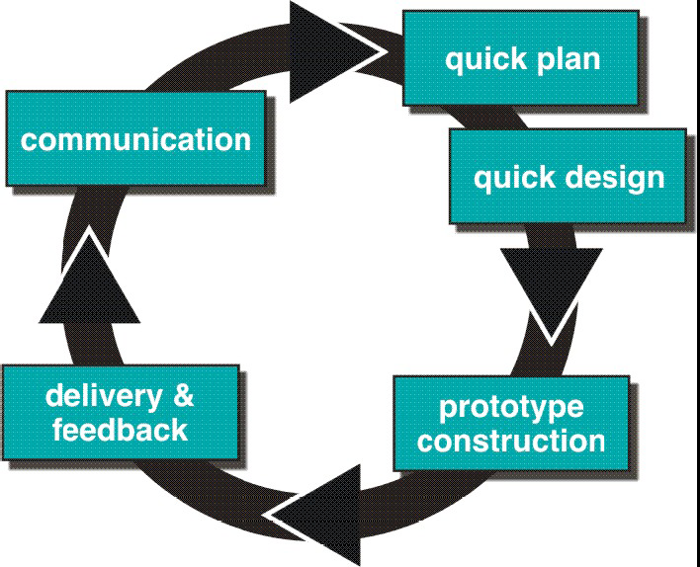
Evolutionary Models: Prototyping
Accommodate product that evolves over time
<number>

Slide 16
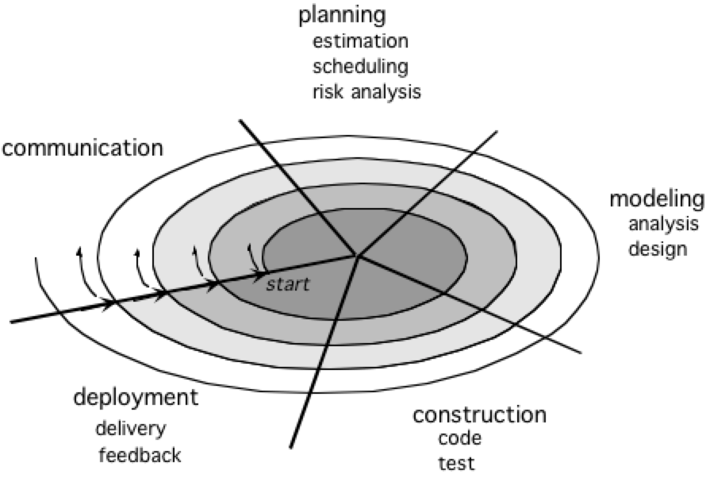
Evolutionary Models: The Spiral
Rapid development of complete versions of software
<number>

Slide 17
Categories for Requirements FURPS+
Per Bob Grady at HP:
Functional - features, capabilities,security
Usability - human factors, help, documentation
Reliability - frequency of failure, recoverability, predictability
Performance - response time, throughput, accuracy, availability, resource usage.
Supportability - adaptability, maintainability, internationalization, configuarability.

Slide 18
The “+” in FURPS+
The + refers to other important requirements:
Implementation - resource limitations, languages and tools, hardware, …
Interface - constraints imposed by interfacing with external systems
Operations - system management in its operational setting.
Packaging
Legal - licensing and so forth.

Slide 19
Chapter 6
Use Cases

Slide 20
What are Use Cases?
Stories developed to understand and record the requirements of a software or system to be developed.
How an actor uses the system?
Use cases can be text based but graphical ones provide more clarity
UML (Unified Modeling Language)
Notes:
Main objective is to discover and bring clarity to requirements in discussion with the customers. Use cases provide functional or behavioral requirements.
<number>

Slide 21
Use case formats
Brief: One paragraph summary
During early requirements gathering
Casual: Informal paragraph
During early requirements gathering
Fully dressed: All steps, variations, preconditions and success guarantees
Detailed, structured

Slide 22
Use case context diagram
Notes:
Context diagram
<number>

Slide 23
Use case write up
Inception
Identifying the use cases
Not all written in fully dressed
Elaboration
Multiple timeboxed iterations
Majority requirements are identified
Construction
Timeboxed iterations
Focus on completing the system

Slide 24
Chapter 9

Slide 25
Partial Domain Model

Slide 26
Reducing Representational Gap

Slide 27
Fig. 9.17

Slide 28
Chapter 10

Slide 29
SSD derived from use cases: One scenario

Slide 30
Chapter 11

Slide 31
Operation Contracts
Prime input:
System operations in SSD
Domain model
Domain insight from experts
Inputs to object design
Assumptions

Slide 32
Post Condition
What is the observed outcome?
State of the objects in domain model
Operations have completed
Guarantees
How do they modify domain model objects?

Slide 33
PostConditions
State of the object in the domain model
Creation of instances
Associations formed or broken
Attributes modified

Slide 34
Chapter 13

Slide 35
Logical architecture
Large scale organization of software classes into packages
Higher layers calls for services from the lower layers
UI
Application Logic and Domain Objects
Technical Services

Slide 36
Layers in package diagram
Notes:
Higher layers calls upon services from lower layers
<number>

Slide 37
Model-View Controller
Data flows/Pipe filters
Independent components
Virtual machines
Layered architectures
Repository

Slide 38
Design Patterns
Based on Material From:
Design Patterns – Elements of Reusable Object-Oriented Software, by Gamma, Helm, Johnson, Vlissides (the Gang of Four), Addison-Wesley, 1995.

Slide 39
Reasons for Software Design with Patterns
Software design patterns also help in finding appropriate objects, in determining the object granularity and in designing a software system that is architected from the outset to better adapt to change.
At the design level, patterns enable large-scale reuse of software architectures by capturing the expert knowledge of pattern based development and distributing it throughout the development team.
Reuse solutions that worked in the past
Notes:
Easier to reuse successful designs and architecture
<number>

Slide 40
What is a design pattern?
Objects and interfaces integrated together to solve a problem in a context
A design pattern has a relevant name, it abstracts and identifies key aspects of a common design structure to make it a reusable OOD
Pattern identifies the participating classes and instances, their roles and collaborators and distribution of responsibilities

Slide 41
Essential Elements of a Design Pattern (GoF)
The pattern name is a handle we can use to describe a design problem, its solutions, and consequences in a word or two.
The problem describes when to apply the pattern. It explains the problem and its context.
The (recommended) solution describes the elements that make up the design, their relationships, responsibilities, and collaborations…an abstract solution typically expressed in UML class diagrams.
The consequences are the results and trade-offs of applying the pattern.

Slide 42
Basic pattern categories based on Purpose
Creation design patterns are associated with object creation
intent is to create software objects without actually knowing what they are creating beyond the interfaces.
fundamental principle -> information hiding. When programmers code using interfaces to object creation and objects, then they are following this fundamental principle well.
“Gang of four”, these creational patterns include the abstract factory, the builder, the factory method, the prototype, and the singleton.

Slide 43
Basic pattern categories (contd.)
Structural design patterns are concerned with composition of classes.
Structural design patterns are static in nature; they are not designed to change.
As laid out by the Gang of four, structural design patterns include the adapter, the bridge, composite, decorator, facade, flyweight, and proxy.

Slide 44
Basic pattern categories (contd.)
Behavioral design patterns are concerned with runtime or dynamic system behavior of the program,
define the roles of software objects and their interactions.
dynamic nature, behavioral patterns are designed to change, and are not static and contain very little “structural” code.
The gang of four describe behavioral software design patterns called the chain of responsibility, command, interpreter, iterator, mediator, memento, observer, state, strategy, template method and visitor.

Slide 45
Pattern category based on Scope
Class patterns:
Relationship between classes and subclasses established through inheritance
Static-fixed at compile time
Object patterns:
Deal with object relationship
Dynamic and can be changed at runtime

Slide 46
Adapter Pattern: Chapter 26
Problem: How to resolve incompatible interfaces or provide a stable interface to similar components with different interfaces
Solution: Convert original interface of a component into another interface, through an intermediate object adapter object

Slide 47
Open-Closed Principle
Classes should be open for extension, but closed for modification.
How is this principle applied in the previous example?

Slide 48
Creation of Objects
Who creates the Adapter pattern?
Maintain separation of concern
Each has a cohesive purpose
Factory pattern
Assign responsibility of creation of objects to helper objects
Hide complex creation logic

Slide 49
Who creates Factory?
One instance of Factory is needed within a process
Method of Factory needs to be called from various places in the code
As Adapters need to be called at different places to access external services

Slide 50
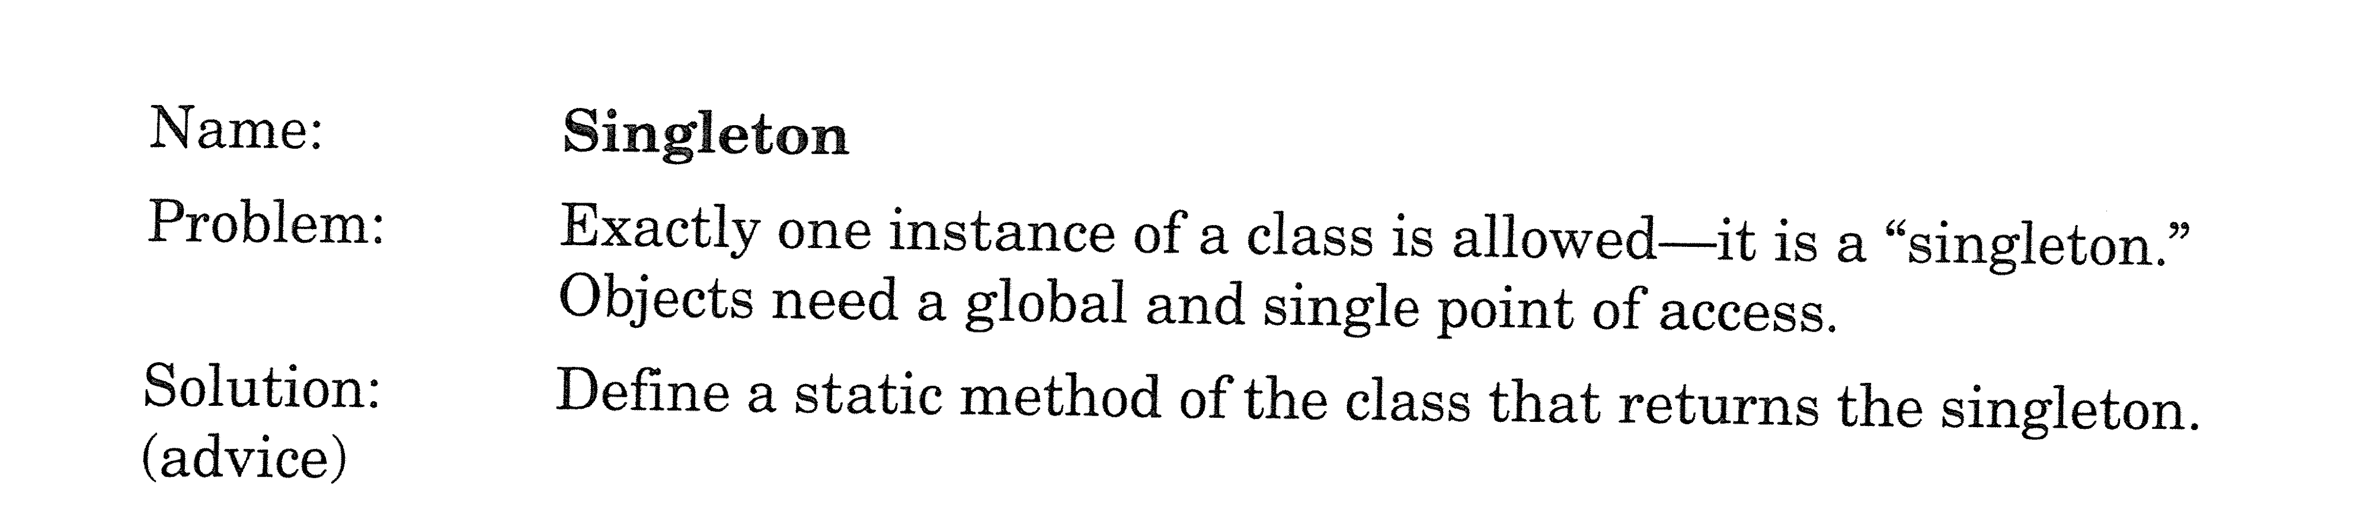
A Related Example Singleton (GoF)
Notes:
The singleton class must provide a global access point to get the instance of the class. Public static method that returns the instance of the class, this is the global access point for outer world to get the instance of the singleton class.
<number>

Slide 51
Singleton: Introduction
Creating one-of-a-kind objects for which there is only one instance
Many objects we only need one of:
thread pools, caches, dialog boxes, objects that handle preferences and registry settings, objects used for logging, and objects that act as device drivers to devices like printers and graphics cards
Singleton Pattern is a time-tested method for ensuring only one object gets created.
A global point of access, just like a global variable, but without the downsides.

Slide 52
Singleton contd.
How do I prevent more than one object from being instantiated?

Slide 53
Class diagram

Slide 54
Dealing with Multithreading

Slide 55
If performance is an issue with Synchronization
Do nothing if application is not critical
Move to an eagerly created instance rather than a lazily created one.

Slide 56
If performance is an issue with Synchronization (contd.)
Use “double-checked locking” to reduce the use of synchronization in getinstance().

Slide 57
Why Factory Pattern?
Instantiation is an activity that shouldn’t always be done in public and can often lead to coupling problems.
Factory Patterns can help save you from embarrassing dependencies.
The decision of which to instantiate is made at runtime depending on some set of conditions.

Slide 58
Separating Creation

Slide 59
Class Diagram for Factory Pattern

Slide 60
Factory method pattern

Slide 61
Applying DIP
High level and low level modules depend on abstraction

Slide 62
Abstract Factory Pattern Defined
The Abstract Factory Pattern provides an interface for creating families of related or dependent objects without specifying their concrete classes.

Slide 63
Abstract Factory Class Diagram

Slide 64
Abstract Factory Class Diagram for Pizza Store

