Slide 1

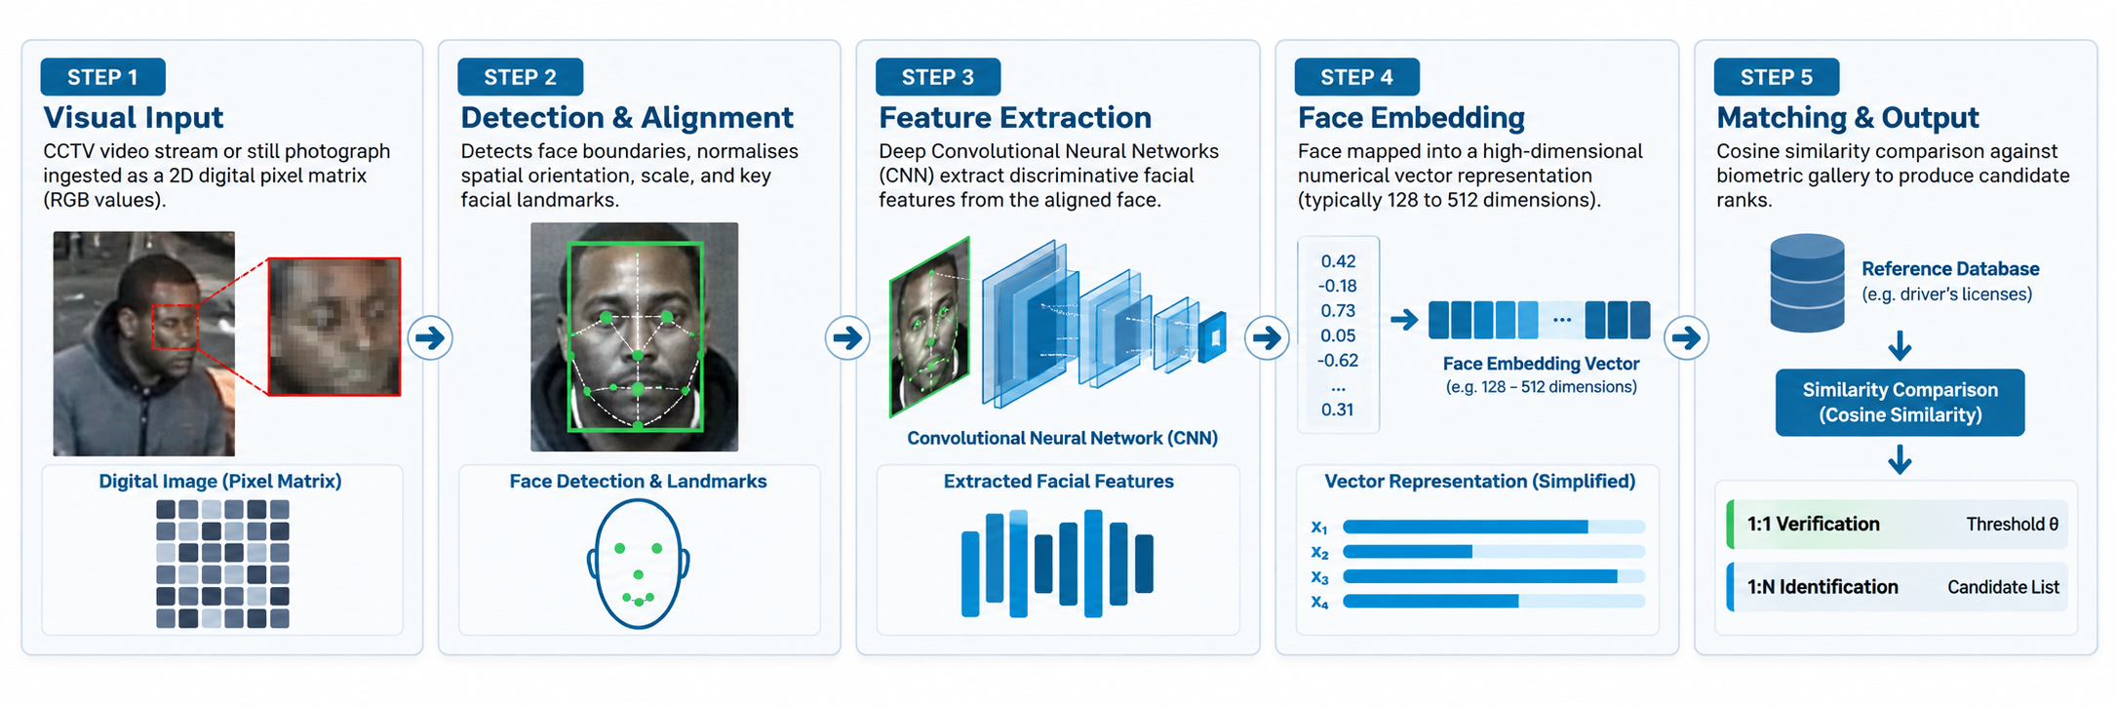
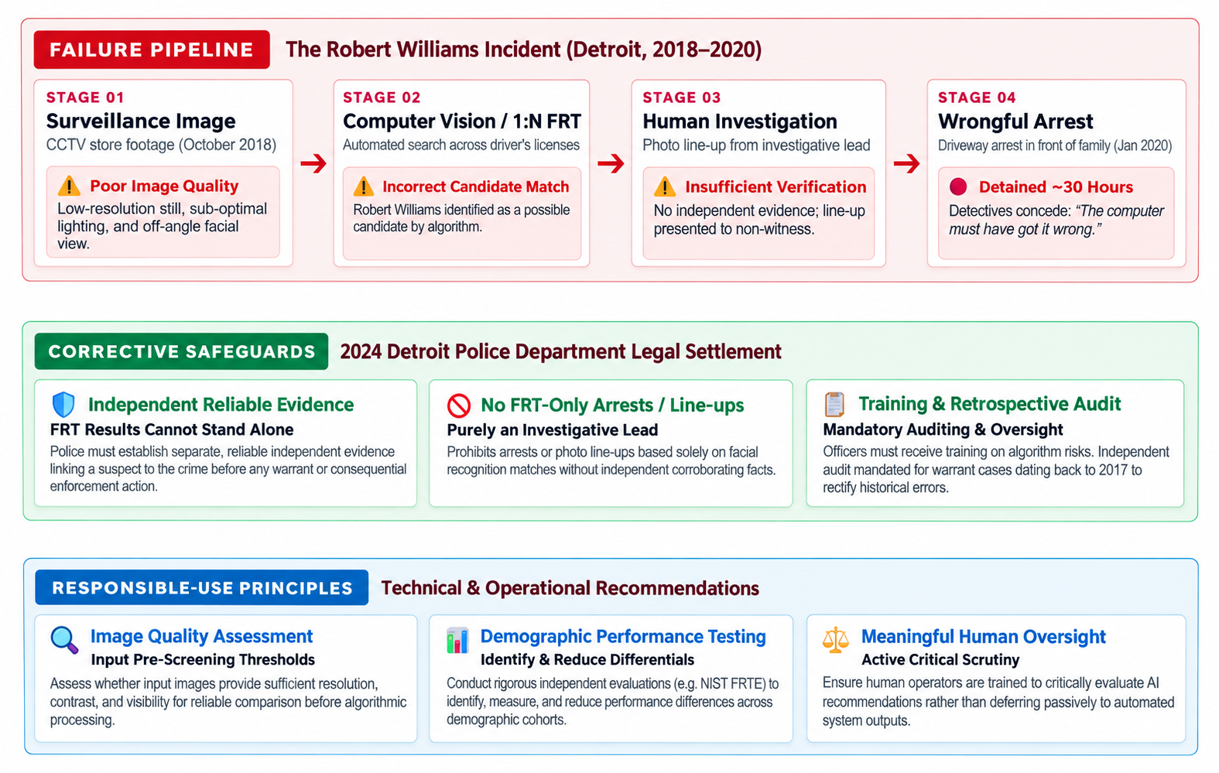
Fig. 1: Simplified Computer Vision Facial Recognition Pipeline
Fig. 1: Simplified Computer Vision Facial Recognition Pipeline
Computer Vision in Law Enforcement: Ethical, Legal, and Social Impacts of Facial Recognition
The Robert Williams Case Study and Approaches to Responsible Use
Caio Jacob (Student ID: 2023168), CCT College Dublin | Module: Artificial Intelligence | Lecturer: David McQuaid
1. AI System: Computer Vision & Facial Recognition
4. Mitigations & Responsible Use
Computer Vision (CV) is a specialized branch of Artificial Intelligence enabling computational systems to process, analyse, and extract structured semantic representations from digital visual inputs, including still images and video streams (Caballar and Stryker, 2025). The foundational pipeline encompasses digital image acquisition, pre-processing, feature extraction, and mathematical classification or similarity comparison (Sturdevant, 2023).
Within Computer Vision, Facial Recognition Technology (FRT) analyses facial features and converts them into numerical representations that can be compared with stored facial data. Recognition operates across two primary paradigms:
1. One-to-One (1:1) Verification: Authenticates an individual's identity by comparing a captured face vector against a single enrolled biometric template (e.g., automated border control gates).
2. One-to-Many (1:N) Identification: Compares an unknown face against a gallery of stored images to produce potential candidate matches.
In law enforcement, 1:N facial recognition is deployed to identify unknown suspects from surveillance cameras or crime scene photography. When designed and evaluated responsibly, the technology can support investigations by rapidly screening large image repositories that would otherwise require extensive manual searching (Caballar and Stryker, 2025). However, algorithm accuracy depends critically on input resolution, illumination, angle, and whether underlying neural models exhibit uniform performance across diverse human demographics.
ETHICAL & LEGAL GOVERNANCE SUMMARY
Regulatory Safeguards: GDPR Article 9 and the EU AI Act provide European legal frameworks for regulating biometric data and AI systems.
Algorithmic Due Process: AI predictions are probabilistic hypotheses requiring independent corroboration.
To preserve the positive investigative utility of Computer Vision while mitigating societal harms, organizations must implement a multi-layered governance model:
1. Mandate Independent Corroborating Evidence: Algorithmic matches must remain preliminary investigative leads. The June 2024 Detroit settlement prohibits arrests or photo line-ups based solely on facial recognition results and requires independent, reliable evidence (University of Michigan Law School, 2024).
2. Apply Image Quality Controls: Systems should assess image quality and flag or reject blurred, low-resolution, or poorly illuminated images that may be unsuitable for reliable facial recognition.
3. Continuous Demographic Testing: Systems should undergo regular benchmarking to identify, measure, and reduce demographic differences in accuracy, informed by NIST findings (Grother, Ngan and Hanaoka, 2019).
4. Meaningful Human Oversight: Officers must receive comprehensive training on AI limitations and automated recommendations, ensuring that AI outputs are critically scrutinised rather than passively accepted.
5. Auditing and Redress Mechanisms: Law enforcement agencies must maintain searchable query logs and conduct retrospective audits of past cases to ensure accountability and rectify wrongful arrests (University of Michigan Law School, 2024).
Implementing these technical and operational safeguards ensures that Computer Vision accelerates legitimate criminal investigations while rigorously upholding civil liberties, fairness, and fundamental human rights.
3. Real-World Case Study: Robert Williams (Detroit Police)
In October 2018, a shoplifting incident involving luxury watches occurred at a retail store in Detroit, Michigan. Investigators obtained a low-resolution, poorly illuminated still image from store surveillance footage and executed an automated 1:N facial recognition search against a statewide database containing millions of driver's license photographs.
The system returned an incorrect candidate match identifying Robert Williams, an innocent Black man. Rather than treating this result purely as an unverified investigative lead, detectives placed Williams's photograph in a photo line-up shown to an off-site loss-prevention contractor who had not witnessed the theft in person. Based on this identification, an arrest warrant was issued.
On 9 January 2020, Williams was arrested on his front driveway in front of his wife and two young daughters (aged 2 and 5) and held in custody for approximately 30 hours (American Civil Liberties Union, 2024). During interrogation, detectives placed the surveillance still next to Williams's license photo and recognised that the images did not match, with one detective stating that 'the computer must have got it wrong.'
This case demonstrates how a poor-quality image, an incorrect facial recognition result, and insufficient independent verification can contribute to severe real-world harm: wrongful deprivation of liberty, personal trauma, and unjustified criminal records (University of Michigan Law School, 2024).
FIVE PILLARS OF RESPONSIBLE FACIAL RECOGNITION
- Probabilistic Leads: Matches serve as investigative leads; independent corroboration is mandatory.
- Input Quality Controls: Image-quality checks should flag or reject blurred, low-resolution, or unsuitable probe imagery.
- Demographic Testing: Regular benchmarking informed by NIST findings across diverse demographic groups.
- Human Oversight: Officer training on AI limitations and critical review of automated recommendations.
- Accountability & Redress: Searchable query logs, retrospective case audits, and mechanisms to review and correct wrongful outcomes.
Fig. 1: Simplified Computer Vision Facial Recognition Pipeline
5. References (Harvard Style)
2. Ethical, Legal, and Social Impacts
- American Civil Liberties Union (2024) Williams v. City of Detroit. Available at: https://www.aclu.org/cases/williams-v-city-of-detroit-face-recognition-false-arrest (Accessed: 14 October 2026).
- Caballar, R.D. and Stryker, C. (2025) 'What is computer vision?', IBM Think, 17 September. Available at: https://www.ibm.com/think/topics/computer-vision (Accessed: 10 October 2026).
- European Parliament and Council of the European Union (2016) 'Regulation (EU) 2016/679 of the European Parliament and of the Council of 27 April 2016 (General Data Protection Regulation)', Official Journal of the European Union, L 119, pp. 1-88. Available at: https://eur-lex.europa.eu/eli/reg/2016/679/ (Accessed: 10 October 2026).
- European Parliament and Council of the European Union (2024) 'Regulation (EU) 2024/1689 of the European Parliament and of the Council of 13 June 2024 laying down harmonised rules on artificial intelligence (Artificial Intelligence Act)', Official Journal of the European Union. Available at: https://eur-lex.europa.eu/eli/reg/2024/1689/oj (Accessed: 10 October 2026).
- Grother, P., Ngan, M. and Hanaoka, K. (2019) Face Recognition Vendor Test (FRVT) Part 3: Demographic Effects. NIST Interagency Report 8280. Gaithersburg, MD: National Institute of Standards and Technology. Available at: https://doi.org/10.6028/NIST.IR.8280 (Accessed: 14 October 2026).
- Sturdevant, M. (2023) 'Introduction to computer vision', IBM Developer, 5 March. Available at: https://developer.ibm.com/articles/introduction-computer-vision/ (Accessed: 10 October 2026).
- UNESCO (2021) Recommendation on the Ethics of Artificial Intelligence. Paris: UNESCO. Available at: https://www.unesco.org/en/artificial-intelligence/recommendation-ethics (Accessed: 10 October 2026).
- University of Michigan Law School (2024) 'Civil Rights Litigation Initiative Helps Achieve the Nation's Strongest Police Department Policy on Facial Recognition Technology', 28 June. Available at: https://michigan.law.umich.edu/news/civil-rights-litigation-initiative-helps-achieve-nations-strongest-police-department-policy (Accessed: 14 October 2026).
Deploying Computer Vision in high-stakes public settings generates interrelated ethical, legal, and social repercussions:
Ethical Impacts:
- Algorithmic Performance Differentials: NIST evaluations have identified demographic differences in the error rates of tested facial recognition algorithms, although the magnitude and direction of these differences vary across algorithms and applications (Grother, Ngan and Hanaoka, 2019).
- Human Oversight: Over-reliance on probabilistic AI outputs can lead investigators to give excessive weight to automated recommendations, particularly when system limitations are not properly understood.
Legal Impacts:
- Regulatory Frameworks: Although the Robert Williams case occurred in the United States, the European context illustrates how facial recognition is legally governed. Under Article 9 of the General Data Protection Regulation (GDPR), processing biometric data for unique identification is generally prohibited absent strict statutory exemptions (European Parliament and Council, 2016). Furthermore, the EU Artificial Intelligence Act places strict limits on certain uses of real-time remote biometric identification in publicly accessible spaces for law enforcement (European Parliament and Council, 2024).
- Due Process: Probabilistic AI outputs should not be treated as sufficient evidence for arrest without independent corroboration.
Social Impacts:
- Erosion of Public Trust: Biometric misidentifications and perceived disparities can undermine community trust in law enforcement institutions.
- Civil Liberties and Public Trust: Widespread biometric monitoring without meaningful safeguards may create concerns about privacy, freedom of expression and participation in public life (UNESCO, 2021).
Fig. 2: Decision Pipeline and Safeguard Framework in the Robert Williams Case. Sources: American Civil Liberties Union (2024); University of Michigan Law School (2024).
CASE SUMMARY & LANDMARK LEGAL PRECEDENTS
Incident: October 2018 Detroit retail theft; 1:N facial recognition search using a low-quality CCTV still.
Failure Chain: Poor-quality probe image + false positive + insufficient independent verification.
Civil Harm: Innocent citizen wrongfully detained for approximately 30 hours, causing significant personal and family impact.
2024 Settlement: Prohibits FRT-only arrests and line-ups; requires independent reliable evidence, training and retrospective audits.
Core Principle: Facial recognition results should support investigations, not replace independent evidence.
GitHub Repository
CA1_Artificial_Intelligence_CaioJacob2023168
Our Dedication.Your Journey.
www.cct.ie

