Slide 1
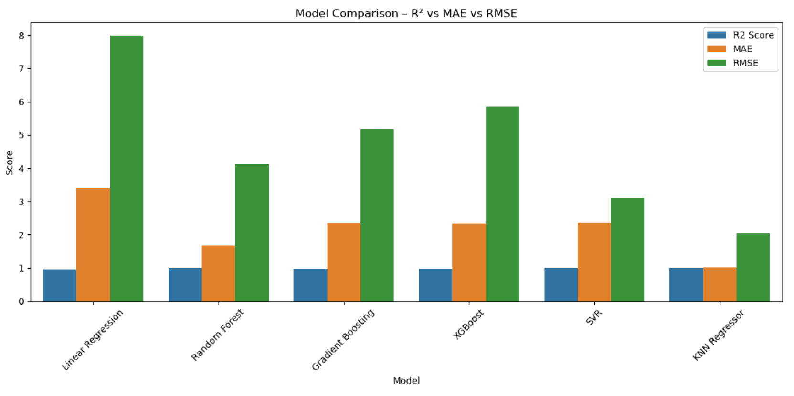
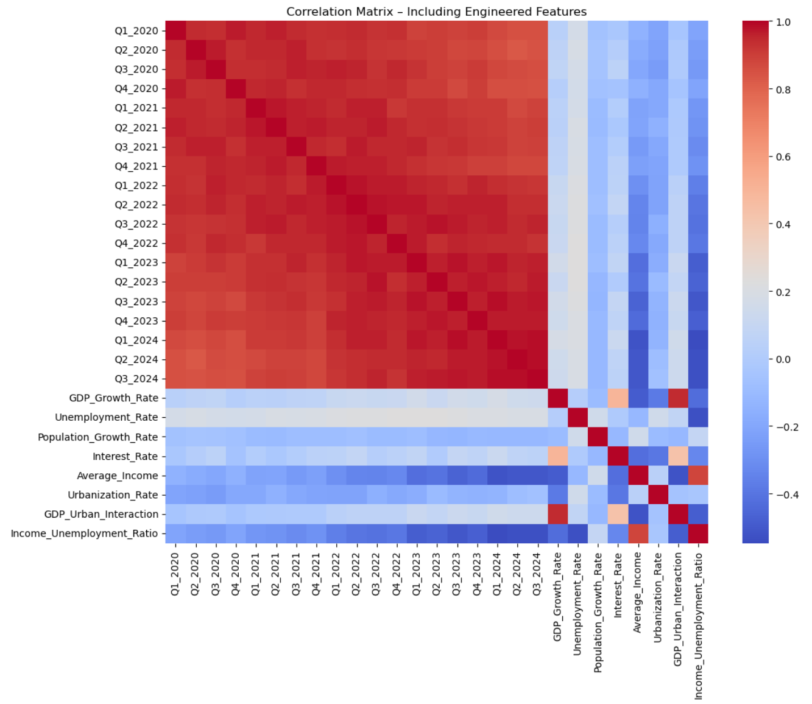
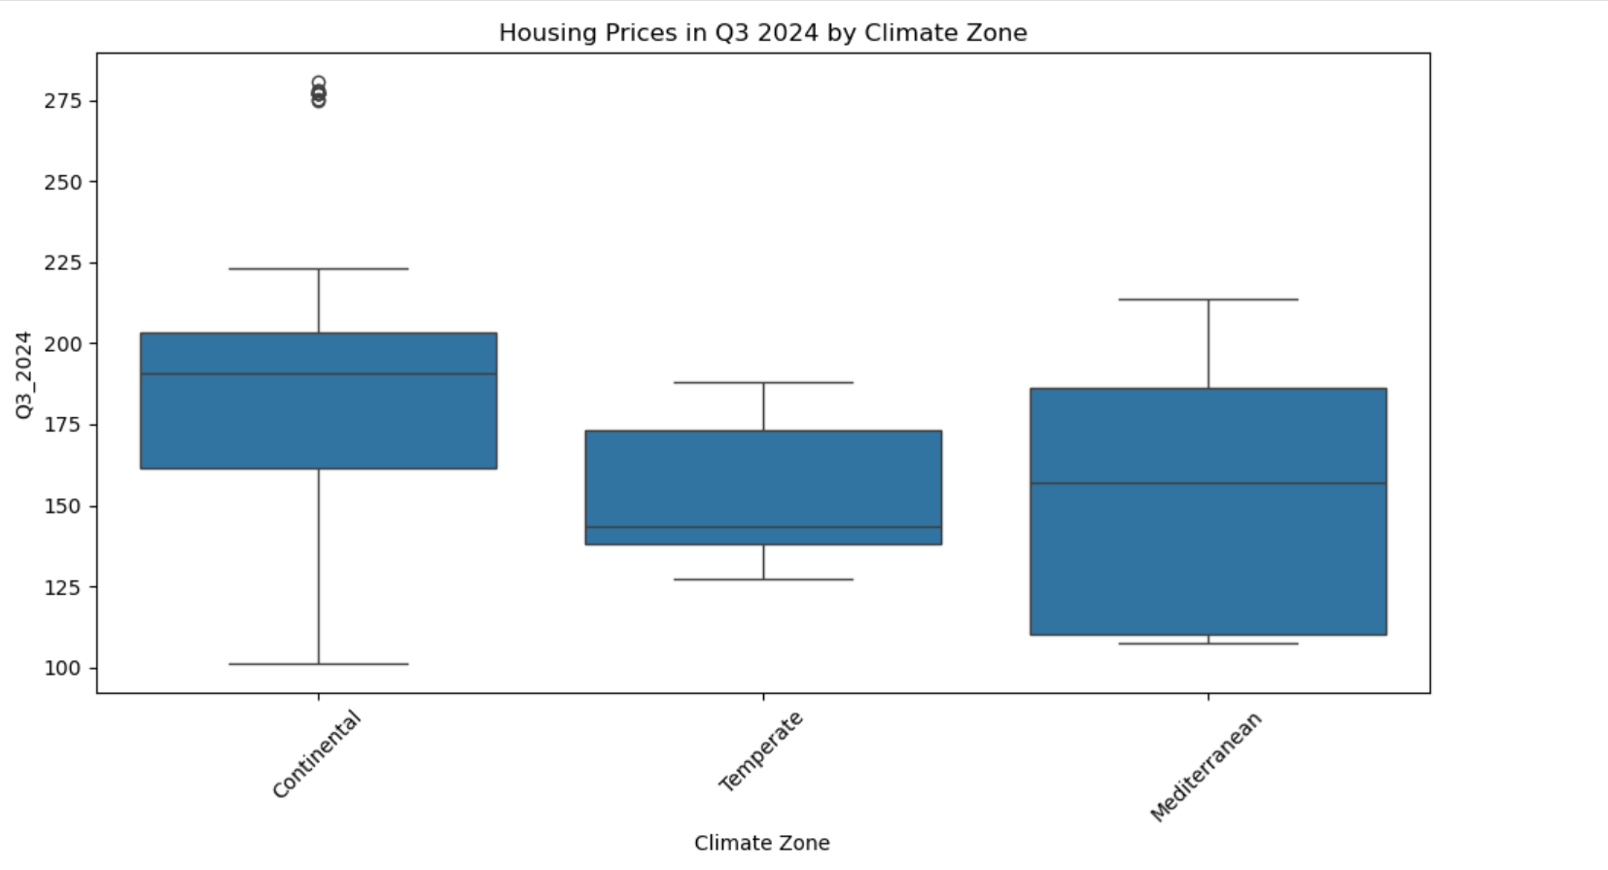
Predicting EU Housing Prices (Q3 2024) with Machine Learning
Robert Jonjic, CCT College Dublin, May 2025
PROJECT RATIONALE
EXPLORATORY INSIGHTS
METHODOLOGY
Europe’s post‑pandemic housing market is characterised by sharp regional price swings, driven by macro‑economic shifts, urban migration and supply constraints (European Commission 2022). Accurate forecasts of near‑term price indices empower:
Investors – portfolio risk management
Policy makers – evidence‑based affordability measures
Banks – prudent loan‑to‑value ratios
Urban planners – infrastructure and zoning decisions
Traditional hedonic or linear time‑series models struggle with multi‑factor, non‑linear relationships (Selim 2009). Machine‑learning (ML) methods can ingest high‑dimensional data, capture latent interactions, and produce highly accurate yet interpretable forecasts. This capstone applies six supervised regressors to predict Q3 2024 housing price indices across 310 EU regions.
Mean Q3 2024 index = 163.2; σ = 28.5 (wide dispersion).
Income correlates strongly with price (ρ = 0.78); unemployment shows inverse correlation (ρ = ‑0.65).
Boxplots reveal higher median prices in temperate climate zones.
Heatmap showcases multicollinearity among lagged quarters; non‑linear models tolerate this.
CRISP‑DM workflow: Business → Data → Modeling → Evaluation → Deployment.
Algorithms tested (with GridSearch ranges)
Linear Regression (baseline, no tuning)
Random Forest {n_estim = 100‑200, depth = 10‑None}
Gradient Boosting {n_estim = 100‑200, lr = 0.05‑0.1}
XGBoost {depth = 5, subsample = 0.8}
SVR (RBF) {C = 100, ε = 0.1}
KNN Regressor {k = 5, weights = uniform}
Cross‑Validation: 5‑fold GridSearchCV (score = R²).
Evaluation Metrics: R² (explained variance), RMSE (penalises large errors), MAE (mean error).
RESULTS
INTERPRETATION & DISCUSSION
- Economic indicators dominate over climate classification, confirming income elasticity and labour‑market influence on property demand (Gyourko et al. 2021).
Retaining all lagged quarters is crucial; dropping them lowered R² by up to 0.04.
Non‑linear algorithms consistently surpass linear baseline; ensemble methods provide stability, but instance‑based KNN captures localised patterns best.
OBJECTIVES & SUCCESS CRITERIA
Model | R² | RMSE | MAE
KNN | 0.9970 | 2.05 | 1.02
SVR | 0.9932 | 3.11 | 2.36
Random Forest | 0.9880 | 4.12 | 1.67
Gradient Boosting | 0.9811 | 5.18 | 2.34
XGBoost | 0.9759 | 5.85 | 2.32
Linear Regression | 0.9551 | 7.98 | 3.41
Objective | Target | Metric
O1 – High predictive power | R² ≥ 0.95 on hold‑out data | R², RMSE, MAE
O2 – Model interpretability | Identify top ≥ 3 drivers | Tree‑based feature importance
O3 – Operational readiness | Train in < 5 min; modular code | Jupyter pipeline + GitHub repo
CHALLENGES & MITIGATION
Issue | Consequence | Solution
Feature‑scaling bias (SVR/KNN) | Poor convergence; distance distortion | Selective StandardScaler pipeline
Grid‑search time | > 3 h initial runs | Focused param ranges + joblib parallelism
Temporal leakage | Inflated scores | Strict cutoff: predictors ≤ Q2 2024
Multicollinearity | Variance inflation in linear model | Acceptable in non‑linear; retained for signal
FEATURE ENGINEERING & PRE‑PROCESSING
Interaction: GDP × Urbanisation – captures economic density effects.
Ratio: Income / (Unemployment + 1) – proxies effective purchasing power.
One‑Hot Encoding: Region (5), Climate Zone (3) → expands to 8 binary columns.
Scaling: StandardScaler applied only to numeric columns for SVR & KNN; tree ensembles ingest raw values.
Train/Test Split: 80 % / 20 % stratified by region (to maintain geographic diversity).
Resultant design matrix: 46 predictors × 310 rows.
Hypothesis: blending macro‑economics (GDP, income), demographics (urbanisation) and recent price trends will outperform linear baselines.
CONCLUSIONS
DATA OVERVIEW
- Combining macroeconomic, demographic, and recent‑price data yields near‑perfect Q3 2024 forecasts.
- KNN (R² = 0.997) and SVR (R² = 0.993) validate the hypothesis that non‑linear, instance‑based approaches best capture housing‑market complexity.
- Feature engineering of simple economic ratios significantly enhances predictive power with minimal cost.
Aspect | Detail
Source | Eurostat datasets, downloaded Apr 2024
Temporal Range | Q1 2020 → Q3 2024 (19 quarters)
Records | 310 NUTS‑level regions
Raw Features (29) | 19 quarterly price indices ● GDP growth % ● Average income (€) ● Unemployment % ● Population growth % ● Urbanisation % ● Interest rate % ● Climate zone (3) ● Region class (5)
Target | Price index in Q3 2024 (contin­uous)
KNN Regressor excels due to proximity‑based learning after proper scaling; lowest error metrics.
SVR delivers strong non‑linear fit; sensitive to C and ε.
Random Forest offers best mix of accuracy and interpretability.
Top Predictors (Random Forest importance)
1. Average Income 2. Q2 2024 Price Index 3. Urbanisation Rate 4. GDP × Urbanisation Interaction 5. Unemployment Rate (negative influence)
REFERENCES
Chen, T. and Guestrin, C. (2016) ‘XGBoost: A Scalable Tree Boosting System’, Proceedings of the 22nd ACM SIGKDD, pp. 785–794.
Chen, H., Hao, Y., Wang, J. and Wang, L. (2017) ‘House price prediction using LSTM’, International Conference on Intelligent Systems.
European Commission (2022) Housing in Europe: 2022 Overview. Available at: https://ec.europa.eu/eurostat
Eurostat (2023) EU Housing Price Index Dataset. Available at: https://ec.europa.eu/eurostat
Glaeser, E. L. and Nathanson, C. G. (2017) ‘Anatomy of a housing bubble’, American Economic Journal: Economic Policy, 9(1), pp. 3–25.
Gyourko, J., Mayer, C. and Sinai, T. (2021) ‘Superstar Cities and Housing Price Dynamics’, Journal of Urban Economics.
Kaufmann, P. and Steinmetz, M. (2020) ‘Machine learning in real estate valuation: Theory and practice’, Journal of Property Research, 37(3), pp. 254–277.
Lundberg, S. M. and Lee, S.-I. (2017) ‘A Unified Approach to Interpreting Model Predictions’, Advances in Neural Information Processing Systems, 30.
Pedregosa, F. et al. (2011) ‘Scikit-learn: Machine Learning in Python’, Journal of Machine Learning Research, 12, pp. 2825–2830.
Selim, H. (2009) ‘Determinants of house prices in Turkey: Hedonic regression versus artificial neural network’, Expert Systems with Applications, 36(2), pp. 2843–2852.

