Slide 1



fdsfccvbfg
US Candy Distributor:
Sales Prediction and Demand Forecast
Capstone Project - Strategic Thinking
Aline Menezes da Silva

Slide 2

In today’s fast-paced and competitive market, it is vital for companies to plan carefully and make smart decisions. One of the best ways to do this is by using data to understand what customers want and predict future sales.
the goal of this project is to use machine learning (ML) and time-series forecasting to predict sales trends, optimise inventory and improve pricing & shipping strategies.
Introduction

Slide 3

1
Data Collection
Gathering relevant data for analysis and exploration.
2
Data Preprocessing
Cleaning, transforming, and preparing data for modeling purposes.
Analysis Process
3
Model Building
Developing predictive models based on data the dataset
4
Evaluation
Assessing model performance and validity using evaluation techniques.
5
Deployment
Implementing and integrating models into operational systems for use.

Slide 4

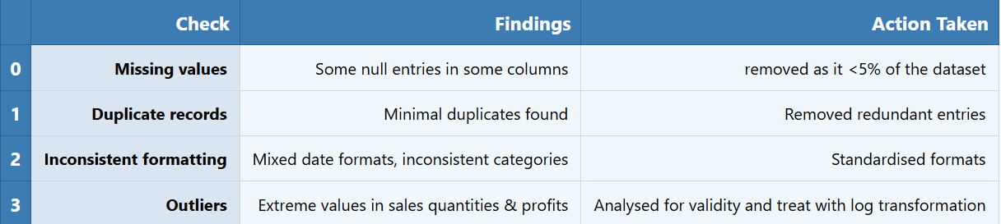
Data Preprocessing
The dataset contains 10,194 sales records from 2020 to 2024 and 19 columns sourced from Maven Analytics. It includes key details like sales figures, profits, order quantities, product types, delivery methods and factory locations.
Key Features: Product category, region, shipping method, unit cost.,

Slide 5
Technologies used
Hypothesis Testing
H1= Shipping methods impact profitability. Using ANOVA Test.
H2 = Different product price levels influence profit margins. Using T-test.
Machine Learning Algorithms
- Linear Regression (Baseline)
- Ridge Regression (Improved linear model)
- Decision Trees (Non-linear patterns)
- Random Forest (Ensemble method)
- Gradient Boosting (GBR)
Libraries
-Data Processing: Pandas, NumPy
-Visualisation: Matplotlib, Seaborn
-ML & Forecasting: Scikit-learn, Stats models (SARIMA)
Time Series Algorithm
- SARIMA tuned for seasonal trends (e.g., holiday spikes).
Hyperparameter Tunning and CV
- GridSearchCV optimized GBR and SARIMA.

Slide 6
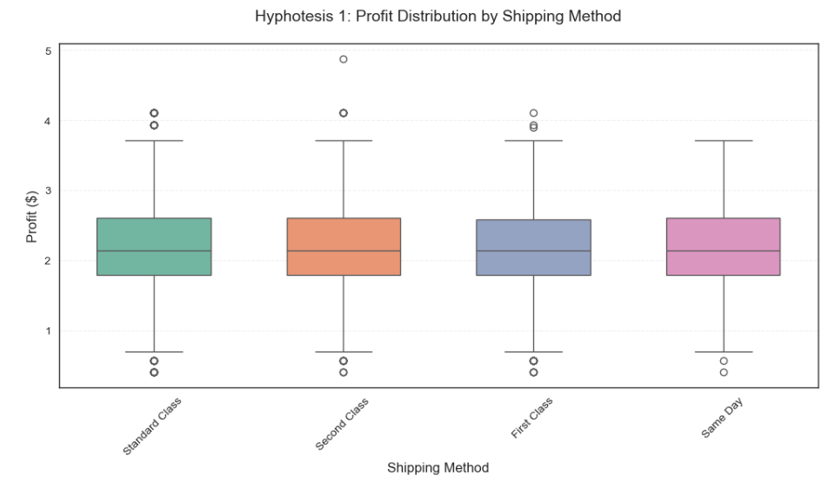
Hypothesis Testing
Hypothesis 1: Does the Choice of Shipping Method Affect Profitability?
We reject the null hypothesis as there is no clear difference in profit margins between faster and slower shipping methods.

Slide 7
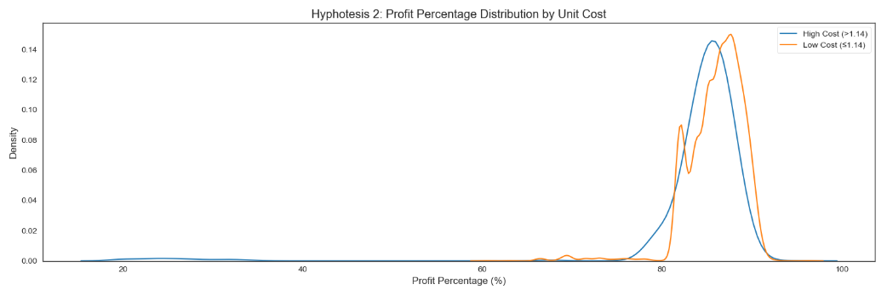
Hypothesis Testing
Hypothesis 2: Does the Candy Distributor Need to Change Prices or Operations Based on Product Costs?
The assumption is that there is no difference in profit margins between low-cost and high-cost products but the data showed a clear difference in profit margins between cheaper and more expensive products, so the null hypothesis is rejected.

Slide 8
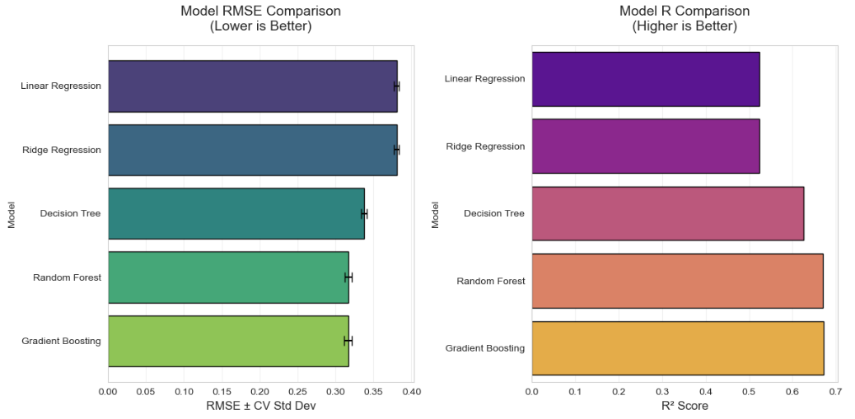
Machine Learning Approach
Linear and ridge regression are simple and work reasonably but have limits. Decision trees can overfit. Random forests and gradient boosting perform best, with gradient boosting slightly better for practical use due to its strong and stable predictions.

Slide 9
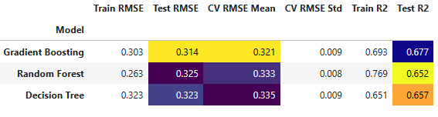
Hyperparameter Tuning and Cross Validation
The tree-based models below show better results than the linear models. Because of this, I focused on these tree-based models and used Hyperparameter Tuning and CV to improve them further.
The results:

Slide 10
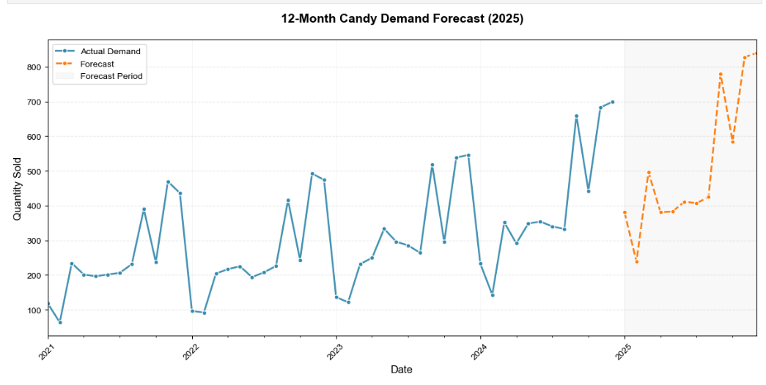
Time-Series Forecasting (SARIMA)
The The SARIMA model forecasts monthly candy demand for 2025, showing key peaks in September, November, and December for events like Halloween and Christmas. Demand drops in February and stays steady over summer. This helps the distributor manage stock, reduce waste, and improve profits by adjusting supply and costs throughout the year.

Slide 11

Challenges and Solutions
Challenges:
Data Skewness: Outliers in sales/profits (fixed via log transformation).
Overfitting: Decision Trees performed poorly on test data (solved with Random Forest/GBR).
easonality: Hard to model sudden spikes (addressed with SARIMA).
Strategy:
Feature Engineering: Created "Sales_Per_Customer" for better predictions.

Slide 12



Key findings :
Profit Margins:
Cheaper products yield 2% higher margins than expensive ones.
Forecast:
Demand peaks in Q4 (Halloween/Christmas); dips in January.
Top Factory:
Wicked-Chacys outperforms others by 30%.

Slide 13


Conclusion
Machine learning and forecasting provide clear data to improve stock planning, helping the USA Candy Distribuitor to keep the right products in the right amounts. They also identify cost-effective ways to increase profits by reducing waste and improving efficiency. These smart, flexible models can grow with the business and quickly adapt to changes in the market.

