Slide 1

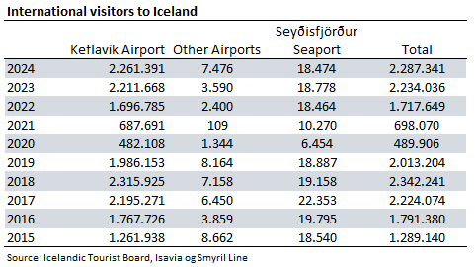

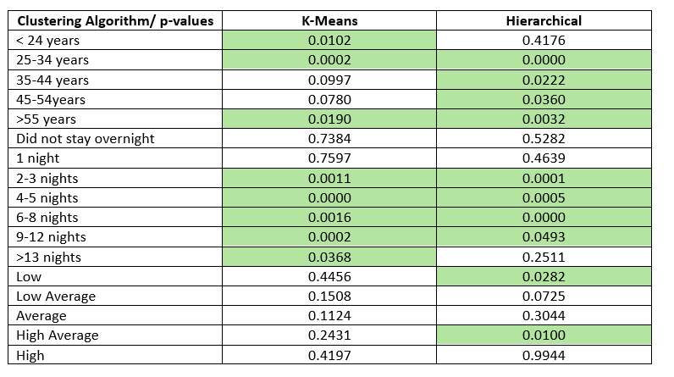
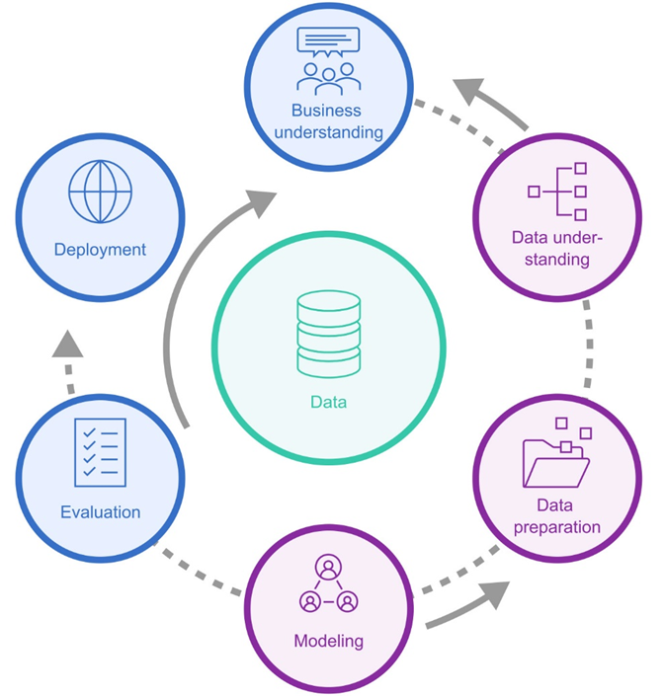
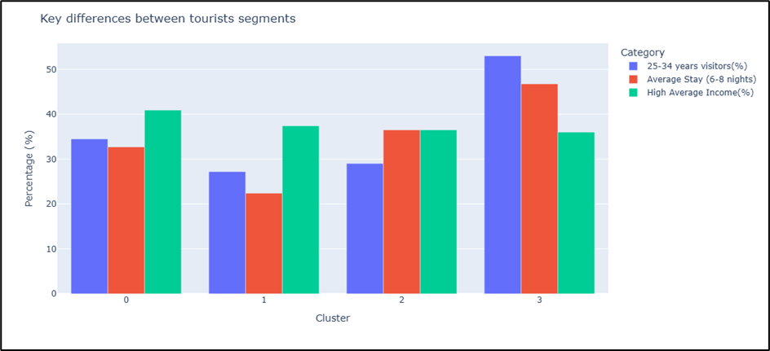
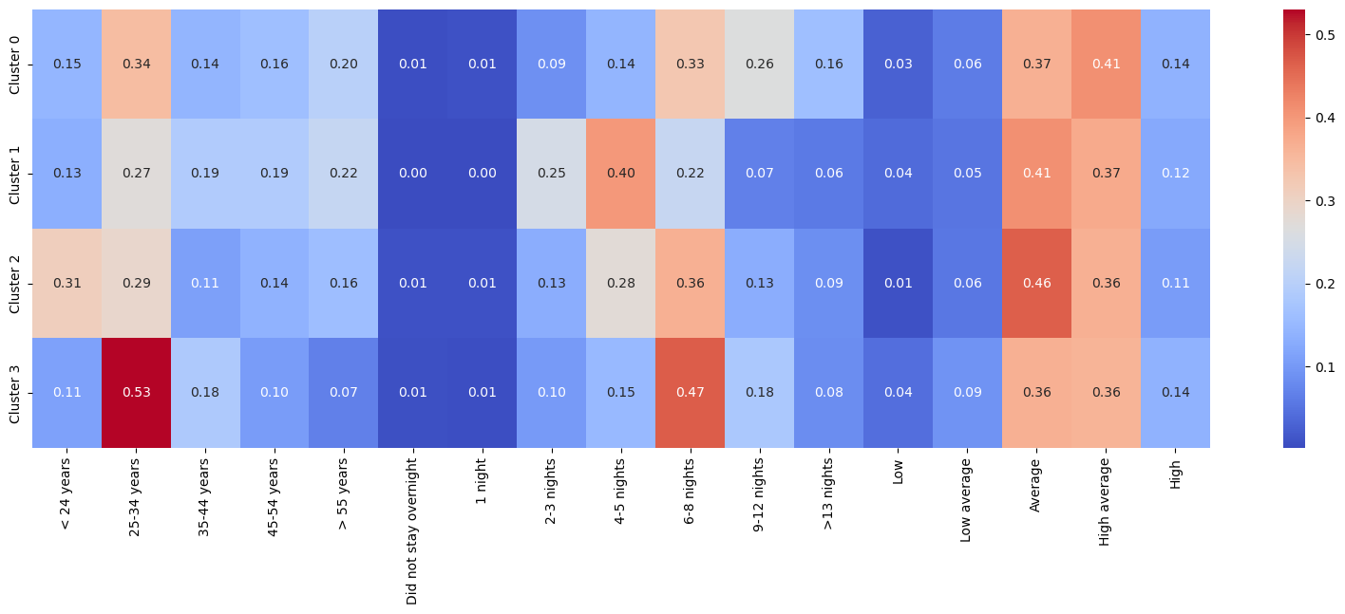
Iceland Tourism Segmentation 2023
Francisca Argandona Alvarado, CCT College Dublin
Introduction
Data Preparation
Tourism in Iceland has grown rapidly in recent years, becoming a major contributor to the economy. However, most existing profiles only considers country of origin or overall arrival numbers. This study aims to go further by applying clustering techniques to segment international tourists visiting Iceland in 2023, based on age, length of stay, and income. The goal is to uncover meaningful visitor segments that can guide more effective tourism strategies.
Data was extracted from multiple sheets of the original Excel and merged into one dataset. The final dataset included 21 nationalities and 17 features, all expressed as proportions. The variables were not scaled and no missing values were found. A heatmap and interactive bar plot helped to understand relationships between variables.
Results
K-Means with four clusters outperformed the other algorithms based on both visual and quantitative evaluation. Hierarchical with three clusters showed some separation, but the clusters were less distinct and less stable. DBSCAN failed to produce meaningful clusters and labelled most data as noise. The ANOVA test confirmed significant differences in age and length of stay, while income showed no clear distinction. ARI values indicated K-Means has stronger cluster stability (mean ARI= 0.61) compared to Hierarchical (mean ARI= 0.011).
Research Question
How can clustering techniques be applied to identify relevant tourist segments visiting Iceland, based on age, length of stay and average income?
Methodology
The study followed the CRISP-DM framework. The data was obtained from 2023 visitor surveys conducted at Keflavik International Airport
Two clusters (2 and 3) stood out for targeting young travellers with longer stays and average to high income levels, representing valuable segments for tourism strategies.
The selected variables were age, stay duration, and income. Three clustering models were applied: Hierarchical, K-Means, and DBSCAN. Clustering quality was assessed using the Silhouette Score, Davies-Bouldin Index, dendrogram visualisation and ANOVA. Dimensionality reduction with PCA helped to visualise cluster separation, besides the heatmaps on cluster centres. Adjusted Rand Index was also used to test stability across multiple runs.
Conclusion
K-Means clustering was chosen for its clearer, more stable, and actionable segments. The results reveal distinct profiles, particularly among young tourists with moderate to long stays. This information can help stakeholders design tailored services and marketing. However, since the dataset is small and represents only one year, findings should be seen as a snapshot due to market segments change over time. Future work should include larger samples and additional behavioural variables.

Slide 2
Iceland Tourism Segmentation 2023
Francisca Argandona Alvarado, CCT College Dublin
Introduction
Data Preparation
Tourism in Iceland has grown rapidly in recent years, becoming a major contributor to the economy. However, most existing profiles only considers country of origin or overall arrival numbers. This study aims to go further by applying clustering techniques to segment international tourists visiting Iceland in 2023, based on age, length of stay, and income. The goal is to uncover meaningful visitor segments that can guide more effective tourism strategies.
Data was extracted from multiple sheets of the original Excel and merged into one dataset. The final dataset included 21 nationalities and 17 features, all expressed as proportions. The variables were not scaled and no missing values were found. A heatmap and interactive bar plot helped to understand relationships between variables.
Results
K-Means with four clusters outperformed the other algorithms based on both visual and quantitative evaluation. Hierarchical with three clusters showed some separation, but the clusters were less distinct and less stable. DBSCAN failed to produce meaningful clusters and labelled most data as noise. The ANOVA test confirmed significant differences in age and length of stay, while income showed no clear distinction. ARI values indicated K-Means has stronger cluster stability (mean ARI= 0.61) compared to Hierarchical (mean ARI= 0.011).
Research Question
How can clustering techniques be applied to identify relevant tourist segments visiting Iceland, based on age, length of stay and average income?
Methodology
The study followed the CRISP-DM framework. The data was obtained from 2023 visitor surveys conducted at Keflavik International Airport
Two clusters (2 and 3) stood out for targeting young travellers with longer stays and average to high income levels, representing valuable segments for tourism strategies.
The selected variables were age, stay duration, and income. Three clustering models were applied: Hierarchical, K-Means, and DBSCAN. Clustering quality was assessed using the Silhouette Score, Davies-Bouldin Index, dendrogram visualisation and ANOVA. Dimensionality reduction with PCA helped to visualise cluster separation, besides the heatmaps on cluster centres. Adjusted Rand Index was also used to test stability across multiple runs.
Conclusion
K-Means clustering was chosen for its clearer, more stable, and actionable segments. The results reveal distinct profiles, particularly among young tourists with moderate to long stays. This information can help stakeholders design tailored services and marketing. However, since the dataset is small and represents only one year, findings should be seen as a snapshot due to market segments change over time. Future work should include larger samples and additional behavioural variables.

Slide 3
Iceland Tourism Segmentation 2023
Francisca Argandona Alvarado, CCT College Dublin
Introduction
Data Preparation
Tourism in Iceland has grown rapidly in recent years, becoming a major contributor to the economy. However, most existing profiles only considers country of origin or overall arrival numbers. This study aims to go further by applying clustering techniques to segment international tourists visiting Iceland in 2023, based on age, length of stay, and income..
Data was extracted from multiple sheets of the original Excel and merged into one dataset. The final dataset included 21 nationalities and 17 features, all expressed as proportions. The variables were not scaled and no missing values were found. A heatmap and interactive bar plot helped to understand relationships between variables.
Results
K-Means with four clusters outperformed the other algorithms based on both visual and quantitative evaluation. Hierarchical with three clusters showed some separation, but the clusters were less distinct and less stable. DBSCAN failed to produce meaningful clusters and labelled most data as noise. The ANOVA test confirmed significant differences in age and length of stay, while income showed no clear distinction. ARI values indicated K-Means has stronger cluster stability (mean ARI= 0.61) compared to Hierarchical (mean ARI= 0.011).
Research Question
How can clustering techniques be applied to identify relevant tourist segments visiting Iceland, based on age, length of stay and average income?
Objectives
The goal is to uncover meaningful visitor segments that can guide more effective tourism strategies
Segment tourists using clustering techniques based on age, stay, and income.
Compare three clustering algorithms.
Evaluate the quality and stability of the clusters.
Support data-informed tourism strategies.
Methodology
The study followed the CRISP-DM framework. The data was obtained from 2023 visitor surveys conducted at Keflavik International Airport
Two clusters (2 and 3) stood out for targeting young travellers with longer stays and average to high income levels, representing valuable segments for tourism strategies.
The selected variables were age, stay duration, and income. Three clustering models were applied: Hierarchical, K-Means, and DBSCAN. Clustering quality was assessed using the Silhouette Score, Davies-Bouldin Index, dendrogram visualisation and ANOVA. Dimensionality reduction with PCA helped to visualise cluster separation, besides the heatmaps on cluster centres. Adjusted Rand Index was also used to test stability across multiple runs.
Conclusion
K-Means clustering was chosen for its clearer, more stable, and actionable segments. The results reveal distinct profiles, particularly among young tourists with moderate to long stays. This information can help stakeholders design tailored services and marketing. However, since the dataset is small and represents only one year, findings should be seen as a snapshot due to market segments change over time. Future work should include larger samples and additional behavioural variables.

