Slide 1
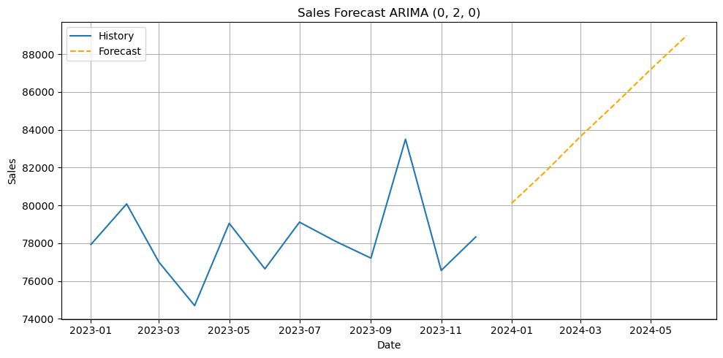
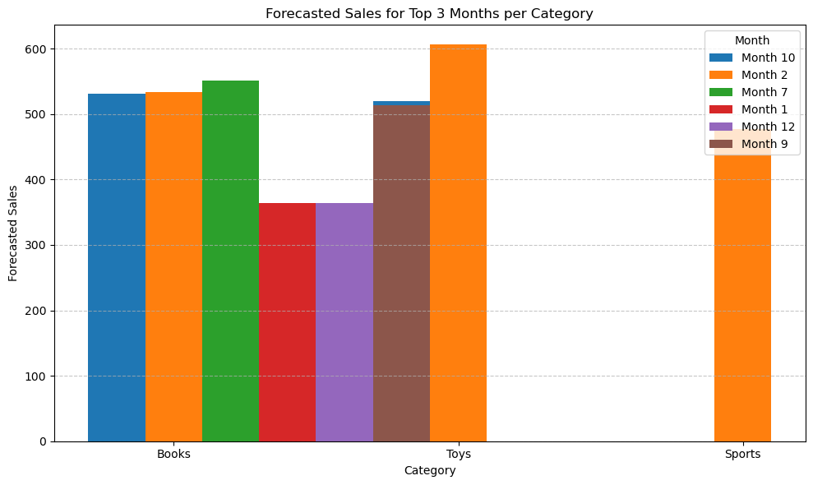
Forecasting e-Commerce Sales Using Machine Learning Models for Strategic Business Decision Making
Alexandra Munik Silva (2024268@student.cct.ie)
Highter Diploma in Data Analytics – CCT College Dublin
ABSTRACT
FUTURE WORK
In today’s data-rich digital economy, use of analytics is not optional any longer — it is essential for survival and growth.
This project looks into the manner in which the use of data analysis and machine learning can support strategic decision-making in e-commerce.
It worked on historical sales data of an online store, studying it with four models — ARIMA, Decision Tree, Random Forest, and Gradient Boosting — not only to forecast sales but to extract actionable insights into customer behaviour, product performance, and seasonality.
- Experiments with additional external variables like promotions, holidays, or even customer demographics will be attempted.
- Development of a forecasting and business insights visualization dashboard for business users.
- Implementation of these models practically in campaigns like dynamic pricing or seasonal marketing.
BEST MODEL
The best model was the Random Forest Regressor that had an R² of 0.45 and the smallest MAE at 277.68, therefore, the most accurate and with lowest prediction error among all other models. This particular type of model improves the overall results because it aggregates multiple individual decision trees.
It further fine-tuned its prediction for the highest selling categories which are Books, Toys, and Sports.
It captured the pattern of the month for each of these top categories as well as the relationship between sales and reviews for these items, and this information can be used to make much better stock decisions and promotions and pricing.
OBJECTIVES
The main goal of this project is to demonstrate how data analysis and machine learning can be used as strategic tools to improve decision-making in e-commerce.
By using predictive models, the project aims to show that businesses of any size—from small retailers to large companies—can use data to forecast sales, understand consumer patterns, and make better decisions related to pricing, inventory, and marketing.
QUESTION RESEARCH
CONCLUSION
How can data analysis—specifically machine learning models—boost sales and improve marketing strategies in e-commerce?
This question looks at whether ARIMA, Decision Tree, Random Forest, and Gradient Boosting goes beyond forecasting to delivering prescriptive insights that would help business better price, promote, and plan inventory which would directly drive sales growth.
This project shows that data analysis and machine learning can power smarter business strategies. Even with basic historical data, it is possible to:
Forecast future sales
Identify top-selling periods
Understand what influences consumer purchases
Whether for a small business or a large e-commerce company, embracing data-driven approaches leads to better decisions, reduced risk, and increased profits.
CCT College

