Slide 1
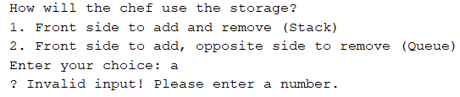

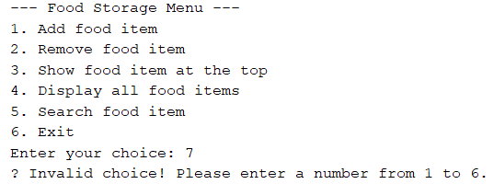

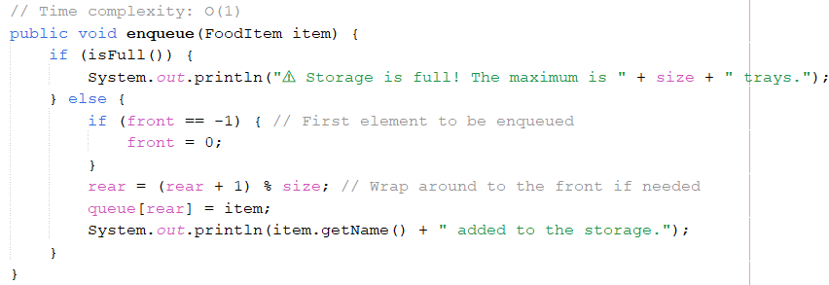
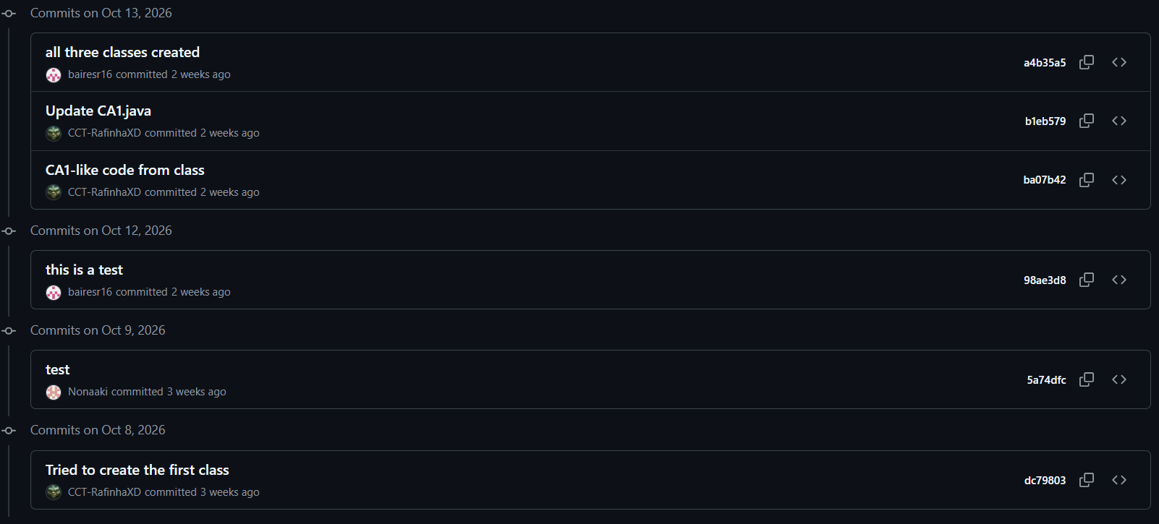
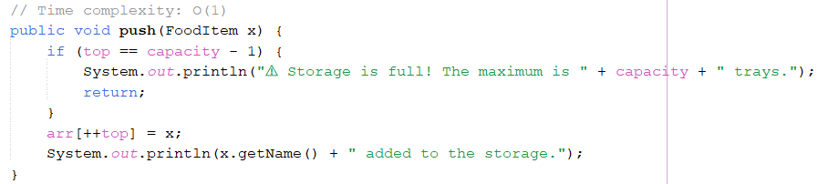
Fast-Food Storage App
Stack (LIFO) and Circular Queue (FIFO) in Java
Group: Rafael, Natalia, Sara · Lecturer: Taufique Ahmed
CA1 – Algorithms and Constructs · CCT College Dublin
GitHub: https://github.com/CCT-RafinhaXD/Algorithms-and-Constructs · Video: (add link)
Object-oriented programming
Why Stack and Queue?
Testing & validation
The program is split into 4 classes, each with one job. Every food item is an object created with new FoodItem(name, weight, bestBefore).
The chef can use the storage in two ways. If only the front side is used, the last tray in is the first out – a Stack. If trays go in at the front and come out of the opposite side, the first tray in is the first out – a Queue, which also sends older food out first. The user picks the mode when the program starts.
Classes & objects
Encapsulation
Abstraction
Modularity
Each food item is a FoodItem object with its own data.
Fields are private; data is read through getters.
CA1 only calls push, pop, enqueue… never the array.
Menu, data, stack and queue each live in their own class.
Advantages
Simple to build and explain
O(1) add, remove and peek
Mirrors the real storage
Limitations
Fixed size of 8 trays
Only the end tray is reachable
Search is O(n)
CA1 – main method: println menu, input validation and error handling
FoodItem – private name, weight, best-before and stored time, with getters
SingleStack.Stack – array stack: push, pop, peek, isFull, display, search
CircularQueue – circular array: enqueue, dequeue, peek, isFull, display, search
Java code: Queue
Data structures and operations
GitHub commits
Stack – LIFO
push / enqueue – add a tray
pop / dequeue – remove a tray
peek – show the item at the top
display / search – list all items / find by name
isEmpty / isFull – error handling for 0 or 8 trays
in ⇅ out (front)
empty
Fries
Burger
Pizza
Operation | Stack | Circular Queue
Add | push O(1) | enqueue O(1)
Remove | pop O(1) | dequeue O(1)
Peek (top) | O(1) | O(1)
Display | O(n) | O(n)
Search | O(n) | O(n)
isEmpty / isFull | O(1) | O(1)
Java code: Stack
back (closed)
Circular Queue – FIFO
in →
empty
Fries
Burger
Pizza
→ out
References
front side
opposite side
Oracle (2024) LocalDate (Java SE 17 & JDK 17). Available at: https://docs.oracle.com/en/java/javase/17/docs/api/java.base/java/time/LocalDate.html (Accessed: 27 October 2026).
Oracle (2024) Scanner (Java SE 17 & JDK 17). Available at: https://docs.oracle.com/en/java/javase/17/docs/api/java.base/java/util/Scanner.html (Accessed: 27 October 2026).
Ahmed, T. (2026) Algorithms and Constructs: Stacks and Queues [Lecture notes]. CCT College Dublin.
n = items stored (max 8) · Space: O(n), fixed array of 8

