Slide 1
TIME SERIES AND MACHINE LEARNING FORECASTING OF ENERGY CONSUMPTION
A Data Analytics Perspective
Name: Moeez Ul Din
Supervisor: Kislay Raj

Slide 2
PROBLEM STATEMENT
Household electricity consumption exhibits high volatility and nonlinear patterns that traditional methods struggle to capture
Traditional statistical methods (ARIMA) fail to model complex temporal dependencies and sudden consumption changes
Machine learning and deep learning show promise but their comparative performance across different temporal horizons remains unclear
Challenge: Identifying optimal forecasting methods for hourly, daily, and weekly energy predictions using real smart meter data

Slide 3
RESEARCH OBJECTIVES
Systematically benchmark traditional time series models (ARIMA, SARIMA, Prophet) on London smart meter data
Develop and optimize machine learning models (XGBoost) for household energy consumption forecasting
Implement deep learning architectures (LSTM) and evaluate performance across different temporal resolutions
Test hybrid models (ARIMA-LSTM, ARIMA-XGBoost, XGBoost-LSTM) to assess whether model combinations improve accuracy
Compare all approaches across hourly, daily, and weekly forecasting horizons using standardized evaluation metrics

Slide 4
LITERATURE REVIEW
Study | Approach | Best Result | Key Finding
Buratto et al. (2024) | Wavelet CNN-LSTM | 1.48% MAPE | Hybrid DL effective
Abumohsen & Owda (2024) | CNN-LSTM-RF | R²=92% | 3-way hybrid superior
Hasanat (2024) | 1D CNN-Bi-LSTM | 3.4% MAPE | Parallel>stacked
Moosbrugger et al. (2025) | xLSTM vs Transformer | Linear scaling | xLSTM promising
Kamtziridis (2024) | XGBoost forecasting | Feature eng. key | Tree models work

Slide 5
DATASET & EXPLORATORY ANALYSIS
Data Source: Low Carbon London (LCL) Smart Meter Dataset (Nov 2011 - Feb 2014)
Scale: 167 million half-hourly readings from 5,567 households, aggregated to 3.5M daily records
Stationarity: ADF test confirmed first-order differencing required (d=1)
Temporal Patterns: Morning peaks (6-9am), evening peaks (5-10pm), 35% higher winter consumption
Socioeconomic Distribution: Affluent 40.1%, Adversity 32.3%, Comfortable 26.7%
Feature Engineering: 7-day lags, rolling statistics (7-day mean/std), calendar features (day, month, weekend)
Data Quality: Weather data 84% missing, limiting external feature utility

Slide 6
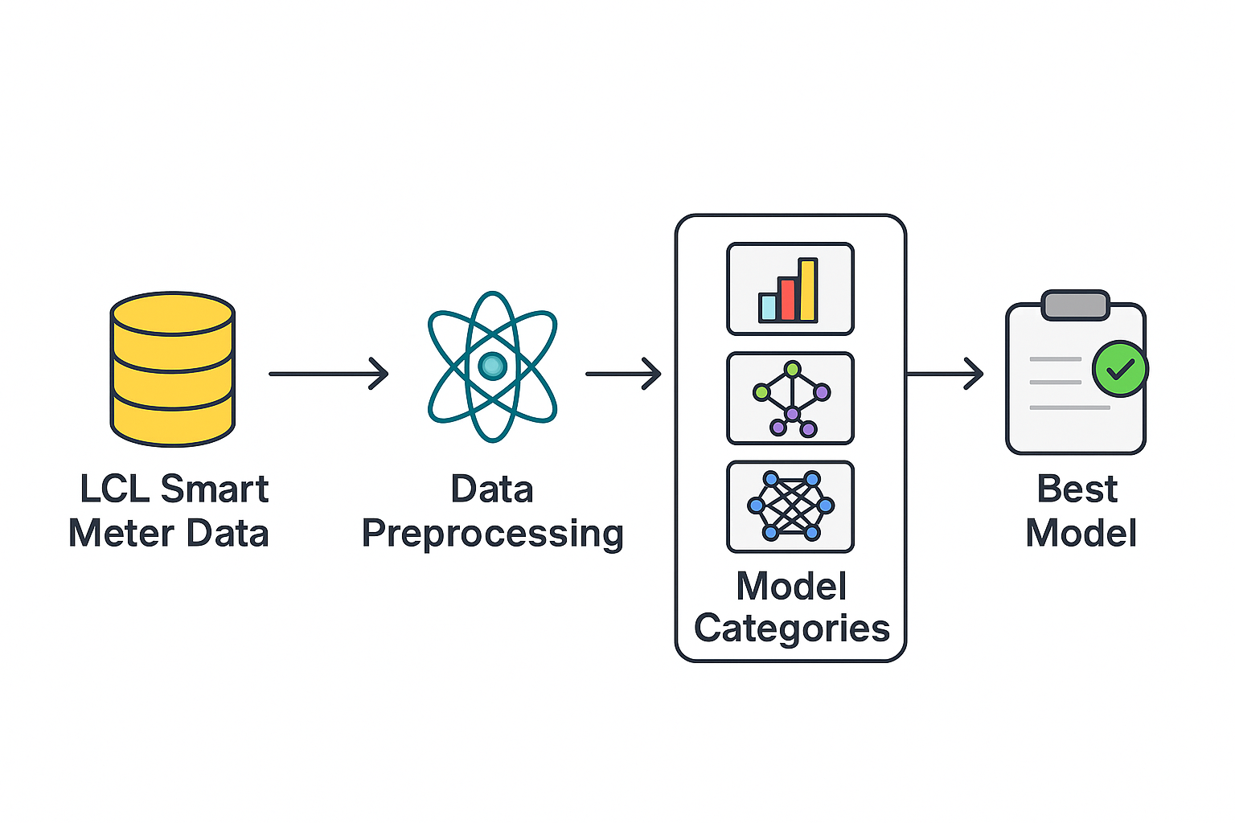
METHODOLOGY & ARCHITECTURE

Slide 7
RESULTS: HOURLY FORECASTING
Model | RMSE (kWh) | MAE (kWh) | MAPE (%) | R²
XGBoost | 0.325 | 0.185 | 35.68 | 0.600
LSTM | 0.361 | 0.227 | 46.04 | 0.502
XGBoost-LSTM | 0.362 | 0.220 | 43.44 | 0.502
Prophet | 0.492 | 0.385 | 118.63 | 0.079
ARIMA | 0.514 | 0.353 | 86.20 | -0.006
ARIMA-LSTM | 0.563 | 0.362 | 63.04 | -0.153
ARIMA-XGBoost Hybrid | 0.5501 | 0.348 | 60.83 | -0.151

Slide 8
RESULTS: DAILY FORECASTING
Model | RMSE (kWh) | MAE (kWh) | MAPE (%) | R²
XGBoost | 3.977 | 2.970 | 31.33 | 0.016
ARIMA | 4.140 | 2.859 | 29.68 | -0.071
SARIMA | 4.085 | 2.828 | 29.97 | -0.043
LSTM | 4.315 | 3.202 | 40.69 | 0.027
Prophet | 5.973 | 4.385 | 49.91 | -1.314
Hybrid XGBoost-LSTM | 4.72 | 3.38 | 33.32 | -0.16
Hybrid ARIMA-XGBoost | 4.89 | 3.59 | 34.92 | -0.45
Hybrid ARIMA-LSTM | 3.11 | 4.21 | 36.61 | 0.073

Slide 9
RESULTS: WEEKLY FORECASTING
Model | RMSE (kWh) | MAE (kWh) | MAPE (%) | R²
XGBoost | 21.97 | 17.06 | 22.20 | -0.134
ARIMA | 21.55 | 17.35 | 34.92 | -0.076
LSTM | 35.67 | 32.49 | 31.49 | -1.948
Prophet | 41.75 | 32.49 | 36.27 | -3.372
XGBoost-LSTM Hybrid | 21.639 | 17.445 | 18.73 | -0.085
ARIMA-XGBoost Hybrid | 4.8935 | 3.5908 | 34.92 | -0.4451
ARIMA-LSTM Hybrid | 21.55 | 17.35 | 36.91 | -0.08

Slide 10
KEY FINDINGS & DISCUSSION
XGBoost consistently superior across all temporal resolutions (hourly, daily, weekly)
Hourly: XGBoost (RMSE 0.325) outperformed LSTM (0.361) - contradicts deep learning superiority hypothesis
Hybrid models failed to improve upon best standalone models (XGBoost-LSTM ≈ LSTM performance)
Weekly forecasting most challenging: limited samples (68 weeks) led to negative R² for all models
Feature engineering (lags, rolling stats) more valuable than architectural complexity
Weather variables minimally useful due to 84% missingness
Statistical significance: XGBoost improvements validated via paired t-tests (p<0.05)

Slide 11
CONCLUSIONS & CONTRIBUTIONS
Systematic benchmarking: 8 models across 3 temporal horizons with standardized metrics
XGBoost most reliable for household energy forecasting - best accuracy-efficiency balance
Well-engineered features + tree-based models > complex deep learning architectures
Hybrid models require careful design - simple combinations insufficient for improvement
Model performance highly sensitive to temporal resolution and data characteristics
Practical impact: Findings inform smart grid optimization and demand response programs
Future directions: Attention mechanisms, probabilistic forecasting, real-time deployment testing

Slide 12
REFERENCES
Buratto, W. G., Waldman, R. K., & Nóbrega, C. E. L. (2024). Wavelet CNN-LSTM time series forecasting of electricity power generation considering biomass thermal systems. IET Generation, Transmission & Distribution, 18(20), 3234-3247.
Moosbrugger, L., Hartl, M., Zellinger, W., & Pichler, P. (2025). Load forecasting for households and energy communities: A benchmark of persistence, LSTM, xLSTM, and Transformer models. arXiv preprint arXiv:2501.05000.
Hasanat, S. M., et al. (2024). Enhancing Load Forecasting Accuracy in Smart Grids: A Novel Parallel Multichannel Network Approach Using 1D CNN and Bi-LSTM Models. International Journal of Energy Research.
Abumohsen, M., & Owda, A. Y. (2024). Hybrid machine learning model combining CNN-LSTM-RF for time series forecasting of Solar Power Generation. Results in Engineering, 22, 102216.
Dong, Q., Huang, R., Cui, C., Towey, D., Zhou, L., Tian, J., & Wang, J. (2024). Short-Term Electricity-Load Forecasting by Deep Learning: A Comprehensive Survey. arXiv preprint arXiv:2408.16202.
Chen, T., & Guestrin, C. (2016). XGBoost: A scalable tree boosting system. Proceedings of the 22nd ACM SIGKDD International Conference on Knowledge Discovery and Data Mining (pp. 785-794).
Hochreiter, S., & Schmidhuber, J. (1997). Long short-term memory. Neural Computation, 9(8), 1735-1780.

Slide 13
THANK YOU
Questions & Discussion

