Slide 1

Mzkit User Manual
BioNovoGene m/z Data Toolkit User Manual
BioNovoGene Bio-Pharm Technology Co., Ltd
Present By: BioDeep R&D Department
E-Mail: R&D@biodeep.cloud

Slide 2
Introduction
The main function of Mzkit includes:
Raw Data Viewer
Metabolite Feature Annotation
Mulecular Networking
Open Source M/z Raw Data File Format Supports:
mzML, mzXML, imzML, mzPack, netCDF, HDF, Mgf

Slide 3
LICENSE
Mzkit application and its source code is distributed under the MIT open source license
Source Code:
https://github.com/xieguigang/mzkit
Downloads:
http://www.biodeep.cn/downloads?lang=en-US

Slide 4
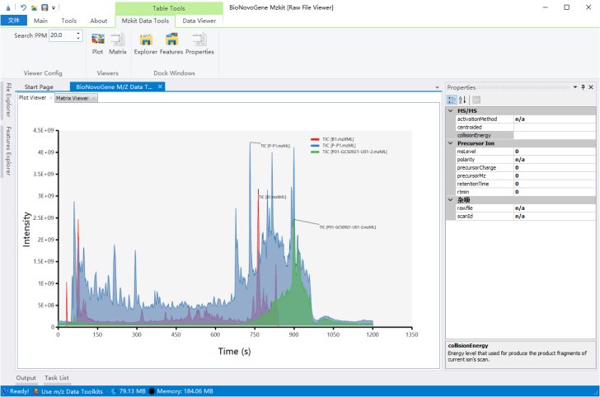
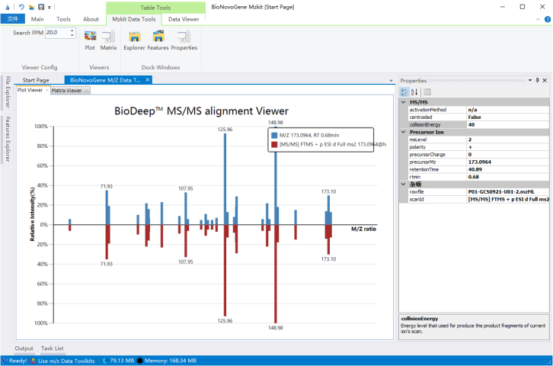
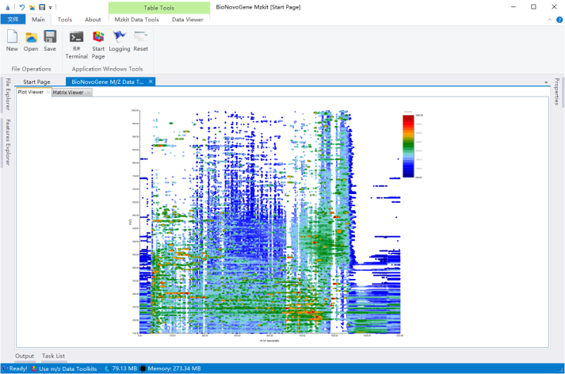
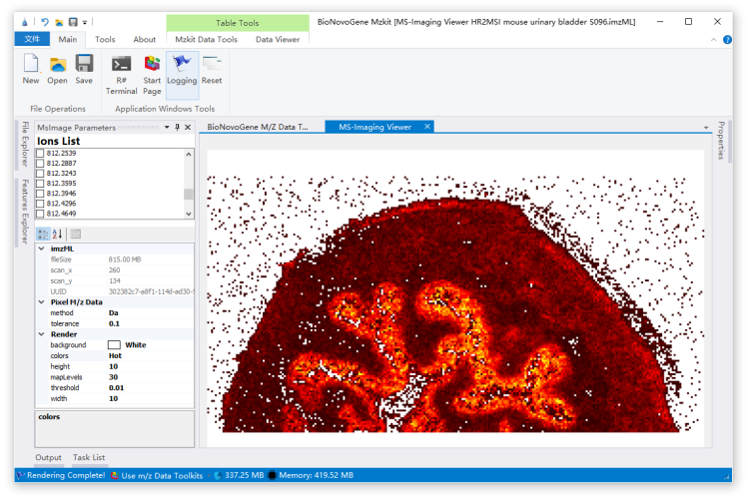
Screenshots
a. Chromatography
b. Spectrum
c. 2D Scatter
d. MS-Imaging

Slide 5
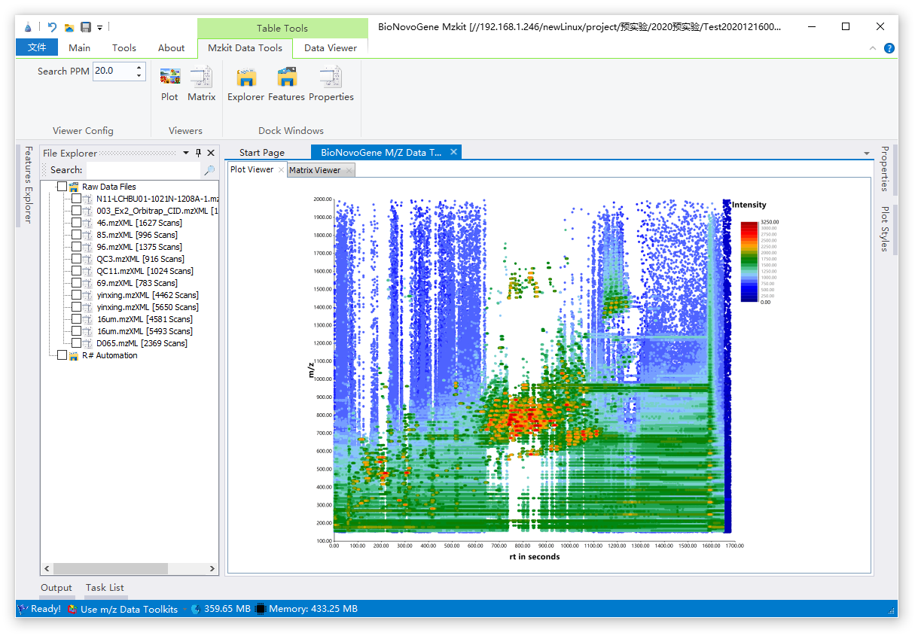
Main Screen
Toolkit Ribbon
Data Explorer
Content Properties
Content Viewer
Status Toolstrip
The main screen page of Mzkit application.

Slide 6
View GC-MS Targetted
Mzkit application and its source code is distributed under the MIT open source license
Source Code:
https://github.com/xieguigang/mzkit
Downloads:
http://www.biodeep.cn/downloads?lang=en-US

Slide 7



感谢观看
Thank you for your attention
苏州帕诺米克生物医药科技有限公司
地址：江苏省苏州市工业园区新平街388号22幢2层
电话：0512-62959105
邮箱：info@bionovogene.com
网址：https://www.bionovogene.com www.biodeep.cn
科研服务订阅号
科研服务公众号
健康服务公众号

