Slide 1
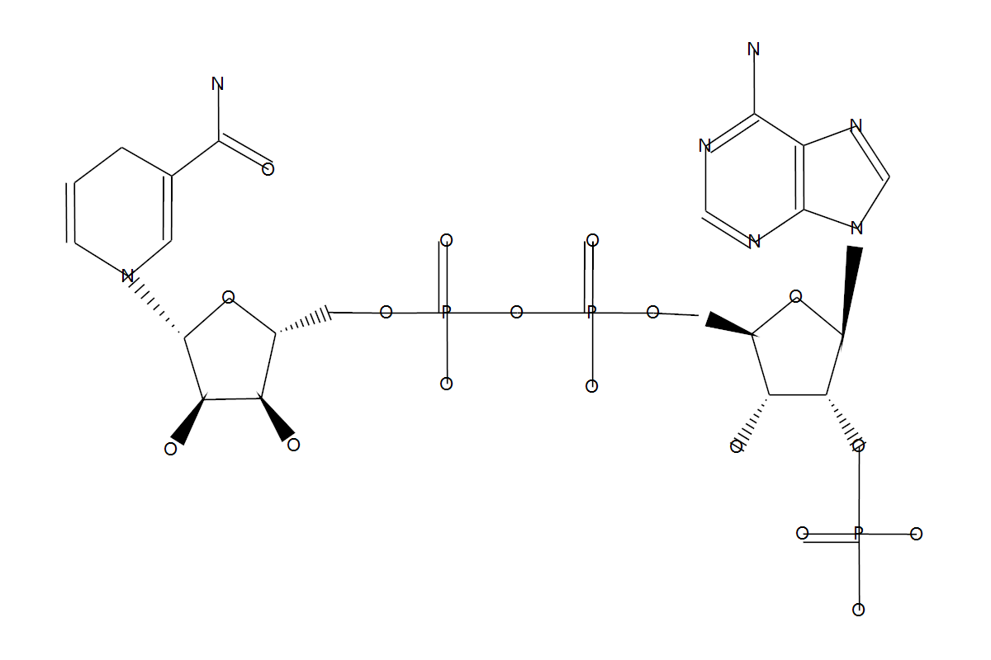
ENTRY C00005 Compound
ATOM 48
1 C1y C 45.6720 -22.9148
2 N4y N 46.0143 -20.6899
3 C1y C 45.2747 -24.1557
4 O2x O 44.5777 -22.1203
5 C8y C 44.7428 -20.2924
......
BOND 52
1 1 2 1 #Up
2 1 3 1
3 1 4 1
4 2 5 1
5 2 6 1
......
///
Example chemical structure from KCF data:
The Atom group in this compound is a graph node
in the network, and then chemical bounds is the
network edge which is link the atom groups.
Due to the reason of energy of these chemical bound may be different with each other,
this will cause different m/z intensity and different m/z value from the atom groups.

Slide 2
5 m/z
5 m/z
C (1 kJ/mol)
A (5 kJ/mol)
10 m/z
B (3 kJ/mol)
20 m/z
10 m/z
20 m/z
5 m/z
5 m/z
A (5 kJ/mol)
A (5 kJ/mol)
10 m/z
20 m/z
B (3 kJ/mol)
10 m/z
20 m/z

Slide 3
35
10
into
into
25
35
m/z
m/z
35
into
10
into
5
20
25
35
m/z
m/z

Slide 4
quantity
6 kj/mol
3 kj/mol
5 kj/mol
energy

Slide 5
into
10
25
5
20
35
m/z

