Slide 1
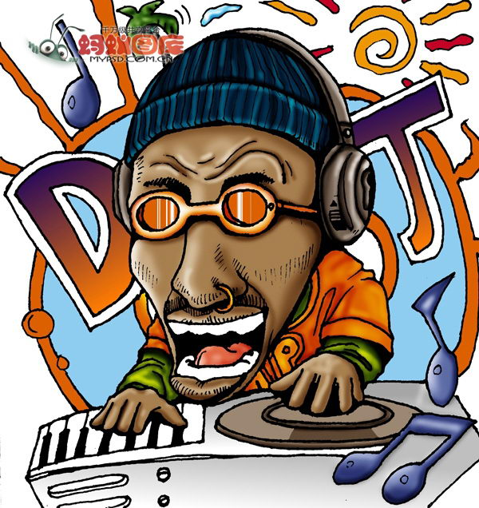

王者之聲
The Shouting King
資管三 莫均朗
資管三 林哲宇
資管三 許為傑

Slide 2
Motivation
Our Motivation is to show off how STT(Speech to text) technology can be used to make a mobile game.

Slide 3
Method
Language: C#
Function: Microsoft Speech to text API

Slide 4
The game
The game is all about STT.
Players can attack each other by speak more or match to the requested words
Players will lose if their health point reach 0.

