Slide 1
How to ask questions that people want to answer
James Howison

Slide 2

http://www.flickr.com/photos/gubatron/3102412751
Notes:
Aka, this guy knows the answer to your question.

Slide 3
Technical Forums
Lakhani and von Hippel (2003) studied Apache httpd mailing list.
Mailed a survey link to participants the first time they saw them post to the list
Only ever mailed each person once.
28.9% info providers responded, 16.6% info seekers.

Slide 4
Findings
Excellent ROI for information seekers (Seekers saved 9 minutes for every 1 minute spent writing questions).
Providers answer questions that are easy for them, rarely do they seek out additional information to help answer.
Information Providers invest a lot of time in the forum, average of 80 hours a year.
Primary motivations to answer were reciprocity and reputation within Apache (not career prospects)
But they are primarily there to learn (>90% of time spent reading, not answering)

Slide 5
Learn by reading?
What will someone reading learn?
That I have a problem? That I need help? That I can’t solve it?
Brainwriting on this:
What does someone learn from reading questions (and answers) in a technical forum?
What does someone learn from answering?

Slide 6
Engage intellectual curiosity
Experts love interesting problems and the solving of them.
Interesting problems are those that reveal some new insights
Uninteresting problems are either obvious or unsolvable (poorly specified or not actionable).
Ask questions like an intellectual partner.

Slide 7
Steps to answered question
Choose the right venue
Do (and show) your homework
Convey your situation
Ask an actionable question
Engage the interest of your audience
Follow up
Once you have their attention hold it
Don’t be the “Ok, fixed it now” guy
From Raymond and Moen, “How to ask questions the smart way”

Slide 8
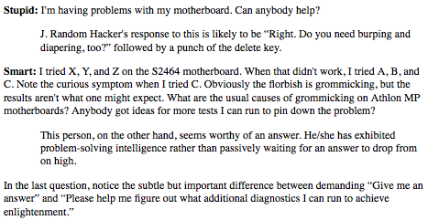
Examples
(From Eric Raymond’s “How to ask questions the smart way”)

Slide 9
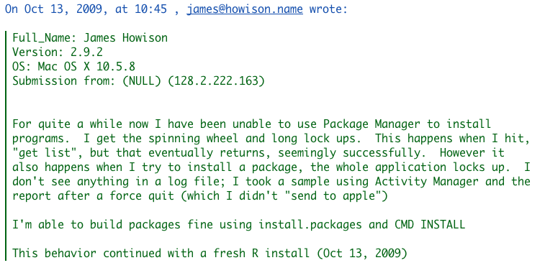
Getting it right (and yet so wrong)
Submitted to R Bugs Website
Included a large file with dump from “sample” command

Slide 10
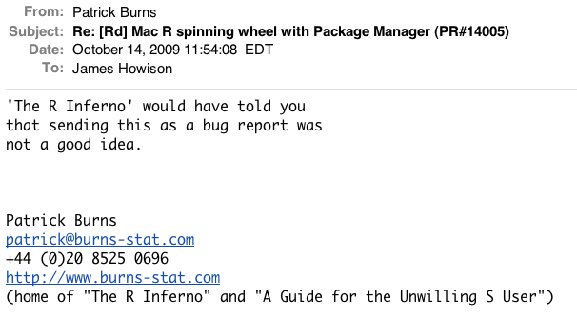
Two Responses

Slide 11
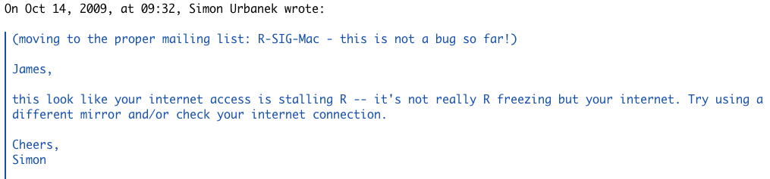
Example Answer 2

Slide 12
Resources
Fogel, K. (1999). Open Source Development with CVS. Coriolis Open Press, Scottsdale, AZ.
Crowston, K., Wei, K., Howison, J., and Wiggins, A. (2011). Free (libre) open source software development: What we know and what we do not know. ACM Computing Surveys, forthcoming.
Bacon, J. (2009). The Art of Community: Building the New Age of Participation. O’Reilly Media.
Raymond, E. S. and Moen, R. (2001). How to ask questions the smart way. Webpage.
http://www.catb.org/esr/faqs/smart-questions.html

