Slide 1

GEL

Slide 2
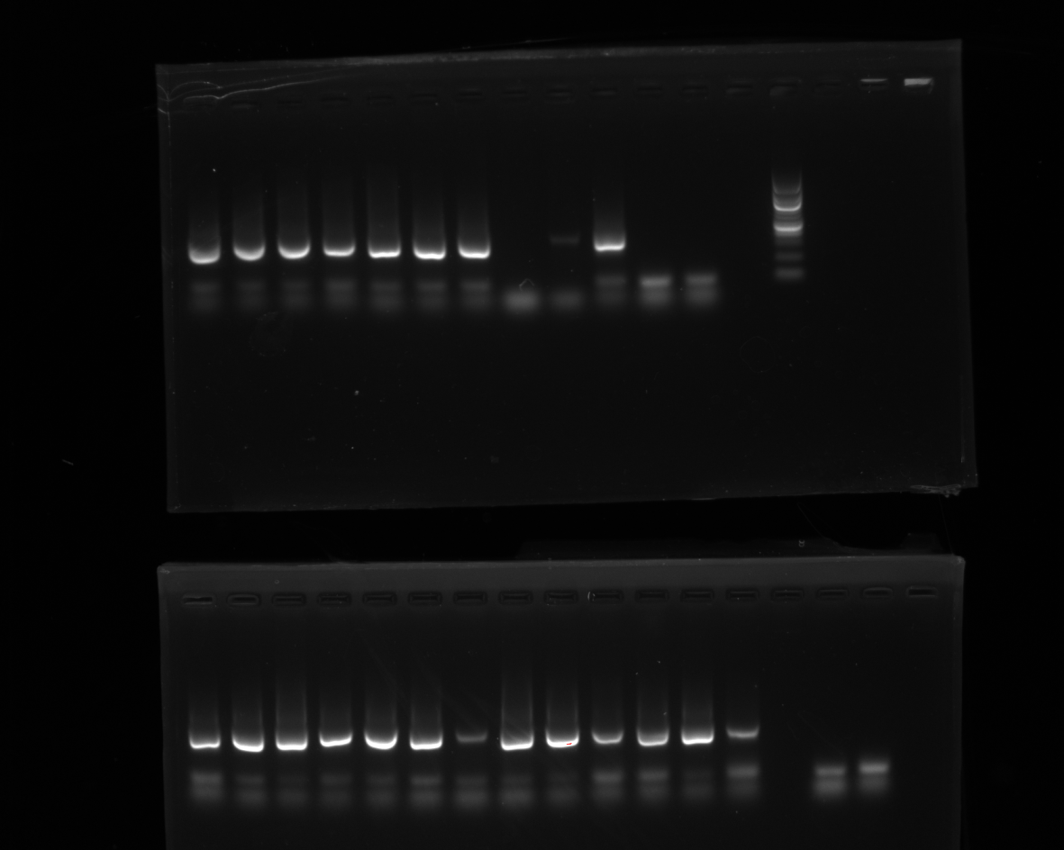
MI S1 P1 | ZA S1 P1 | ZP S1 P1 | S1 S1 P1 | S2 S1 P1 | G1 S1 P1 | G2 S1 P1 | YO S1 P1 | AW S1 P1 | SK S1 P1 | SN S1 P1 | HI S1 P1 | POSITIVE |  | EXT 15/06 | NEGATIVE
Missing ladder!
DATE | 2022/08/
RUN | 2
FILE NAME | NUCLEIC_ACID_08152022_155005 (bottom)

Slide 3
MI D1 P1 | ZA D1 P1 | ZP D1 P1 | S1 D1 P1 | S2 D1 P1 | G1 D1 P1 | G2 D1 P1 | AW D1 P1 | SN D1 P1 | HI D1 P1 | ZAYO FIE P1 | ZAYO FIL P1 |  | LADDER
DATE | 2022/08/
RUN | 1
FILE NAME | NUCLEIC_ACID_08152022_155005 (top)

Slide 4
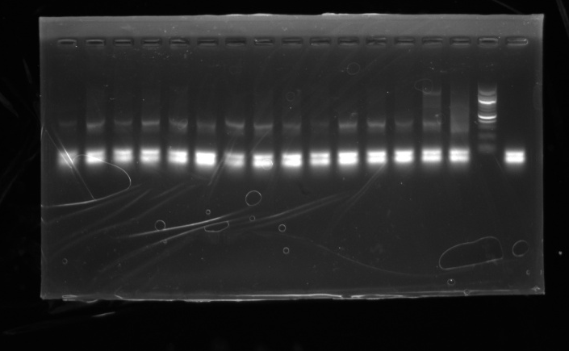
S1 D1 P3 | S2 D1 P3 | H1 D1 P3 | ZP D1 P3 | G1 D1 P3 | G2 D1 P3 | SN D1 P3 | MI D1 P3 | ZA D1 P3 | AW D1 P3 | S1 S1 P3 | S2 S1 P3 | HI S1 P3 | ZP S1 P3 | positive | ladder | negative
DATE | 2022/08/16
PCR | 2
FILE NAME | NUCLEIC_ACID_08162022_164150

Slide 5
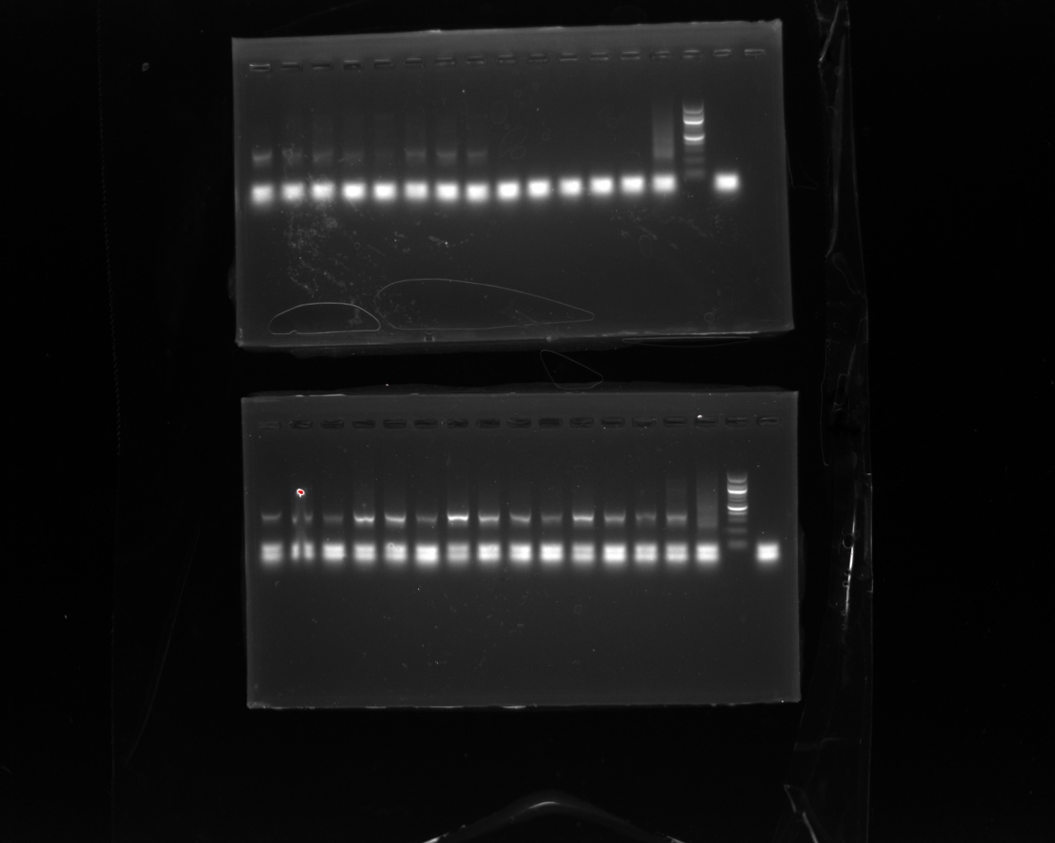
G1 S1 P3 | G2 S1 P3 | SNS1P3 | MI S1 P3 | SK S1 P3 | ZAS1P3 | YOS1P3 | AWS1P3 | ZAYOFIEP3 | ZAYOFILP3 | EXT1506P3 | ZPFILP2 | ZP FIEP2 (MMold) | positive | ladder | negative
DATE | 2022/08/16
PCR | 2
FILE NAME | NUCLEIC_ACID_08162022_181420 (top)

Slide 6
S1D1P2 | S2D1P2 | H1D1P2 | ZPD1P2 | G1D1P2 | G2D1P2 | SND1P2 | MID1P2 | ZAD1P2 | AWD1P2 | S1S1P2 | S2S1P2 | HIS1P2 | ZPS1P2 | positive | ladder | negative
DATE | 2022/08/16
PCR | 1
FILE NAME | NUCLEIC_ACID_08162022_181420 (bottom)

Slide 7
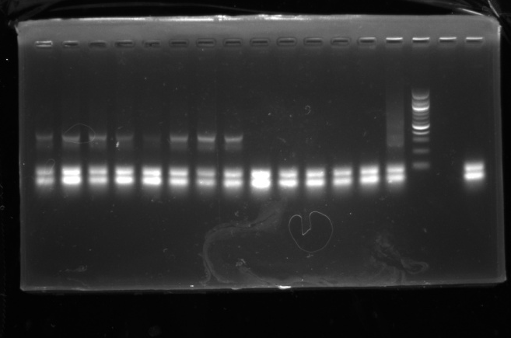
G1S1P2 | G2S1P2 | SNS1P2 | MIS1P2 | SKS1P2 | ZAS1P2 | YOS1P2 | AWS1P2 | ZAYOFIEP2 | ZAYOFILP2 | EXT1506P2 | ZPFILP1 | ZPFIEP1 |  | positive | ladder | negative
DATE | 2022/08/16
PCR | 1
FILE NAME | NUCLEIC_ACID_08162022_181945

Slide 8
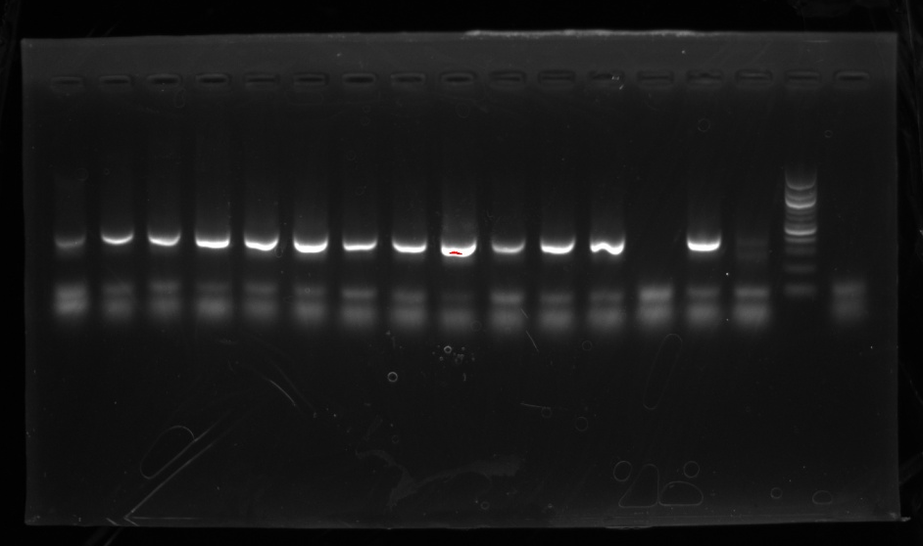
S1 D2P1 | S2D2P1 | H1D2P1 | ZPD2P1 | G1D2P1 | G2D2P1 | SND2P1 | MID2P1 | ZAD2P1 | AWD2P1 | YOD2P1 | S1S2P1 | S2 S2 P1 | HIS2P1 | positive | ladder | negative
DATE | 2022/08/17
PCR | 1
FILE NAME | NUCLEIC_ACID_08172022_160526

Slide 9
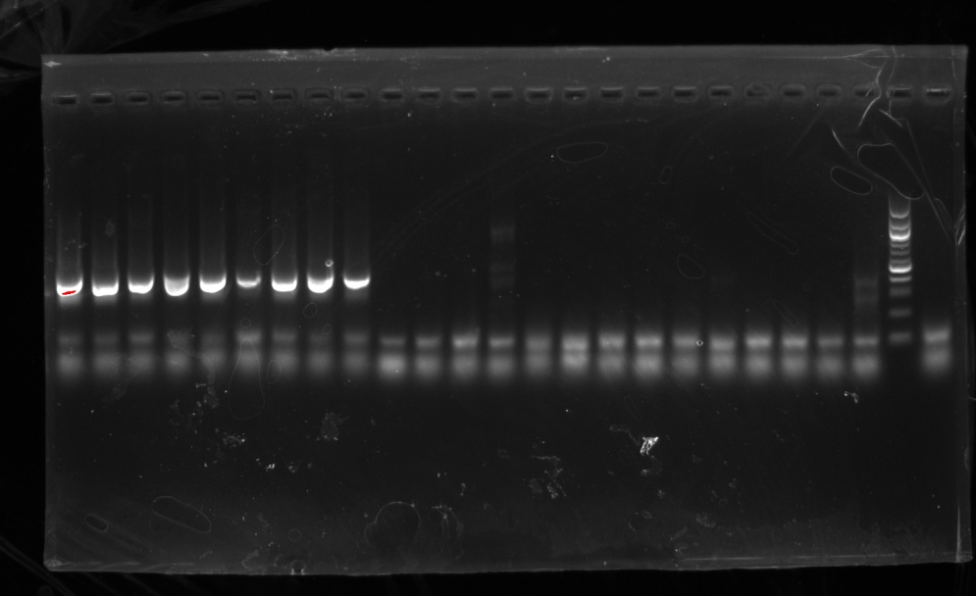
ZPS2P1 | G1S2P1 | G2S2P1 | SNS2P1 | MIS2P1 | SKS2P1 | ZAS2P1 | YOS2P1 | AWS2P1 | ZPFILP3 | ZPFIEP3 | HIFILP1 | HIFIEP1 | MIFILP1 | MIFIEP1 | SNFILP1 | SNFIEP1 | G12FILP1 | G12FIEP1 | AWFILP1 | AWFIEP1 | ext10/08P1 | positive | ladder | negative
DATE | 2022/08/17
PCR | 1
FILE NAME | NUCLEIC_ACID_08172022_160526

Slide 10
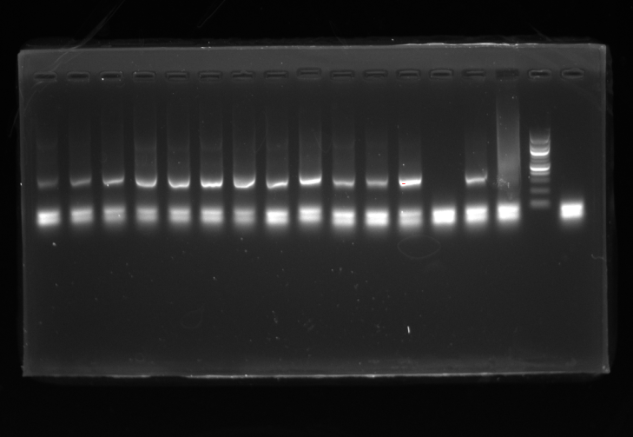
S1D2P2 | S2D2P2 | H1D2P2 | ZPD2P2 | G1D2P2 | G2D2P2 | SND2P2 | MID2P2 | ZAD2P2 | AWD2P2 | YOD2P2 | S1 S2 P2 | S2 S2 P2 | HIS2P2 | positive | ladder | negative
DATE | 2022/08/17
PCR | 2
FILE NAME | NUCLEIC_ACID_08172022_170743

Slide 11
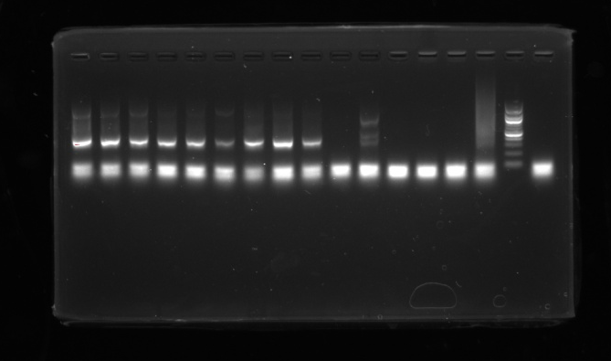
ZPS2P2 | G1S2P2 | G2S2P2 | SNS2P2 | MIS2P2 | SK S2 P2 | ZAS2P2 | YOS2P2 | AWS2P2 | HIFILP2 | HI FIEP2 | MIFILP2 | MIFIEP2 | SNFILP2 | positive | ladder | negative
DATE | 2022/08/17
PCR | 2
FILE NAME | NUCLEIC_ACID_08172022_170743

Slide 12
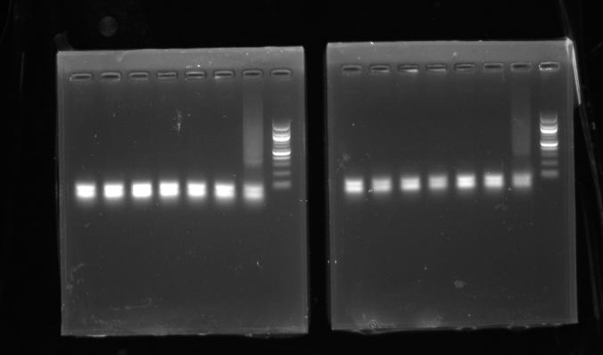

Slide 13
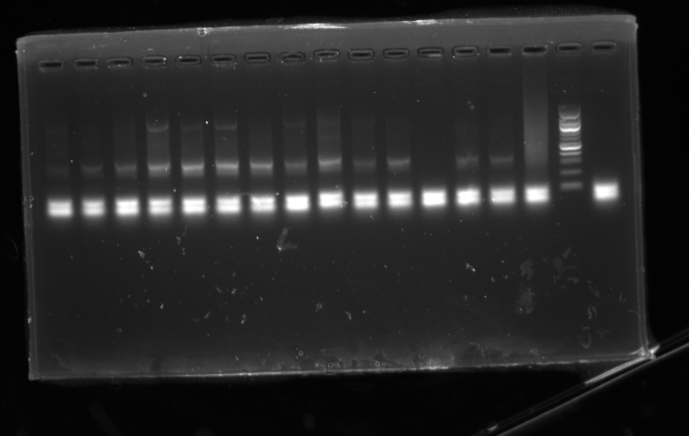
S1 D2 P3 | S2D2P3 | H1D2P3 | ZPD2P3 | G1D2P3 | G2D2P3 | SND2P3 | MID2P3 | ZAD2P3 | AWD2P3 | HIS2P3 | S1 S2 P3 | S2 S2 P3 | YOD2 P3 | positive | ladder | negative
DATE | 2022/08/17
PCR | 3
FILE NAME | NUCLEIC_ACID_08172022_182145

Slide 14
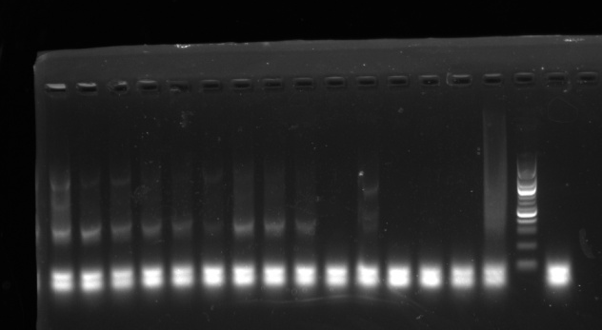
ZPS2P3 | G1S2P3 | G2S2P3 | SNS2P3 | MIS2P3 | SK S2 P3 | ZAS2P3 | YOS2P3 | AWS2P3 | HIFILP3 | HIFIEP3 | MIFILP3 | MIFIEP3 | SNFILP3 | positive | ladder | negative
DATE | 2022/08/17
PCR | 3
FILE NAME | NUCLEIC_ACID_08172022_182145

Slide 15
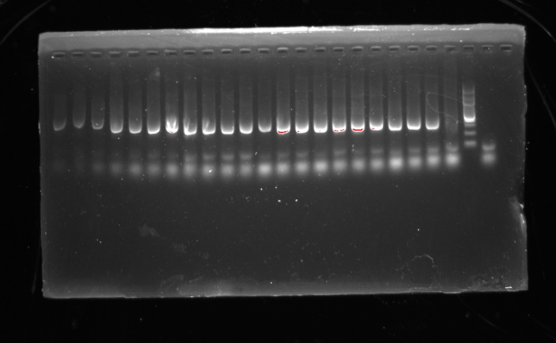
S1 D3 P1 | S2 D3P1 | H1D3P1 | ZP D3P1 | G1D3P1 | G2D3P1 | SND3P1 | MID3P1 | ZAD3P1 | AWD3P1 | YOD3P1 | S1 S3 P1 | S2 S3 P1 | HI S3 P1 | ZP S3 P1 | G1 S3 P1 | G2 S3 P1 | SN S3 P1 | MI S3 P1 | SK S3 P1 | ZA S3 P1 | positive | ladder | neg
DATE | 2022/08/18
PCR | 1
FILE NAME | NUCLEIC_ACID_08182022_151540

Slide 16
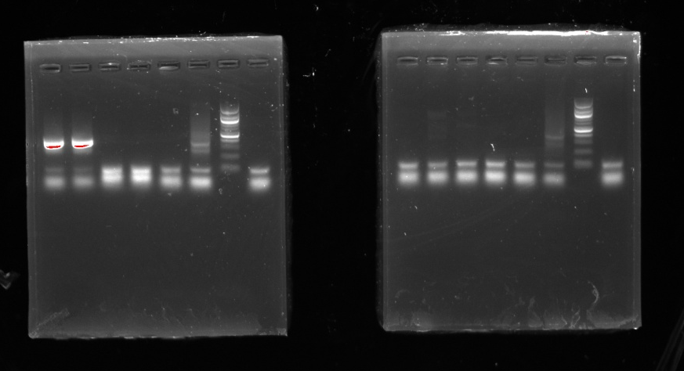
YOS3 P1 | AWS3 P1 | S2D FILP1 | S2D FIEP1 | SK FILP1 | positive | ladder | negative
SK FIEP1 | SAHI FILP1 | SAHI FIEP1 | EXT 22/08/02 P1 | EXT 22/07/29 P1 | positive | ladder | negative
DATE | 2022/08/18
PCR | 1
FILE NAME | NUCLEIC_ACID_08182022_153620

Slide 17
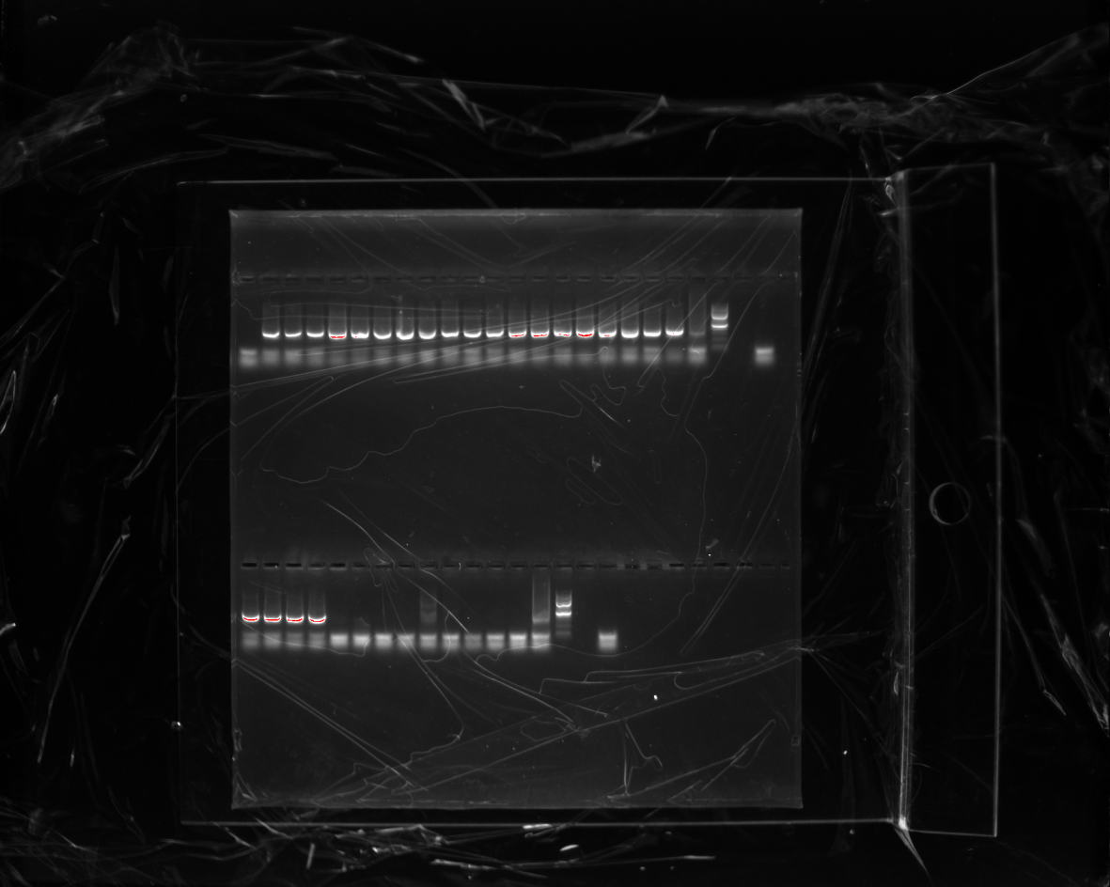
EXT 22/06/29 P1 | S1D3P2 | S2D3P2 | H1 D3P2 | ZPD3P2 | G1 D3P2 | G2D3P2 | SND3P2 | MID3P2 | ZAD3P2 | AWD3P2 | YOD2P2 | S1S3P2 | S2S3P2 | HIS3P2 | ZPS3P2 | G1S3P2 | G2S3P2 | SNS3P2 | MIS3P2 | SKS3P2 | positive | ladder |  | negative
DATE | 2022/08/18
PCR | 2
FILE NAME | NUCLEIC_ACID_08182022_165540 (top)

Slide 18
ZA S3 P2 | YO S3 P2 | AW S3 P2 | S2D FIL P2 | S2DFIEP2 | SKFILP2 | SKFIEP2 | SAHIFILP2 | SAHIFIEP2 | EXT 22/08/02 P2 | EXT 22/07/29 P2 | EXT 22/06/29 P2 | positive | ladder |  | negative
DATE | 2022/08/18
PCR | 2
FILE NAME | NUCLEIC_ACID_08182022_165540 (bottom)

Slide 19
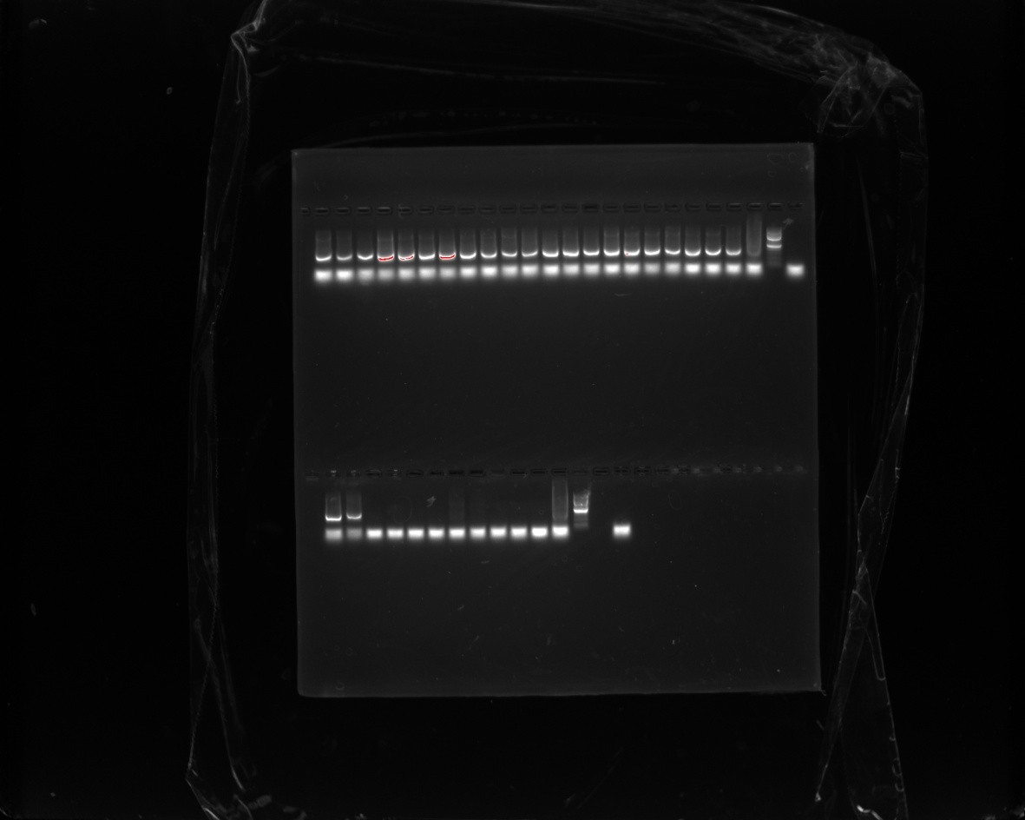
S1D3P2 | S2D3P2 | H1D3P2 | ZPD3P2 | G1D3P2 | G2D3P2 | SND3P2 | MID3P2 | ZAD3P2 | AWD3P2 | YOD2P2 | S1S3P2 | S2S3P2 | HIS3P2 | ZPS3P2 | G1S3P2 | G2S3P2 | SNS3P2 | MIS3P2 | SKS3P2 | ZAS3P2 | positive | ladder | negative
DATE | 2022/08/18
PCR | 3
FILE NAME | NUCLEIC_ACID_08182022_180204 (bottom)

Slide 20
YOS3P2 | AWS3P2 | S2DFILP2 | S2DFIEP2 | SKFILP2 | SKFIEP2 | SAHIFILP2 | SAHIFIEP2 | EXT 22/08/02 P2 | EXT 22/07/29 P2 | EXT 22/06/29 P2 | positive | ladder |  | negative
DATE | 2022/08/18
PCR | 3
FILE NAME | NUCLEIC_ACID_08182022_180204 (bottom)

Slide 21
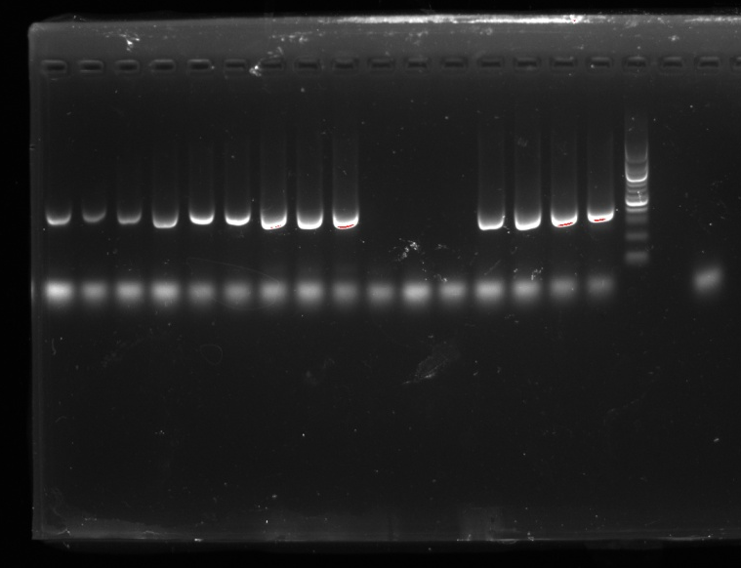
S1S2DILP1 | S1S2DILP2 | S1S2DILP3 | AWD1CLEANP1 | AWD1CLEANP2 | AWD1CLEANP3 | S1D2CLEANP1 | S1D2CLEANP2 | S1D2CLEANP3 | S2S2CLEANP1 | S2S2CLEANP2 | S2S2CLEANP3 | S1S2CLEANP1 | S1S2CLEANP2 | S1S2CLEANP3 | POSITIVE | LADDER | - | NEGATIVE
DATE | 2022/08/19
PCR | 1
FILE NAME

