Slide 1
DS HW4
助教： 黃郁洺 M11015203@mail.ntust.edu.tw 湯冠維 M11015045@mail.ntust.edu.tw 郭勁宏 M11015068@mail.ntust.edu.tw

Slide 2
Cycle detection

Slide 3
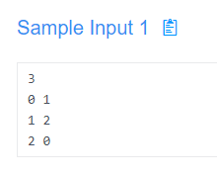
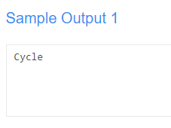
Description
Given N nodes and the relationship between nodes.
Please check whether a cycle exists in the directed graph.
Input: Two integers a, b (a -> b).
Output: “Cycle” or “No Cycle”
Hint: DFS
0
1
nodes
2
Edge: 0 -> 1

Slide 4
Minimum Spanning Tree

Slide 5
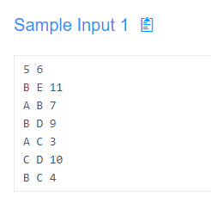
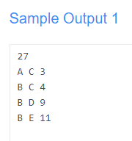
Description
Given an undirected graph, please find the Minimum Spanning Tree by applying Kruskal or Prim algorithm.
When applying Prim's algorithm, the start vertex should be the leftmost node in ascending order.
nodes
edges
For each edge in MST, the two nodes are in ascending order,
ex. An edge connects "A" and "H", then you should output "A" before "H".
If two edge weights are the same, they will be output according to the first vertex in ascending order.
ex. Two edges: 1-4, 5-9 have the same weight, then edge 1-4 outputs before 5-9.
Two nodes connected by an edge with weight
Sum of edge weight in MST
Edges in MST.

Slide 6
A
7
B
11
E
3
4
9
If applying Prim’s algorithm, start vertex would be node “A”.
C
D
10
A
B
11
E
MST
3
4
9
C
D

Slide 7
Rules
OJ Link: https://nlp.csie.ntust.edu.tw:2021/contest/9
OJ 截止日期： 2022/12/28 11:59 (截止前無限制上傳次數)
程式語言：C (gcc 9.4)、C++ (g++ 9.4)、python(3.8)
請注意 OJ 的 compiler version，以及 python 版本，否則能會產生 compile error, runtime error 等問題。
請勿使用與 graph 或 tree 相關的 library (vector 可以使用)，請自行實作基礎資料結構。
請勿抄襲他人程式碼

