Slide 1
EE351 微机原理与微系统
姜俊敏
电子与电子工程系

Slide 2

第三章 Introduction to Unix

Slide 3
Early History of Unix
∗ 1960s
Multics project (MIT, GE, AT&T)
∗ 1970s
AT&T Bell Labs
∗ 1970s/80s
UC Berkeley
∗ 1980s
DOS imitated many Unix ideas
Commercial Unix fragmentation
GNU (GNU’s Not Unix) project

Slide 4
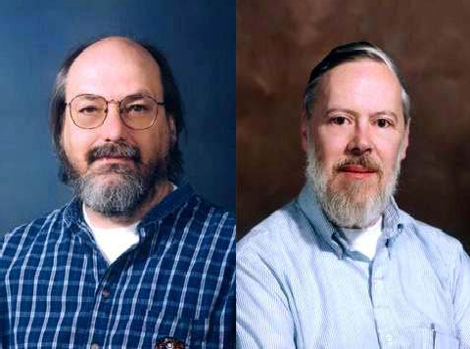
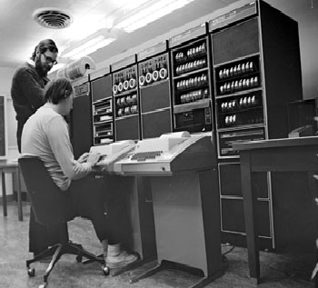
The Inventors
Ken Thompson Dennis Ritchie ACM Turing Award winners, 1983

Slide 5
C Language as a Byproduct
Problem
Need to port Unix to other platforms
Unix written in assembly language
Solution
Rewrite Unix using 'B'
Extensive changes made for Unix
Renamed to 'C'
High & low level programming language
Increased portability
Easier to improve & enhance Unix

Slide 6
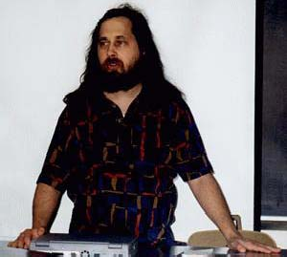
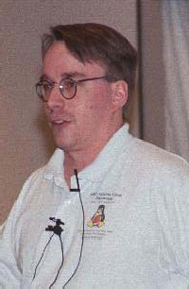
The Rebels
Richard Stallman who founded
Free Software Foundation
Linus Torvalds, father of
LINUX

Slide 7
A Post Seen in comp.os.minix
From: torvalds@klaava.Helsinki.FI (Linus Benedict Torvalds) Newsgroups: comp.os.minix
Subject: Gcc-1.40 and a posix-question
Message-ID: <1991Jul3.100050.9886@klaava.Helsinki.FI> Date: 3 Jul 91 10:00:50 GMT
Hello netlanders,
Due to a project I'm working on (in minix), I'm interested in the posix standard definition. Could somebody please point me to a (preferably) machine- readable format of the latest posix rules? Ftp-sites would be nice.
Two years after this post, there were 12,000 Linux users.

Slide 8
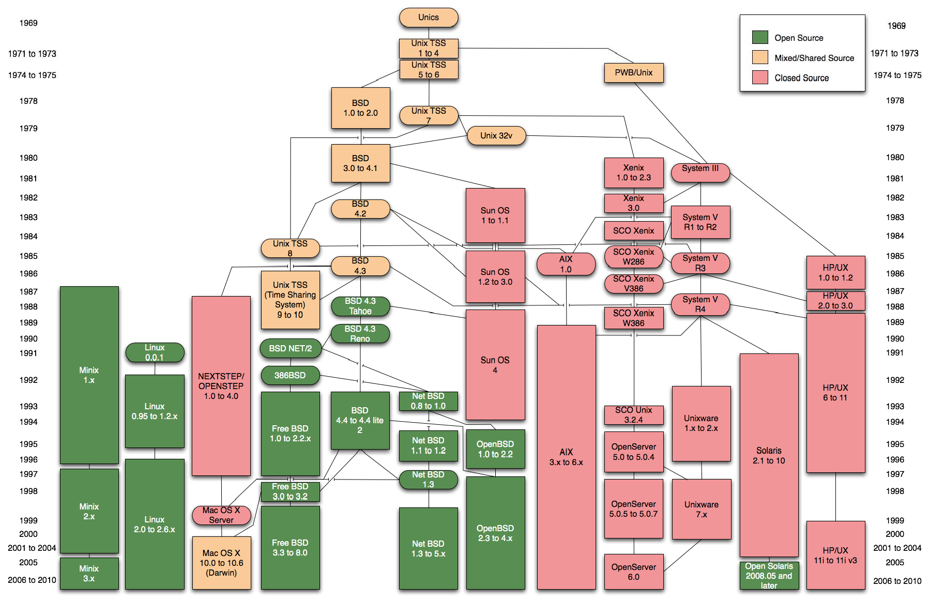
Family Tree

Slide 9

Prevailed/Prevailing Systems
Unix is widespread and available from many sources, both free and commercial
SunOS/Solaris/Open Solaris - Sun Microsystems -> Oracle
Digital Unix (Tru64) - Digital -> Compaq -> HP
HP-UX - Hewlett Packard
Irix - SGI
AIX - IBM
MacOS X - Apple
NetBSD/FreeBSD/OpenBSD - UC Berkeley / the Net
Linux - Linus Torvalds / the Net
∗ Redhat/Fedora/CentOS
Ubuntu
Debian, SuSE, Mandrake…, etc.

Slide 10
Unix Philosophy
Multiuser / Multitasking
Toolbox approach (make each do one thing well)
Flexibility / Freedom
Conciseness (small is beautiful)
Everything is a file
File system has places, process has life
Designed by programmers for programmers
Even of the programmers

Slide 11
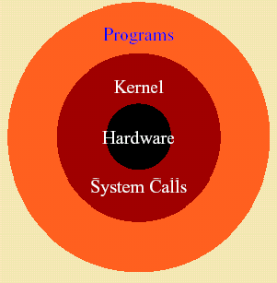
The Operating System Structure

Slide 12
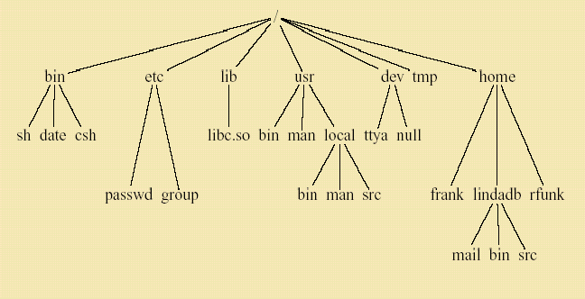
The File System

Slide 13
Unix Programs
Shell is the command line interpreter
Shell is just another program
A program or command interacts with the kernel may be any of:
built-in shell command
interpreted script
compiled object code file

Slide 14
Command Line Structure (1)
A command is a program that tells the Unix system to do something. It has the form:
command options arguments
'Whitespace' separates parts of the command line
An argument indicates on what the command is to perform its action
An option modifies the command, usually starts with '-'

Slide 15
Command Line Structure (2)
Not all Unix commands will follow the same standards
Options and syntax for a command are listed in the 'man page' for the command
Be aware that Unix is case sensitive
Use lower case
To terminate a command
^C interrupt
^D can log a user off; frequently disabled

Slide 16
Text-based and GUI-based
Historical reason
tty/modem based terminal
Why text on command prompt mode?
Efficiency for engineering
Record keeping
And etc.
Desktop use vs. server use
Experienced user vs. ordinary people

Slide 17

Getting Started

Slide 18
Login
Your user name
Your password
Control keys (^) perform special functions
^H or Backspace erase a character
^U cancel line
^S pause display
^Q restart display
^C cancel operation
^D signal end of file
^V treat following control character as normal character

Slide 19
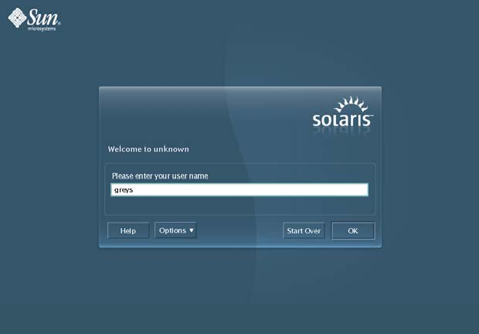
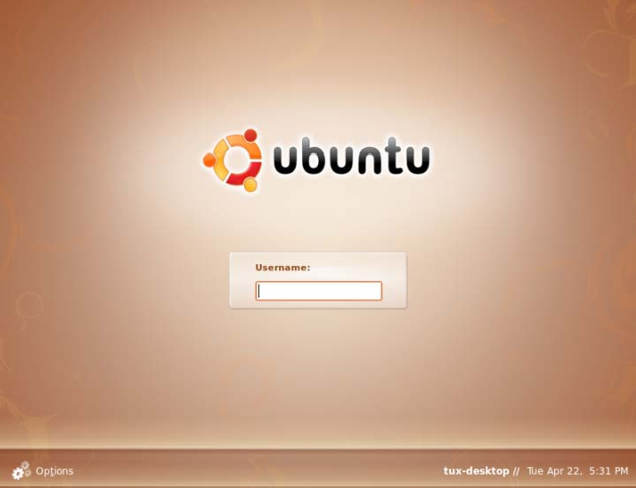
Login/Logout Commands
Commands:
login
logout
exit
Snapshots of login GUI on Solaris and Ubuntu

Slide 20
Find Version of Unix
uname [options]

Slide 21
Change Password
passwd
o l d passwd : new passwd : r e t ype new
passwd :
Warning: don’t change your passwd unless the system administrator permits doing so

Slide 22
System Date and Time
date
F r i Ju l 28 14 : 44 : 15 CST
System administrator can use 'date' to change the system time
'man date' for more details

Slide 23
Set User Environment (1)
stty - terminal control
reports or sets terminal control options configures aspects of I/O control
syntax: stty attribute value
example: stty erase ^H; stty kill ^U;
Environment variables
HOME
PATH
SHELL
env - show current EV values

Slide 24
Set User Environment (2)
setenv (csh)
setenv PATH .:~/bin:/bin:/usr/bin
setenv MANPATH /usr/share/man:/usr/local/man
setenv MANPATH $HOME/man:$MANPATH
set and export (sh, bash)
PATH=/usr/local/bin:/home/jack/bin; export PATH
export PATH=$PATH:/opt/acroread/bin
alias
syntax: alias aname pname
alias dir 'ls -al | more'
alias listc 'ls -al *.c | more'

Slide 25
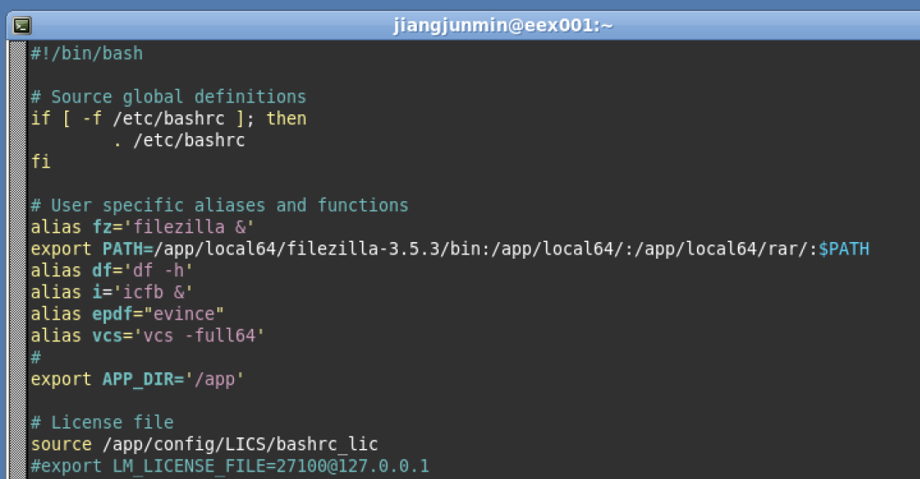
A .bashrc Example (1)

Slide 26
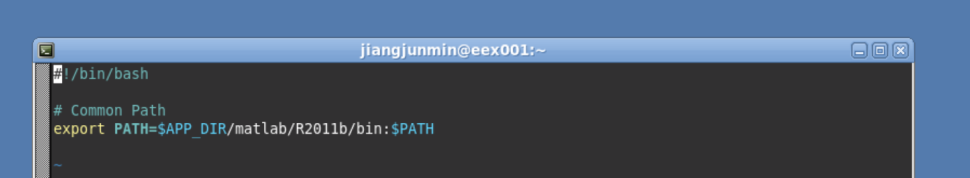
A .bashrc Example (2)

Slide 27
Commands for Useful Info
who, who am i, whoami
p i ano% who
opc | conso l e | Ap r | 16 | 08 : 02 | ( : 0 )
li angzs | p t s / 2 | Ap r | 16 | 15 : 49 | ( 10 . 14 . 111 . 198 )
yu j un | d t r emo t e | Ap r | 18 | 19 : 37 | ( 10 . 14 . 111 . 244 : 0 )
wangs j | p t s / 10 | Ap r | 18 | 12 : 47 | ( 10 . 14 . 111 . 132 )
ps
p i ano% ps
P I D TTY
4059 p t s / 38
4061 p t s / 38
4286 p t s / 38
T I ME 0 : 00
0: 01
0 : 00
CMD
csh
ps
x t e r m

Slide 28
Manual (1)
man
Manual sections
man man
NAME
man - find and display reference manual pages SYNOPSIS
man [ - ] [ -adFlrt ] [ -M path ] [ -T macro-package ] [ -s section ] name ...
man [ -M path ] -k keyword ...
man [ -M path ] -f file ...
DESCRIPTION
The man command displays information from the reference manuals. It displays complete manual pages that you select

Slide 29
Online Manual (2)
by name, or one-line summaries selected either by keyword (-k), or by the name of an associated file (-f). If no manual page is located, man prints an error message.
Source Format
Reference Manual pages are marked up with either nroff(1) or sgml(5) (Standard Generalized Markup Language) tags.
The man command recognizes the type of markup and processes the file accordingly. The various source files are kept in separate directories depending on the type of markup.
Location of Manual Pages
The online Reference Manual page directories are convention-
……

Slide 30
Online Manual (3)
OPTIONS The following options are supported:
-a Show all manual pages matching name within the MANPATH search path. Manual pages are displayed in the order found.
-d
Debug. Displays what a section-specifier evaluates to, method used for searching, and paths searched by man .
-f file...
man attempts to locate manual pages related to any of the given file s. It strips the leading
path name components from each file , and then
prints one-line summaries containing the resulting basename or names. This option also uses the win- dex database……

Slide 31
Other Paragraphs in 'man man'
USAGE
ENVIRONMENT VARIABLES
EXIT STATUS
SEE ALSO
apropos(1), cat(1), col(1), eqn(1), more(1),
nroff(1),
refer(1), tbl(1), troff(1), vgrind(1), whatis(1), catman(1M), attributes(5), environ(5), eqnchar(5), man(5), sgml(5)
BUGS

Slide 32
Browse through the man Pages
Spacebar - display next page
b - previous page
q - quit
xman - man has X GUI on Solaris
KDE/Gnome help browsers on Linux
Web resources

Slide 33

File System

Slide 34
Unix File System
Storing files
Text, programs, images, other formatted documents, etc.
Being made up of many files
User, Unix System, Unix Commands
Generally, Everything is a file

Slide 35
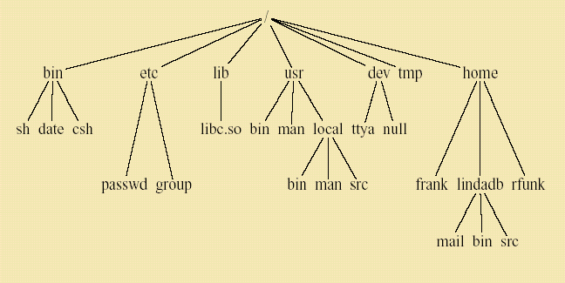
Standard Unix Directories

Slide 36
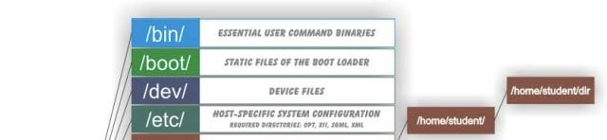
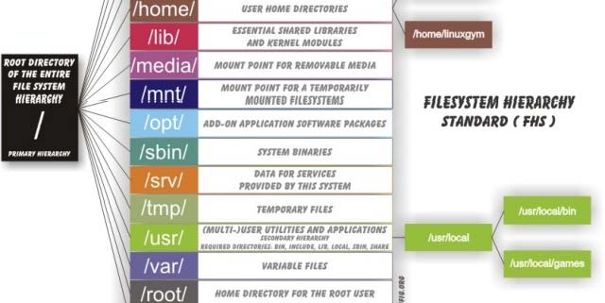
Some Other Possible Standard
Directories
/boot
/lost+found
/misc
/mnt
/net
/proc
/opt
/sbin
/var

Slide 37
Identifying Files in the Tree
Identifying files using full path names
Full path names always begin with /
$HOME, ~, and EVs
Example: /usr/dt/bin/dtterm
Identifying files using relative path names
Dependent on your location in the file system
. and ..
Example: ../../include/define.h

Slide 38
File Structures on Disk
Disks mounted to positions in file tree
A disk is divided into blocks
512, 1024, 2048 bytes are common block sizes
A disk partition divided into three major sections
superblock
inodes
data blocks
More left for later on System Administration

Slide 39
File & Directory Naming Guidelines
Don’t Use Meta Characters
∗ / \ " ` * ; ? { } ( ) [ ] ~ ! $ < > | & #
http://en.wikipedia.org/wiki/Punctuation
Do Use
a-z A-Z
∗ 0-9
∗ . _ -
Remember Unix is Case Sensitive!

Slide 40

Directory Commands (1)
pwd
cd [directory]
cd Full Path Names
cd Relative Path Names
cd = cd ~ = cd $HOME
cd ~thompson

Slide 41
Directory Commands (2)
mkdir directory-list
Example: mkdir personal manage
rmdir directory-list
Directory must be empty
Example: rmdir personal manage

Slide 42
ls – List Contents of Directory
Syntax:
ls [ -aAbcCdfFgilLmnopqrRstux1 ] [ file ... ]
Frequently used options:
-a all, including files begin with '.'
-d directory
-l long
-F format
-R recursive
-t time

Slide 43
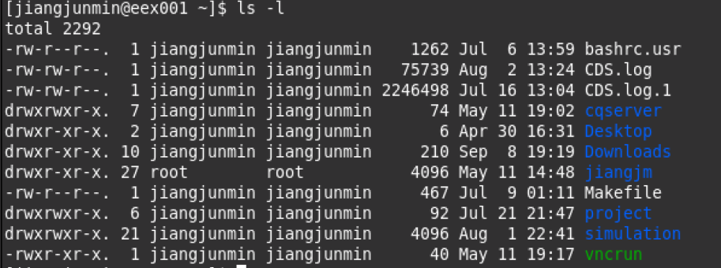
List Directory Contents
Try to run 'ls -l'
Type field (first character)
d the entry is a directory;
l the entry is a symbolic link;
b the entry is a block special file;
c the entry is a character special file;
- the entry is an ordinary file;

Slide 44
Permissions
Access permissions (characters 2-10):
first 3: user/owner
second 3: assigned Unix group
last 3: others
Permissions are designated:
r
w
read permission write permission
x
∗ -
execute permission no permission

Slide 45
Other Fields
Number of links
Owner
Group
Size or device number
Modified time
File name
d r wx ------ d r wx r- x r- x
54 opc
11 r oo t
85
o t he r 512
3072 Ap r 18 14 : 4.
2001
Aug 15
../
-r w -r--r-- | 1 | opc | s t a f f | 70 | Sep | 20 | 2001 | M I L . l og
d r wx ------ | 4 | opc | s t a f f | 512 | Dec | 6 | 22 : 14 | Ma il /
d r wx r- x r- x |  | 4 opc | 85 | 2048 | Ap r | 1 | 21 : 19 | Sp i ce /

Slide 46
Types Displayed on Linux
alias ls
l s -- co l o r =au t o
blue directories
red compressed archives
white/black text files cyan links
green executables
pink images yellow devices
(flashing) red broken links
ls -F
nothing regular file
directory
* executable file
= socket
@ link
| named pipe

Slide 47
File Maintenance Commands
chmod change the file or directory access permissions (mode)
umask
get or set the file mode creation mask
change the group of the file
chgrp
chown change the owner of a file

Slide 48
Change Permissions on File
chmod [options] file
using + and - with a single letter: u user owning file
g those in assigned group o others
Examples chmod u+w file chmod g+rw file chmod go-x file
gives the user (owner) write permission gives the group read/write permission removes execute permission for group
and others

Slide 49
Permission in Numeric
chmod [options] file
using numeric representations for permissions: r = 4
w = 2
x = 1
Total: 7
chmod
7 7 7 filename user group others
Gives user, group and others the r, w, x permissions by this representation

Slide 50
Permission in Numeric
chmod 750 filename
gives the user read, write, execute
gives group members read, execute
gives others no permissions
chmod 640 filename
gives the user read, write
gives group members read
gives others no permissions

Slide 51
Setting Default Permissions
umask mask
set in startup files for the account
masks out permissions
umask numbers added to desired permission number
equals 7
Example
umask 022
means default permission of file is 755, that is, rwxr-xr-x

Slide 52
Display Commands
echo
echo the text string to stdout
cat
concatenate (list)
head
tail
more
display first 10 (or #) lines of file display last 10 (or #) lines of file browse or page through a text file
SPACE RETURN b q

Slide 53
File Manipulation Commands
cp copy file
cp [ -fipRr ] source_file target_file
mv move (or rename) file
mv [ -fi ] source target_file
mv [ -fi ] source ... target_dir
rm remove (delete) a file (directory)
∗ rm [ -f ] [ -i ] file ...
rm -rR [ -f ] [ -i ] dirname ... [ file ... ]
Meaning of each option here

Slide 54
ln and unlink
ln [options] source target - Link to another file
symbolic link
hard link
unlink filename - Remove the link

Slide 55
find - Find Files
find directory-list [options] [actions] [...]
find . -name Net\*.c -print
find . -newer empty -print
find /usr/local -type d -print
find . \(user Bill -o -size +10000c \) -print - exec rm { } \;
find ~Bill ~Denis -size +1000 -atime 30 -ok rm
{ } \;

Slide 56
Compression/decompression
compress [ -cfv ] [ -b bits ] [ file ]
uncompress [ -cfv ] [ file ... ]
.Z as suffix
gzip [-cdfhlLnNrtvV19] [-S suffix] [file ...]
gzip filename
gzip -d filename
gzip -h
gunzip
bzip2 / bunzip2
filename->filename.gz filename.gz->filename help for gzip

Slide 57
Utility - wc
wc - display a count of lines, words and characters in a file
-c
-l
-w
ls | wc -l

Slide 58
Utility - diff
diff file1 file2
Line-by-line differences between pairs of text files
Often used for comparing text file (source code, netlist, data list, etc.) in different versions.
tkdiff vs. windiff

Slide 59
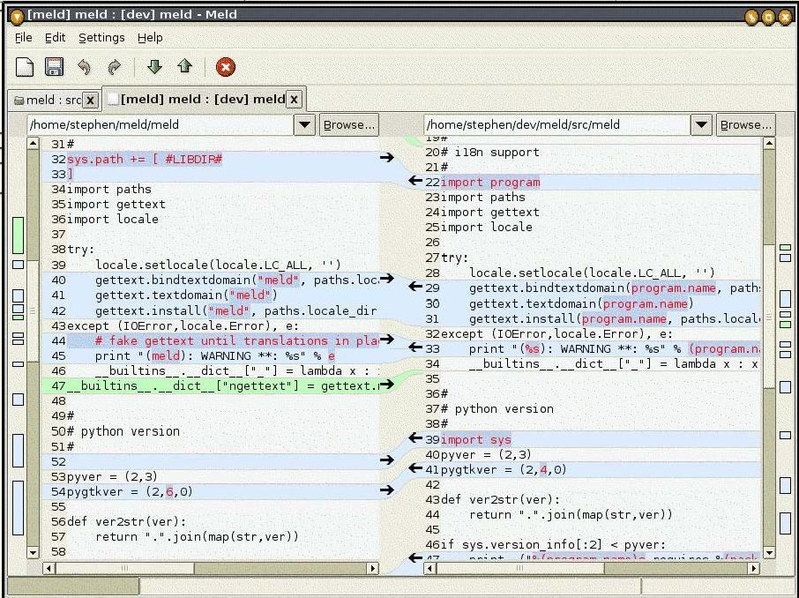
Sample Output of tkdiff

Slide 60
Utility - grep
grep/egrep/fgrep - search the argument for all occurrences of the search string (get REP)
The grep utility is used to search for regular expressions in Unix files.
fgrep searches for exact strings (not pattern).
egrep uses "extended" regular expressions.
grep regexp file
grep static ./*.c
grep ^# *.c
man ls | grep -ci permission

Slide 61
grep a Word in a File
piano% grep -ni Event main.c
=> Check for output from real example

Slide 62
Question
? What’s the difference of grep and find?
--- An interconnecting network of the commands and utilities

Slide 63
Utilities
file - determine file type
sort - sort, merge, or sequence check text files
which - locate a command; display its pathname or alias
whatis - search the whatis database for word
apropos - search the whatis database for string
spell - report spelling errors of file
look - find words in dictionary
Other standard utilities in /usr/bin, /usr/sbin
See http://en.wikipedia.org/wiki/List_of_Unix_utilities

