Slide 1
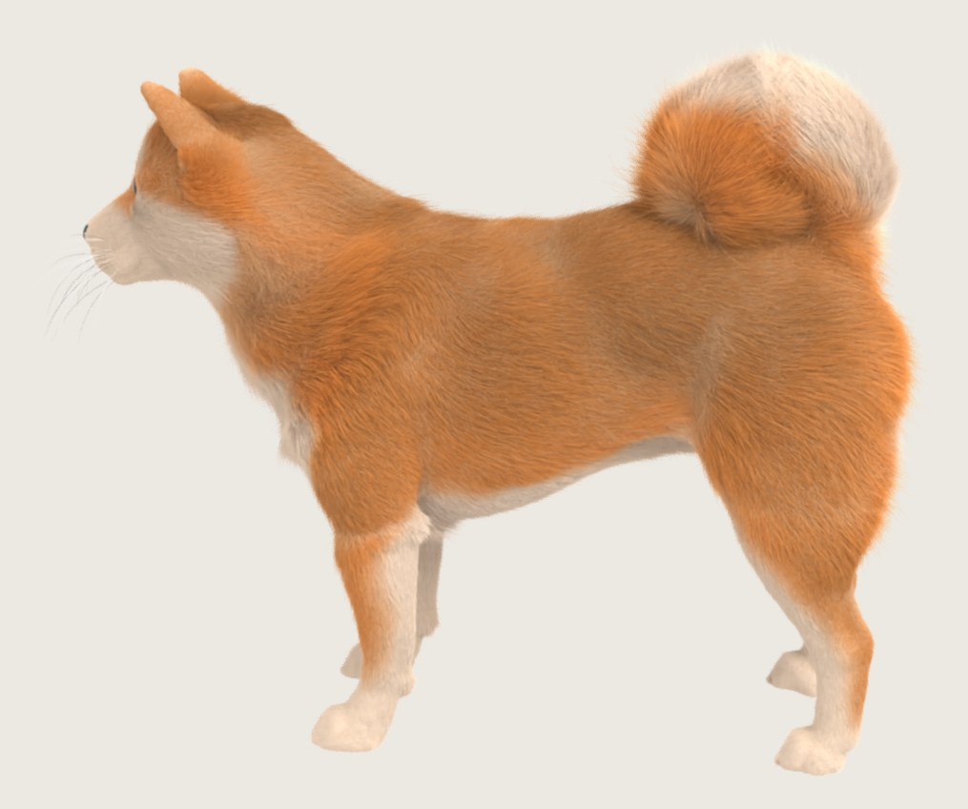
PROJECT REPORT · NOVEMBER 2026
From three photos to four million hair strands
A general, runnable animal-modeling pipeline built on diffusion models
Code: github.com/CCdydy/diffusion_pet · Weights: huggingface.co/zengzzy/diffusion_pet · Generated video: MiniMax H3
Notes:
One sentence: three ordinary photos of a dog become an explicit 3D groom of about four million strands, with diffusion models at every stage, and the same program runs on a new breed by swapping one config file.

Slide 2
THE GOAL
A usable, general, diffusion-based pipeline for modeling animals
Input
Output
Requirements
Three ordinary photos of one animal. No camera calibration, no multi-camera rig.
An explicit 3D groom: millions of strand curves on a closed body mesh, ready to render and edit.
Runs on a new breed by swapping one config file. About an hour on one workstation. No per-animal training from scratch.
Notes:
The requirement is a pipeline people can run, that is not tied to one dog, and that uses diffusion models as the engine.

Slide 3
THE PIPELINE
Five stages, three diffusion models
1
2
3
4
5
White body mesh
Furry videos
Case
Fur prior
Coat and color
Fur-less video from the photos, then a closed mesh
Mesh depth drives the video; every frame has a known camera
Cameras, fur masks, direction maps, alignment check
Strand shape and length per surface patch, one sampling pass
Two-layer growth, breed table, a few fixed coat colors
H3 + Hunyuan3D
MiniMax H3
Geometry tools
v18 (ours)
Growth tools
Orange outline = a diffusion model does the work. Only one config file changes between animals: species, ears, tail, coat description, coat table and colors.
H3 = MiniMax H3 video diffusion · Hunyuan3D = Hunyuan3D-2mv multi-view 3D diffusion · v18 = our geometry-conditioned fur prior
Notes:
Three of the five stages are diffusion models: H3 makes the fur-less and the furry videos, Hunyuan3D-2mv lifts the fur-less video to a mesh, and our v18 predicts strand shapes and lengths. Stages three and five are geometry.

Slide 4
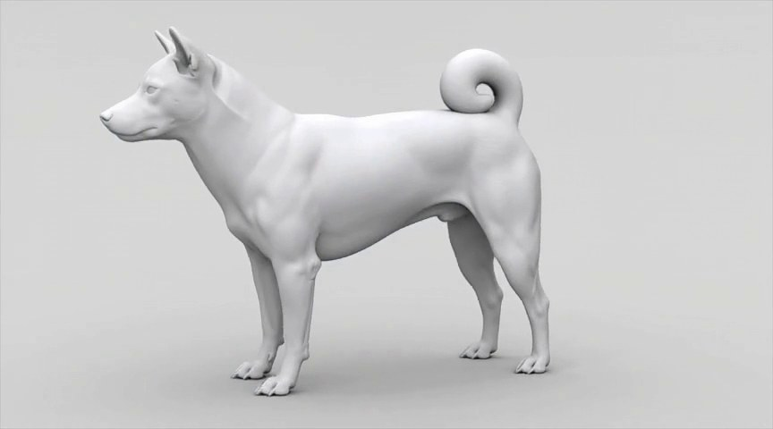
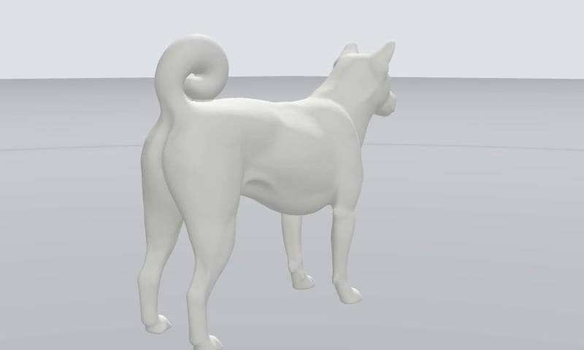
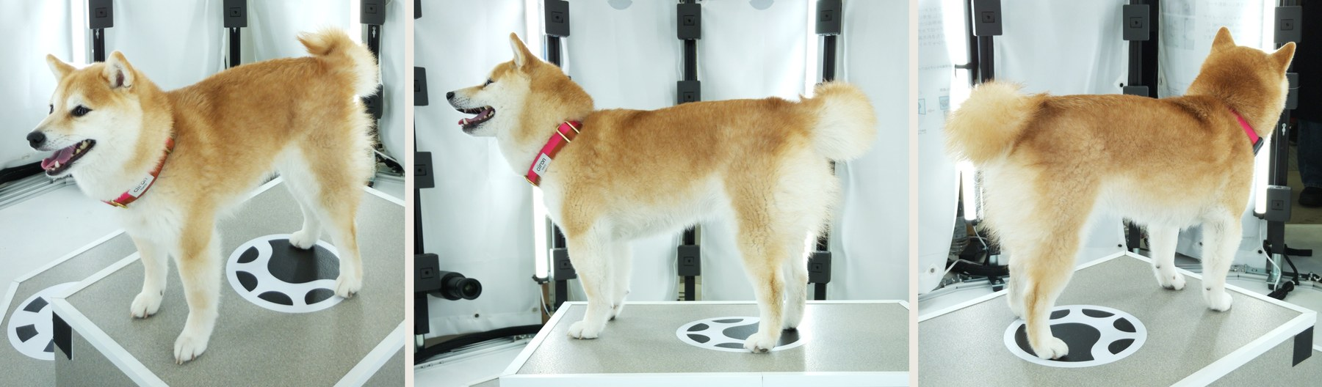
STAGE 1 · WHITE BODY MESH
Shave the dog in video, then lift it to 3D
Three photos. Front-left, left, back-right; no calibration.
H3 fur-less video. Prompted: no fur, matte white, mouth closed, paws still.
Hunyuan3D-2mv. First and last frames in, one closed, cleaned mesh out (about 130k vertices).
About 3 minutes · the mesh is then scaled to metres and turned so the head points forward, from one height value in the species config
Notes:
Photos show the coat, not the body, so H3 first generates a slow orbit of the same dog as a smooth white body; two frames go into Hunyuan3D-2mv, which returns a mesh that we close and clean. About three minutes.

Slide 5
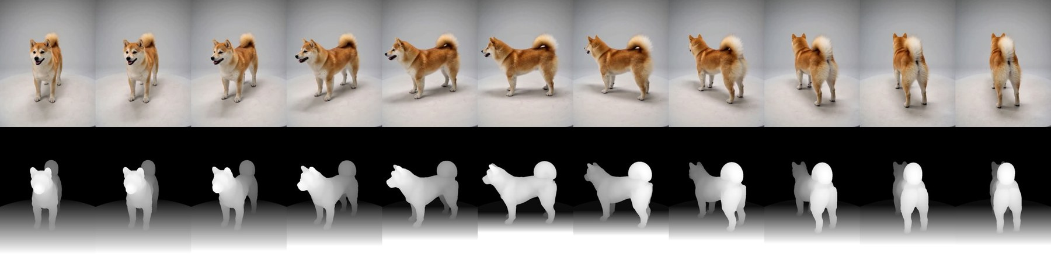
STAGE 2 · FURRY VIDEOS WITH KNOWN CAMERAS
The mesh drives the video, so every frame has a camera
Control. Mesh depth guides H3 for the first 40% of denoising; then the fur grows past the silhouette.
Coverage. 3 orbits and 19 close-ups: muzzle, cheeks, ears, chest, legs, paws, tail, back.
Output. 1,364 frames aligned with the mesh, plus fur masks and direction maps.
22 clips of 124 frames · 30–36 minutes on two GPUs (RTX 4090 + RTX 6000 Ada) · coat words and per-part fur come from the species config
Notes:
We render the white mesh along a camera path we choose and feed its depth to H3 as control, so every generated frame comes with an exact camera aligned to the mesh. Close-ups push in to about 15 cm.

Slide 6
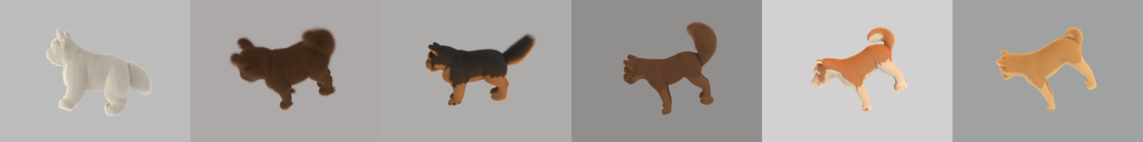
STAGE 4 · FUR DIFFUSION PRIOR (OURS)
A diffusion model that knows how fur grows on curved skin
For each surface patch, samples the strands that grow there along the given flow: how they rise, droop and clump.
Conditioned on multi-view image features and the local skin shape: height, normals, gravity.
Trained only on synthetic dogs: random SMAL bodies with realistic coat types; 135 dogs, 8,640 patches.
One sampling pass of 10 steps replaces per-animal optimization.
Held-out test bodies (1,280 patches) | Shape error ↓
v17, flat-patch prior | 0.430
Procedural growth, same parameters | 0.220
v18 without geometry | 0.181
v18 | 0.163
Shape error = median per-patch point error ÷ strand length, against the synthetic ground truth
Notes:
Our model works on small surface patches: told the flow, it decides how strands grow on skin of that curvature. Trained only on synthetic dogs. Skin geometry lowers the strand-shape error from 0.181 to 0.163; a flat-patch prior is at 0.430.

Slide 7
STAGES 3 AND 5 · FROM VIDEO TO A GROOMED COAT
Video gives the flow, diffusion the length, the config the style
Flow
Length
Solved in closed form from all 1,364 frames’ direction maps, then smoothed on the mesh. No swirls, no seams.
From the diffusion prior, each strand scaled so the coat matches the fur silhouettes in the video.
Two-layer coat
Color
Guard hairs that rise at the root and lie down along the flow, over a short, lofty undercoat; per-part table in the config.
A few fixed coat colors mixed by smooth weights read from the video, so no per-strand photo noise. Eyes and whiskers added last.
Notes:
Direction comes from every frame of the video, length from the diffusion prior corrected against silhouettes, and the coat style from a small per-breed table. Per-strand photo colors looked noisy, so colors are a few clean coat colors.

Slide 8
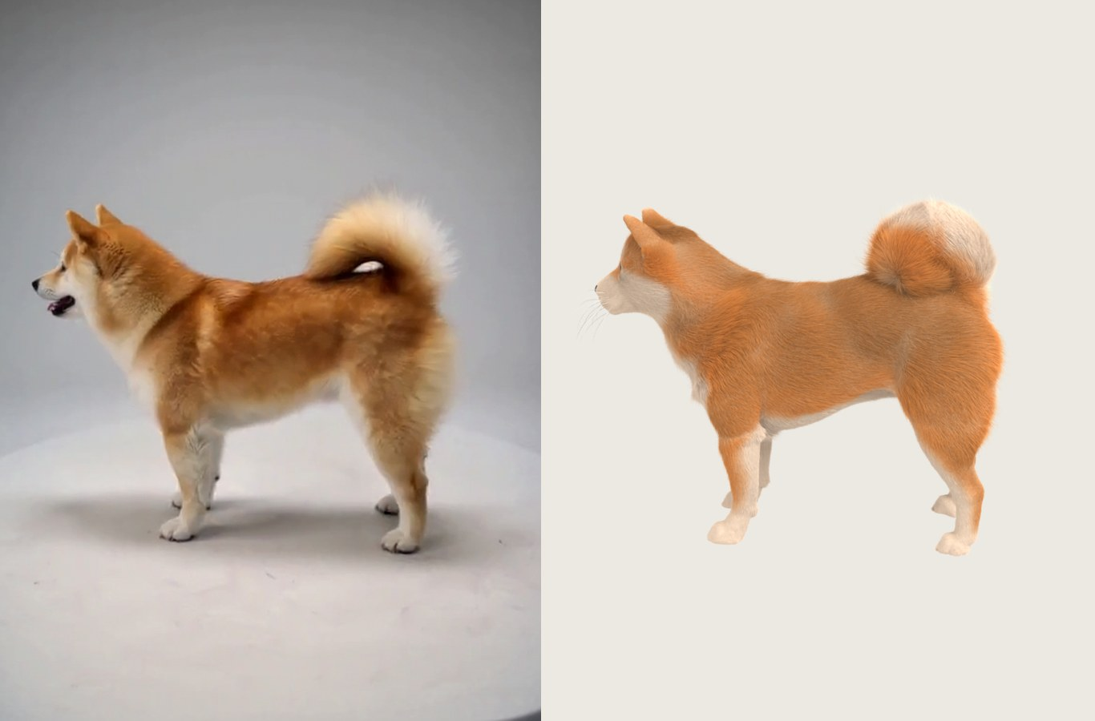
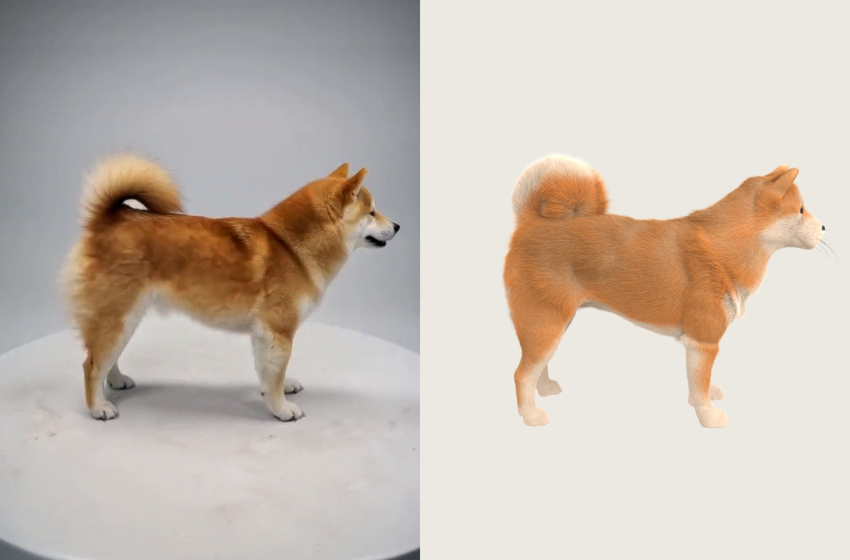
RESULT · SHIBA INU
H3 frame and our strands, from the same camera
In each pair: left = H3 frame, right = render of the reconstructed groom (Blender Cycles, hair shader) · red guard hairs over a cream undercoat
Notes:
Each pair: the generated video frame on the left and our groom rendered from exactly the same camera on the right.

Slide 9
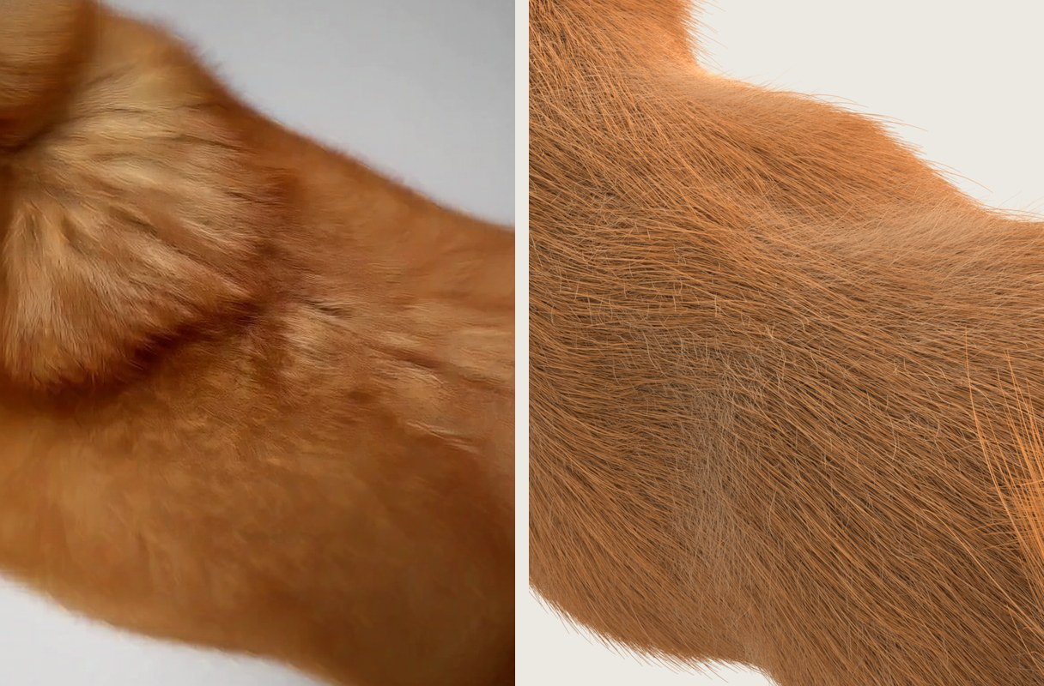
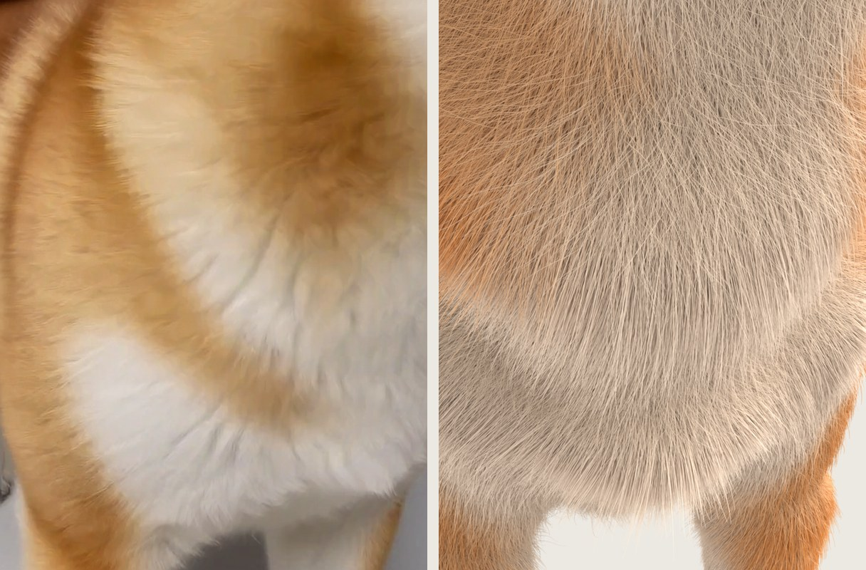
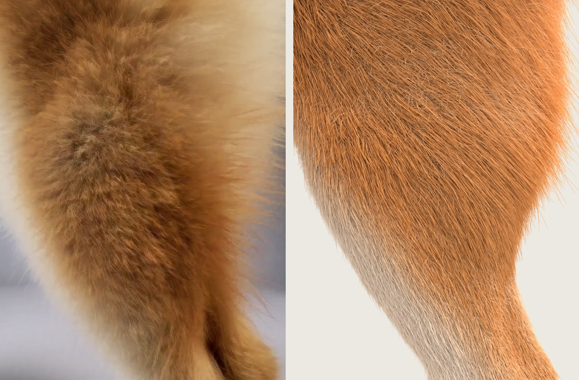
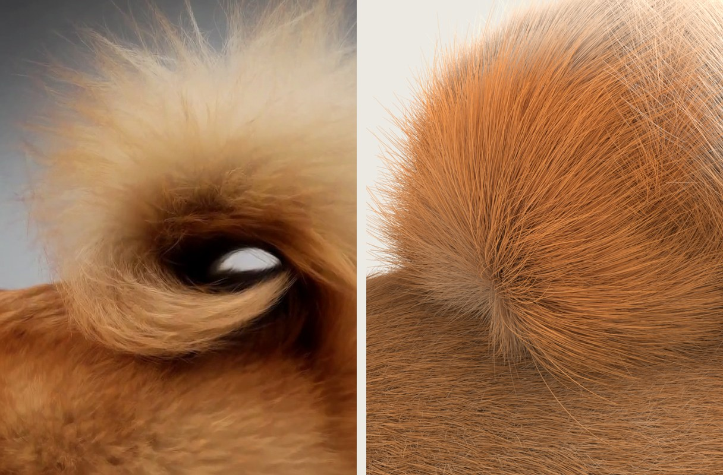
RESULT · CLOSE-UPS
Close-ups on frames the reconstruction never used
Back
Chest
Thigh
Tail
In every clip, frames 0, 4, 8 … feed the reconstruction and frames 2, 6, 10 … are held out; these pairs are held-out frames. Each image: left = H3 frame, right = our render.
Strand radius 150 µm (guard) / 90 µm (undercoat) at render scale · whiskers mixed dark and white
Notes:
Held-out close-up frames (frames 2 mod 4 in each clip are never used for reconstruction). The face is the weakest region today.

Slide 10
THE FINAL MODEL
4,000,050 strands
4 million fur strands (53% guard hair, 47% undercoat) plus 50 whiskers, each an explicit 3D curve
80 M
54 km
11.6 mm
129 k
curve points, 20 per strand
of hair in total
median strand length
vertices on the closed skin mesh
Notes:
Not an image or a neural field: four million individual hair curves on a closed body mesh, about 54 km of hair end to end.

Slide 11
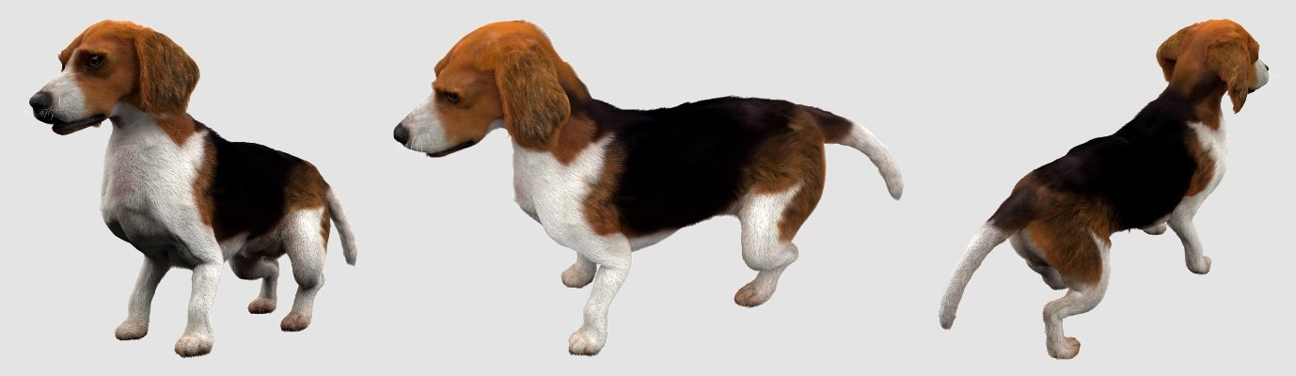
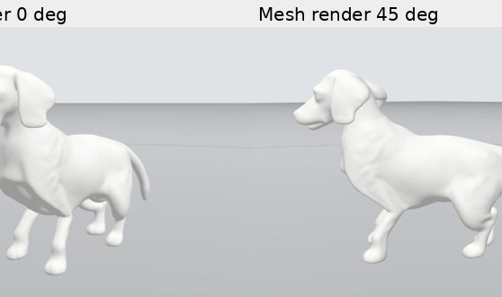
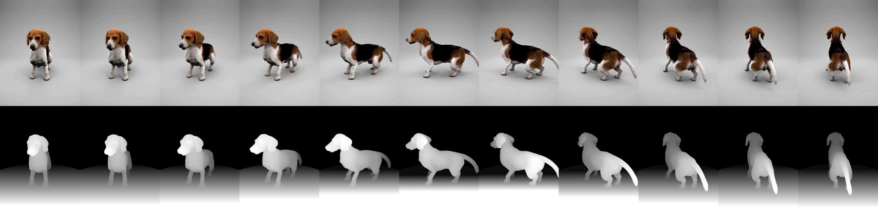
GENERALITY · BEAGLE
Same program, one new config file
Floppy ears and a straight tail: different rules place the close-ups and label the parts.
Coat words for H3: black saddle, tan, white.
Coat table: short, smooth, lies flat, almost no clumping.
Three coat colors instead of two.
Nothing else changed. The run exposed four bugs that only a second animal could find; all are fixed in the shared code.
Photos → white mesh → H3 orbit with the mesh depth as control (bottom row)
Beagle photos: public ARTEMIS renders · fixes: SAM2 QC on close-ups, NaN guard in the flow solver, eye detection next to dark coat, root-to-patch lookup
Notes:
To test the word general we ran the packaged program on a very different dog; only the species config changed. The run surfaced four bugs the Shiba never triggered; they are fixed in the shared code.

Slide 12
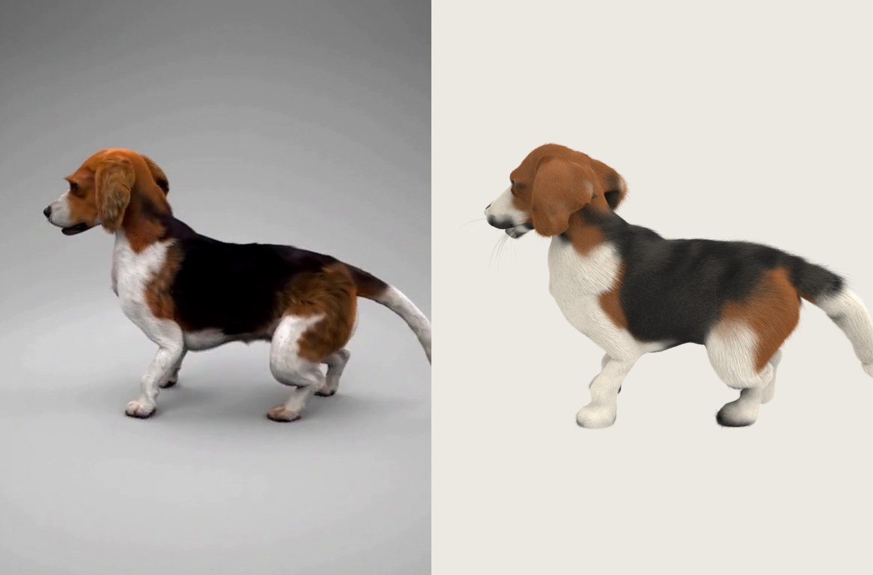
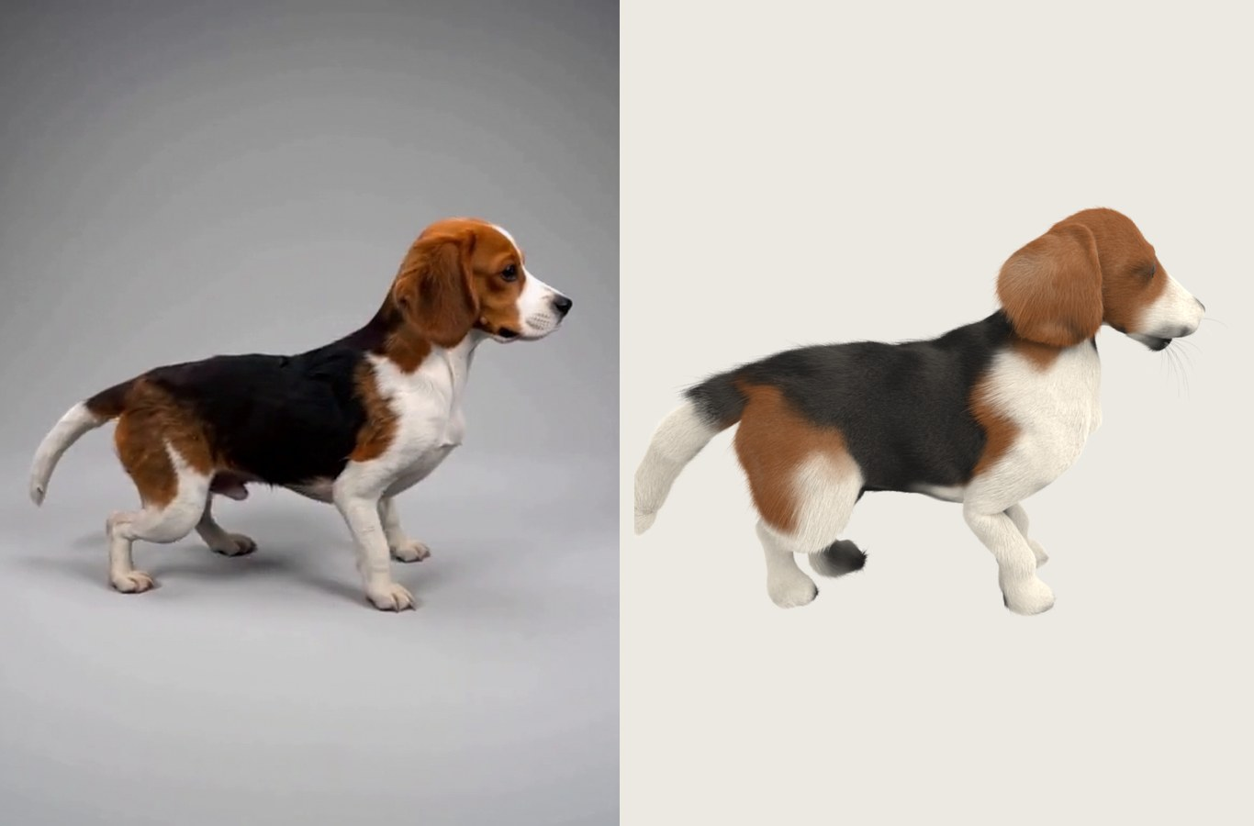
RESULT · BEAGLE
Black saddle, tan and white, from the same camera
In each pair: left = H3 frame, right = our render · 4,000,041 strands (68% guard hair, median 11.8 mm) · black 36%, tan 26%, white 38% of the skin
Notes:
Same four million strands, but the coat table makes them short and flat, and the three-color palette reproduces the black saddle, tan head and thighs, and white legs and tail.

Slide 13
TIME
About 70 minutes of compute, from photos to groom
Furry videos · 30 min
22 H3 clips, two GPUs
Case · 20 min
SAM2 masks on 1,364 frames
Fur · 17 min
v18 pass 5.5 · coat 0.3
White body mesh: 3.2 min (H3 fur-less video 2.3 + Hunyuan3D 0.8)
Fur reconstruction alone, same scale
Ours: about 17 min
Per-animal optimization from scratch (NeuralFur): about 10 hours
Beagle, packaged program, RTX 4090 + RTX 6000 Ada · Shiba Inu (earlier route with the v17 prior): 78 min · rendering not included · NeuralFur as reported (A100)
Notes:
Measured times of the packaged program on the beagle. The fur itself, including one diffusion pass, takes 17 minutes; per-animal optimization methods report about ten hours for that step.

Slide 14
USING IT
A new animal is one config file
bash pipeline/run_animal.sh <photos> pipeline/species/beagle.json <out>
In the species config | Shiba Inu | Beagle
Ears · tail | erect · curled | floppy · straight
Coat description for H3 | red guard hair, cream undercoat | black saddle, tan, white
Coat table (per body part) | fluffy double coat, clumped | short, smooth, lies flat
Coat colors | 2 (red, cream) | 3 (black, tan, white)
Standing height | 0.47 m | 0.48 m
Code: github.com/CCdydy/diffusion_pet · weights: huggingface.co/zengzzy/diffusion_pet · two GPUs (ours: RTX 4090 + RTX 6000 Ada), ComfyUI with H3 and Hunyuan3D-2mv
Notes:
Everything that differs between breeds lives in one JSON file; the rest of the program is the same for every dog.

Slide 15
LIMITS
NEXT
What is not solved yet
Where it goes from here
The face is the weakest region: eyes are round, without lids, and the eye opening is rough.
Shape errors in the white mesh carry through, for example the volume of a curled tail.
The coat table is still set by hand per breed.
Commercial use of H3 output needs a MiniMax license.
Let the diffusion prior also predict the coat table, so a new breed needs no hand-set values.
Close-up face clips at higher resolution for eyes, nose and whiskers.
More animals: long-haired dogs and cats.
Strand-level editing: change length or color of one body part and regrow.
Notes:
Be direct about the face: it is the part we still hide in demos. Next: let the diffusion prior predict the coat table.

