Slide 1







IBM Data Analyst Capstone Project
Christina Clabeaux
08/28/2024

Slide 2



OUTLINE
Executive Summary
Introduction
Methodology
Results
Visualization – Charts
Dashboard
Discussion
Findings & Implications
Conclusion
Appendix

Slide 3

EXECUTIVE SUMMARY
To be competitive in the IT market, you need to keep up with changing technologies.
Utilizing current trends regarding most used languages and programs it provides a future trend of what to learn.
Data was gathered from Stack overflow survey, IBM Site, GitHub job postings. It was collected, cleaned and then utilized to created visualization on dashboards.
The findings show JavaScript it still one of the most popular languages. We are also showing MySQL is the title holder for first place but may lose the title to Postgre SQL in the future.

Slide 4

INTRODUCTION
Utlizing the ahboard we show current and projected trends in the need for skills related to languages, databased & platforms for data analytics.
Which Program languages are in demand today?
What’s the most used database skill?
What popular Web Frame are there?

Slide 5

METHODOLOGY
Utilized the data provided by IBM we created graphs and trends.
First we cleaned the data utilizing the excel formats.
Then utilizing Google Looker Studio created graphs for this presentation.

Slide 6
RESULTS

Slide 7
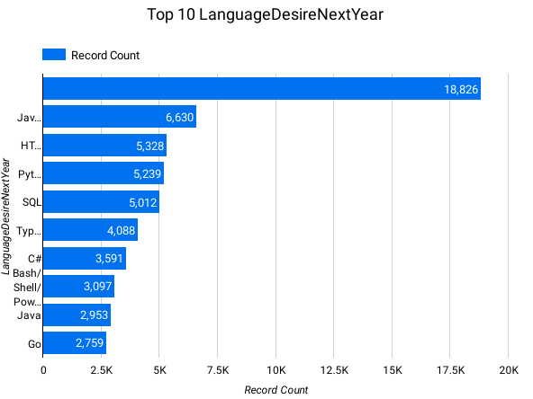
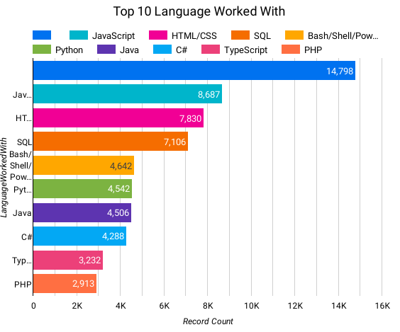
PROGRAMMING LANGUAGE TRENDS
Current Year
Next Year

Slide 8
PROGRAMMING LANGUAGE TRENDS - FINDINGS & IMPLICATIONS
Findings
JavaScript, HTMS/CSS SQL are the top 3 languages used currently.
JavaScript, HTMS/CSS SQL are the top 3 languages used currently.
Python will be more in demand then SQL next year.
Implications
JavaScript and HTML are used for web development. This means they would be a high demand tech skill to learn, especially as Typescript is becoming viral.
Python is getting mor traction due to the increase in AI & ML Skills.
SQL remains the most relevant language for data professionals. It is the must have Skill.

Slide 9
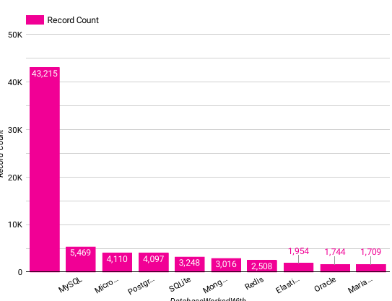
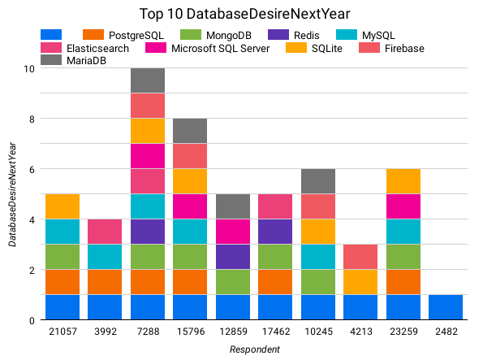
DATABASE TRENDS
Current Year
Next Year

Slide 10
DATABASE TRENDS - FINDINGS & IMPLICATIONS
Findings
MySQL, Microsoft SQL server & Postgre are the Top 3 most used databases.
Postgre, MongoDB, Redis are projected to become more popular than they currently are
Redis & Elasticsense are relatively new tools & set to gain traction with time.
Implications
SQL remains the top tool to utilizing as data specialists.
Analysts still prefer to utilize Open-Source Databases.
With Time Oracle SQL is losing its relevance in the field.

Slide 11

DASHBOARD
CClabeaux/IBM-Data-Analyst-Capstone-Project (github.com)

Slide 12
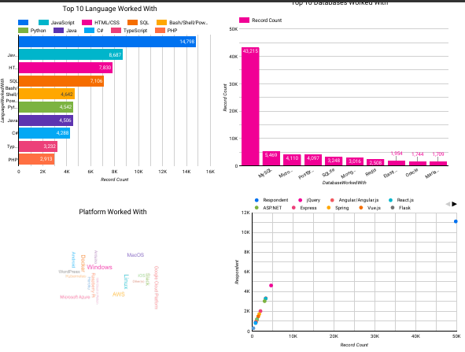
DASHBOARD TAB 1

Slide 13
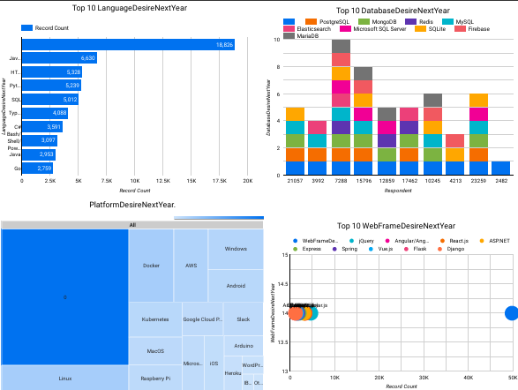
DASHBOARD TAB 2

Slide 14
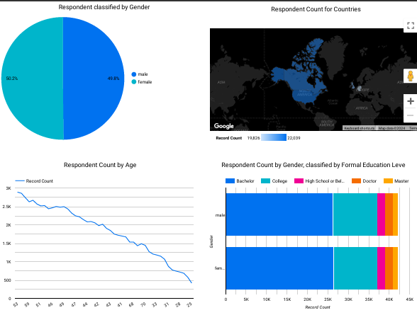
DASHBOARD TAB 3

Slide 15
DISCUSSION
How do we close the gender gap in the Technology Sector?
Is a master degree really a requirement when we don’t have a bachelors or associate program for our field?
How relevant will Oracle be in the future?

Slide 16
OVERALL FINDINGS & IMPLICATIONS
Findings
Most people in the IT field have degrees not in there field to start til higher level learning.
The tech sector is filled with mostly people under 50 years old.
Most learn SQL and Python the most.
Implications
It is import to develop SQL knowledge and proficiencies in it.
Web development is still a very lucrative skill.
We need more data analytic based learning programs in colleges and not just a master's program for learning.

Slide 17

CONCLUSION
Data analysis technology is evolving every day.
SQL & Python is the most needed skills to learn to start.
We need more options for degrees specific to data visualization.

Slide 18
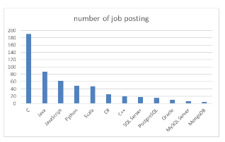
JOB POSTINGS

Slide 19
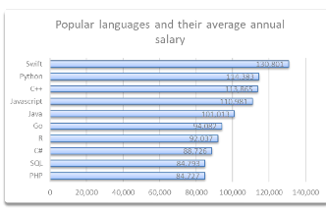
POPULAR LANGUAGES

