Slide 1
Web Scraping using R
Madison Volpe

Slide 2
Motivation
Think back to a simpler time maybe in middle school and you are writing a report on public employees in your county. You stumble across a website that provides you with salary information. However, 12 year old you is not familiar with web-scraping and has little to no programming experience…
As a result, you are stuck copying and pasting pages of information into an excel spreadsheet
What is wrong with copying and pasting data ?
Inefficient (not automated)
Limited reproducibility
Error prone
Notes:
https://salaries.texastribune.org/search/?q=Dallas

Slide 3
What is Web Scraping ?
In my own words:
A data collection method to automatically harvest data from the internet
The process is often messy as data can be in a variety of forms
Likewise, once you pull the data into your working environment, it is often not in a “tidy” format
Overall: Web scraping is a tool (process) used to automatically extract and store data from the internet for analysis!
A formal “non-Madison” definition:
“Web scraping (web harvesting or web data extraction) is a computer software technique that allows you to extract information from websites. When you want to extract data from a document, you would copy and paste the elements you want. For a website, this is a little trickier because of the way the information is formatted and stored, typically as HTML code. Thus, scrapers work by parsing the HTML source code of a website in order to extract and retrieve specific elements within the page’s code.”
From: https://www.mailman.columbia.edu/research/population-health-methods/web-scraping

Slide 4
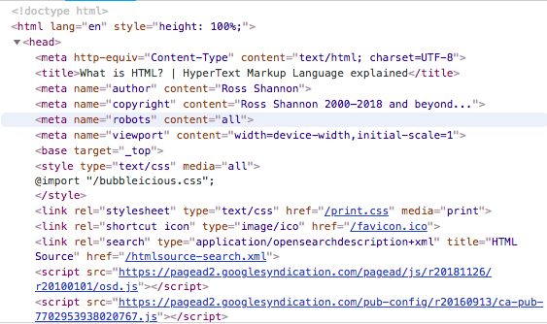
HTML
Hypertext Markup Language
Not really an expert, but from what I know:
Language used for website creation
Tree-like structure similar to XML
Nodes
Tags and attributes
Can view a website’s underlying HTML code by right clicking on Chrome or Firefox
Reading through will help you see the tree like structure

Slide 5
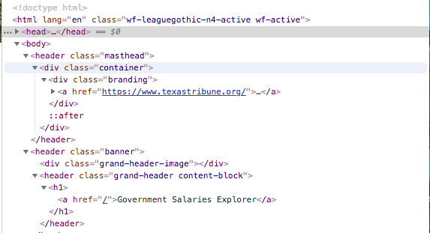
XML + XPath
Elements Overview
<me>
<name>
<first> madison </first>
<last> volpe </last>
<eye> brown </eye>
<hair> brown </hair>
<stature> short </stature>
</me>
In this example the me element has four child elements name, eye, hair, and stature. The name element also has child elements of its own first and last
Attributes Overview
Attributes are in the form name = “value”
They appear in the beginning of a tag and must be contained in quotes. An element can have more than attribute!
Way to describe data
XML Path Language
What we will use to navigate the HTML and extract the data we want
Obviously you also use Xpath to navigate an XML document!
Within an XML document, the main unit is an element (node) that begins with a start tag and ends with an end tag
Notes:
What are the attributes in the following html?
Lang
Class
Href

Slide 6
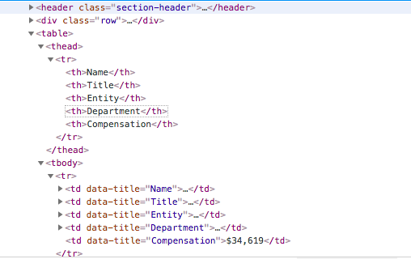
XPath
We can create an Xpath to extract the information we want, for example we can use //td[@data-title='Department’] to extract all text in the Department column in the table. We know it is a table by the tbody tag and the td tag indicates a cell in a standard HTML table

Slide 7
CSS
Cascading Style Sheets
This language describes the style of an HTML document
Like XPath, you can use CSS to extract data you want from an HTML
It differs from XPath in that:
Some say it is more readable, concise, and efficient
However, with CSS you can only move down the tree structure from a parent node to a child node, but with XPath you can move up the tree from a child node to a parent node
SelectorGadget is a useful tool that identifies CSS on an webpage for you
Add in for chrome
My personal preference is XPath, but that is because I am more familiar with it ☺

Slide 8
R Packages
httr
rvest
XML
Xml2
Rcurl
Rselenium

Slide 9
Helpful Hints
To test XPath, you can use the console in chrome or firefox
This is accessed after right clicking and pressing inspect on a webpage
Keep an open mind and there can be multiple ways to scrape the same webpage

Slide 10
R Example
R script
Install packages you need!

