Slide 1

Dive into React Native
Xz.Yaoi
Adorable Zhitan Engineer
@Shenzhen Univ.

Slide 2
Intro
Learn Once, Write Everywhere != Write Once, Run Everywhere
Lets you build mobile apps using only JavaScript
A React Native App is a Real Mobile App
Reload your app instantly
Use Native Code When You Need To

Slide 3
Content
1. Layout
2. Component
3. Network
4. Example – Tech Builds

Slide 4
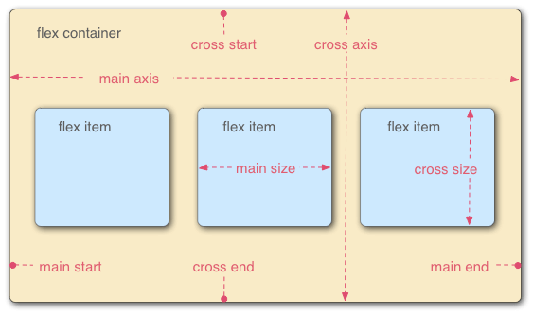
Layout-Flexible Box
flex-direction
flex-wrap
flex-flow
justify-content
align-items
align-content
http://www.ruanyifeng.com/blog/2015/07/flex-grammar.html

Slide 5
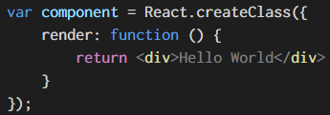
Component -- JSX

Slide 6
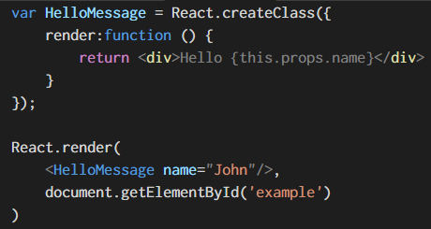
Component – A Simple Component
React
React.createClass
Render
React.Render

Slide 7
Component – Life Cycle
Create -- createClass
getDefaultProps()
Construct -- <>
getInitialState()
componentWillMount()
Render()
componentDidMount()
Update
componentWillReceiveProps()
shouldComponentUpdate()
componentWillUpdate()
Render()
componentDidUpdate()
Unmount
componentWillUnmount()
Construct
Update
Unmount
Create

Slide 8

Network
fetchData() {
fetch('http://10.10.1.120:6789/article')
.then((response) => response.json())
.then((responseData) => {
this.setState({
articles: responseData.articles,
});
}).done();
}

Slide 9
Network
post:function (url,data,callback) {
var fetchOptions={
method:'POST',
headers:{
'Accept':'application/json',
'Content-Type': 'application/json'
},
body: JSON.stringify(data)
};
fetch(url,fetchOptions)
.then((response)=> response.text())
.then((responseText)=>{
callback(JSON.parse(responseText));
});
}

Slide 10

Network
Parse.initialize("YOUR_APP_ID");
Parse.serverURL = 'http://localhost:1337/parse'

Slide 11
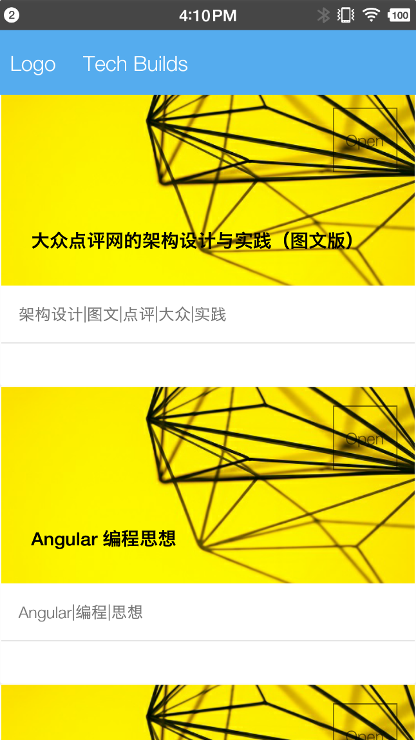
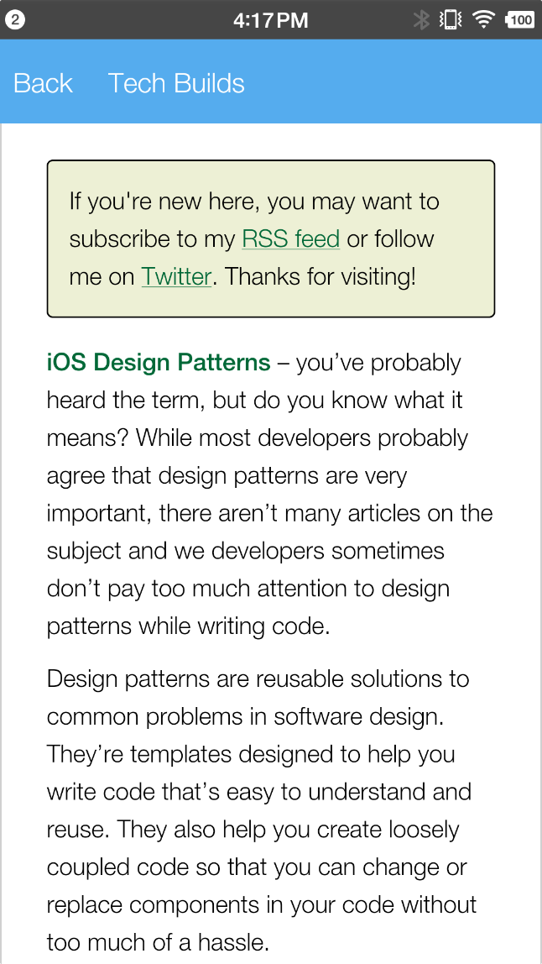
Example – Tech Builds

