Slide 1

COVID-19 Impact on Navajo Nation

Slide 2
COVID-19 Impact on Navajo Nation
Since January of 2020 Covid-19 has become a Global Pandemic
One of the hardest hit groups
people effected by the
pandemic in the United States
has been the Navajo Nation
Indian Tribe.
In this presentation we are going to look
at a Data Science point of view of how and why.

Slide 3



COVID-19 Impact on Navajo Nation
The Presenters
Craig Costenbader
Matt McMahon
Richard Brown

Slide 4
Bio: Craig Costenbader
COVID-19 Impact on Navajo Nation
Before becoming a student at Southern Careers Institute / Woz U in the Data Science Program.
I was born and raised in Seattle WA.
I have worked in the service industry for 25 years.
Including 11 years with Enterprise Rent A Car, 7 years of which were in Car Sales, personally delivering over 3000 vehicles.
I also drove for Uber in Seattle and completed 22000 trips in 4 years.
I also have my own sales and marketing consulting business since 2012, where I share my experience and help other people run their small businesses to improve their customer service and profitability.
I love working with people and have lifelong love of all things technology and have always been a numbers guy.
Covid-19 in March of 2020 brought all my businesses to a grinding halt, so I decided to go back to school.
I decided on Data Science because I literally could not find an industry in all the ones that I looked at being re-trained to work in that did not use DATA.
The online learning program with Woz-U ended up being a perfect fit!

Slide 5
COVID-19 Impact on Navajo Nation
FACTS ABOUT THE NAVAJO NATION
The Navajo Nation is a American Indian Territory covering over 27,000 square miles occupying portions of Northeastern Arizona, Southeastern Utah, and Northwestern New Mexico
This is the largest land area retained by an indigenous tribe in the United States
https://www.navajo-nsn.gov/history.htm
The Navajo Nation is famous for many things, most famously was the Navajo Code Talkers, who took part in every assault the U.S. Marines conducted in the Pacific from 1942 to 1945 during WWII, they were instrumental in defeating the Japanese.
Excerpts taken from a Fact Sheet prepared by the Navy & Marine Corps WWII Commemorative Committee.II.

Slide 6
Additional Facts
COVID-19 Impact on Navajo Nation
POPULATION/DEMOGRAPHICS:
(As recorded in the 2010 U.S. Census on Navajo)
(As recorded in the 2010 U.S. Census on Navajo)
Total Enrollment 332,129
Total Navajos (living on the Navajo Nation) 156,823 or 47%
Unemployment Rate 55.9%
Avg. Household Income $27,389
Source: https://www.census.gov/

Slide 7
COVID-19 Impact on Navajo Nation
For the purposes of this exercise, this presentation will speak on the effects of COVID-19 in the states of Arizona and New Mexico.
We will be answering the following two questions:
Is there a significant difference in the number of cases and deaths from the spread of COVID-19 effecting the population in the states of AZ and NM by comparing the Navajo Nation vs Non-Navajo Nation lands?
What were the biggest contributing factors to the number of confirmed cases and deaths resulting from COVID-19?

Slide 8
Methods
COVID-19 Impact on Navajo Nation
Once we had decided on a topic and what to research on, we went to work.
The first thing we did was go to Google and started looking…
We found many websites with information on COVID-19
We did not find very much data on the Navajo Nation
The best source of data we found was from two places
Johns Hopkins University Center for Systems Science and Engineering
(JHU CSSE) Source: https://github.com/mattrm8/COVID-19/blob/master/README.md
Citing an article that was written on www.thelancent.com regarding the original discovery and outbreak when it stated in Wuhan China in December of 2019.
Source: https://www.thelancet.com/journals/laninf/article/PIIS1473-3099(20)30120-1/fulltext
New Mexico Highland University
Source: Dr Gil Gallegos, Computer Science Professor and Dr Orit Tamir, Anthropology Professor. As well as several of their students in Masters Program. (NMHU) Source: https://www.appliedanthro.org/publications/news/august-2020/grant-help-navajo-nation-covid-19-data

Slide 9
Tools and Methods (Summary)
COVID-19 Impact on Navajo Nation
We used a Github Repository from Github.com, to download the data from JHU CSSE, store the data, and share among our three team members.
www.github.com
We used a Trello KanBan Board to organize our project and keep in it all straight as far as who was responsible for doing certain tasks.
www.trello.com
We performed our Statistical Analysis using the programming language R, which is designed specifically for statistics. Using also R Studio which is a Graphical User Interface (GUI)
www.rstudio.com
To be able to upload data, manipulate the date (Wrangling), and then produce a .xlsx spreadsheet that could then be uploaded into another really versatile program called TABLEAU.
www.tableau.com
And of course we used good old www.google.com

Slide 10
Statistical Analysis in R
COVID-19 Impact on Navajo Nation
Next we set upon the task of sorting through our data.
In the WRANGLING part mentioned in the previous slide, we loaded our dataset .csv file into R Studio and used the language of R to begin performing our analysis of the data from Johns Hopkins.
Our original sample size included data that was compiled from 3982 locations from around the world.
We took this data and cross referenced it with FIPS Codes which is a system developed (US only), and is Federal Information Processing Standards code that uniquely identify counties within the USA..
Source: https://www.policymap.com/2012/07/tips-on-fips-a-quick-guide-to-geographic-place-codes/
These codes we verified on Google.com, to determine what locations were on and around the Navajo Nation in the states of Arizona and New Mexico.
When we were done with the WRANGLING we had a Dataset that included information from 48 locations. These locations from here forward will be referred to our SAMPLE SIZE.

Slide 11
Statistical Analysis in R (Continued)
COVID-19 Impact on Navajo Nation
With our WRANGLED dataset that now had a SAMPLE SIZE OF 48, we then changed the information within the dataset to reflect data that was NAVAJO and NON-NAVAJO NATION locations.
the data that we used to determine Navajo and Non-Navajo we re-coded to be 1 = Navajo and 0 = Non-Navajo in the dataset.
Then we ran ANOVAS all of the different variables that we had in the dataset.
An ANOVA is an analysis of variant, and is used to compare two variables against each other.
The variables we were comparing were four columns / data frames in our dataset. They were:
CONFIRMED (Cases)
DEATHS
CASE_FATALITY_RATIO = Number recorded deaths / Number cases
INCIDENT_RATE = cases per 100,000 persons

Slide 12
The Analysis – Running the ANOVAs
COVID-19 Impact on Navajo Nation
In R we used the following libraries to complete the analyses:
library("dplyr")
library("rcompanion")
library("car")
library("fastR2")
library("IDPmisc")
We ran an ANOVA on each of the variables mentioned on the previous slide comparing them and sorting them as a variable that was either NAVAJO or NON-NAVAJO land locations.
We then converted this information into a .xlsx file to uploaded into a TABLEAU PUBLIC which is a very versatile Graphic User Interface for producing graphs etc.
The results of which are shown on the next slides

Slide 13
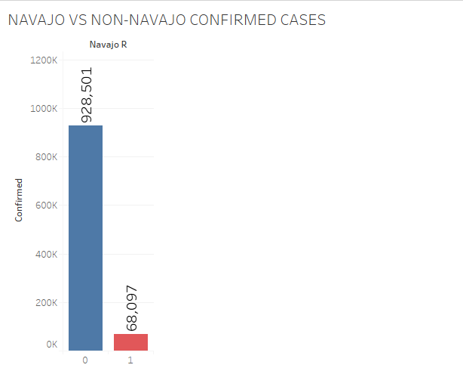
Analysis / Reporting
COVID-19 Impact on Navajo Nation
For the variable CONFIRMED of 48 locations in AZ and NM we confirmed the number of cases.
Non-Navajo Nation
928,501 cases
Navajo Nation
68,097 cases
The analysis:
The Welch’s One Way ANOVA told us the
P-VALUE = 0.001 < .05 and is significant
We can also see from the columns that two amounts were significantly different.

Slide 14
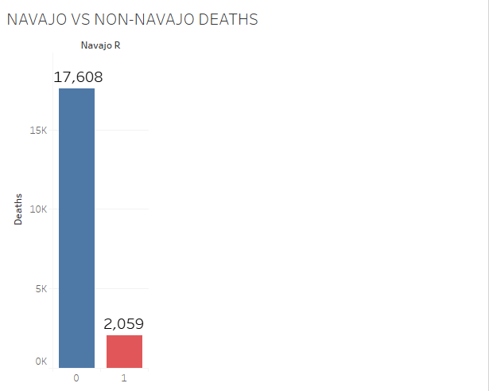
The Analysis / Reporting
COVID-19 Impact on Navajo Nation
For the variable DEATHS of 48 locations in AZ and NM we confirmed
Non-Navajo Nation
17,608 DEATHS
Navajo Nation
2059 DEATHS
This was a pretty easy one as well
This analysis and chart confirms that there was a significant difference between the two.
The Welch’s one way ANOVA told us the
P-VALUE = 0.001 < .05 and is significant
We can also see from the analysis and the graph that there is a significant difference between the two groups

Slide 15
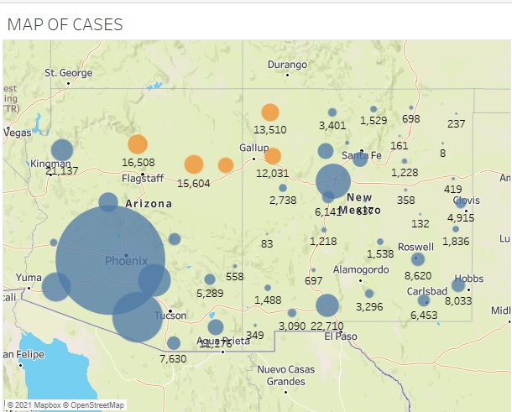
Analysis / Reporting
COVID-19 Impact on Navajo Nation
Here we can see a map of the
CONFIRMED cases.
Blue Dots are NON-NAVAJO cases
Orange is NAVAJO NATION cases
The map confirms the analysis as well as showing locations and significantly more NON-NAVAJO CONFIRMED Cases.

Slide 16
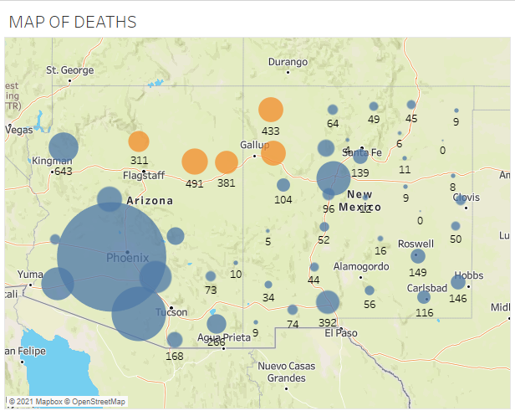
The Analysis / Reporting
COVID-19 Impact on Navajo Nation
Here we can see a map of the
DEATHS
Blue Dots are NON-NAVAJO DEATHS
Orange is NAVAJO NATION DEATHS
The map confirms the analysis as well as showing locations and significantly more
NON-NAVAJO DEATHS.

Slide 17
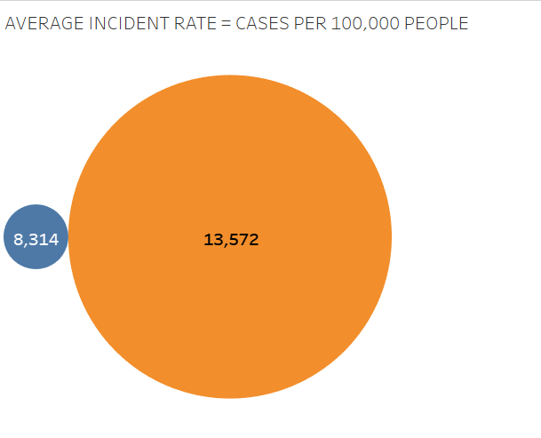
The Analysis / Reporting
COVID-19 Impact on Navajo Nation
For the variable INCIDENT_RATE of 48 locations in AZ and NM we confirmed
Non-Navajo Nation
8314 = CASES PER 100,000 PEOPLE
Navajo Nation
13,572 = CASES PER 100,00 PEOPLE
THIS ONE SHOWS SOMETHING VERY DIFFERENT
This analysis and chart confirms that there was a significant difference between the two.
The ANOVA told us the
P-VALUE = 0.01 < .05 and is significant
We can also see from the analysis and the graph that there is a significant difference between the two groups
The difference is 5258 or 63.24% Greater NAVAJO NATION CONFIRMED cases PER 100,000 PEOPLE

Slide 18
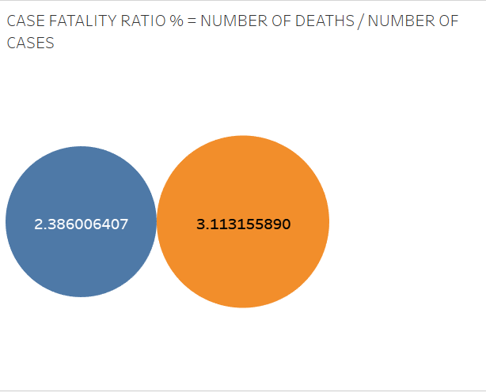
The Analysis / Reporting
COVID-19 Impact on Navajo Nation
Looking at CASE_FATALITY_RATIO
= Number of deaths / Number of cases.
Blue is NON-NAVAJO 2.39%
Orange is NAVAJO NATION 3.11%
Running the ANOVA on this variable tells us that the difference between the two is not significant as a percentage.
CONCLUSION: Looking at the previous slide, if NAVAJO NATION DEATHS per 100,000 people is 63.24% greater than NON-NAVAJO areas we can assume that the death rate is at least that much greater as well.
The people of the NAVAJO NATION are getting crushed by COVID-19 compared to the surrounding population!

