Slide 1

COVID-19 Impact on Navajo Nation in Arizona & New Mexico

Slide 2
COVID-19 Impact on Navajo Nation in Arizona & New Mexico
Since January of 2020 Covid-19 has become a Global Pandemic
One of the hardest hit groups
people effected by the
pandemic in the United States
has been the Navajo Nation
Indian Tribe.
In this presentation we are going to look
at a Data Science point of view of how and why.

Slide 3


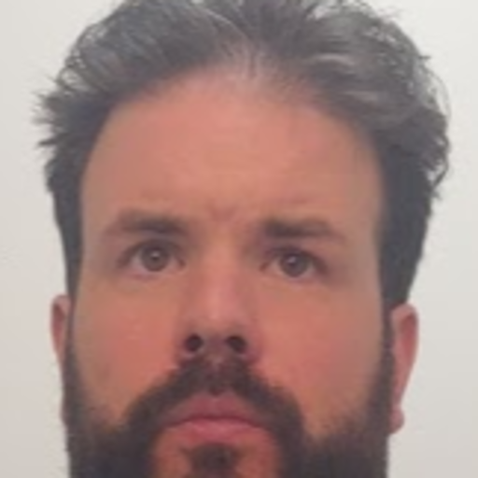
HistoryCOVID-19 Impact on Navajo Nation in Arizona & New Mexico
The Presenters
Craig Costenbader
Matt McMahon
Richard Brown

Slide 4
Bio: Craig Costenbader
COVID-19 Impact on Navajo Nation in Arizona & New Mexico

Slide 5
HistoryCOVID-19 Impact on Navajo Nation in Arizona & New Mexico

Slide 6
HistoryCOVID-19 Impact on Navajo Nation in Arizona & New Mexico

Slide 7
HistoryCOVID-19 Impact on Navajo Nation in Arizona & New Mexico

Slide 8
HistoryCOVID-19 Impact on Navajo Nation in Arizona & New Mexico

Slide 9
HistoryCOVID-19 Impact on Navajo Nation in Arizona & New Mexico

Slide 10
HistoryCOVID-19 Impact on Navajo Nation in Arizona & New Mexico

Slide 11
HistoryCOVID-19 Impact on Navajo Nation in Arizona & New Mexico

Slide 12
HistoryCOVID-19 Impact on Navajo Nation in Arizona & New Mexico

Slide 13
HistoryCOVID-19 Impact on Navajo Nation in Arizona & New Mexico

Slide 14
HistoryCOVID-19 Impact on Navajo Nation in Arizona & New Mexico

Slide 15
HistoryCOVID-19 Impact on Navajo Nation in Arizona & New Mexico

Slide 16
HistoryCOVID-19 Impact on Navajo Nation in Arizona & New Mexico

Slide 17
HistoryCOVID-19 Impact on Navajo Nation in Arizona & New Mexico

Slide 18
HistoryCOVID-19 Impact on Navajo Nation in Arizona & New Mexico

Slide 19
HistoryCOVID-19 Impact on Navajo Nation in Arizona & New Mexico

Slide 20
Questions & answers
HistoryCOVID-19 Impact on Navajo Nation in Arizona & New Mexico
Invite questions from the audience

